Slide 1

Mathematics at Caistor Yarborough Academy
How to help your child achieve the best grade
Join us on our journey….

Slide 2

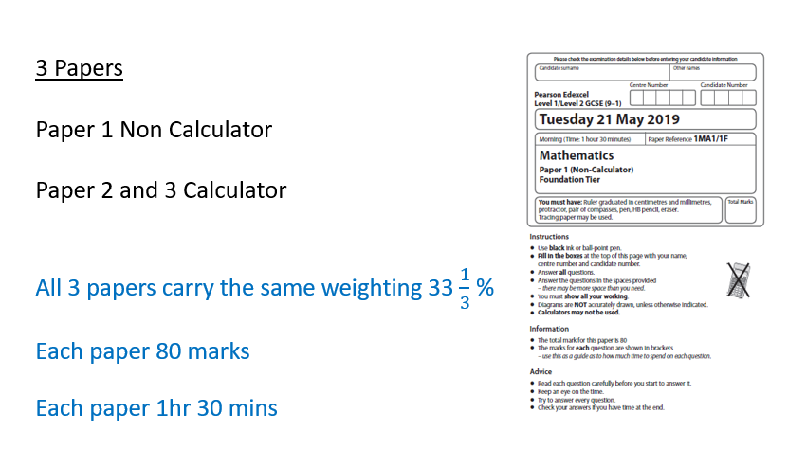
Join us on our journey….

Slide 3
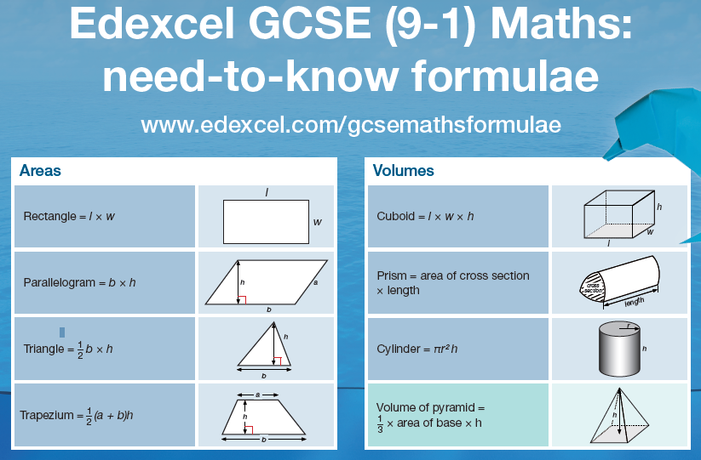

We will give you Flashcards to help
Join us on our journey….

Slide 4
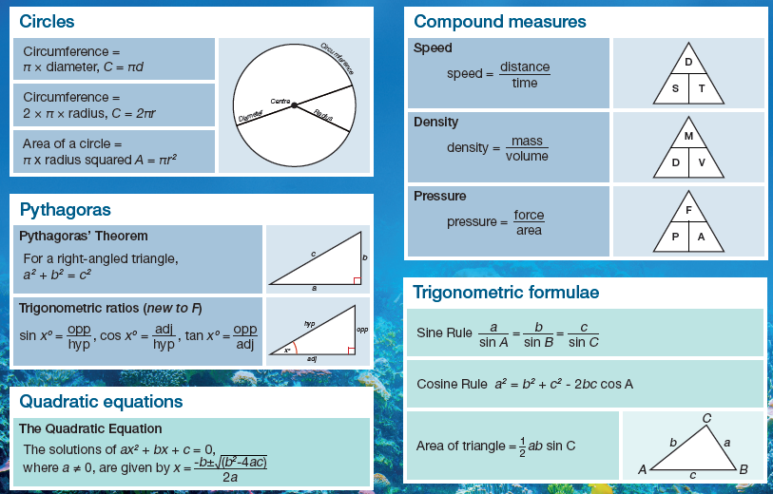
Make sure that you learn all the formulae
We will give you Flashcards to help
Join us on our journey….

Slide 5
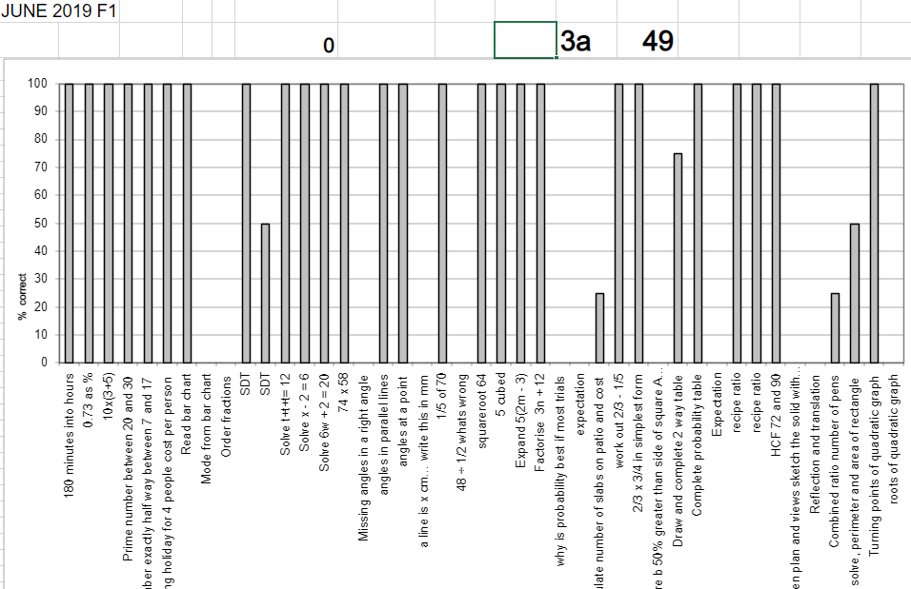
You will be given:
Homework designed to fill gaps in knowledge and reinforce the common topics
Every student will be given a set of Assessment grids to show their personal strengths and weaknesses from the previous exam
Join us on our journey….

Slide 6
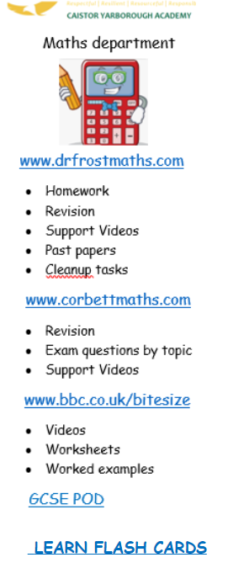
You will be given:
Homework designed to fill gaps in knowledge and reinforce the common topics
Revision and Intervention materials
Join us on our journey….

Slide 7
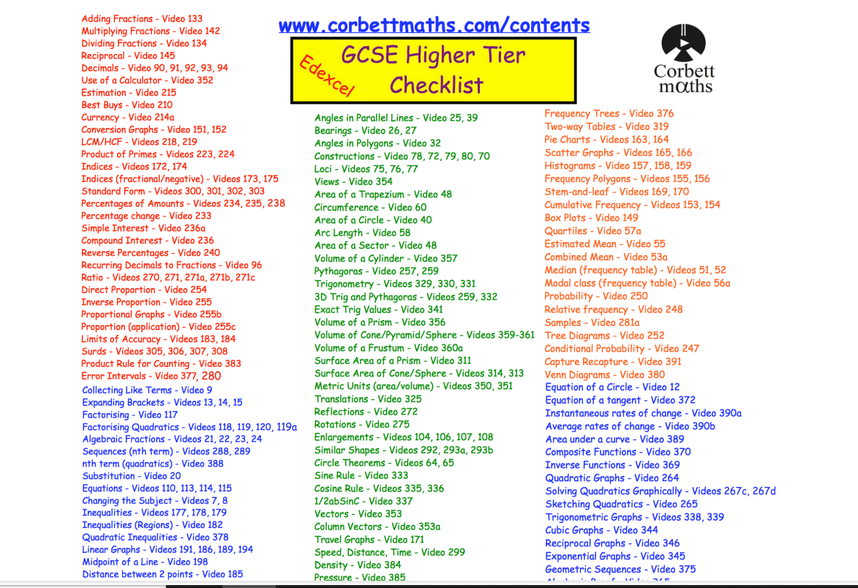
You will be given ;
*Corbett Maths
Edexcel Foundation Revision - Corbettmaths
Edexcel Higher Checklist 2022 (corbettmaths.com)
Edexcel Foundation Revision - Corbettmaths
Join us on our journey….

Slide 8
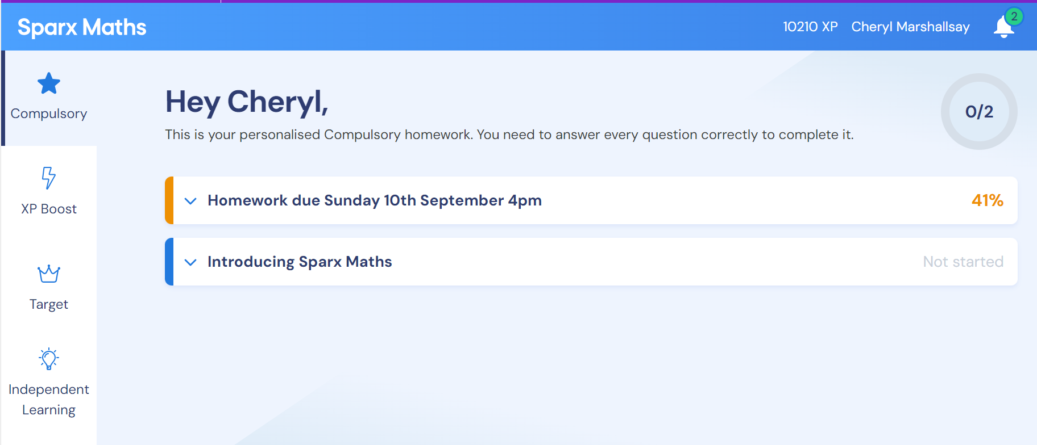
You will be given:
Access to SPARX Maths
Join us on our journey….

Slide 9

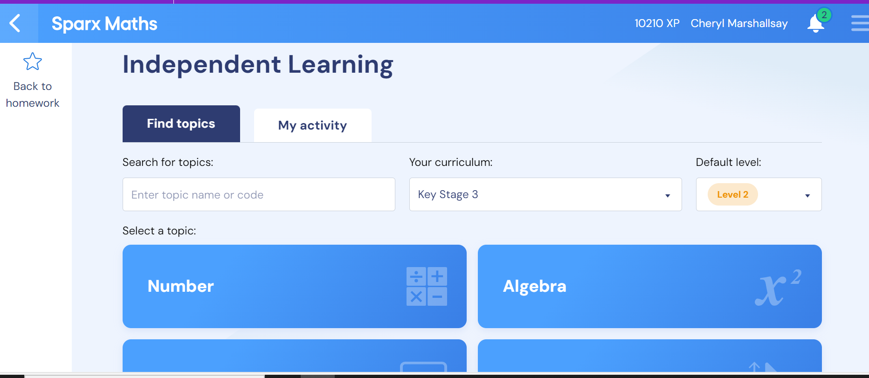
Join us on our journey….

Slide 10

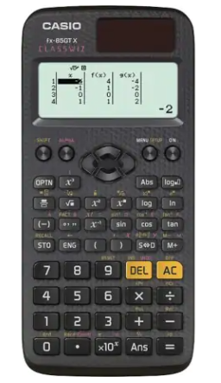
Calculator:
Remember, 2 of the 3 exams are calculator papers.
Get yourself the same calculator we use in school. We can then teach you how to use it effectively.
You will need it for homework and revision
Casio Fx 83 GT CW or Casio Fx 85 GT CW
Join us on our journey….

Slide 11
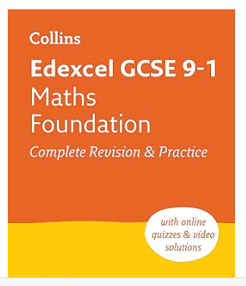
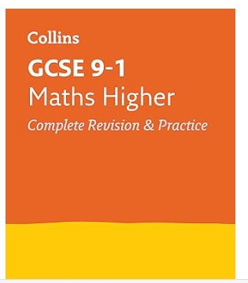
Recommended revisions guides.
Join us on our journey….

