Slide 1

Science Department
- Reach your potential!
RESPECTFUL RESILIENT RESOURCEFUL RESPONSIBLE

Slide 2

Combined Science
2 GCSEs
Covers Biology, Chemistry and Physics
6 exams – Biology: B1, B2
Chemistry: C1, C2
Physics: P1, P2
All exams are 1 hour 10 minutes / 60 marks
Foundation (1-5) and Higher (9-4) available
6 hours / week
RESPECTFUL RESILIENT RESOURCEFUL RESPONSIBLE

Slide 3
Separate Sciences
3 GCSEs – Biology, Chemistry and Physics
6 exams – Biology: B1, B2
Chemistry: C1, C2
Physics: P1, P2
All exams are 1 hour 45 minutes / 100 marks
Foundation (1-5) and Higher (9-4) available
6 hours / week
RESPECTFUL RESILIENT RESOURCEFUL RESPONSIBLE

Slide 4
Mocks – November 2024
Paper 1 Topics
Physics
Topic 1 Motion | Vectors and scalars Distance/ time graphs Acceleration Velocity/ time graphs
Topic 2 Motion and forces | Resultant forces Newton’s Laws Mass and weight Momentum (Higher only) Stopping distance Braking distance Crash hazards
Topic 3 Conservation of Energy | Energy stores and transfers Energy efficiency Conduction, convection radiation Stored energy Renewable vs Non-renewable energy
Topic 4 Waves | Waves – longitudinal and transverse Wave speeds Refraction Ears and hearing (Separate science only) Ultrasound (Separate science only) Infrasound (Separate science only)
Topic 5 Light and the EM spectrum | Ray diagrams (Separate science only) Colour (Separate science only) Lenses (Separate science only) EM spectrum Uses of long and short wavelengths Radiation and temperature (Separate science only) Dangers of EM waves
Topic 6 Radioactivity | Atomic structure Inside the atom Electrons and orbits Background radiation Radioactive decay (Separate science only) Half life Using radioactivity Dangers of radioactivity Nuclear energy (Separate science only) Nuclear fission and fusion (Separate science only) Using a nuclear reactor (Separate science only)
Topic 7 Astronomy (Separate Science only) | The solar system (Separate science only) Gravity and orbits (Separate science only) Life cycle of stars (Separate science only) Red shift (Separate science only) Origin of the universe → Big Bang/ CMBR (Separate science only)
Chemistry
Topic 1 & 2 States of matter | States of matter Mixtures Filtration, crystallisation Chromatography Distillation
Topic 3 Atomic structure | .Structure of an atom Atomic number and mass number Isotopes
Topic 4 | . Elements of the periodic table Atomic number and the periodic table Electronic configuration
Topic 5,6,7 Ionic and Covalent bonding | Ionic bonds and lattices Properties of Ionic and covalent bonding Covalent bonding Molecular compounds Allotropes of carbon Metal properties Bonding models
Topic 8 Acids and Alkalis | Acids, alkalis and indicators Bases and salts Alkalis and balancing equations Alkalis and neutralisation Reactions of acids with metals and carbonates Solubility
Topic 9 Calculations involving mass | Masses and empirical formulae Conservation of mass Moles
Topic 10, 11, 12, 13 Electrolyte processes, using metals, transition metals, alloys and corrosion | Electrolysis Products of electrolysis Reactivity Ores Oxidation and reduction Life cycle assessment and recycling Dynamic equilibrium Transition metals Corrosion Electroplating Alloying Uses of metals and their alloys
Biology
Topic 1 Key concepts of Biology | Structure of cells Specialised cells Microscopy Enzyme action Factors affecting enzymes Food tests Transport of substances- diffusion/ osmosis/ active transport
Topic 2 Cells and control | Mitosis Growth of plants and animals Stem cells The brain The nervous system The eye
Topic 3 Genetics | Sexual and asexual reproduction Meiosis DNA Protein synthesis Genetic crosses Genetic disorders
Topic 4 Natural selection and genetic modification | Human evolution Natural selection Classification Breeds and varieties Selective breeding Tissue culture (Separate science only) Genetic engineering (Separate science only) Fertilisers and biological control (Separate science only)
Topic 5 Health, disease and the development of medicine | Communicable and non-communicable diseases Types of pathogens Spread of pathogens Virus life cycles (Separate science only) Plant defences (Separate science only) Plant diseases (Separate science only) Physical and chemical barriers The immune system Antibiotics Monoclonal antibodies (Separate science only)

Slide 5
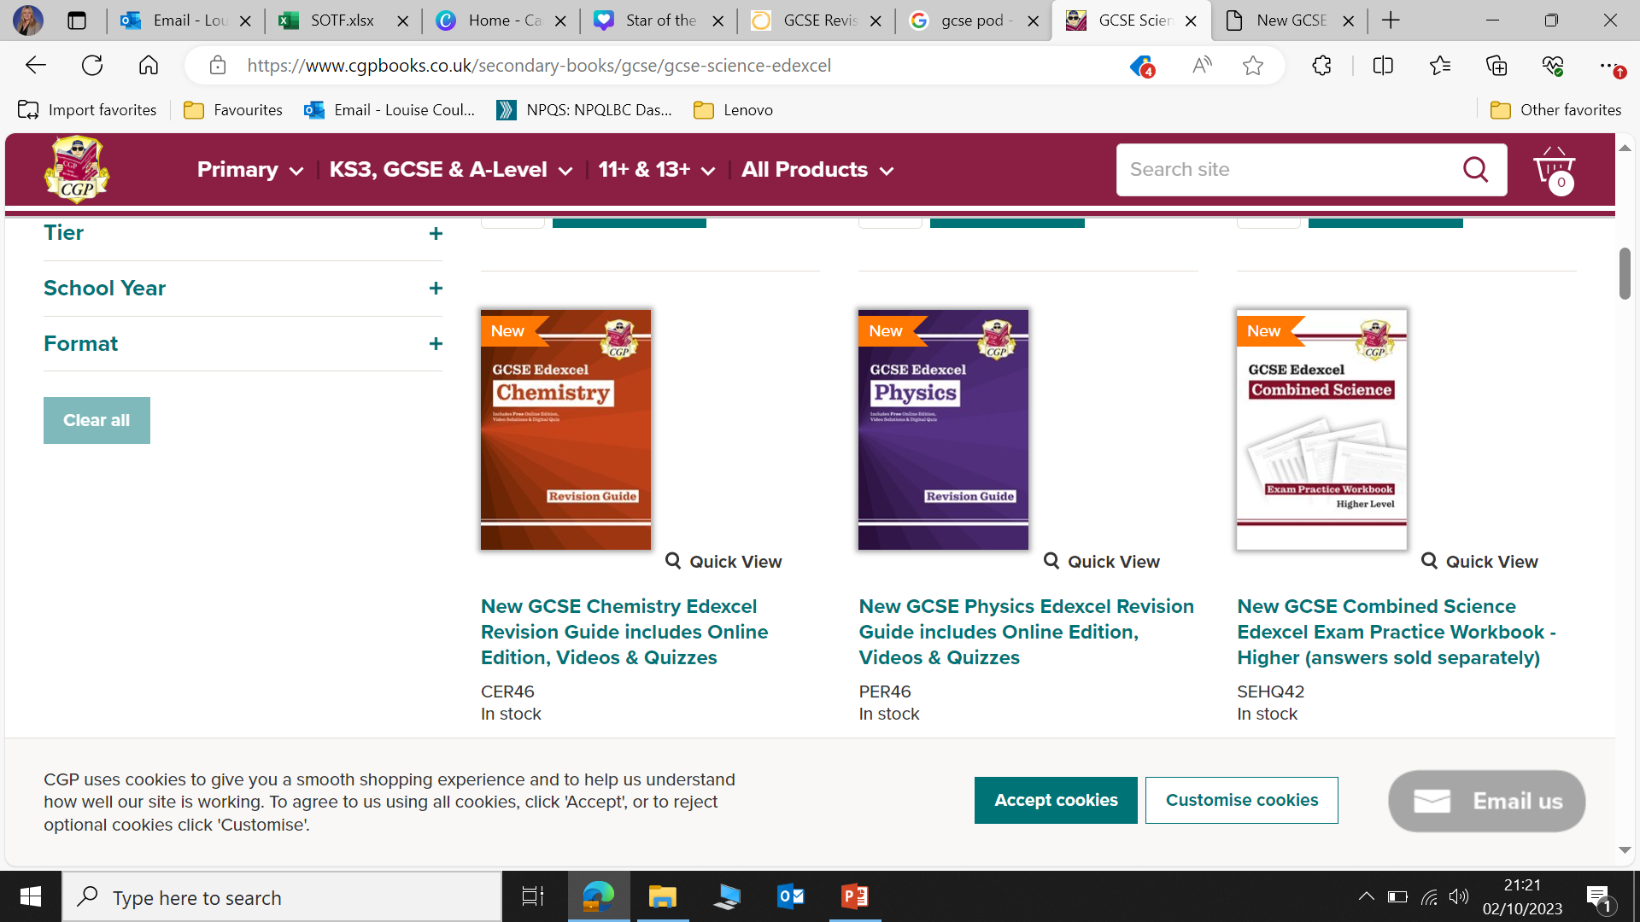
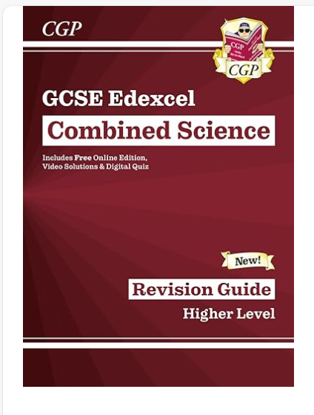
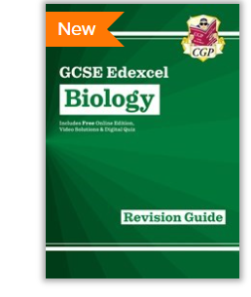
Revision Guides
You'll find QR codes throughout, providing quick and easy access to worked video solutions
Online Knowledge Retrieval quizzes for students to practise
A free Online Edition of the whole book is included so you can read it on a PC
RESPECTFUL RESILIENT RESOURCEFUL RESPONSIBLE

Slide 6


Online book
Activities
Videos
See teachers for logins
Homework
Videos
Differentiated tasks/ practice questions
Questions are tailored to meet the needs of students
RESPECTFUL RESILIENT RESOURCEFUL RESPONSIBLE

Slide 7

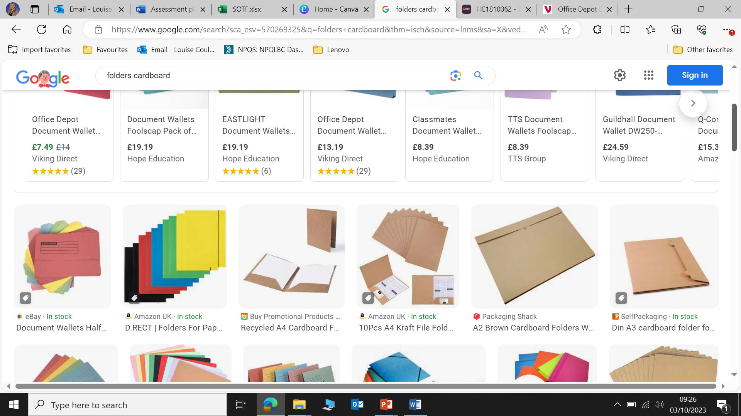
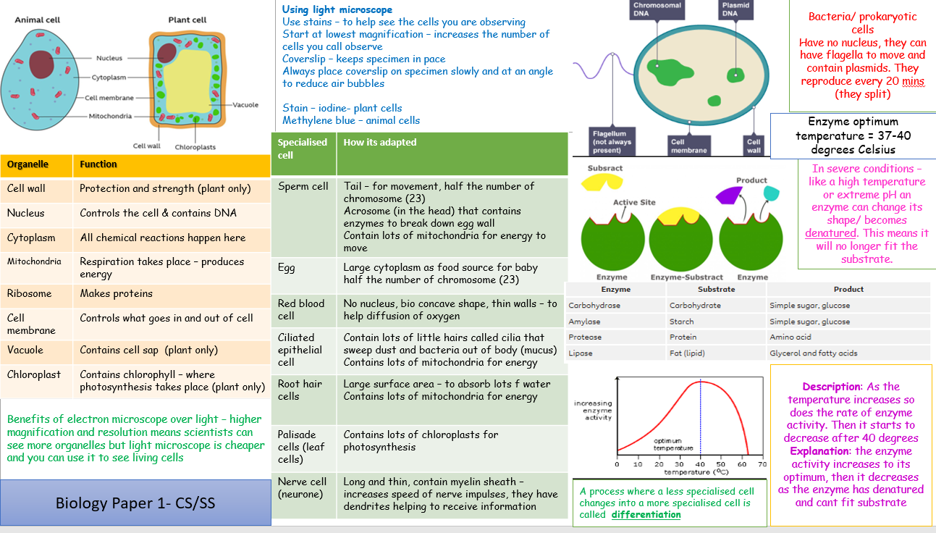
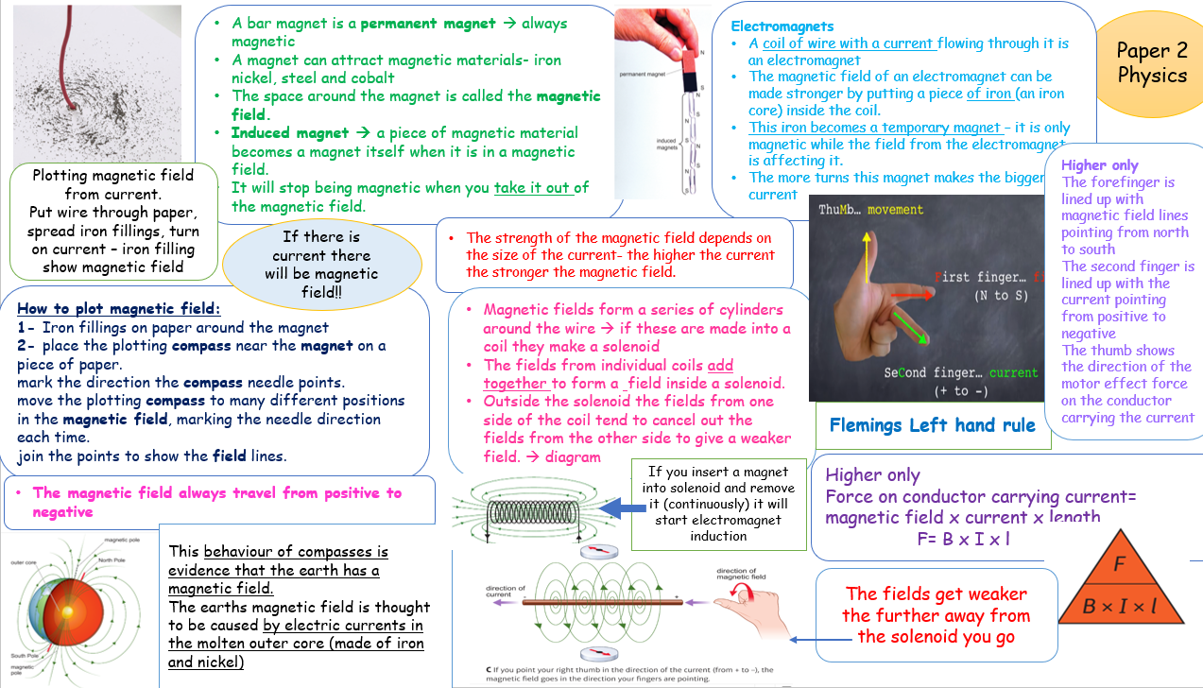
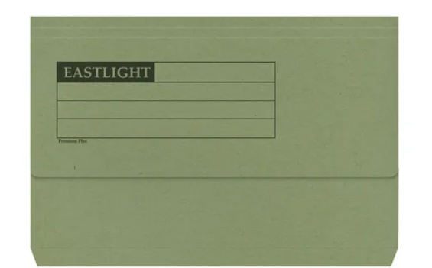
Teams
All Lessons are available on teams
Exam style questions
Knowledge Organisers/ exam folders
Revision materials
Exam style questions
RESPECTFUL RESILIENT RESOURCEFUL RESPONSIBLE

Slide 8
Websites to help with revision
GCSE Revision | Revision Science
GCSE Science - BBC Bitesize
FuseSchool - Global Education – YouTube → contains videos on all topics
Past papers | Past exam papers | Pearson qualifications → past papers and mark schemes to practice exam techniques
Seneca homework app.
RESPECTFUL RESILIENT RESOURCEFUL RESPONSIBLE

