Slide 1

Spanish at Caistor Yarborough Academy
Supporting Your Child with GCSE Revision
Join us on our journey….

Slide 2


Purpose of this Guide
This leaflet supports parents and carers in helping their child prepare effectively for GCSEs in Spanish. It outlines key content, exam structures, and practical revision approaches that make a difference at home.
Exam Board: Edexcel
Join us on our journey….

Slide 3
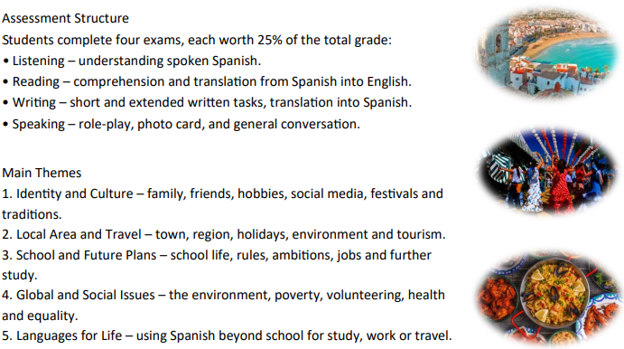

Assessment Structure
Join us on our journey….

Slide 4
The Exam Element
• Students complete four assessments: three externally examined papers (Listening, Reading,
Writing) and one Speaking assessment set by Pearson.
• Paper 1: Speaking in Spanish — tested by Pearson, designed to assess spontaneous and prepared
speaking tasks.
• Paper 2: Listening — students listen to spoken Spanish, answer in English and Spanish, including
comprehension and dictation tasks.
• Paper 3: Reading — includes comprehension of texts, translation from Spanish into English, and
related grammar tasks.
• Paper 4: Writing — students produce written Spanish responses, including translation from English
into Spanish, and tasks requiring control of grammar, vocabulary and structure.
Join us on our journey….

Slide 5
Examples of Revision Tools
Flashcards:
• Identity & Culture – family vocabulary (padre, madre, hermano), personality adjectives, phrases like me llevo bien con…
• Local Area & Travel – holiday vocabulary (hotel, transporte, playa), weather and directions.
• School & Future Plans – school subjects, future tense verbs (seré, estudiaré, trabajaré).
• Global Issues – environment vocabulary (reciclar, contaminación, energía verde), opinion phrases (en mi opinión, es importante que…).
• Grammar Focus – common verbs (tener, ser, estar), present, preterite, and future tense endings.
Mind Maps:
• Identity & Culture – family and friends → technology → free time → festivals.
• Local Area & Travel – home, town, region → transport → holidays → environment.
• School & Future Plans – subjects → opinions → school rules → post-16 and career aspirations
Join us on our journey….

Slide 6

How Parents Can Help
• Encourage regular speaking practice: ask your child to teach you a few new Spanish words each day.
• Support weekly revision of vocabulary using flashcards or digital apps such as Duolingo or Language
Nut.
• Encourage your child to watch or listen to Spanish media (songs, short clips, news, or films with subtitles).
• Check written work together – focus on accuracy in tenses and spelling.
• Practise listening tasks aloud using past paper recordings or GCSEPod resources.
• Praise small steps of progress — language learning improves most through frequent short sessions.
Join us on our journey….

