Slide 1



Y10 Curriculum Evening
GCSE Spanish
Join us on our journey….

Slide 2

Why study GCSE Spanish?
Studying any language is a vital asset in the modern world.
Every industry is desperate for graduates who have the skills and qualities that learning a language grants you.
74% of employers are looking for school-leavers with language skills. (Most employers do not require complete fluency. They want conversational ability, which will give a good impression, help to build relationships and make new contacts).
Having a second language will set you apart from other job seekers, as well as potentially increasing your salary by up to 20%!!
Join us on our journey….

Slide 3
Why study GCSE Spanish?
Our planet has over 6 billion people who speak between 6000 and 7000 different languages.
Only 6% of the world’s population are native English speakers.
75% of the world’s population speak no English at all!
As well as learning the language itself you will learn about the wider Spanish-speaking cultures and nuances to enable you to increase your understanding of the world we live in.
Join us on our journey….

Slide 4
Why study GCSE Spanish?
Some universities now require a language GCSE for certain degree courses e.g English, History and Law
A GCSE in a language will help you get into university
You will need a GCSE in a language to be awarded the English Baccalaureate (Ebacc)
Join us on our journey….

Slide 5
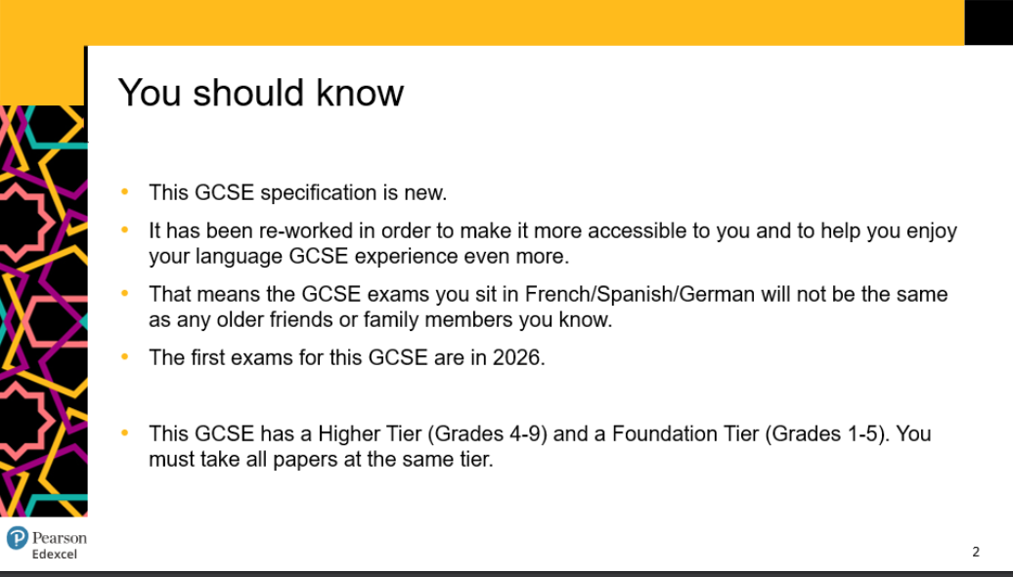
What is involved in GCSE Spanish?
Join us on our journey….

Slide 6
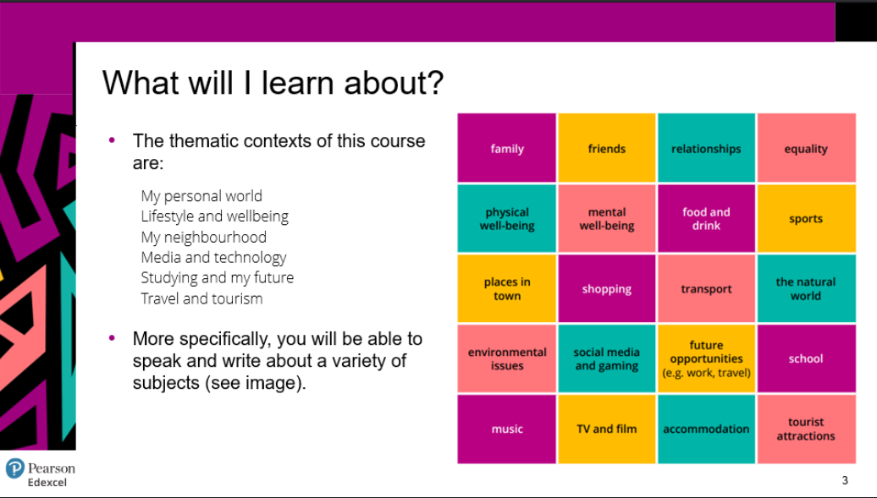
What is involved in GCSE Spanish?
Join us on our journey….

Slide 7
How you will be assessed:
Language GCSEs have tiered entry - this means there are two different exams. One is called Foundation and the other is called Higher.
The Foundation exam is easier, but the highest grade you can achieve is a 5.
The Higher exam is more difficult, but you can achieve up to a 9.
Decisions on which tier students should take will occur during the early part of Year 11.
There are 4 different papers to take (each worth 25% of your grade), all exams take place during Year 11:
Paper 1 - Listening
Paper 2 - Speaking (takes place during April-May of Year 11)
Paper 3 - Reading
Paper 4 - Writing
Join us on our journey….

Slide 8
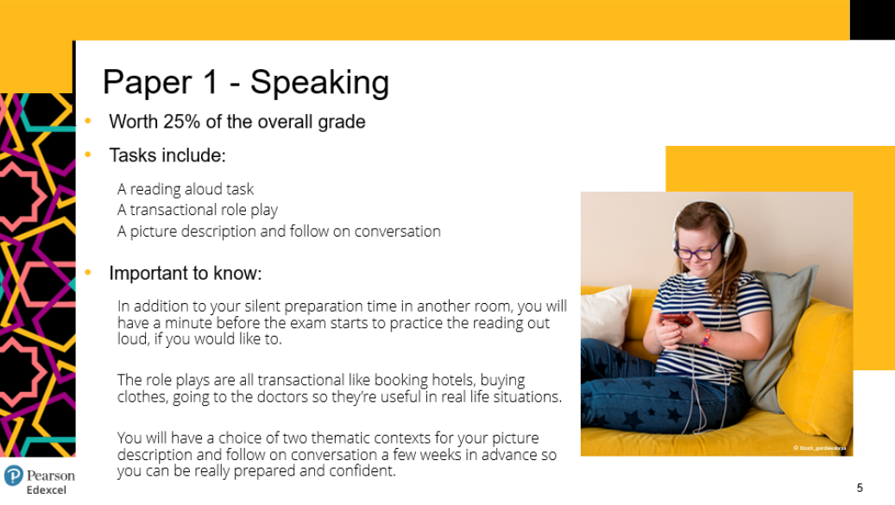
How you will be assessed:
Join us on our journey….

Slide 9
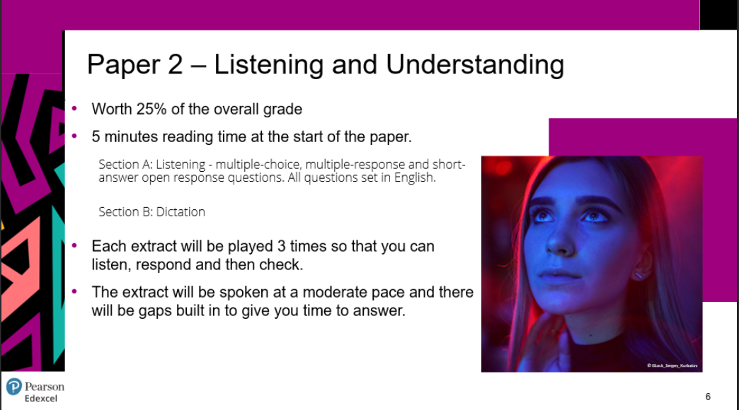
How you will be assessed:
Join us on our journey….

Slide 10
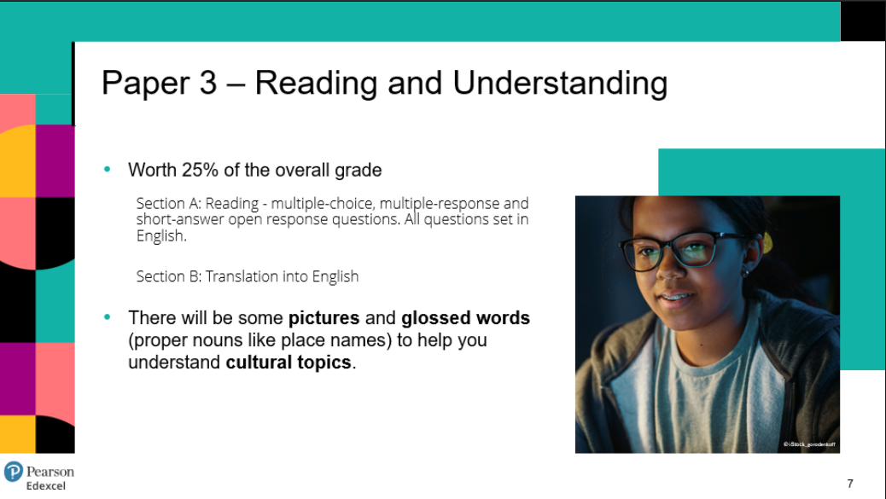
How you will be assessed:
Join us on our journey….

Slide 11
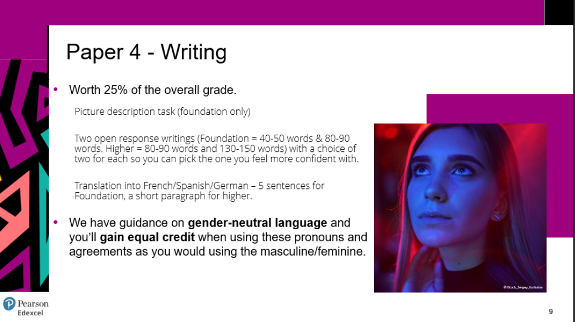
How you will be assessed:
Join us on our journey….

Slide 12
Careers:
A language is beneficial to any career, however these are some of the most common careers language graduates go into:
Translation (for governments, businesses, publishers & more!
Journalism & The media
Marketing
Law
The Police (especially detective work)
Sales executives
Engineering
Tourism
Transport & Logistics industries
Teaching
Hospitality & catering industries.
Join us on our journey….

