Slide 1


Year 11
Information evening

Slide 2

Attendance
If you are not here, you are not learning
GCSE’S may seem a long way off for you and your child, however all absences can lead to gaps in your child’s learning
This in turn can :
Mean that they fall behind in work
Affect their motivation
Affect their desire to attend school regularly
Affect their enjoyment in learning
Potentially lead to poor behaviour
Affect their confidence in school
Did you know that :
A child who is absent a day of school per week misses an equivalent of two years of their school life
90% of young people with absence rates below 85% fail to achieve five or more good grades for GCSE
Poor examination results limit young people’s options and poor attendance suggests to colleges and employers that these students are not reliable
So plenty of time for shopping, family holidays and appointments.
175 days are not spent in school each year

Slide 3
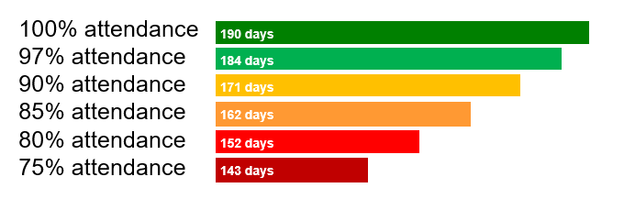
Attendance
If you are not here, you are not learning
100% attendance
97% attendance
90% attendance
85% attendance
80% attendance
75% attendance
190 days
184 days
171 days
162 days
Nationally, pupils that have only 91%
attendance or less will drop at least one GCSE grade across their subjects.
152 days
143 days

Slide 4
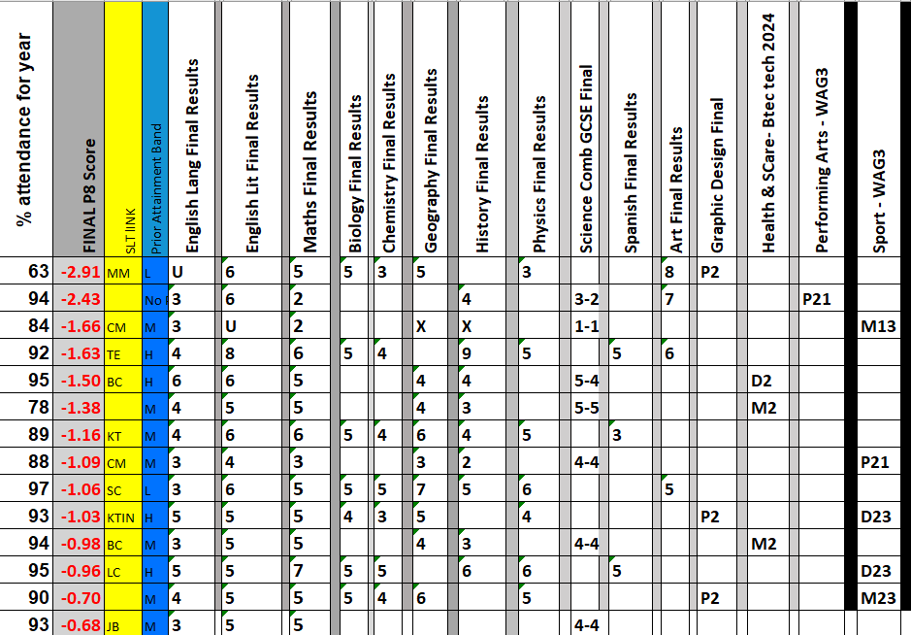
Attendance If you are not here, you are not learning
Our Year 11 2024
Of the 15 lowest achieving students, only 1 had an attendance of over 95%

Slide 5
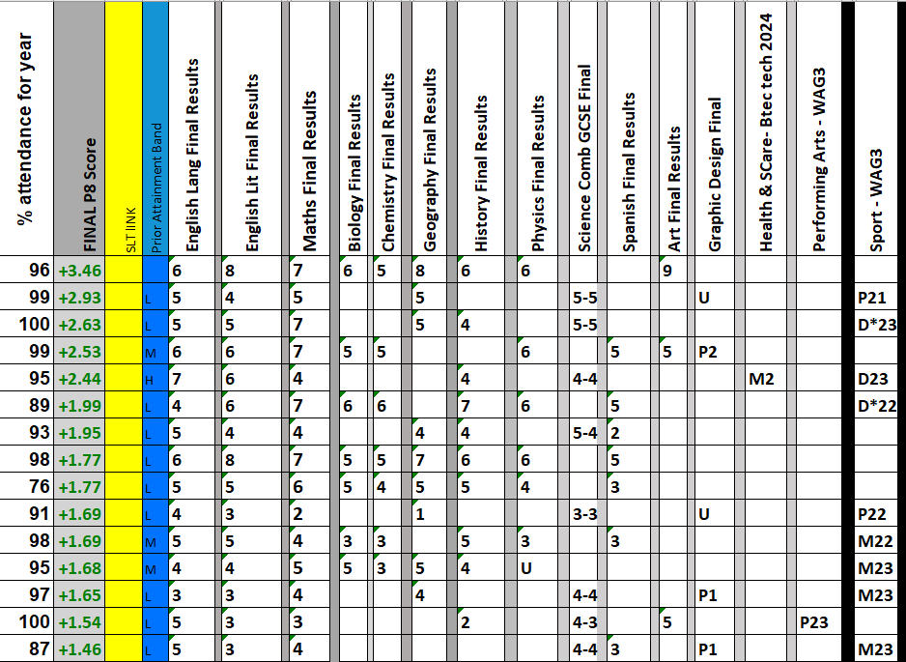
Attendance If you are not here, you are not learning
Our Year 11 2024
Of the 15 HIGHEST achieving students, only 4 had an attendance of below 95%

Slide 6

Year 11 attendance to date
Attendance If you are not here, you are not learning
93.5% (10th Oct)

Slide 7
Year 11 Important numbers (As of today 2nd October)
0
2
68
104
128
133
1
(Letter to follow with all key dates)
School days until MOCK 1
School days until half term
School days until MOCK 2 (Feb)
School days until GCSEs Start (May)
School days before you leave!
School days before prom

Slide 8
Information
Work hard in all lessons (104 days)
Complete all homework SPARX
Attend intervention sessions (Main ones start after Xmas. Some may start earlier)
Revise (Advice tonight and Revision guides on MCAS)
Other revision sources faculties will let you know GCSE Pod , Active Learn, TEAMS, SPARX
Mock results day and Parents Evening
Local colleges and careers advice
Attend EVERY DAY

