Slide 1


Year 11
Information evening

Slide 2

Attendance
If you are not here, you are not learning
GCSE’S may seem a long way off for you and your child, however all absences can lead to gaps in your child’s learning
This in turn can :
Mean that they fall behind in work
Affect their motivation
Affect their desire to attend school regularly
Affect their enjoyment in learning
Potentially lead to poor behaviour
Affect their confidence in school
Did you know that :
A child who is absent a day of school per week misses an equivalent of two years of their school life
90% of young people with absence rates below 85% fail to achieve five or more good grades for GCSE
Poor examination results limit young people’s options and poor attendance suggests to colleges and employers that these students are not reliable
So plenty of time for shopping, family holidays and appointments.
175 days are not spent in school each year

Slide 3
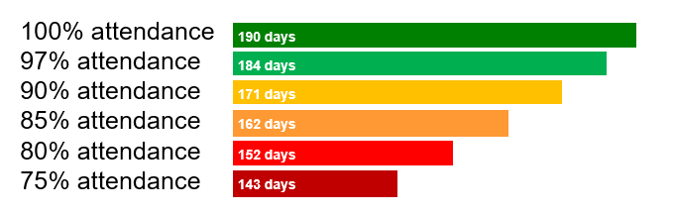
Attendance
If you are not here, you are not learning
100% attendance
97% attendance
90% attendance
85% attendance
80% attendance
75% attendance
190 days
184 days
171 days
162 days
Nationally, pupils that have only 91%
attendance or less will drop at least one GCSE grade across their subjects.
152 days
143 days

Slide 4
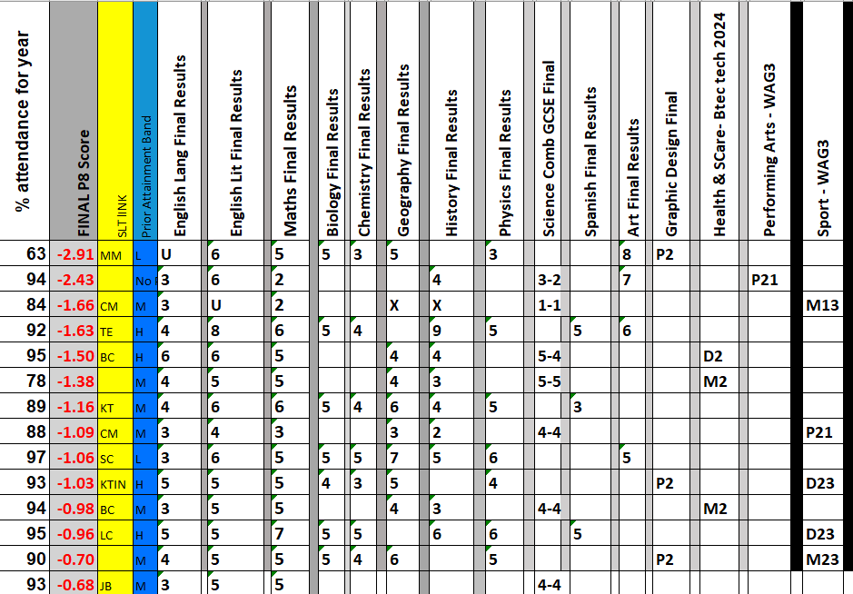
Attendance If you are not here, you are not learning
Our Year 11 2024
Of the 15 lowest achieving students, only 1 had an attendance of over 95%

Slide 5
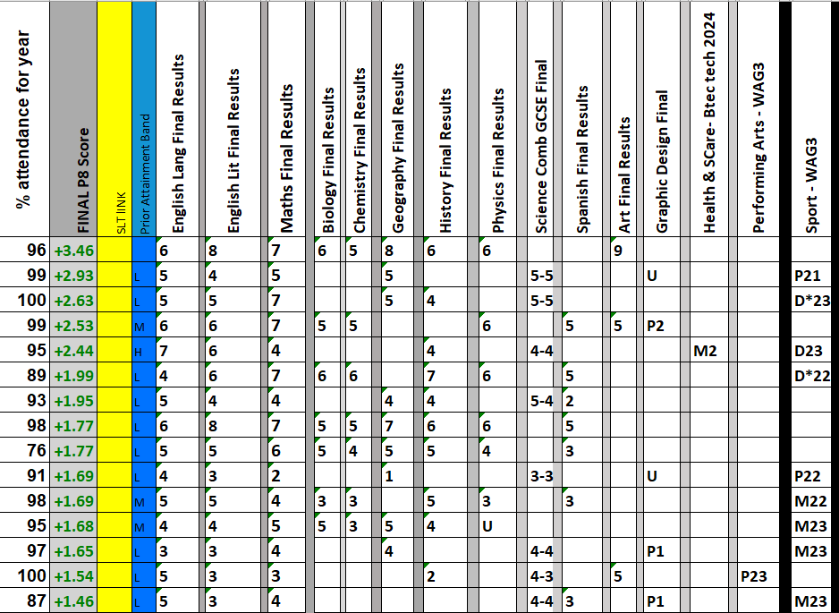
Attendance If you are not here, you are not learning
Our Year 11 2024
Of the 15 HIGHEST achieving students, only 4 had an attendance of below 95%

Slide 6

Year 11 attendance to date
Attendance If you are not here, you are not learning
92.5% (29th Sept)

Slide 7
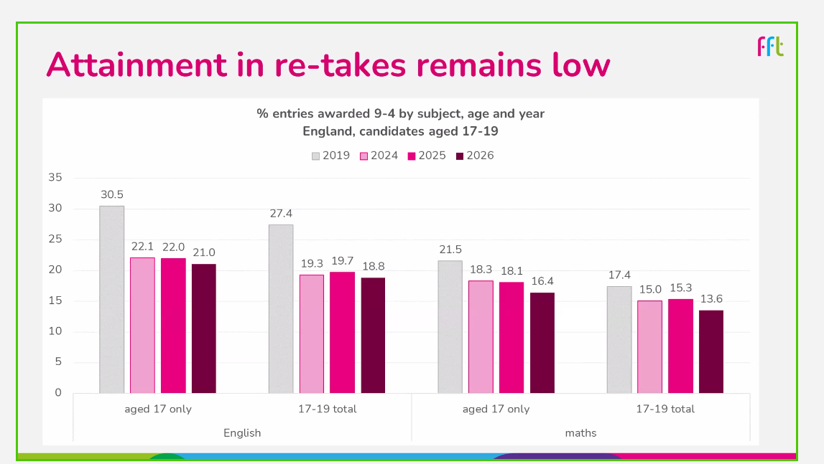
Year 11 attendance to date
Attendance If you are not here, you are not learning
92.5% (29th Sept)

Slide 8
Year 11 Important numbers (As of today 1st October)
9
11
72
109
138
???
Final exam Friday 18th June
Contingency date (Must be here for) Wednesday 23rd June
School days until MOCK 1
School days until half term
School days until MOCK 2 (Feb)
School days until GCSEs Start (May)
School days before you leave!
School days before prom

Slide 9
Information
Work hard in all lessons (109 days)
Complete all homework SPARX
Attend intervention sessions (Main ones start after Xmas. Some may start earlier)
Revise (Advice tonight and Revision guides on MCAS)
Other revision sources faculties will let you know GCSE Pod , Active Learn, TEAMS, SPARX
Mock results day and Parents Evening 3rd Dec
Local colleges and careers advice
Attend EVERY DAY

Slide 10
Interventions
Interventions will be communicated with parents.
Most half terms
Starting January Afterschool Monday to Thursday 1 hour sessions
Considered compulsory
Attendance will make a difference
We will support with any issues where we can
Letter to be sent prior to the sessions

Slide 11

Mathematics at Caistor Yarborough Academy
How to help your child achieve the best grade
Join us on our journey….

Slide 12

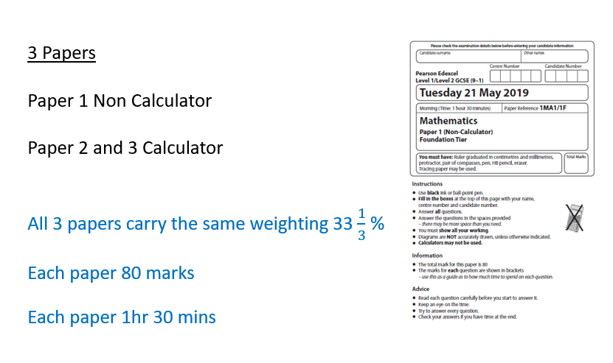
Join us on our journey….

Slide 13
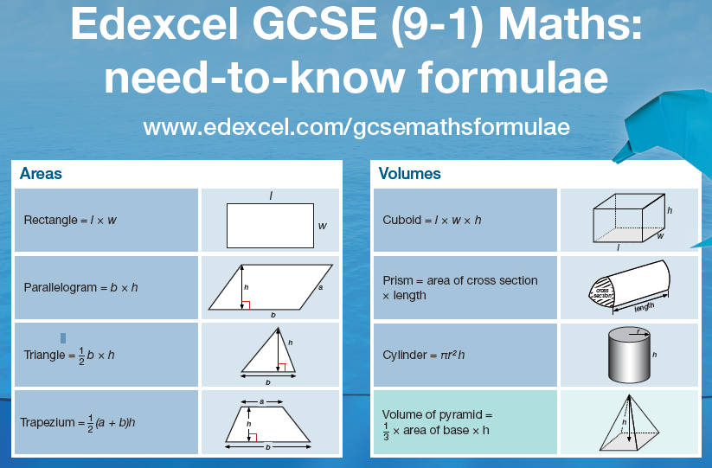

We will give you Flashcards to help
Join us on our journey….

Slide 14
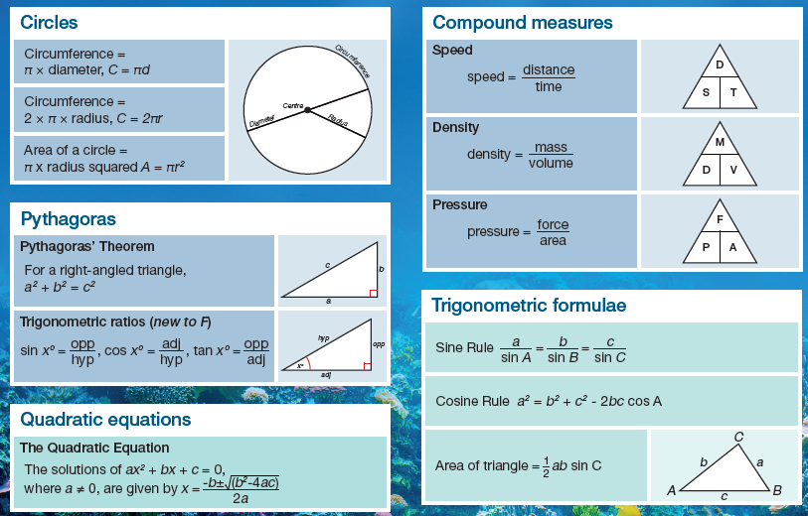
Make sure that you learn all the formulae
We will give you Flashcards to help
Join us on our journey….

Slide 15
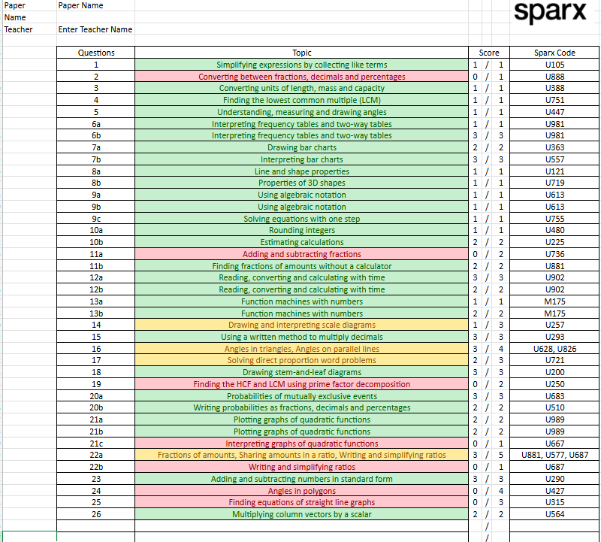
You will be given:
Homework designed to fill gaps in knowledge and reinforce the common topics
Every student will be given a set of Assessment grids to show their personal strengths and weaknesses from the previous exam
Join us on our journey….

Slide 16

You will be given:
Homework designed to fill gaps in knowledge and reinforce the common topics
Revision and Intervention materials
Join us on our journey….

Slide 17
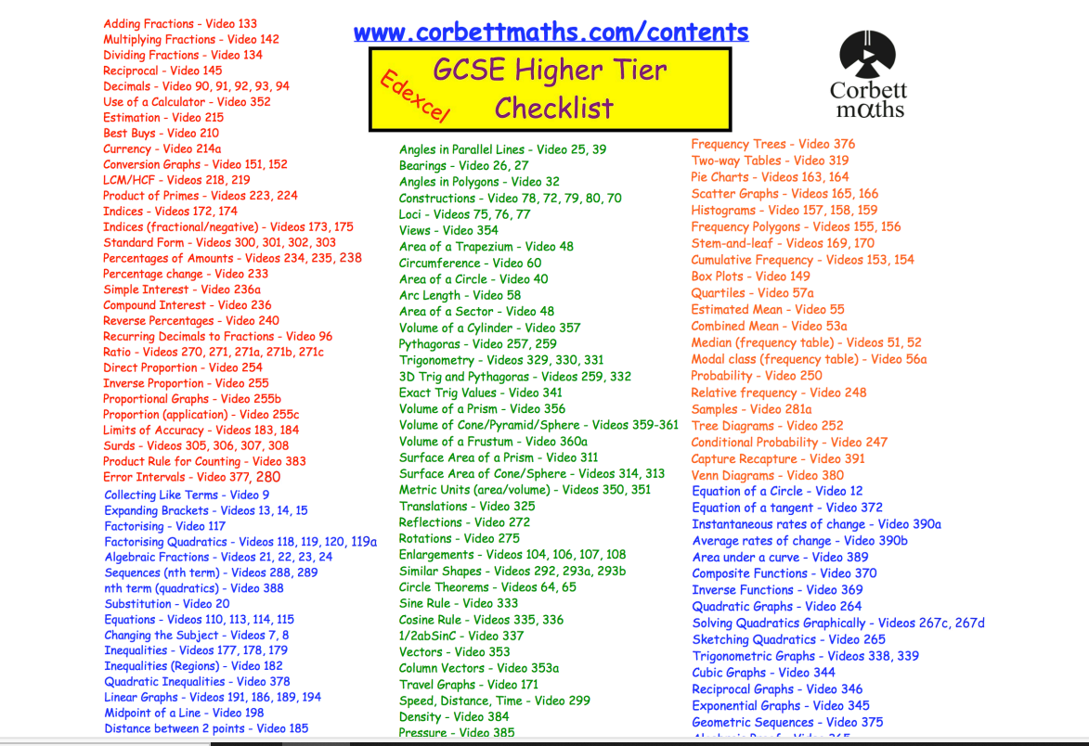
You will be given ;
*Corbett Maths
Edexcel Foundation Revision - Corbettmaths
Edexcel Higher Checklist 2022 (corbettmaths.com)
Edexcel Foundation Revision - Corbettmaths
Join us on our journey….

Slide 18
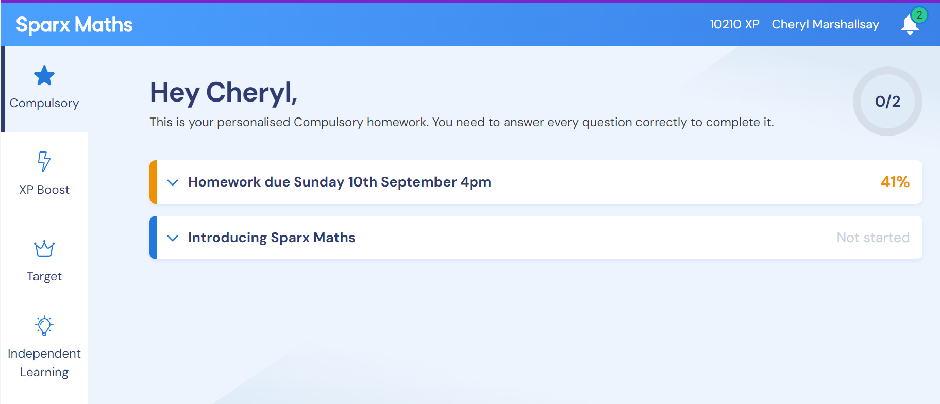
You will be given:
Access to SPARX Maths
Join us on our journey….

Slide 19
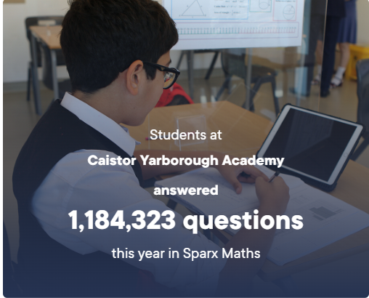
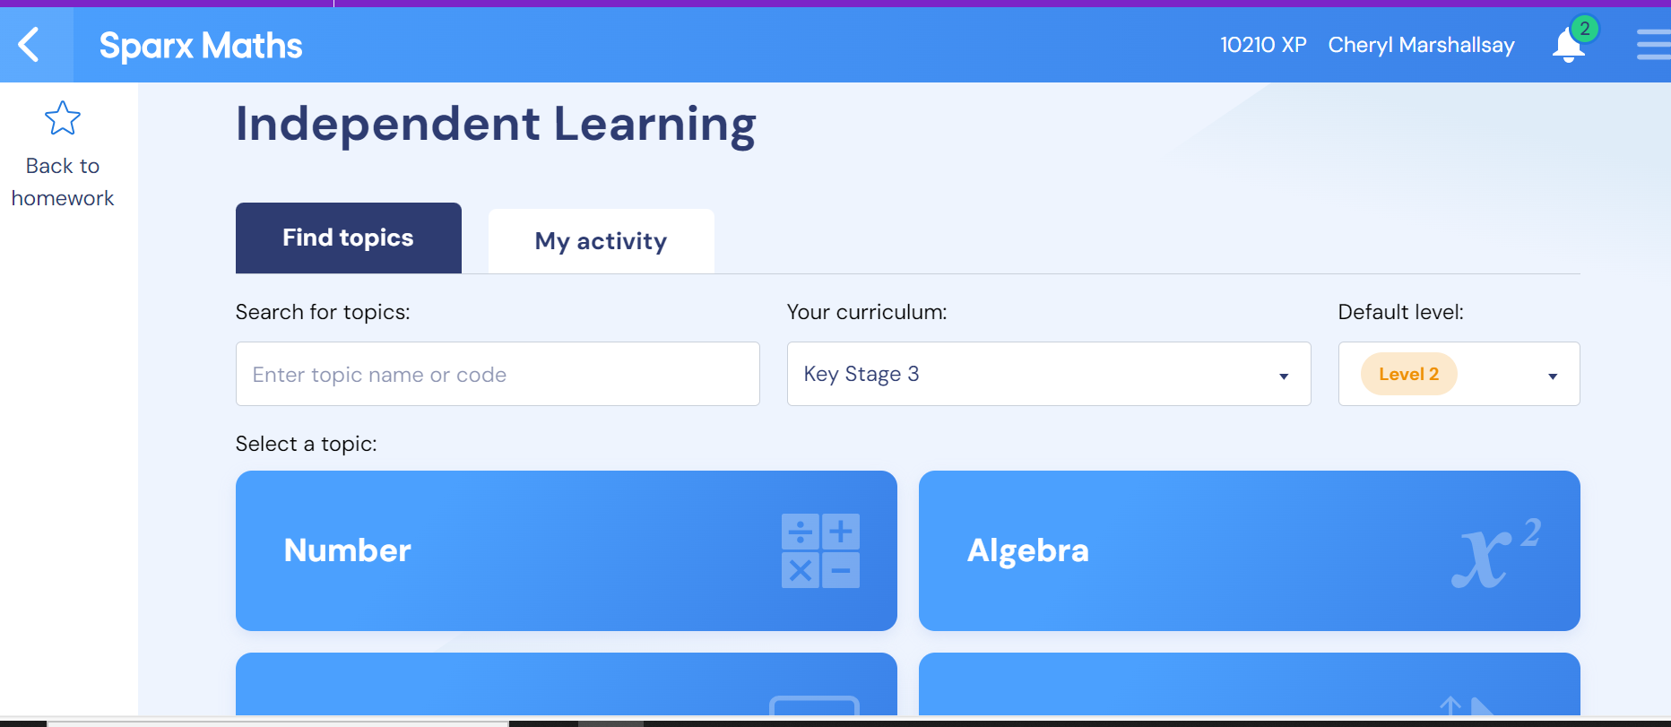
Join us on our journey….

Slide 20

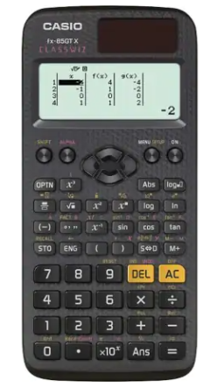
Calculator:
Remember, 2 of the 3 exams are calculator papers.
Get yourself the same calculator we use in school. We can then teach you how to use it effectively.
You will need it for homework and revision
Casio Fx 83 GT CW or Casio Fx 85 GT CW
Higher trialling fx 991 CW+UK
Join us on our journey….

Slide 21
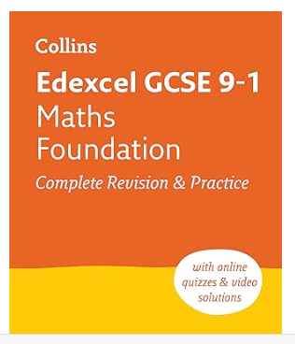
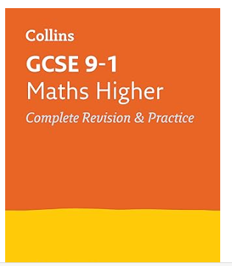
Recommended revisions guides.
Join us on our journey….

Slide 22
Revising GCSE
English Language and
English Literature
Join us on our journey….

Slide 23


English Language Component 1
1 hour 45 minute exam
English Language Component 2
2 hour exam
English Literature Component 1
2 hour exam
English Literature Component 2
2 hours 30 minute exam

Slide 24
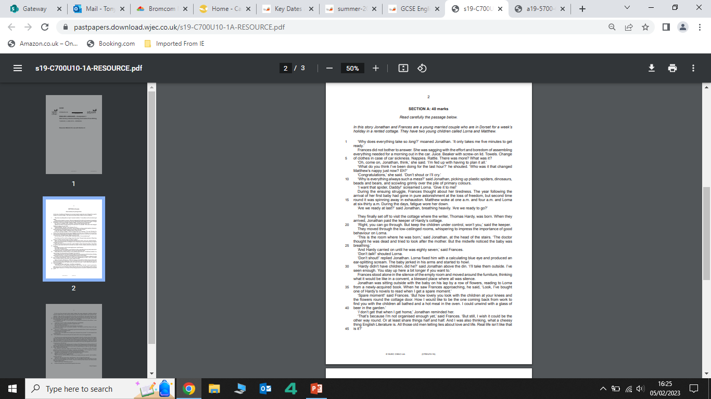
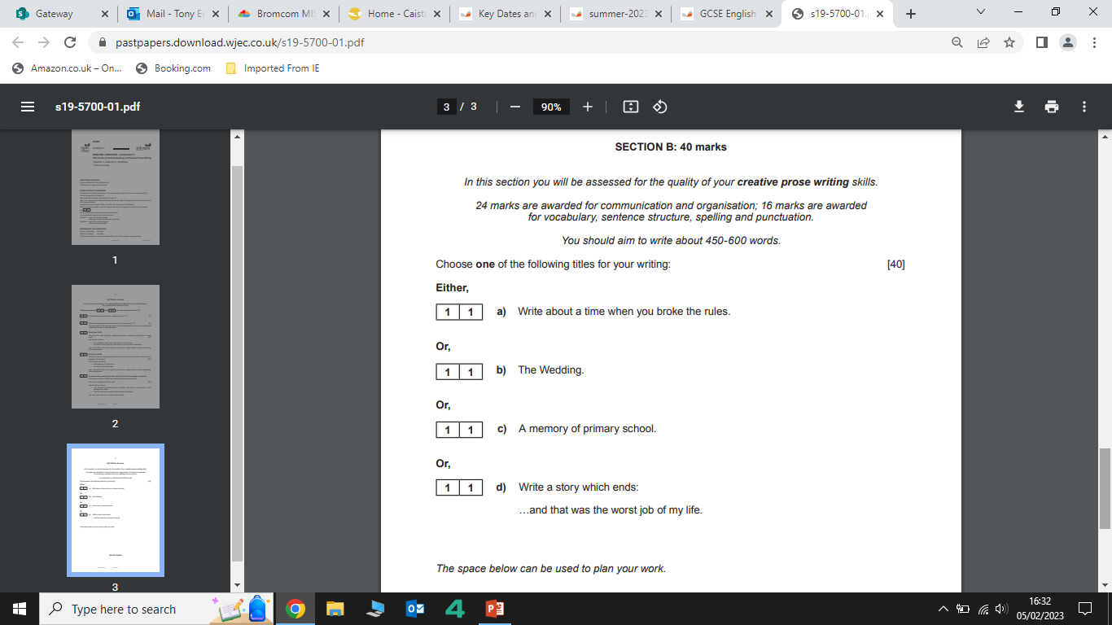
English Language Component 1
Q1: Retrieval
Q2 Impressions
Q3 Lang & Structure
Section B
Section A
Q4: Language
Q5: Evaluation
Q6: Write a Narrative!

Slide 25
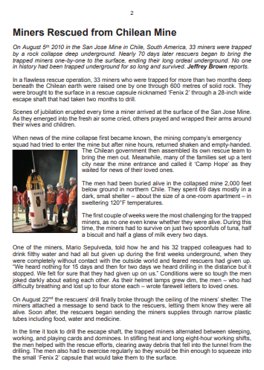
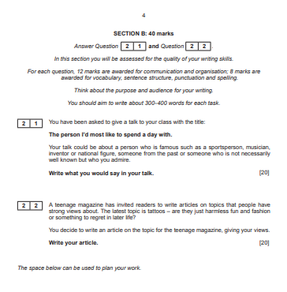
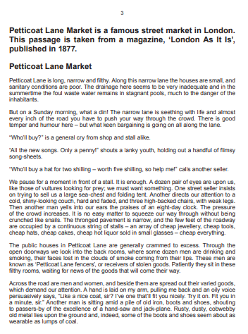
English Language Component 2
Q1.1: Retrieval
Q1.2: Language
Section A
Q1.3: Retrieval
Section B
Q1.4: Evaluation
Q1.5: Brief Explanation
Q1.6: Comparison
Transactional Writing

Slide 26

REVISING GCSE ENGLISH LANGUAGE
Use past exam papers to practice under timed conditions.
Break revision into manageable chunks with specific goals.
Create flashcards for key vocabulary and language techniques.
Annotate texts to highlight important ideas and techniques.
Write short practice answers and get feedback.
Read a variety of texts to improve understanding and vocabulary.
Use mind maps to organize ideas and themes.
Teach someone else what you’ve learned to reinforce knowledge.
Take regular breaks to stay focused and avoid burnout.
Review spelling, punctuation, and grammar regularly
Remember, revision that takes place daily will enable you to independently build the skills you need for the linear exams!

Slide 27
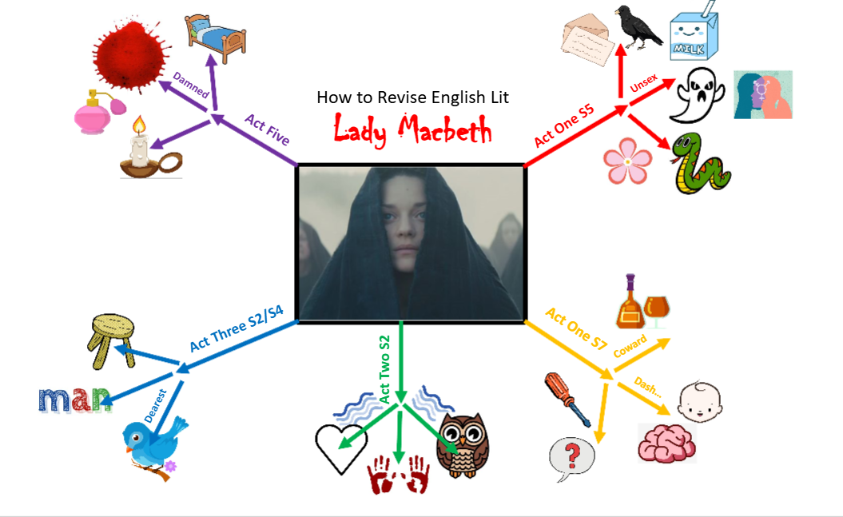
REVISING GCSE ENGLISH LITERATURE
Remember, the literature exams are entirely closed-book.
You will need to remember key quotations and ideas

Slide 28


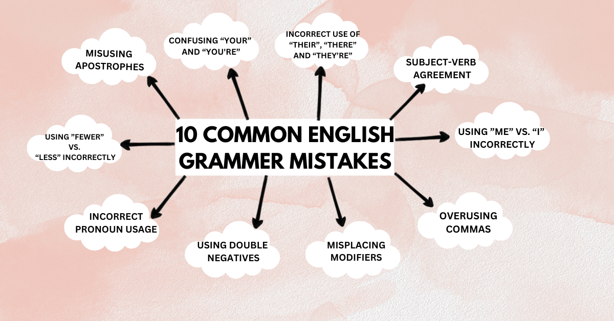
English Language: Writing Skills
GRAMMAR

Slide 29




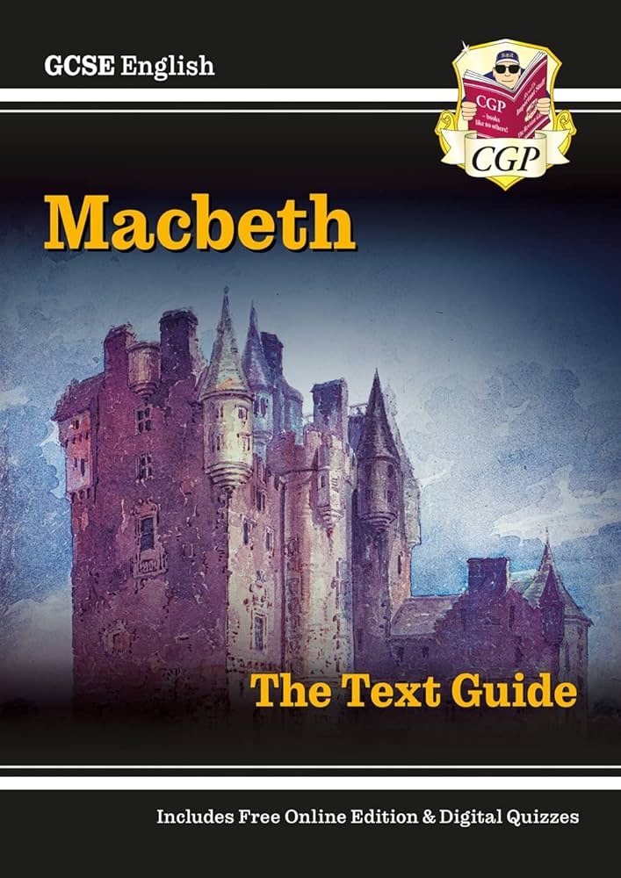
English Literature Component 1
Poetry Anthology
Macbeth

Slide 30



English Literature Component 2
An Inspector Calls
A Christmas Carol
Unseen Poetry

Slide 31

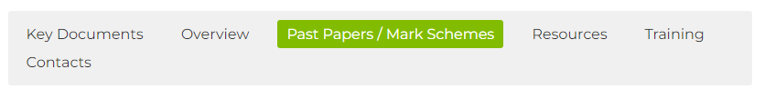
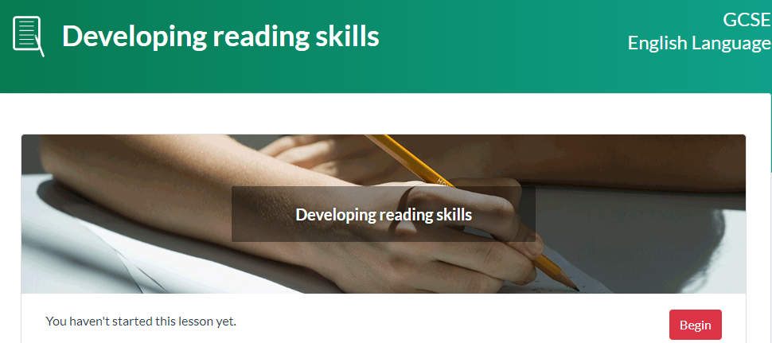

The most effective way to revise & prepare?
A full range of past papers and mark schemes are readily available

Slide 32
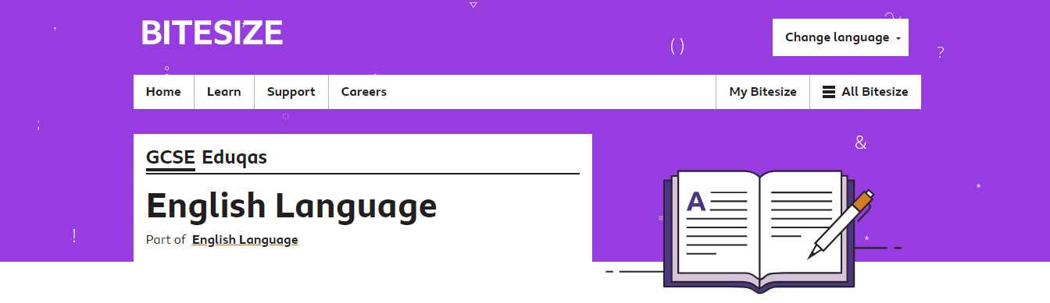
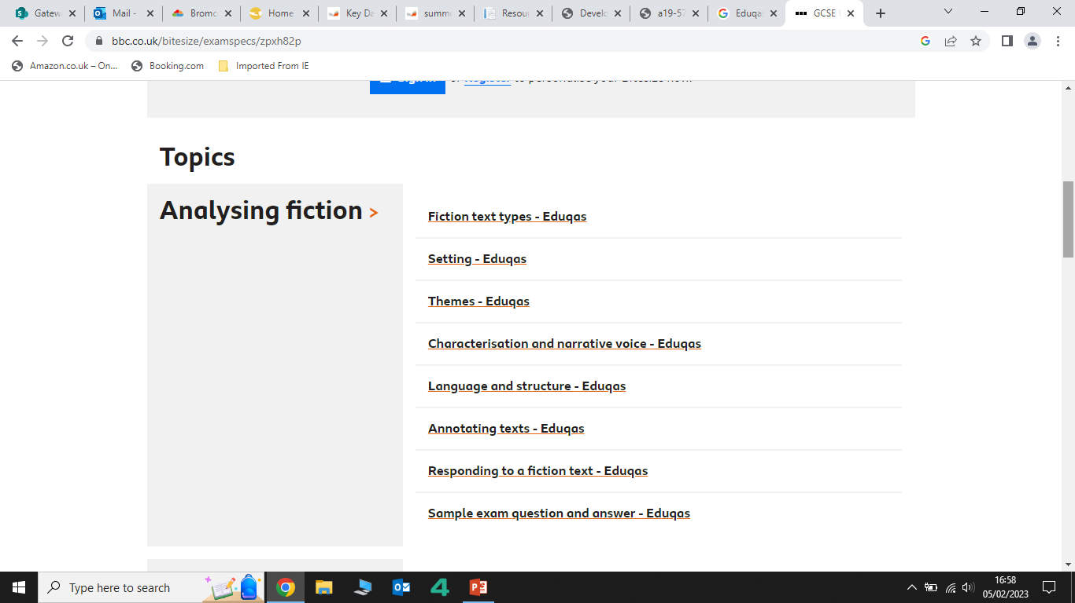
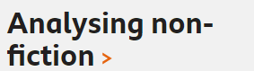
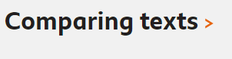
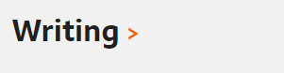
The most effective way to revise & Prepare?

Slide 33

Contact Details:
Tony.Edmondson@cyac.org.uk

Slide 34
Science Department
- Reach your potential!
RESPECTFUL RESILIENT RESOURCEFUL RESPONSIBLE

Slide 35
Combined Science
2 GCSEs
Covers Biology, Chemistry and Physics
6 exams – Biology: B1, B2
Chemistry: C1, C2
Physics: P1, P2
All exams are 1 hour 10 minutes / 60 marks
Foundation (1-5) and Higher (9-4) available
6 hours / week
RESPECTFUL RESILIENT RESOURCEFUL RESPONSIBLE

Slide 36
Separate Sciences
3 GCSEs – Biology, Chemistry and Physics
6 exams – Biology: B1, B2
Chemistry: C1, C2
Physics: P1, P2
All exams are 1 hour 45 minutes / 100 marks
Foundation (1-5) and Higher (9-4) available
6 hours / week
RESPECTFUL RESILIENT RESOURCEFUL RESPONSIBLE

Slide 37
Mocks –
Paper 1 Topics
Physics
Topic 1 Motion | Vectors and scalars Distance/ time graphs Acceleration Velocity/ time graphs
Topic 2 Motion and forces | Resultant forces Newton’s Laws Mass and weight Momentum (Higher only) Stopping distance Braking distance Crash hazards
Topic 3 Conservation of Energy | Energy stores and transfers Energy efficiency Conduction, convection radiation Stored energy Renewable vs Non-renewable energy
Topic 4 Waves | Waves – longitudinal and transverse Wave speeds Refraction Ears and hearing (Separate science only) Ultrasound (Separate science only) Infrasound (Separate science only)
Topic 5 Light and the EM spectrum | Ray diagrams (Separate science only) Colour (Separate science only) Lenses (Separate science only) EM spectrum Uses of long and short wavelengths Radiation and temperature (Separate science only) Dangers of EM waves
Topic 6 Radioactivity | Atomic structure Inside the atom Electrons and orbits Background radiation Radioactive decay (Separate science only) Half life Using radioactivity Dangers of radioactivity Nuclear energy (Separate science only) Nuclear fission and fusion (Separate science only) Using a nuclear reactor (Separate science only)
Topic 7 Astronomy (Separate Science only) | The solar system (Separate science only) Gravity and orbits (Separate science only) Life cycle of stars (Separate science only) Red shift (Separate science only) Origin of the universe → Big Bang/ CMBR (Separate science only)
Chemistry
Topic 1 & 2 States of matter | States of matter Mixtures Filtration, crystallisation Chromatography Distillation
Topic 3 Atomic structure | .Structure of an atom Atomic number and mass number Isotopes
Topic 4 | . Elements of the periodic table Atomic number and the periodic table Electronic configuration
Topic 5,6,7 Ionic and Covalent bonding | Ionic bonds and lattices Properties of Ionic and covalent bonding Covalent bonding Molecular compounds Allotropes of carbon Metal properties Bonding models
Topic 8 Acids and Alkalis | Acids, alkalis and indicators Bases and salts Alkalis and balancing equations Alkalis and neutralisation Reactions of acids with metals and carbonates Solubility
Topic 9 Calculations involving mass | Masses and empirical formulae Conservation of mass Moles
Topic 10, 11, 12, 13 Electrolyte processes, using metals, transition metals, alloys and corrosion | Electrolysis Products of electrolysis Reactivity Ores Oxidation and reduction Life cycle assessment and recycling Dynamic equilibrium Transition metals Corrosion Electroplating Alloying Uses of metals and their alloys
Biology
Topic 1 Key concepts of Biology | Structure of cells Specialised cells Microscopy Enzyme action Factors affecting enzymes Food tests Transport of substances- diffusion/ osmosis/ active transport
Topic 2 Cells and control | Mitosis Growth of plants and animals Stem cells The brain The nervous system The eye
Topic 3 Genetics | Sexual and asexual reproduction Meiosis DNA Protein synthesis Genetic crosses Genetic disorders
Topic 4 Natural selection and genetic modification | Human evolution Natural selection Classification Breeds and varieties Selective breeding Tissue culture (Separate science only) Genetic engineering (Separate science only) Fertilisers and biological control (Separate science only)
Topic 5 Health, disease and the development of medicine | Communicable and non-communicable diseases Types of pathogens Spread of pathogens Virus life cycles (Separate science only) Plant defences (Separate science only) Plant diseases (Separate science only) Physical and chemical barriers The immune system Antibiotics Monoclonal antibodies (Separate science only)

Slide 38
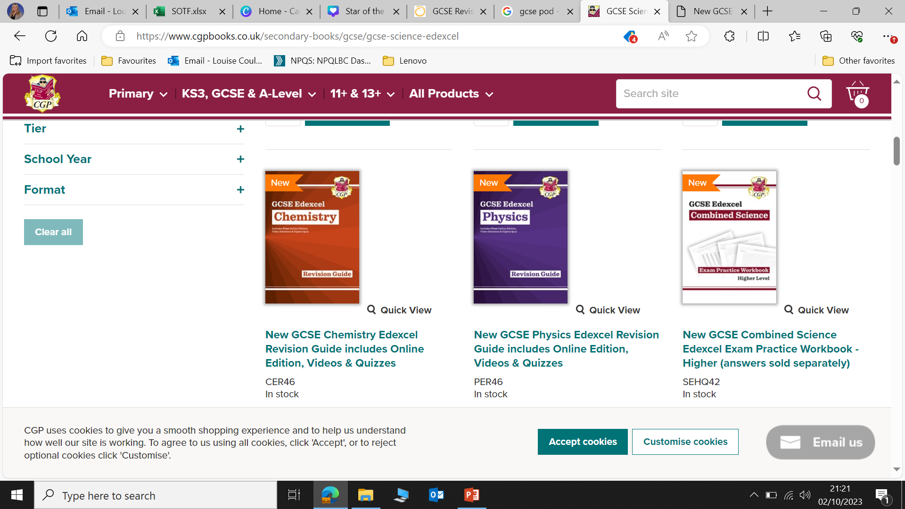
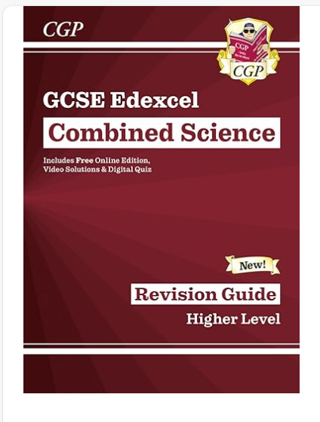
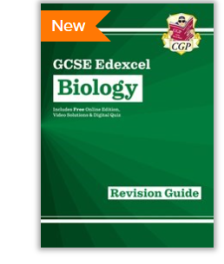
Revision Guides
You'll find QR codes throughout, providing quick and easy access to worked video solutions
Online Knowledge Retrieval quizzes for students to practise
A free Online Edition of the whole book is included so you can read it on a PC
RESPECTFUL RESILIENT RESOURCEFUL RESPONSIBLE

Slide 39

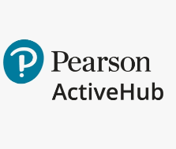
Online book
Activities
Videos
See teachers for logins
Homework
Videos
Differentiated tasks/ practice questions
Questions are tailored to meet the needs of students
RESPECTFUL RESILIENT RESOURCEFUL RESPONSIBLE

Slide 40

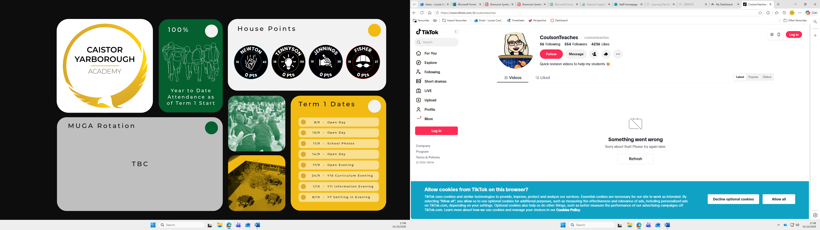

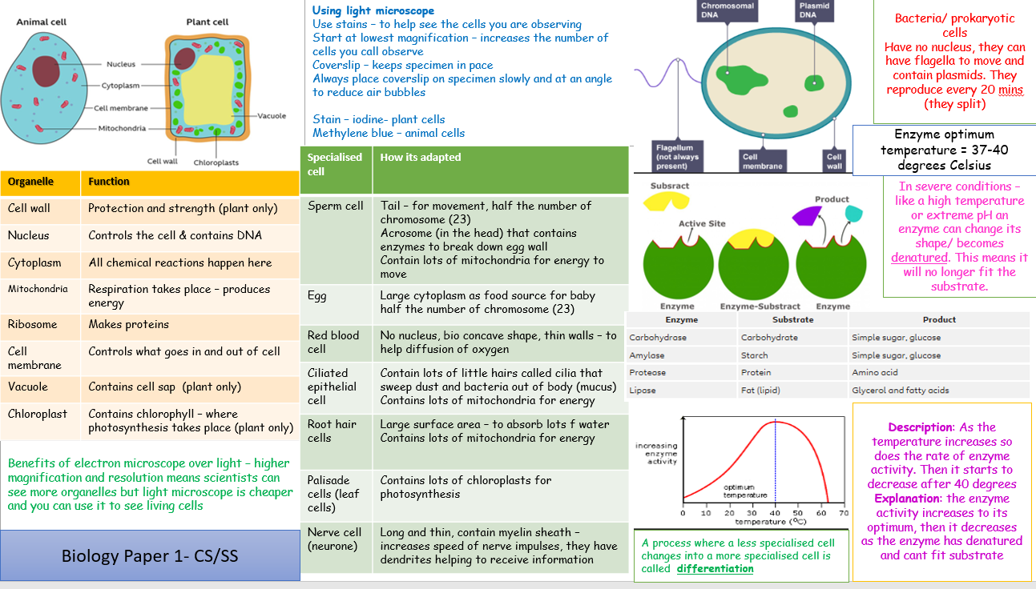
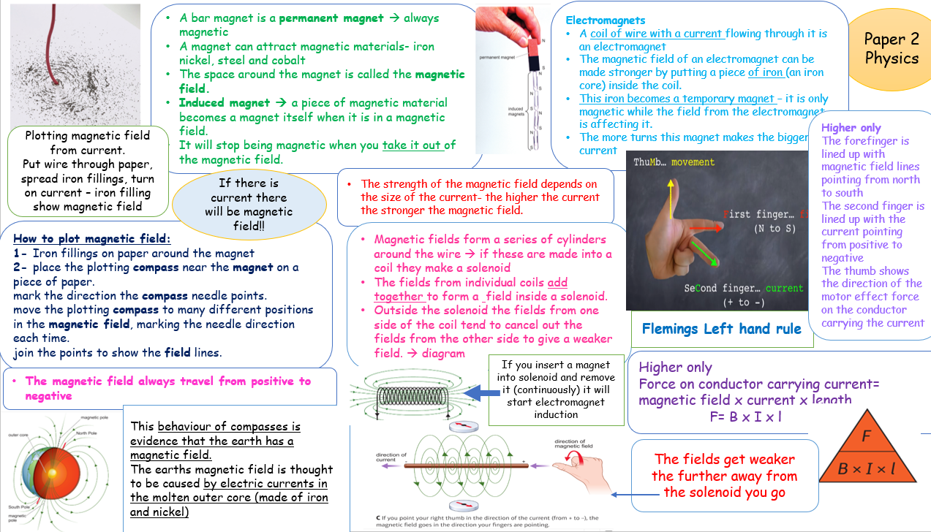
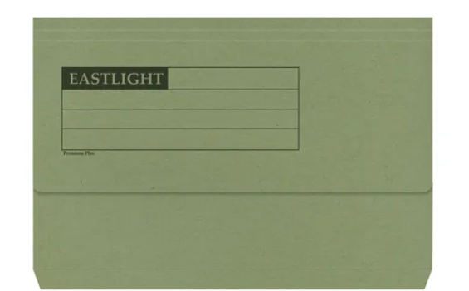
Teams
All Lessons are available on teams
Exam style questions
Knowledge Organisers/ exam folders
Revision materials
Exam style questions
RESPECTFUL RESILIENT RESOURCEFUL RESPONSIBLE

Slide 41
Websites to help with revision
GCSE Revision | Revision Science
GCSE Science - BBC Bitesize
FuseSchool - Global Education – YouTube → contains videos on all topics
Past papers | Past exam papers | Pearson qualifications → past papers and mark schemes to practice exam techniques
Seneca homework app.
RESPECTFUL RESILIENT RESOURCEFUL RESPONSIBLE

