Slide 1

Health & Social Care
BTEC Level 1/2 Tech Award
Notes:
You will start thinking about and deciding, if you would like to study Health and Social Care, as an option subject over the next few weeks, before a September start

Slide 2

Qualification Structure
There are THREE units that you will be covering, two coursework units in Year 10 and one exam in Year 11
These are;
Component 1 – Human Lifespan Development (coursework)
Component 2 – Service and Values in HSC (coursework)
Component 3 – Health and Well-being (Exam)
Notes:
Mrs.Burtonis teaching the course work units and Mrs.eccott will focussed on the exam assessed unit

Slide 3
Your Qualification Grade
Component 1
Assignment
30%
Component 2
Assignment
30%
Component 3
Assignment
40%
Year 1
Year 2
Notes:
Your Year 10 work will be 60% of your end grade and your Year 11 40%. This is different to your other GCSE’s as you’re working for the end grade in Year 10

Slide 4

Exam Assessed Unit
The exam content is all of the Year 10/11 learning.
Students will sit a mock exam in February
Your final exam will be taken in May
Your overall grade will be a Pass, Merit or Distinction
Notes:
Your teacher will ensure you have the best opportunity to be successful in your exams but it’s your responsibility to revise at home.

Slide 5
Year 10; Component 1
Component 1: Human Lifespan Development (coursework assignment assessed PSA)
How do people grow and develop throughout their lives?
How can factors such as lifestyle choices, relationships and lifestyle events affect your growth and development?
Different life events and how people cope
This unit will help you to understand people’s differences and those individuals who are vulnerable
Notes:
Remember a Component is actually a Unit. This unit is a Pass, Merit or Distinction and Component 2 is also worth 30% of the end qualification grade

Slide 6
Year 10/11; Component 2
Component 2: Health and Social Services and Care Values (assignment assessment PSA)
Health and Social Care values underpin good practice at work. This unit is about working in both health and social care settings
You will learn about the range of services and professions as well as how the care values and care staff behaviours impact on service users in health and social care settings.
Individuals, patients or residents, should have control of their own care and their own specific needs are met.
Notes:
This unit is a Pass, Merit or Distinction and Component 2 is also worth 30% of the end qualification grade

Slide 7
Year 11; Unit (Component 3)
Component 3: Health and well-being (exam assessed; a 2 hours exam)
This final unit builds on knowledge learned in
Components 1 and 2 and enables you to be bring these together and related to a real-life situation. This will be given to you as a case study.
You will need knowledge about a variety of health conditions and how to improve these as well as positive life style choices for the best possible health and well-being.
Notes:
Your exam result is marked as a Pass, Merit or Distinction and Component 3 is also worth 40% of the end qualification grade

Slide 8
Student Responsibility
Students will need to have their books in every lesson. These will be kept in school for most of the time but may be sent home occasionally.
All homework will be set on teams and recorded on MCAS.
If you are absent from lessons, you will be expected to catch up your notes in your own time.
Notes:
Over the summer… take a trip to get some nice pens!

Slide 9
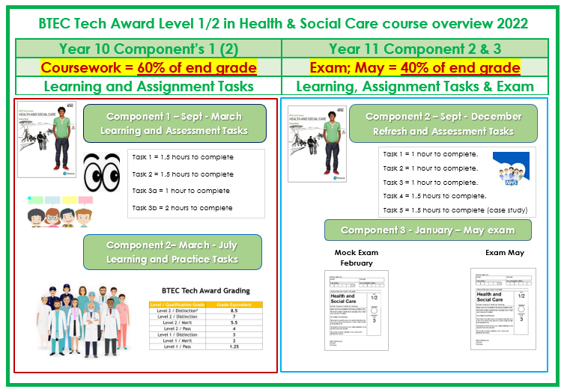
A Visual Overview
Component 1 – Sept - May
Component 1 – May - July
Notes:
Let’s look at the two years again and see the work you will need to do to pass the course

