Slide 1
Art
Join us on our journey….

Slide 2
Overview
Art and Design is both a form of communication and a means of expressing ideas and feelings. The course aims to encourage students to develop their imagination, the way they look at objects and how they record what they see. The syllabus has been devised to combine both breadth and depth of study with the freedom of choice to accommodate a wide range of abilities and material resources
2 lessons a week
GCSE

Slide 3
What will you study?
The course requires you to produce at least two coursework projects, consisting of one Design and one Fine Art projects, a Year 10 examination and a pre-public examination (PPE) in Year 11. Students also have to complete a timed examination project at the end of the course. From a common starting point students will have the opportunity to develop and refine their skills in a variety of media in order to achieve a final outcome. Personal research is important. The techniques and media available to each student will include drawing, painting, collage, printmaking, graphic design and clay. Each project must link to the work of an artist or designer. The topics and themes covered will include a range of genres and art movement

Slide 4
Skills Required
The most important requirements for this course are to be independent, creative, dedicated, determined, organised and to be able to meet deadlines. To do the latter you must be self-disciplined and driven. Good observational drawing skills are an advantage but not essential. It is essential that you have an interest in art.

Slide 5
Assessment Objectives
Your 4 coursework projects and Year 11 examination will be marked using the following criteria:
AO1 Develop your ideas through investigations informed by contextual and other sources demonstrating analytical and cultural understanding.
AO2 Refine your ideas through experimenting and selecting appropriate resources, media, materials, techniques and processes.
AO3 Record ideas, observations and insights relevant to your intentions in visual and/or other forms.
AO4 Present a personal, informed and meaningful response demonstrating analytical and critical understanding, realising intentions and, where appropriate, making connections between visual, written, oral or other elements.
A final piece must be created to conclude each project. It must be creative and original. This final piece must reflect everything you have done in Assessment Objectives 1, 2 and 3.

Slide 6
Course breakdown
Art and Design Portfolio
The GCSE exam requires the successful completion of:
2 coursework projects
Year 10 Examination (which will be added to the coursework portfolio)
Year 11 PPE (which will be added to the coursework portfolio)
Year 11 Examination (8 weeks preparation time, plus a 10 hour Timed Examination)

Slide 7
Extended Study
To complete the course, Art students are expected to use their own initiative and demonstrate that they are prepared to study in their own time. It is imperative that all Art students complete all coursework if they are to achieve the highest grade possible.
GCSE students have access to the Art Room (T7) every lunch time (when staffed). They are expected to come to any GCSE catch up session organised by their teacher.

Slide 8
Careers and Opportunities
Careers and occupational opportunities following this course include over a hundred different job types with the creative industries in the UK growing faster than any other industry. There has never been a better time in relation to the wealth of jobs in this area.

Slide 9
Any Questions ?

Slide 10
Sport
Join us on our journey….

Slide 11
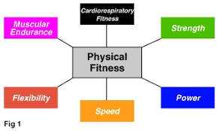
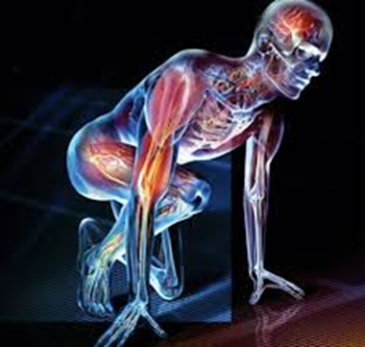
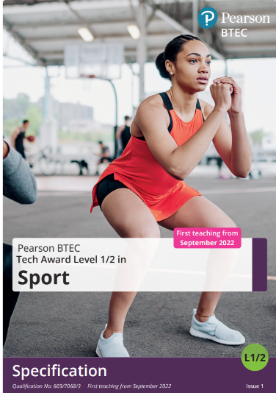
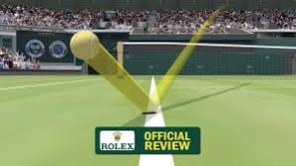
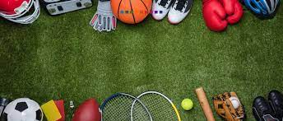
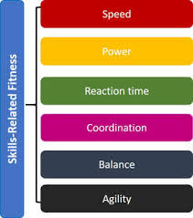
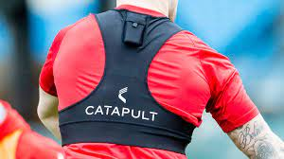
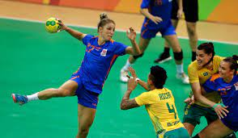
2 ASSIGNMENTS
1 EXAM

Slide 12
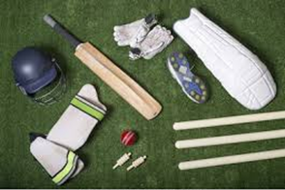
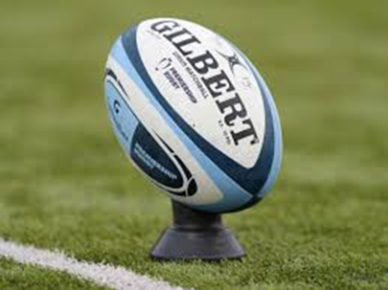
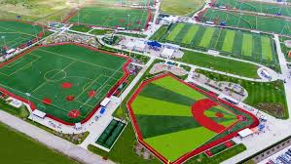
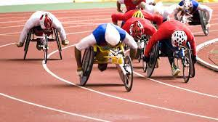
30%
COMPONENT 1
PREPARING PARTICIPANTS TO TAKE PART IN SPORT AND PHYSICAL ACTIVITY
Learning outcomes:
Explore types and provision of sport and physical activity for different types of participant
Examine equipment and technology required for participants to use when taking part in sport and physical activity
Be able to prepare participants to take part in sport and physical activity.
ASSIGNMENT
BASED

Slide 13
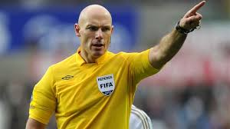
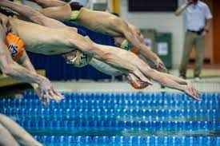
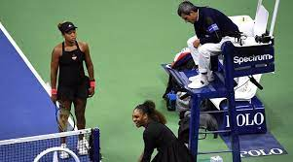
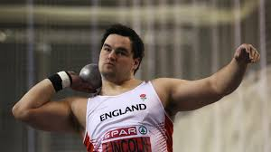
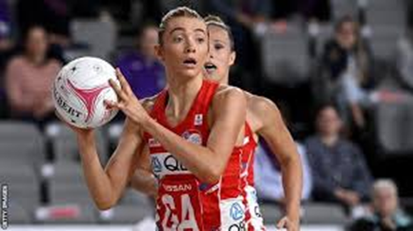
30%
ASSIGNMENT
BASED
COMPONENT 2
TAKING PART AND IMPROVING OTHER PARTICIPANTS SPORTING PERFORMANCE
Learning outcomes
Understand how different components of fitness are used in different physical activities
Be able to participate in sport and understand the roles and responsibilities of officials
Demonstrate ways to improve participants sporting techniques

Slide 14
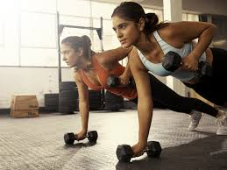
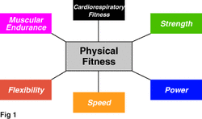
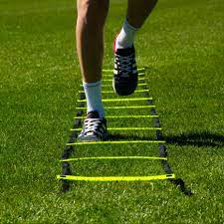
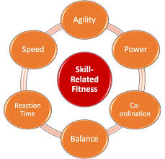
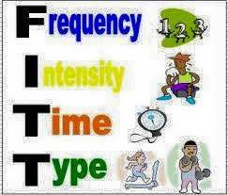
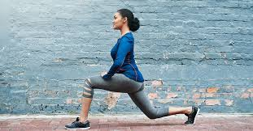
Component 3
FITNESS FOR SPORT AND EXERCISE
Demonstrate knowledge and understanding of the following:
Physical components of fitness,
Skill components of fitness,
Fitness testing,
Training methods,
Principles of training
Explain how the above will work together to improve performance, participation and enjoyment in sport and physical activity
40%
EXAM
BASED

Slide 15
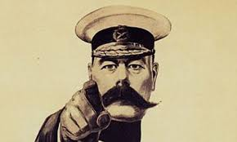
SPORT BTEC LEVEL 2
Is this course for you?
Have an interest in sport and physical activity
Wants to learn more about the fitness, training and preparation required to be a successful sports performer
Is willing to work hard and be part of a team
Participate in at least one sport or activity outside of school
Enjoy keeping fit and healthy
Can work independently
Has competent ICT skills

Slide 16
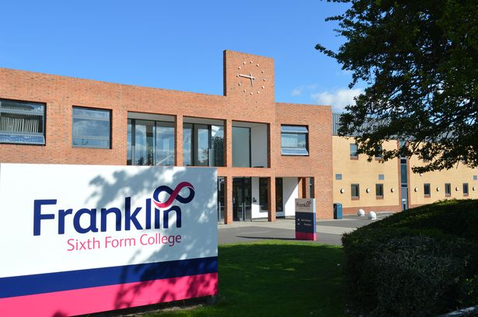
Further education in SPORT
Sport level 2
BTEC level 3/ A Level
University
Work within industry

Slide 18
Any Questions ?

