Slide 1
Creativity subjects
RESPECTFUL RESILIENT RESOURCEFUL RESPONSIBLE

Slide 2
Eduqas GCSE Drama
Key Dates:
Component 1 – All coursework must be completed and handed in by Friday 18th October (In addition to the exam we did!)
Component 2 – Externally assessed examiner to confirm assessment date between January and May 2025
Component 3 – Written exam in early June 2025
Intervention:
Wednesday after school – intervention until 4:30 every Wednesday for extra rehearsals for comp 2 and prep for comp 3.
Lunchtimes – Mondays, Tuesday and Fridays. (Can use it other days if not in use and asked Miss B first)
Support from parents/guardians:
Encouragement to attend lunchtime and after school interventions - and please collect them!
Avoid any medical appointments in lesson time – effects whole group as then have to spend time catching them up next lesson.
Understanding – their coursework must be completed at home in order to allow us to spend the 2 hours a week lesson time on the practical rehearsals to ensure the quality of the performances.
Support with any props or costumes they need – you shouldn’t have to buy anything but if you let us borrow things you already have we will be eternally grateful!
RESPECTFUL RESILIENT RESOURCEFUL RESPONSIBLE
Notes:
As students enter have Macklemore same love playing - https://www.youtube.com/watch?v=0eLH0GOXlCM

Slide 3
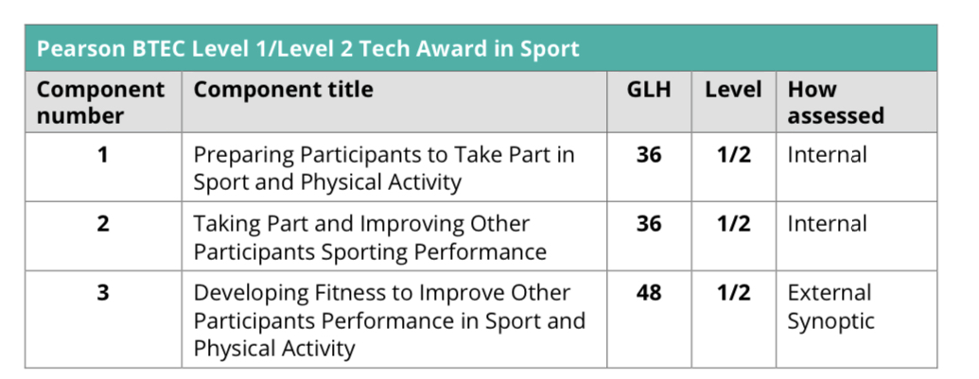
BTEC Tech Award – Sport
Key Dates:
Component 1 – 30% complete. Grades given.
Component 2 – 30% complete. Grades given.
Submission date for both components– 15th Dec (fully marked and sent to exam officer)
Component 3 – externally assessed unit – 40 %
Intervention:
Wednesday after school – 3.20-4.20 after mocks
Lunchtimes – Wednesday lunch between our two sport lessons.
Support from parents/guardians:
Encouragement to attend lunchtime and after school interventions - and please collect them!.
Homework will be set each week. During component 2, this will be 30 minutes minimum to complete the task on teams. Component 3 starts, this will be on the Everlearner.
RESPECTFUL RESILIENT RESOURCEFUL RESPONSIBLE
Notes:
As students enter have Macklemore same love playing - https://www.youtube.com/watch?v=0eLH0GOXlCM

Slide 4
CNAT Enterprise and marketing
Key Dates:
Component 1 RO68– 30% complete. Grades given.
Component 2 – RO69 due in December, half term intervention on invite, to give students to enhance grades further 30%
Enterprise- planning a business pitch
Submission date for both components– 15th Dec (fully marked and sent to exam officer)
Component 3 – externally assessed unit – 40 %
RO67 exam
Intervention:
Wednesday after school – 3.20-4.20 after mocks
Lunchtimes – Tuesday lunch
UnitMarksDurationGLH*
R067: Enterprise and marketing concepts
701 hour 15 mins48Written paper, OCR set and marked
1st Exam in January, 2nd attempt (if needed) in June.
R068: Design a business proposal
60Approx. 10-14 hours36Centre-assessed tasks, OCR moderated- Complete
R069: Market and pitch a business proposal
60Approx. 10-14 hours36Centre-assessed tasks, OCR moderated- Completing currently
Support from parents/guardians:
Encouragement to attend lunchtime and after school interventions .
Homework will be set each week, this will be 30 minutes minimum to complete the task on teams. Component 3 will be exam practice on teams and via revision booklet that will be provided.
RESPECTFUL RESILIENT RESOURCEFUL RESPONSIBLE
Notes:
As students enter have Macklemore same love playing - https://www.youtube.com/watch?v=0eLH0GOXlCM

Slide 5
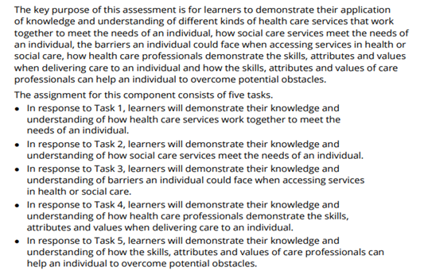
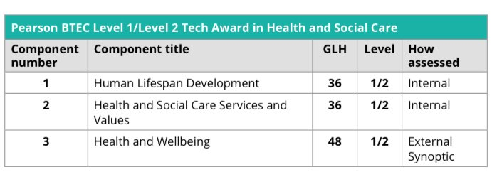
BTEC Tech Award- Health and Social Care
Current work
Component 2 is currently being completed by students with a deadline of Dec 15th. Revision work will be sent home as homework and will be accessible via TEAMS.
Component 3 will be an Exam that takes place Early May – From Jan Students will be revising all work from components 1 & 2
Intervention:
Lunchtime Intervention – Wednesday lunch (when needed)
Intervention – one day in Oct Half Term (invite only)
Support from parents/guardians:
Encouragement to attend all lessons.
Understanding that the current component 1 is complete and worth 30% of their actual overall grade.
Component 2 is currently being completed and needs to be done at the highest possible standard, as this will be externally moderated.
Support will be needed from Jan as revision will be taking place for the exam set in May alongside their other exams.
Revision homework will be set each week after Component 2 is completed on TEAMS.
Revision Guides-
CGP BTEC Tech Award Health and Social Care
CGP BTEC Tech award Health and Social Care Exam Practice Workbook
RESPECTFUL RESILIENT RESOURCEFUL RESPONSIBLE
Notes:
As students enter have Macklemore same love playing - https://www.youtube.com/watch?v=0eLH0GOXlCM

Slide 6
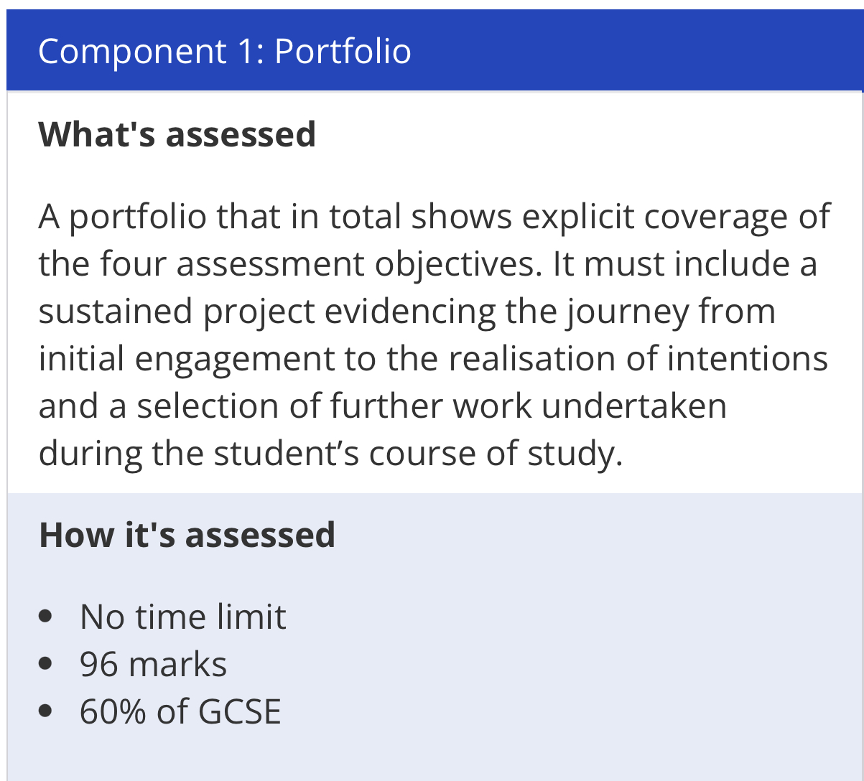
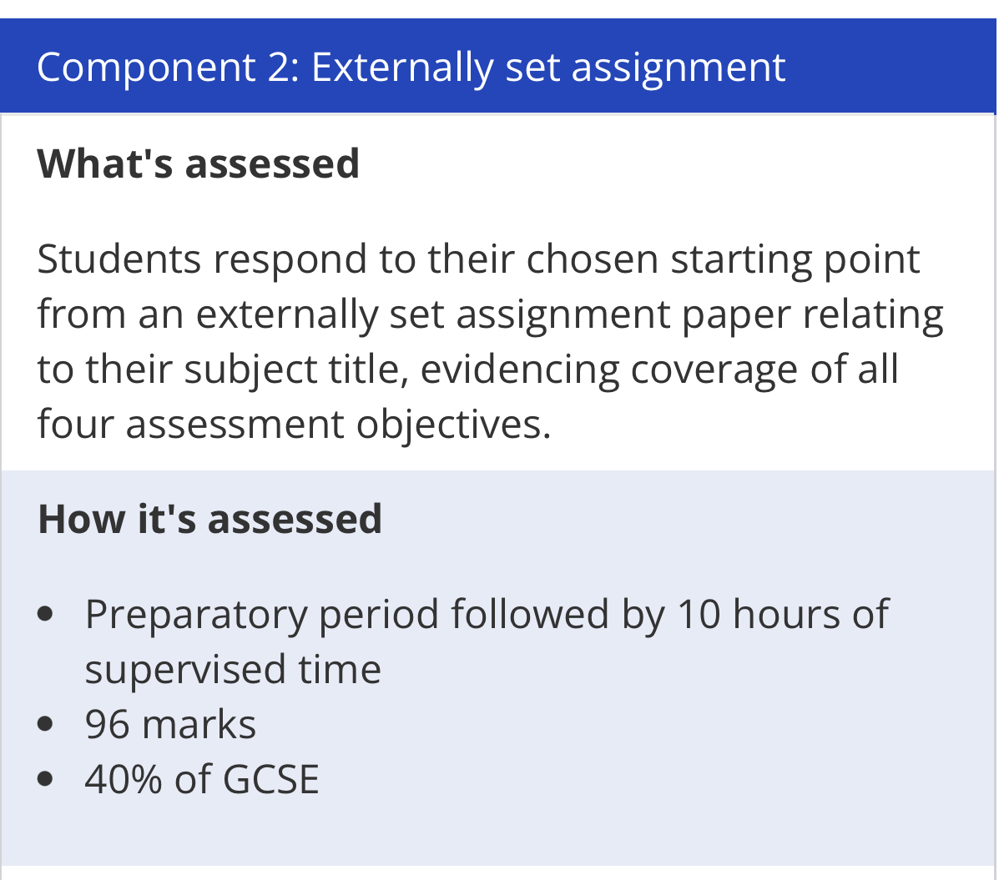
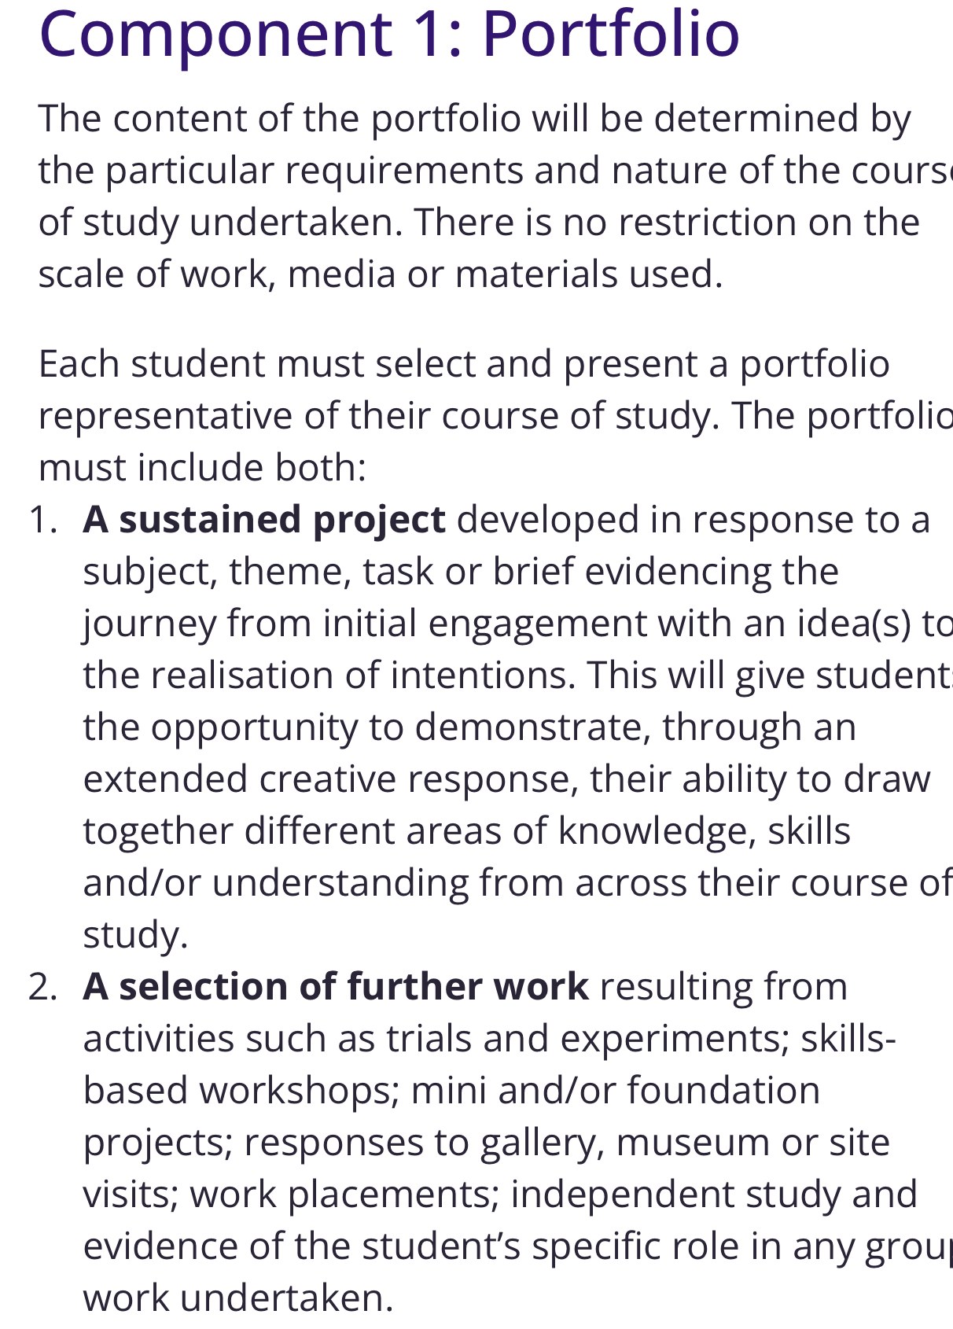
AQA GCSE Art
Current work
Intervention:
Lunchtimes – Wednesday lunch between the two art lessons.
Support from parents/guardians:
Encouragement to attend lunchtime interventions.
Understanding that the current component 1 is 60% of their actual overall grade, all classwork and homework can be used as part of their body of work.
Students should build to having up to 2 full sketchbooks of work. All work can be used.
Homework will be set each week. During component 1 this will be 30 minutes minimum to complete the task.
RESPECTFUL RESILIENT RESOURCEFUL RESPONSIBLE
Notes:
As students enter have Macklemore same love playing - https://www.youtube.com/watch?v=0eLH0GOXlCM

Slide 7
AQA GCSE Photography
Y10:
Photography Basics and Typology
Y11:
Portraiture
Exam
Exam paper comes out in January – students pick a theme from a range of starting points
Support from parents/guardians:
•Encourage your child to attend lunchtime sessions to catch up and progress further
•Students to complete 1-2 hours of work on their portfolio at home
Intervention:
Lunchtimes – Monday to Friday
RESPECTFUL RESILIENT RESOURCEFUL RESPONSIBLE
Notes:
As students enter have Macklemore same love playing - https://www.youtube.com/watch?v=0eLH0GOXlCM

Slide 8
OCR GCSE Graphic Communication
Y10:
Project 1 – Festival Re-brand
Y11:
Project 2 – Packaging project
Exam
Exam paper comes out in January – students pick a theme from a range of starting points
Support from parents/guardians:
•Encourage your child to attend lunchtime sessions to catch up and progress further
•Students to complete 1-2 hours of work on their portfolio at home
Intervention:
Lunchtimes – Monday to Friday
RESPECTFUL RESILIENT RESOURCEFUL RESPONSIBLE
Notes:
As students enter have Macklemore same love playing - https://www.youtube.com/watch?v=0eLH0GOXlCM

Slide 9
GCSEPod video
f714b393-998f-4913-9859-7a0366f83890 2024-10-02 12_38_54.mp4
RESPECTFUL RESILIENT RESOURCEFUL RESPONSIBLE

