Slide 1
English Language and Literature
At Caistor Yarborough Academy
Join us on our journey….

Slide 2
The English Team
Mr. Edmondson (Head of English)
Mr. Hostead
Miss. Moll
Mrs Spalding
Miss. Olsen
Mrs. Elliott

Slide 3
English Language Component 1
1 hour 45 minute exam
English Language Component 2
2 hour exam
English Literature Component 1
2 hour exam
English Literature Component 2
2 hours 30 minute exam

Slide 4
English Language Component 1
Q1: Retrieval
Q2 Impressions
Q3 Lang & Structure
Section B
Section A
Q4: Language
Q5: Evaluation
Q6: Write a Narrative!

Slide 5
English Language Component 2
Q1.1: Retrieval
Q1.2: Language
Section A
Q1.3: Retrieval
Section B
Q1.4: Evaluation
Q1.5: Brief Explanation
Q1.6: Comparison
Transactional Writing

Slide 6
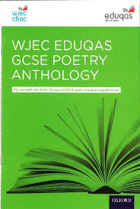
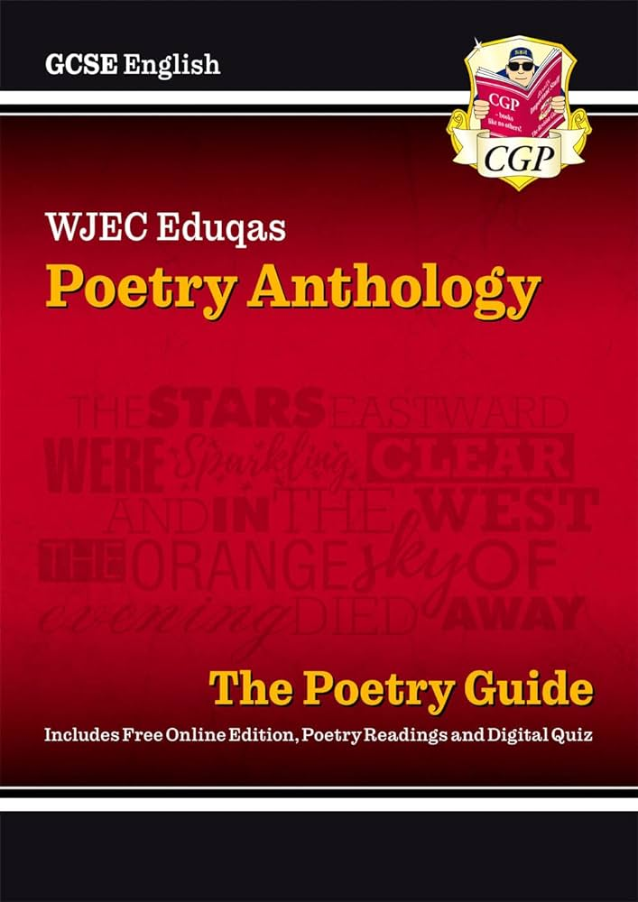
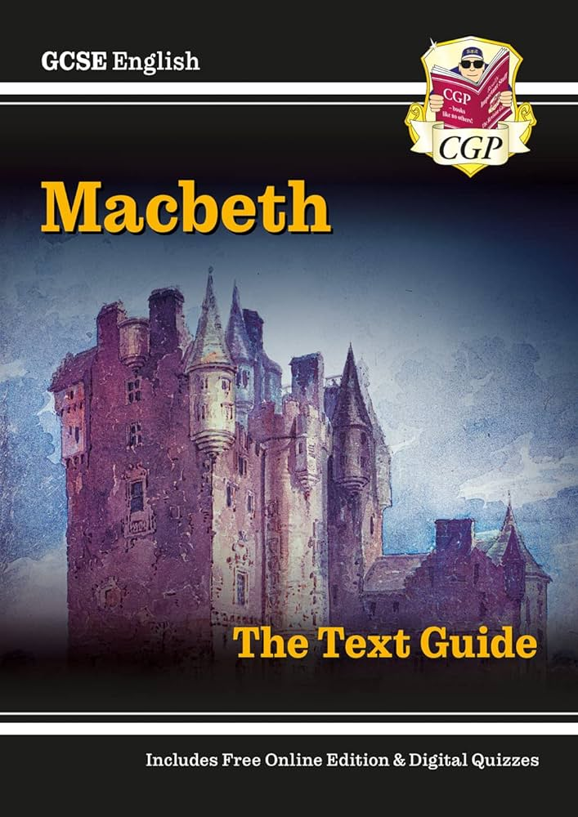
English Literature Component 1
Poetry Anthology
Macbeth

Slide 7
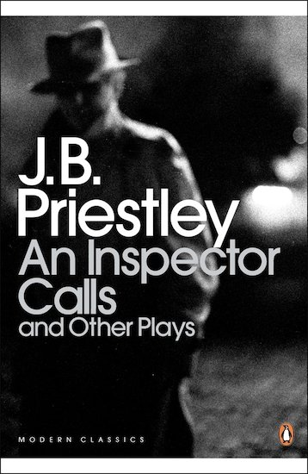
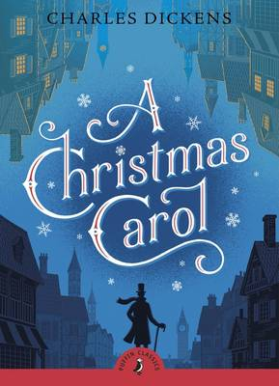
English Literature Component 2
An Inspector Calls
A Christmas Carol
Unseen Poetry

Slide 8
The most effective way to revise & Prepare?
A full range of past papers and mark schemes are readily available
There are a full range of blended learning revision materials available via the Eduqas website. The English team will provide full details and hyperlinks on Microsoft Teams.

Slide 9
The most effective way to revise & Prepare?

Slide 10
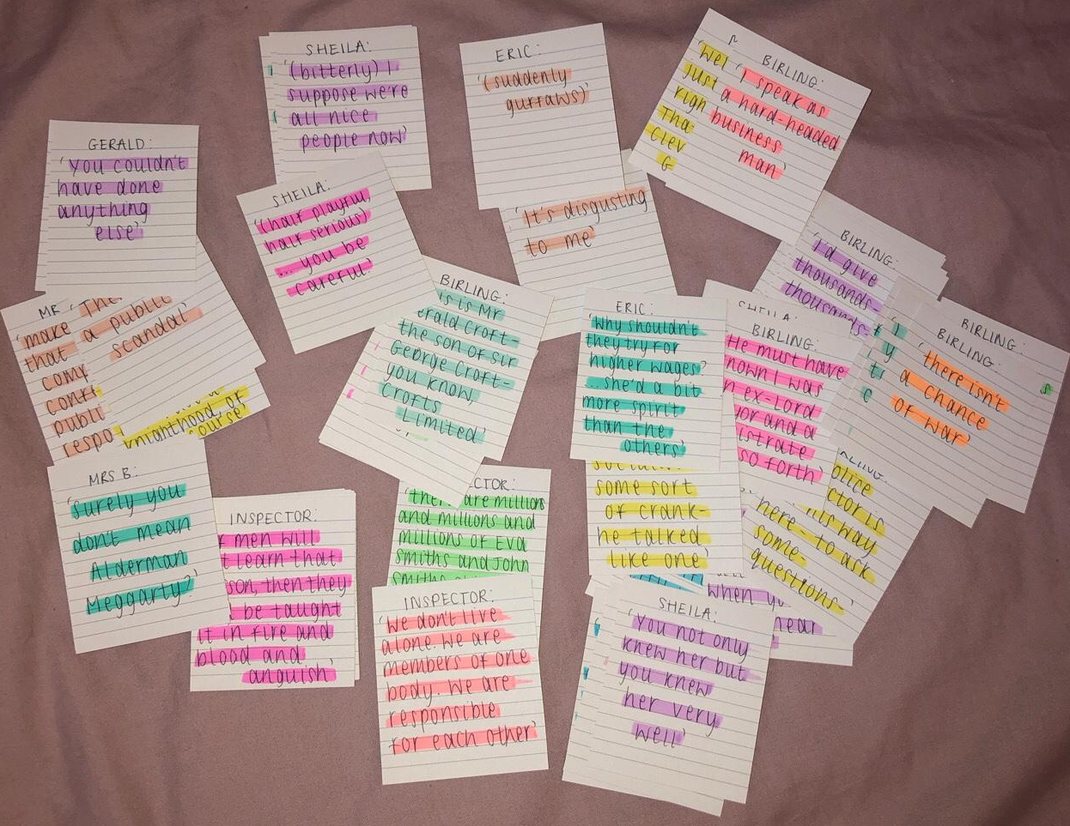
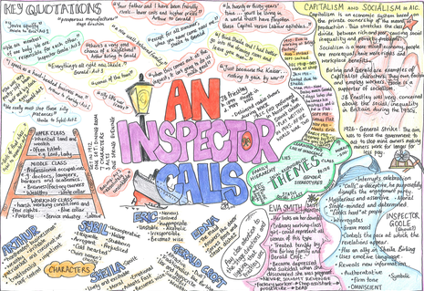
Building your understanding of literature

Slide 11
Contact Details:
Tony.Edmondson@cyac.org.uk

