Slide 1
GCSE Geography
What will my child study over the next two years and how will they be assessed?

Slide 2

An Overview
Students complete 3 Exams at the end of the 2 year course
The exams cover a mixture of Physical and Human Geography Themes as well as Fieldwork and Geographical Skills
The Course is graded from 9-1, 4 is a pass/5 is a good pass
The Academy uses the WJEC/Eduqas GCSE Specification A Geography Course

Slide 3
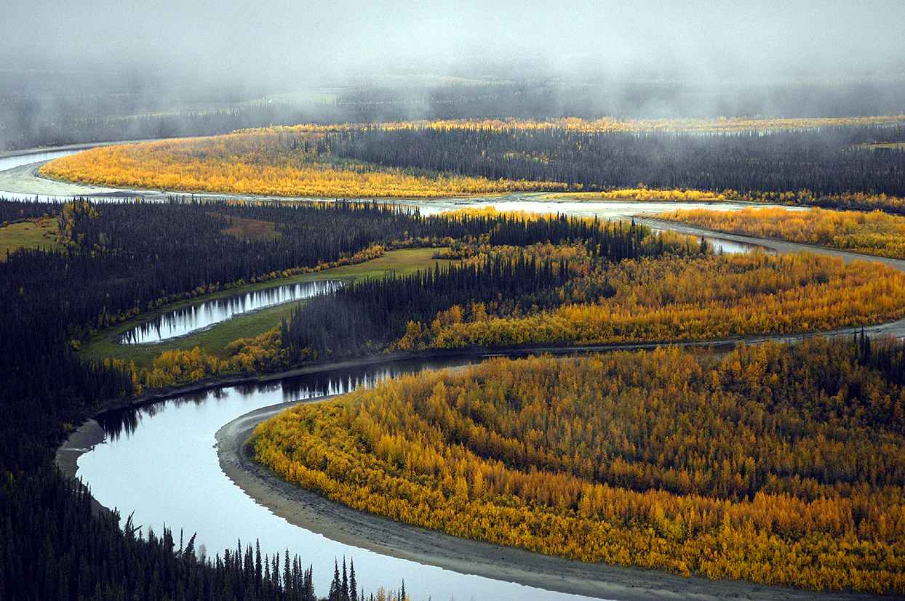

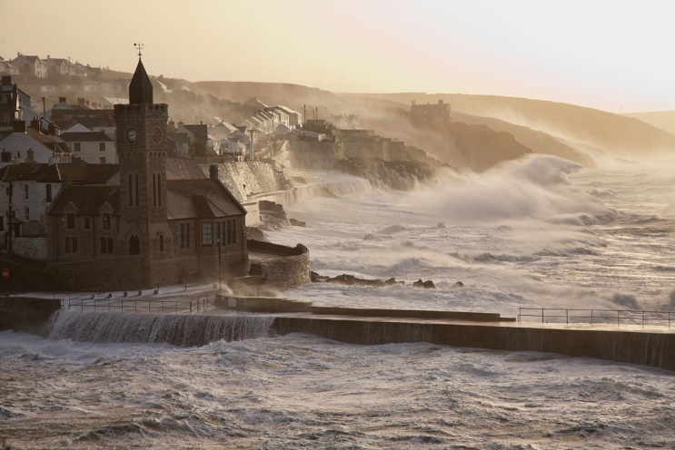
Course Content – Paper 1
Over the two year course, students study a set of key Geographical Themes. These are:
Core Theme 1: Landscapes & Physical Processes.
This Theme looks at:
The Distinctive Landscapes of the UK & related issues
River and Coastal Landforms & Processes
The Causes of Flooding & Flood Management
Core Theme 2: Rural – Urban Links
This Theme looks at:
The Rural-Urban continuum & how Rural areas are changing
Population Change in the UK
Challenges facing towns & cities
Changes in Retailing in the UK
Global Patterns of Urbanisation & The Development of Global Cities
Option Theme 4: Coastal Hazards and their Management
This Theme looks at:
The Vulnerability of UK coastlines
How are Coastlines managed?
Sustainable management of coastlines linked to rising sea levels

Slide 4
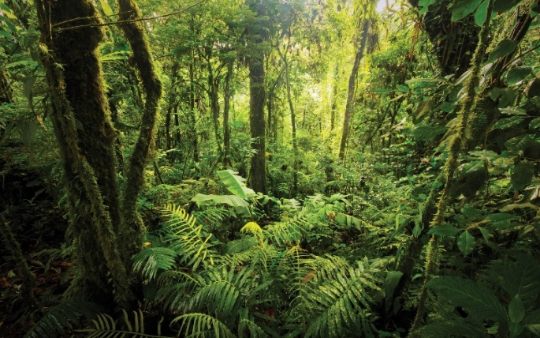
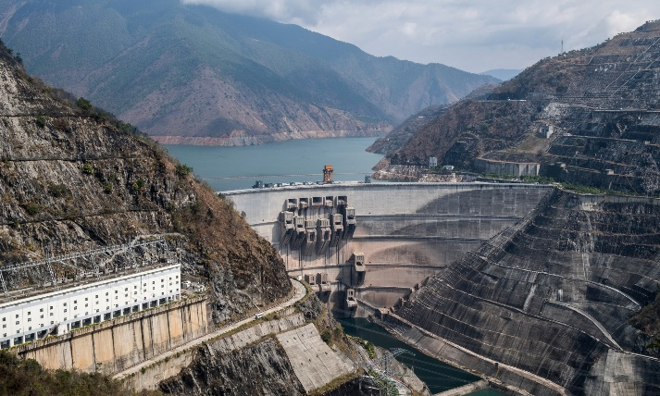
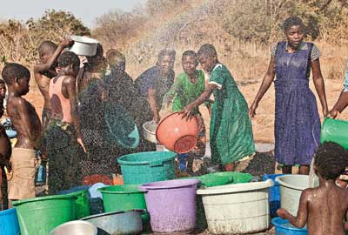
Course Content – Paper 2
Over the two year course, students study a set of key Geographical Themes. These are:
Core Theme 1 – Weather, Climate and Ecosystems
This Theme looks at:
The Issue of Climate Change
Global Weather Systems
Global Weather Hazards
Weather & Climate in the UK
Ecosystem Distribution, Processes, Threats & Management
Core Theme 2 – Development and Resource Issues
This Theme looks at:
Measuring Economic Development & assessing Global Patterns
Causes & Consequences of uneven development & Global Responses
Issues & Management of Water Resources
Regional Economic Development & Inequalities in the UK
Option Theme 7: Social Development Issues
This Theme looks at:
The concept and measuring of Social Development
Issues relating to Social Development in Sub-Saharan Africa
Health Care Issues in Sub-Saharan Africa

Slide 5
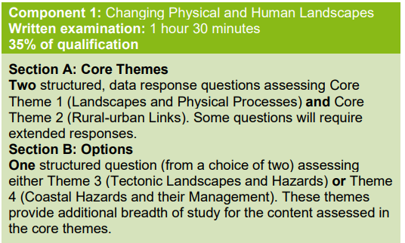
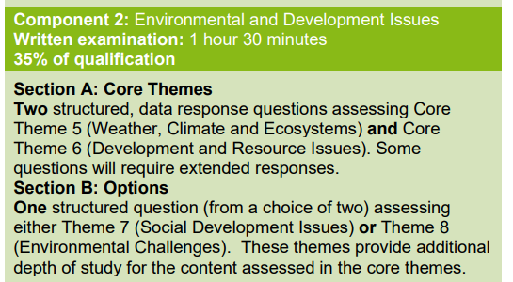
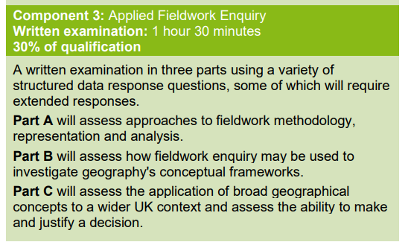
Examinations
At the end of the course, students will sit 3 exams which are designed to test their knowledge of the three key themes and also their problem solving, fieldwork and Geographical skills:

Slide 6
How will we support your child in Geography?
- Planned and structured lessons which use a variety of resources to engage students and ensure understanding and progress including the use of Homework to embed knowledge
- In-depth knowledge of exam requirements to develop exam technique and improve grades – staff have experience of marking for Exam boards
- Regular assessment to check progress and understanding – Knowledge re-call starters, homework assessment & mid/end of topic tests
- School holiday revision sessions and intervention sessions at lunchtimes and after school.
- Communication and additional support materials through Microsoft Teams, including comprehensive revision guide videos
- Revision materials for each of the Themes of the course

Slide 7
How can I support my child in Geography?
- Encourage your child to watch the news and TV documentaries on Physical and Human Geography to further understand key ideas and concepts
- Encourage them to develop their own revision materials such as Knowledge organisers, Mind Maps and Flash Cards of important Case Study locations and Events
- Encourage them to develop their own key word list of terms for each Theme. Test them on their knowledge of key words and their definitions
- Discuss current affairs with your child – this will help them develop a viewpoint. Recent examination topics have been natural disasters, deprivation in coastal towns, extreme sports, climate change. Challenge your child’s opinion – many teenagers love to argue!
- Direct your child towards GCSEPod if they claim they have no homework. They can even get it on their phone or tablet and can check their understanding through the quizzes.

Slide 8


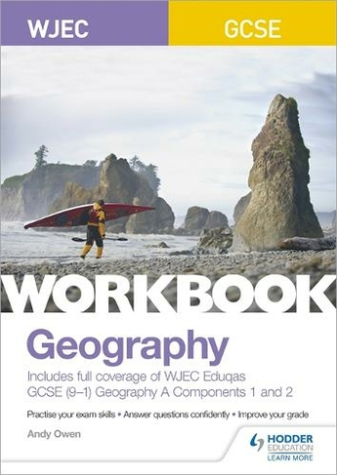

Revision Materials Available

Slide 9
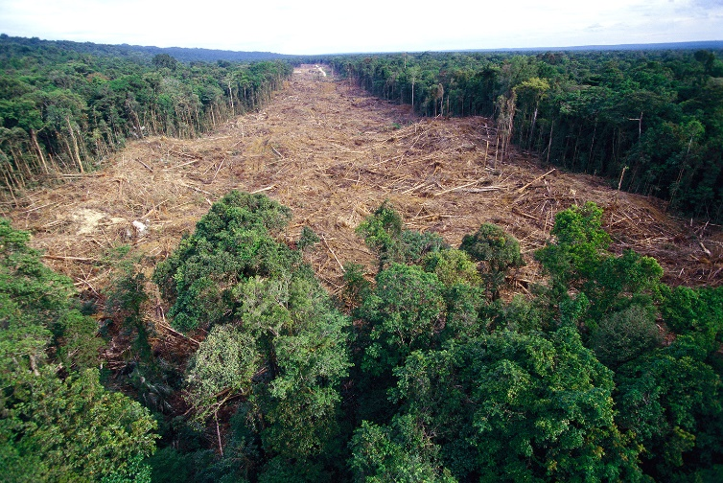
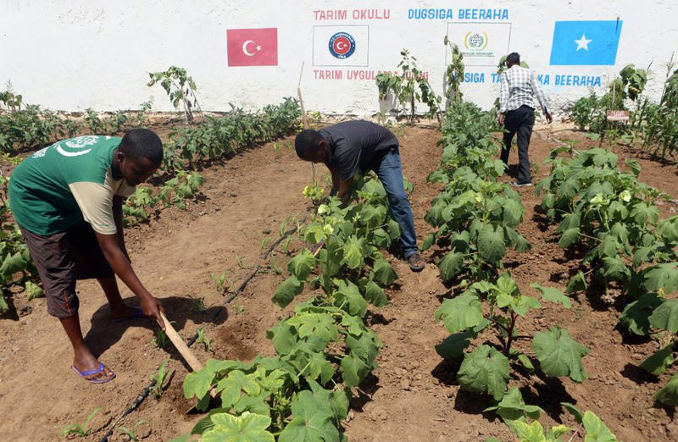

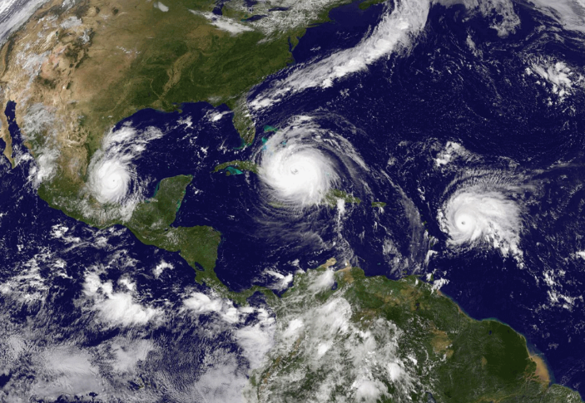
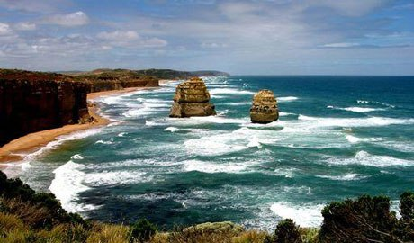
We’re here to help…
If you have any questions or issues you would like to discuss about the course, resources available and supporting your child, please contact:
Ben.Curtis@cyac.org.uk
Ellie.Mulligan@cyac.org.uk

