Slide 1
GCSE graphic communication (ocr)

Slide 2
Why would I choose it?
GC develops a wide range of skills, which will be useful in university applications and future careers.
GC may offer a highly creative and hands-on alternative to other subjects you may be studying.
Develop an awareness of the different roles available in the creative and industries.
This course will teach you to look at the world in a creative way.
The creative potential stimulated in this course will enable you to apply creative, analytical, and critical thinking to any other course that you do.

Slide 3
Course structure
Year 10
Mini packaging project
Sustained design brief – Festival Rebrand
Logos
Advertising
Year 11
Sustained design brief – Festival Rebrand
Print design
Illustration
January – March: Exam component
April – 10 hour final response to NEA

Slide 4
How are you assessed?
Component 1: Portfolio
What's assessed A portfolio that in total shows explicit coverage of the four assessment objectives. It must include a sustained project evidencing the journey from initial engagement to the realisation of intentions and a selection of further work undertaken during the student’s course of study.
How it's assessed No time limit 60% of GCSE
Non-exam assessment (NEA) set and marked by the school/college and moderated by OCR during a visit. Moderation will normally take place in June.

Slide 5
Component 2: Externally set assignment
What's assessed Students respond to their chosen starting point from an externally set assignment paper relating to their subject title, evidencing coverage of all four assessment objectives.
How it's assessed Preparatory period followed by 10 hours of supervised time 40% of GCSE
Non-exam assessment (NEA) set by OCR; marked by the school/college and moderated by OCR during a visit. Moderation will normally take place in June.

Slide 6
Points to consider
Graphic Communication coursework can be demanding – presentation is everything and you will need to be able to dedicate time to your portfolio outside of school time.
As soon as you step foot in the classroom in September in Y10 your work is marked for your GCSE – you will need to have great attendance in order to keep up with the content. If you are off, you will be expected to catch up in your own time.
Whilst this is a creative subject, you will still need to produce written work to communicate your ideas and intentions!
If you are a keen, creative student – none of the above will seem like hard work!

Slide 7
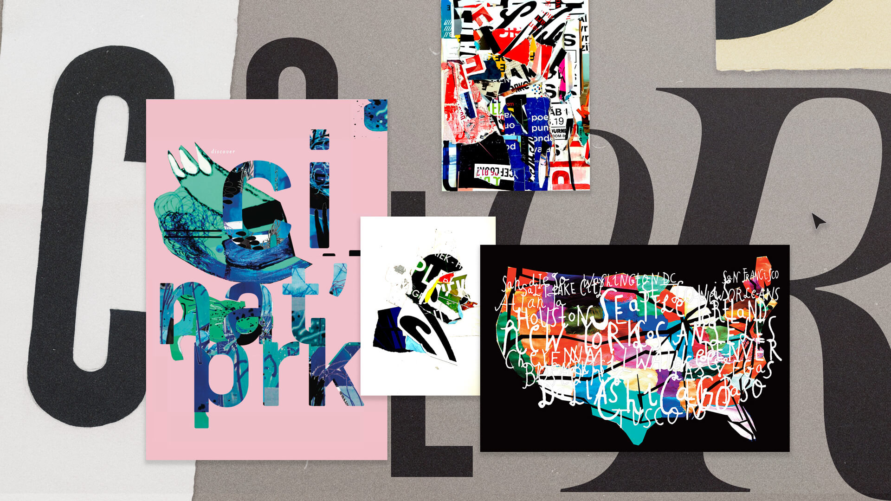
Careers
The UK’s creative industry is worth £115.9 billion, is worth 6% of the entire UK economy and employs 2.3 million people. YOU COULD BE PART OF IT!
Photo Editor
Illustrator
Graphic Design
Publishing
Games Designer
Marketing
Web designer
UX designer
Product designer

