Slide 1
GCSE Photography (AQA)

Slide 2
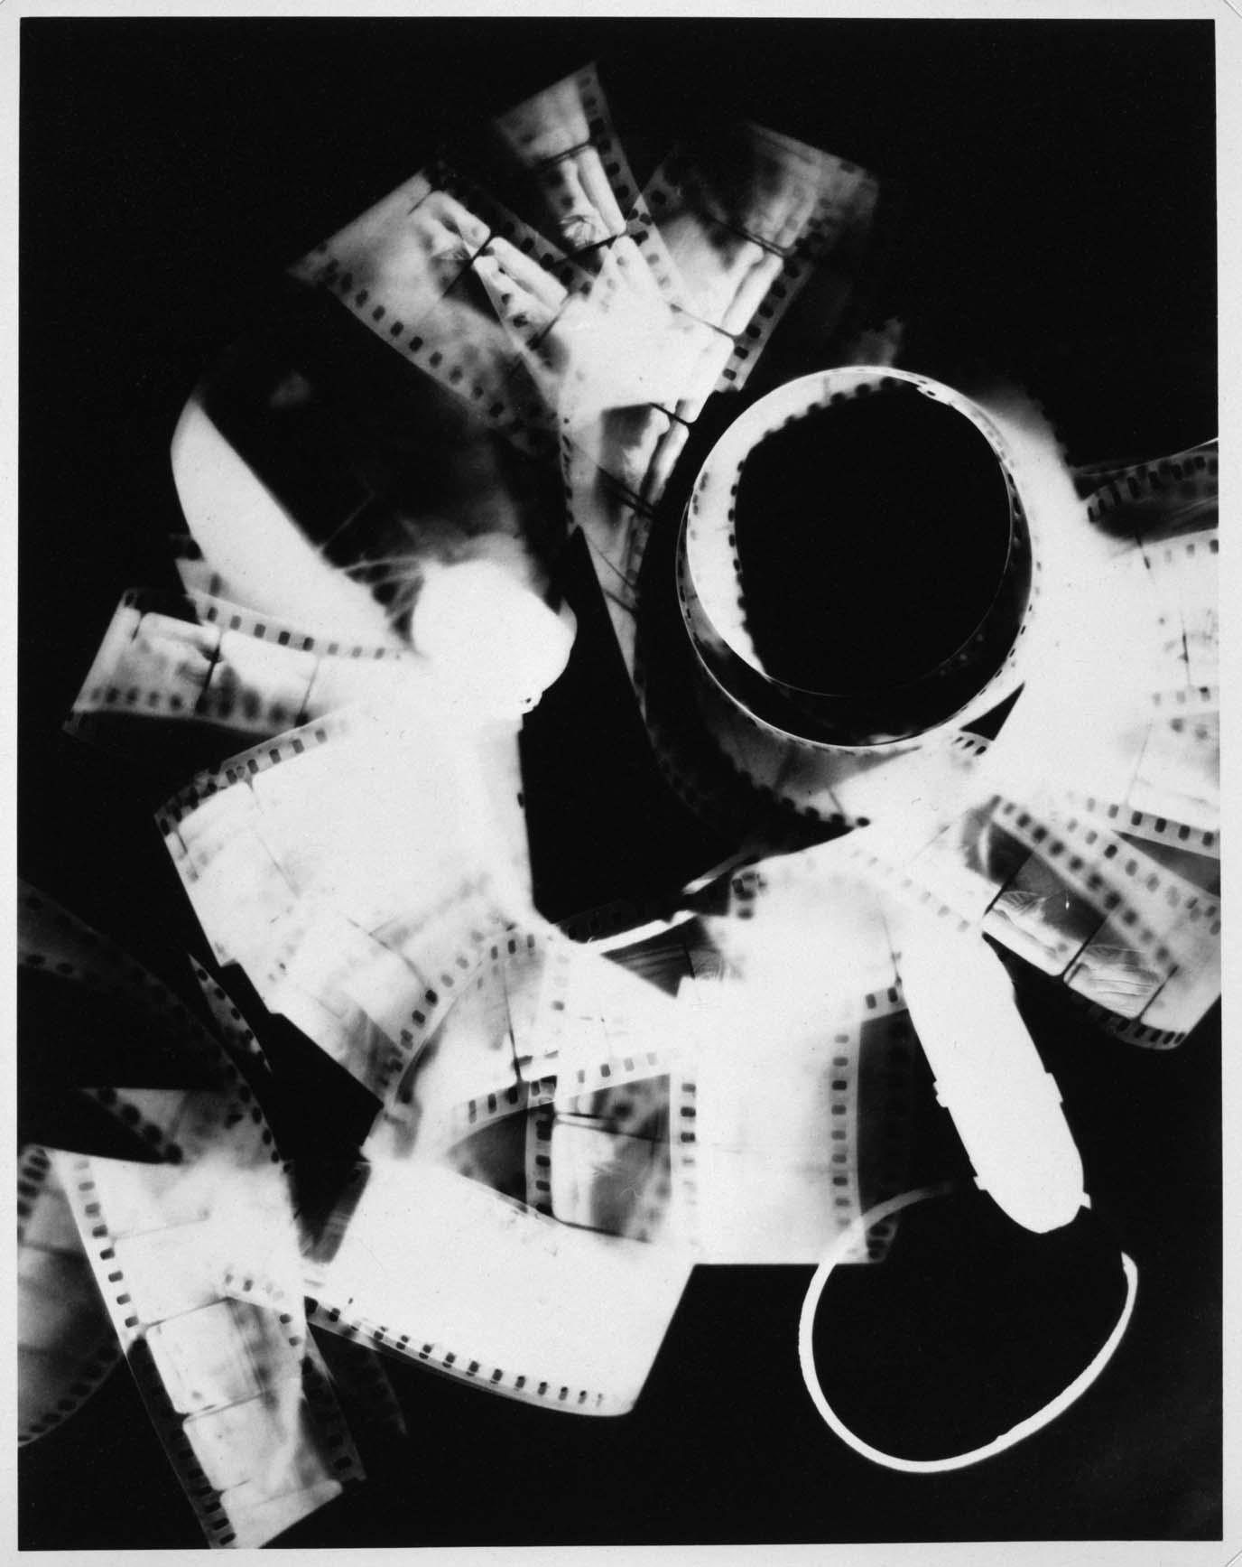
What is photography?
Photography is the art of producing images using light-sensitive materials such as photographic film, digital technology and experimental methods.
At CYA we offer a unique opportunity to explore a wide range of skills and techniques, using a range of photography methods and creative techniques.

Slide 3
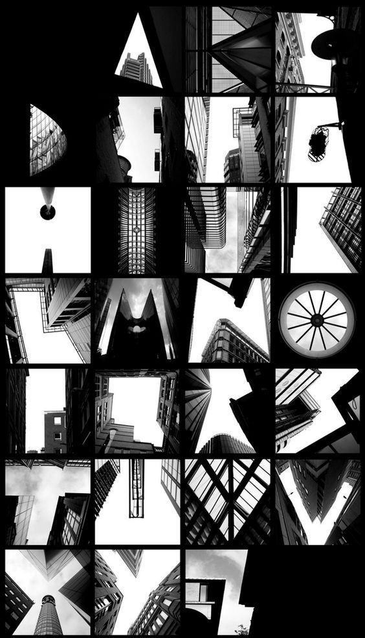
Why would I choose it?
Photography develops a wide range of skills, which will be useful in university applications and future careers.
Photography may offer a highly creative and hands-on alternative to other subjects you may be studying.
Photography is an exciting medium that can be used in many ways such as, artistic, commercial, personal, industrial, through to fashion and architecture.
This course will teach you to look at the world in a creative way.
The creative potential stimulated in this course will enable you to apply creative, analytical, and critical thinking to any other course that you do.

Slide 4
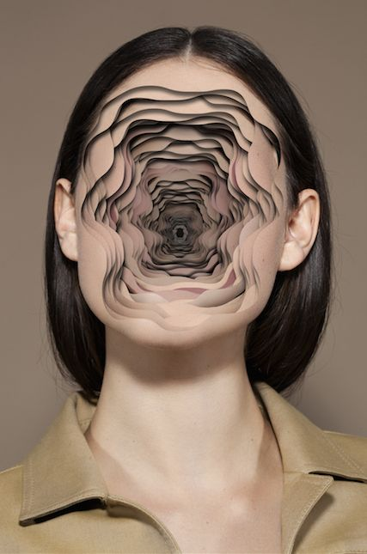
Course structure
Year 10
September – February: Collections
February – September: Portraiture
Year 11
September – December: Human Figure
January – May: Exam component

Slide 5
How are you assessed?
Component 1: Portfolio
What's assessed A portfolio that in total shows explicit coverage of the four assessment objectives. It must include a sustained project evidencing the journey from initial engagement to the realisation of intentions and a selection of further work undertaken during the student’s course of study.
How it's assessed No time limit 96 marks 60% of GCSE
Non-exam assessment (NEA) set and marked by the school/college and moderated by AQA during a visit. Moderation will normally take place in June.

Slide 6
Component 2: Externally set assignment
What's assessed Students respond to their chosen starting point from an externally set assignment paper relating to their subject title, evidencing coverage of all four assessment objectives.
How it's assessed Preparatory period followed by 10 hours of supervised time 96 marks 40% of GCSE
Non-exam assessment (NEA) set by AQA; marked by the school/college and moderated by AQA during a visit. Moderation will normally take place in June.

Slide 7
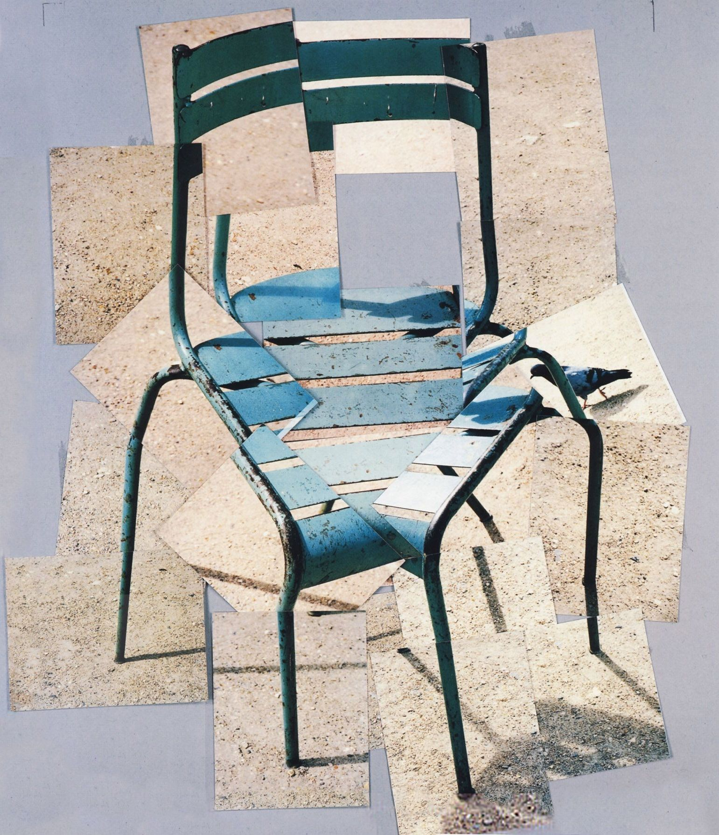
Points to consider
Photography coursework can be demanding – presentation is everything and you will need to be able to dedicate time to your portfolio outside of school time.
As soon as you step foot in the classroom in September in Y10 your work is marked for your GCSE – you will need to have great attendance in order to keep up with the content. If you are off, you will be expected to catch up in your own time.
Whilst this is a creative subject, you will still need to produce written work to communicate your ideas and intentions!
If you are a keen, creative student – none of the above will seem like hard work!

Slide 8
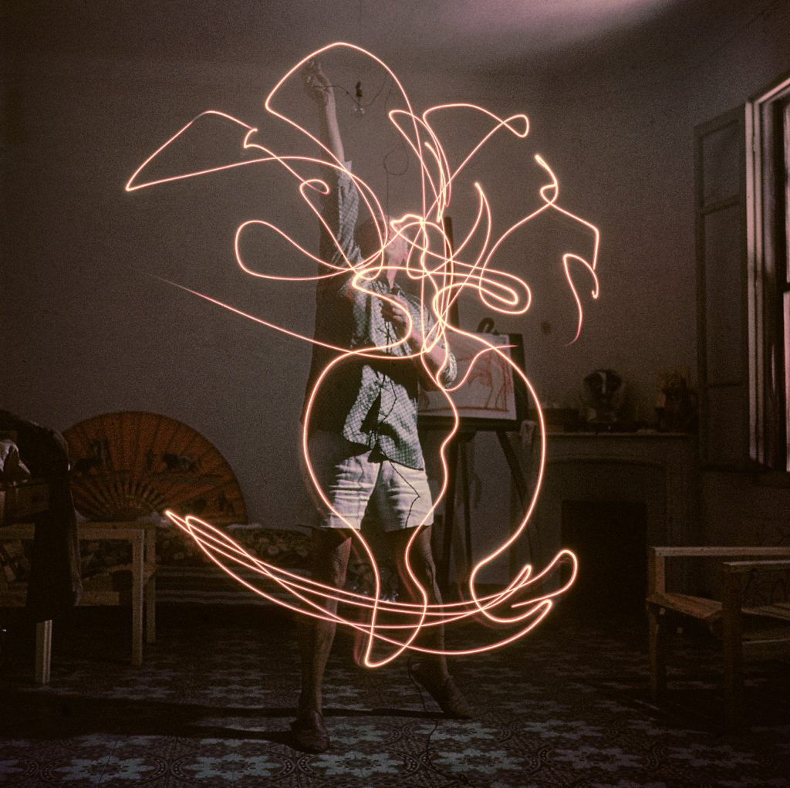
Careers
The UK’s creative industry is worth £115.9 billion, is worth 6% of the entire UK economy and employs 2.3 million people. YOU COULD BE PART OF IT!
Film
Television
Photography
Editor
Theatre and Stage Design
Product Design
Fashion Photographer
Interior Design
Architecture
Illustration
Graphic Design
Publishing
Games Design

