Slide 1
Science

Slide 2
Overview
Edexcel exam board
No coursework
Core practicals – assessed within exam
Grading 1-9

Slide 3
Combined Science
You will get 2 GCSEs – Science
Covers Biology, Chemistry and Physics
6 exams –
Biology: B1, B2
Chemistry: C1, C2
Physics: P1, P2
All exams are 1 hour 10 minutes / 60 marks
Foundation (1-5) and Higher (4-9) available
6 hours / week

Slide 4
Separate Sciences
You will get 3 GCSEs – Biology, Chemistry and Physics
6 exams –
Biology: B1, B2
Chemistry: C1, C2
Physics: P1, P2
All exams are 1 hour 45 minutes / 100 marks
Foundation (1-5) and Higher (4-9) available
6 hours / week

Slide 5
Assessing mathematical skills in Science
All Science courses will cover a list of required mathematical skills.
For Foundation tier, this will be at the level of KS3 maths.
For Higher tier, this will be at the level of Foundation tier maths.
There are different weightings for maths within the exams:
Combined science 20%
Biology 10%
Chemistry 20%
Physics 30%

Slide 6
Assessing practical skills in Science
16 core practicals will be completed in the Combined Science course
8 core practicals will be completed in each of the separate science courses
Knowledge and understanding of these core practicals, as well as investigative skills will be tested in the exams (15% of marks).

Slide 7
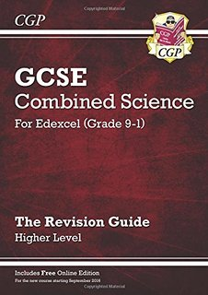
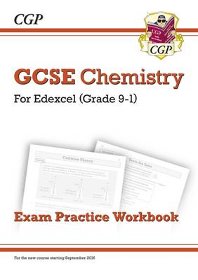
Resources
Active Learn, an online resource which has feedback and guidance – students given login
GCSE pod has short podcasts containing informative science content.
BBC Bitesize
Revision guides

