Slide 1
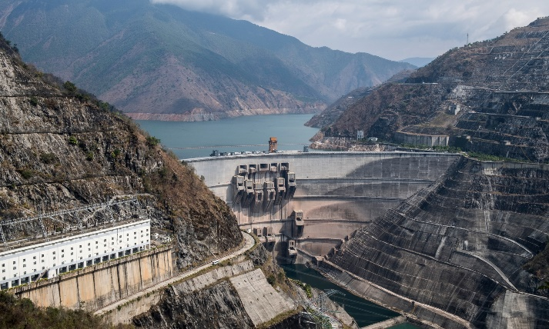
Revising Humanities – Geography Key Information
Core Theme 1: Landscapes & Physical Processes.
This Theme looks at:
The Distinctive Landscapes of the UK & related issues
River and Coastal Landforms & Processes
The Causes of Flooding & Flood Management
Core Theme 2: Rural – Urban Links
This Theme looks at:
The Rural-Urban continuum & how Rural areas are changing
Population Change in the UK
Challenges facing towns & cities
Changes in Retailing in the UK
Global Patterns of Urbanisation & The Development of Global Cities
Option Theme 4: Coastal Hazards and their Management
This Theme looks at:
The Vulnerability of UK coastlines
How are Coastlines managed?
Sustainable management of coastlines linked to rising sea levels
RESPECTFUL RESILIENT RESOURCEFUL RESPONSIBLE

Slide 2
Core Theme 1 – Weather, Climate and Ecosystems
This Theme looks at:
The Issue of Climate Change
Global Weather Systems
Global Weather Hazards
Weather & Climate in the UK
Ecosystem Distribution, Processes, Threats & Management
Core Theme 2 – Development and Resource Issues
This Theme looks at:
Measuring Economic Development & assessing Global Patterns
Causes & Consequences of uneven development & Global Responses
Issues & Management of Water Resources
Regional Economic Development & Inequalities in the UK
Option Theme 7: Social Development Issues
This Theme looks at:
The concept and measuring of Social Development
Issues relating to Social Development in Sub-Saharan Africa
Health Care Issues in Sub-Saharan Africa
RESPECTFUL RESILIENT RESOURCEFUL RESPONSIBLE

Slide 3
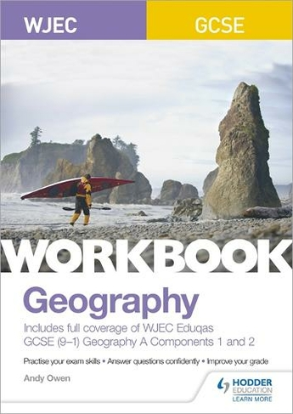
Revision Strategies
Key Words & Processes – e.g. Coastal Processes – Look, Cover & Repeat – practice writing out definitions
Mind Maps – useful for Global Cities – London & Lagos – Why a Global City, Population Make-Up, Challenges & Solutions or Ecosystems – Tropical Rainforests – Distribution, Climate, Processes, Threats & Management
Map Skills – BBC Bitesize – Excellent for OS Map Skills – Compass Direction, Grid References, Map Skills
Maths Skills – Range, Interquartile Range, Mean, Median & Mode, Percentage and Percentage Increase
Diagram Drawing – Physical Processes/Landform Creation – e.g. Waterfall, Meanders, Headlands & Bays, Spits – Drawing, labelling & step by step explanations
Past Papers – Search Eduqas Geography Spec A – Go to website - Click Past Papers/Mark Schemes
GCSE Pod – Useful for generic topics such as Rivers, Coasts, Rainforests, Weather & Climate & Climate Change
Youtube Revision Videos
RESPECTFUL RESILIENT RESOURCEFUL RESPONSIBLE

Slide 4
Revising Humanities – History Key Information
Period 1 - Medicine in Britain, c1250–present and The British sector of the Western Front, 1914–1918: injuries, treatment and the trenches
This period looks at:
- Medicine in Medieval England
- The Medical Renaissance in England
- Medicine in 18th & 19th Century Britain
- Medicine in Modern Britain
- The challenges associated with medicine on the Western Front
Period 4 – The USA, 1954–75: conflict at home and abroad
This period looks at:
- The development of the civil rights movement, 1954–60
- Protest, progress and radicalism, 1960–75
- US involvement in the Vietnam War, 1954–75
- Reactions to, and the end of, US involvement in Vietnam, 1964–75
Period 2 – Henry VIII & his Ministers, 1509-1540
This period looks at:
- England in 1509 – its government & society
- Henry VIII’s rise to power
- The role of Thomas Wolsey and Thomas Cromwell as Henry’s ministers
- Key domestic and international events
- England’s relationship with France & Spain
- The Break with Rome & The Reformation
Period 3 – The American West – 1835-1895
This period looks at:
- The beliefs and society of the Plains Indians
- Migration of Settlers to the West Coast
- The challenges of settling on the Great Plains
- The issue of Law & Order in the American West
- Relations between the US Government & Plains Indians
- The end of the Plains Indian’s way of life
RESPECTFUL RESILIENT RESOURCEFUL RESPONSIBLE

Slide 5
Examinations
At the end of the course, students will sit 3 exams which are designed to test their knowledge of the four periods as well as their historical skills around source analysis and interpretation and the ability to justify analyse and evaluate:
RESPECTFUL RESILIENT RESOURCEFUL RESPONSIBLE

Slide 6
Past Papers – Search Edexcel GCSE History – Look for Course Materials & Click Exam Materials
Paper 11 – Medicine Through Time
Paper B3 – Henry VIIII
Paper P3 – American West
Paper 33 – : The USA, 1954–75: conflict at home and abroad
Examiner Reports – Free & Good for Model answers
Statistics
People
Events
Dates
Timelines to see Units in
Chronological order
Flashcards
Good for key individuals – e.g. American West Cattle Industry – Joseph McCoy & John Iliff
Revision Strategies
Mind Maps – Excellent for specific topics – e.g. Medicine Through Time – Medieval Medicine – Break down into
Important Individuals
Ideas about the Causes of Disease
Treatments and Prevention
Medics and Care
Case Study
Youtube Channels – Great for a Podcast – Visual & Audio
Revise GCSE History
Lessons in History
History Revision Success
Mr Swift History
A Long, Long Time Ago…
BBC Bitesize & GCSE Pod
- Good for Revision & Test – Revising a Chunk & then Questions to Check Knowledge
RESPECTFUL RESILIENT RESOURCEFUL RESPONSIBLE

Slide 7
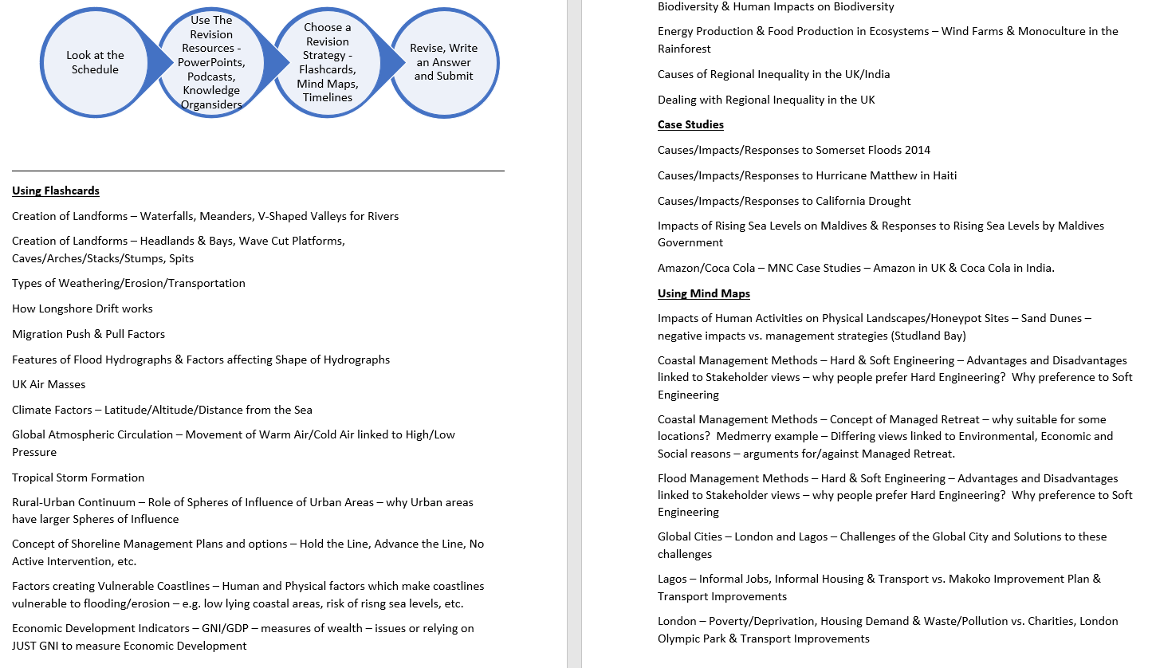
RESPECTFUL RESILIENT RESOURCEFUL RESPONSIBLE

Slide 8
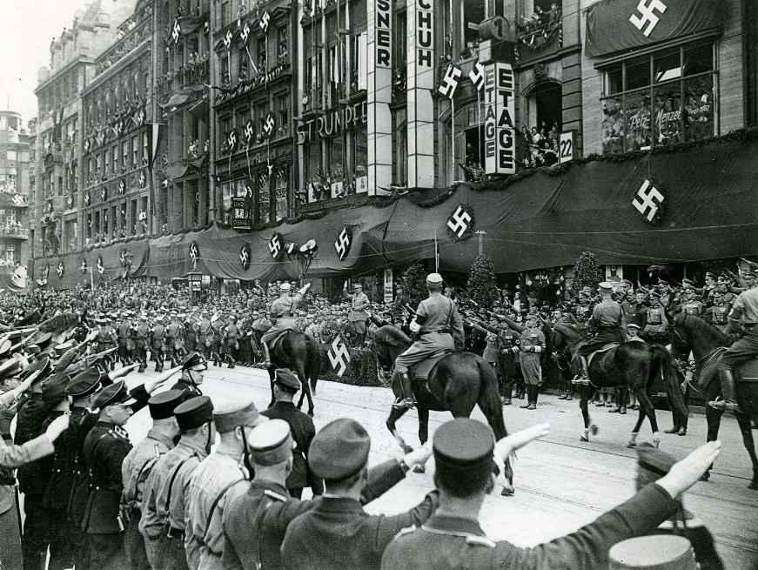
Hitler’s route to Fuhrer – Key Events
AO1 - What did it state?
AO2 - How did Hitler use it to his advantage & increase power?
Enabling Act
Reichstag Fire
AO1 - What was this?
Night of the Long Knives
AO2 - Significance & fall-out from Night of the Long Knives
AO2 - How did Hitler use it to his advantage & increase power?
AO1 - Why did Hitler need to remove the threat of Rohm & The SA

Slide 9
Revising Humanities – Spanish Key Information
4 examinations
Listening 25%
Section A Questions in English, Answers in English
Section B Questions in Spanish, Answers in Spanish
Reading 25%
Section A Questions in English, Answers in English
Section B Questions in Spanish, Answers in Spanish
Section C Translation from Spanish to English (minimum of 35/50 words)
Writing 25%
Extended pieces of writing + Translation Tasks
Speaking 25%
Part 1 – Role play 15 marks – 2 mins
Part 2 – Photo card 15 marks – 2/3 mins
Part 3 – General conversation 30 marks – 3-5/5-7 mins
Theme 1 – Identity and Culture
Topic 1: Me, my family and friends - Relationships with family and friends - Marriage/partnership
Topic 2: Technology in everyday life - Social media - Mobile technology
Topic 3: Free-time activities - Music - Food and eating out - Cinema and TV – Sport
Topic 4: Customs and festivals in Spanish speaking countries/communities
Theme 2 – Local, national, international and global areas of interest
Topic 1: Home, town, neighbourhood and region
Topic 2: Social issues - Charity/voluntary work - Healthy/unhealthy living
Topic 3: Global issues - The environment - Poverty/homelessness
Topic 4: Travel and tourism
Theme 3 – Current and future study and employment
Topic 1: My studies
Topic 2: Life at school/college
Topic 3: Education post-16
Topic 4: Jobs, career choices and ambitions
RESPECTFUL RESILIENT RESOURCEFUL RESPONSIBLE

Slide 10
Revising Humanities – Spanish Revision Strategies
Students need to know:
- Key Vocab related to each Theme – all 8 modules
- Syllabus of all vocab to be provided before Half Term
- Learn Time Frames – Key phrases for Past, Present & Future
- Students have been given Translation booklet of speaking questions – students need to translate the words they don’t understand, not just the whole question.
- Students have access to Listening & Reading Homework activities on Language Nut each week
- Fortnightly vocab tests
Revision Key
- Learn Speaking Answers & Questions – Prepare & Script answers. Get parents to read the Spanish Questions – students respond Spanish – weekly practice – at least 3 questions per week.
- Watch programs/films in Spanish with English subtitles - watch, listen & read
- Focus on Tenses from Revision Guides – to avoid confusion over Past, Present and Future – e.g. cannot mix up played, play or playing – lose marks on accuracy
- Practice writing out speaking answers in Spanish with correct Tense
- Download Duo Lingo App to develop Listening & Reading – helps to develop accuracy around Gender & Plurals – 10 minutes per day
- Language Nut – Can be used to revise and test weaker areas
- GCSE Pod – For Grammar tests
RESPECTFUL RESILIENT RESOURCEFUL RESPONSIBLE

