Slide 1
Y10 Curriculum evening
Join us on our journey….

Slide 2
Mathematics at Caistor Yarborough Academy
Join us on our journey….

Slide 3
Staff
Mrs Marshallsay (Head of Mathematics)
Mrs Mirmolavi/ Mr Frame (2nd Department)
Mr Mill
Mrs Hickson
Mrs Chisnall (department LSA)
Join us on our journey….

Slide 4
GCSE Mathematics:
Graded from 9-1
All linear exams – 100% external assessment
Pearson Edexcel exam board
2 tiers Higher (grades 4 - 9)
Foundation (grades 1 – 5)
Join us on our journey….

Slide 5
Exam Papers
3 exams in May/June – Paper 1: NON CALCULATOR
Paper 2: CALCULATOR
Paper 3: CALCULATOR
All exams are 1 hour 30 minutes/ 80 marks
Each exam is worth 33 1/3 of the final grade (equal weighting)
Join us on our journey….

Slide 6
Assessing skills in Mathematics
Each exam will assess the 6 core strands of Mathematics
Number
Algebra
Ratio, proportion and rates of change
Geometry and measures
Probability
Statistics
Join us on our journey….

Slide 7
Expectations:
Pupils will be expected to complete all classwork without disrupting the learning of others.
Pupils will be expected to complete all homework which is set regularly with clear deadlines.
Pupils have a range of resources to help them with homework and they are also expected to work independently to consolidate their understanding and address problem areas.
4+ 83% 5+ 55% N.A. 4+ 60% 5+ 43%
Join us on our journey….

Slide 8
Ways to help yourself
And how we help you:
There is a lot of formulae to be learned
Join us on our journey….

Slide 9
Make sure that you learn all the formulae
We will give you Flashcards to help
You will also get time in form periods to practice
Use this time wisely!!!
Join us on our journey….

Slide 10
Make sure that you learn all the formulae
We will give you Flashcards to help
You will also get time in form periods to practice
Use this time wisely!!!
Join us on our journey….

Slide 11
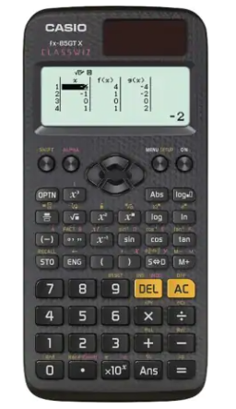
Calculator:
Remember, 2 of the 3 exams are calculator papers.
Get yourself the same calculator we use in school. We can then teach you how to use it effectively.
You will need it for homework and revision
Casio Fx 83 GT or Casio Fx 85 GT
Join us on our journey….

Slide 12
You will be given ;
*Access to SPARX Maths
Dashboard - Teacher View | Sparx Maths
Join us on our journey….

Slide 13
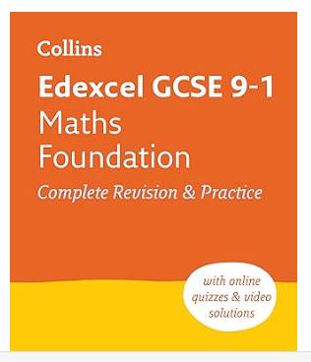
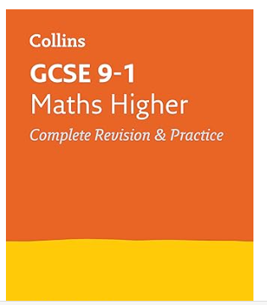
The best way to LEARN Mathematics is to DO Mathematics ;
*SPARX Maths
*Corbett Maths … Videos, Practice exercises and Exam questions
Edexcel Higher Checklist 2022 (corbettmaths.com)
*A set of flashcards to help you learn the formulae needed
*Revision and Intervention materials
Join us on our journey….

Slide 14
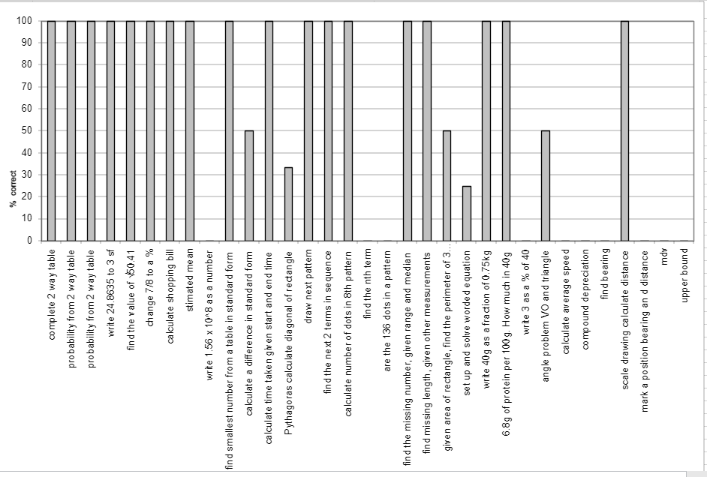
The best way to LEARN Mathematics is to DO Mathematics;
*Personalised assessment grid following exams
Join us on our journey….

Slide 15
Contact us: with any questions
Cheryl.Marshallsay@cyac.org.uk (Head of Faculty)
Ginny.Gregory@cyac.org.uk (Second in Faculty)
Claire.mirmolavi@cyac.org.uk
George.frame@cayac.org.uk
Gemma.Chisnall@cyac.org.uk
Join us on our journey….

