Slide 1
GCSE Geography
What will you study over the next two years and how will you be assessed?

Slide 2
An Overview
You will complete 3 Exams at the end of the 2 year course
The exams cover a mixture of Physical and Human Geography Themes as well as Fieldwork and Geographical Skills
We follow the Eduqas GCSE Specification A Geography Course

Slide 3
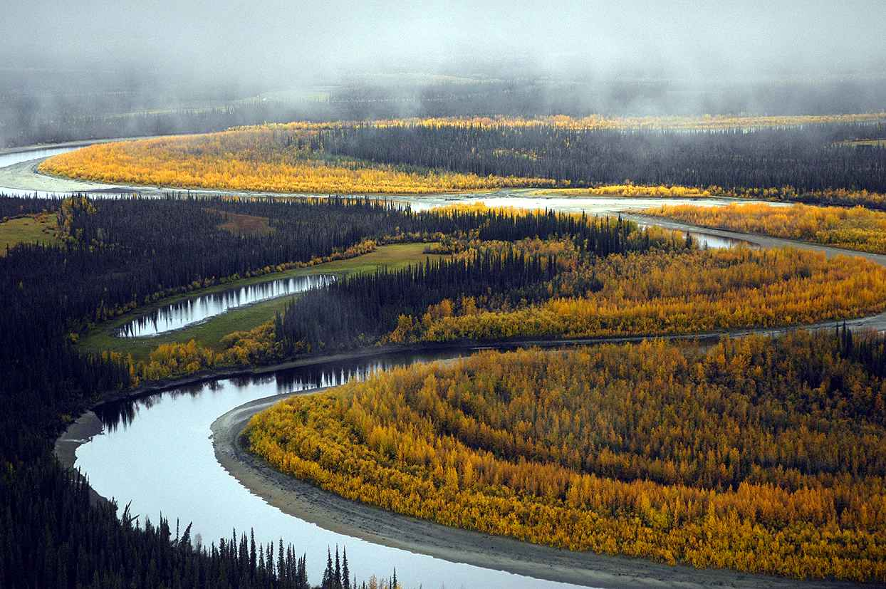
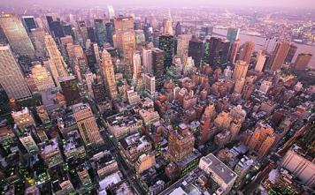
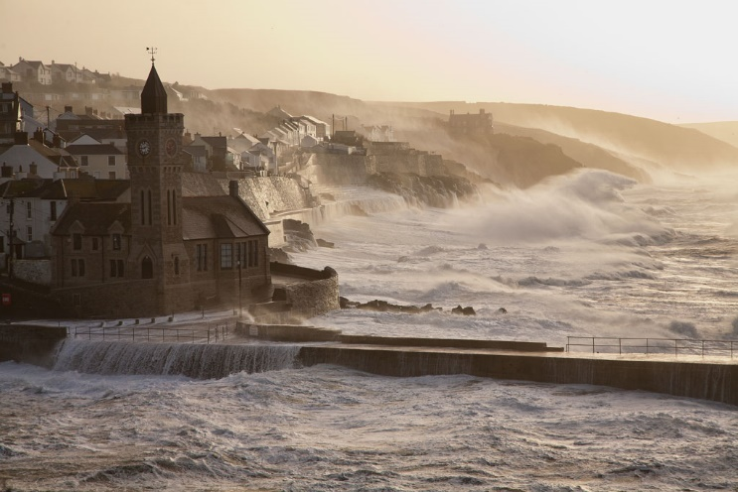
Course Content – Paper 1
Over the two year course, students study a set of key Geographical Themes. These are:
Core Theme 1: Landscapes & Physical Processes.
This Theme looks at:
The Distinctive Landscapes of the UK & related issues
River and Coastal Landforms & Processes
The Causes of Flooding & Flood Management
Core Theme 2: Rural – Urban Links
This Theme looks at:
The Rural-Urban continuum & how Rural areas are changing
Population Change in the UK
Challenges facing towns & cities
Changes in Retailing in the UK
Global Patterns of Urbanisation & The Development of Global Cities
Option Theme 4: Coastal Hazards and their Management
This Theme looks at:
The Vulnerability of UK coastlines
How are Coastlines managed?
Sustainable management of coastlines linked to rising sea levels

Slide 4
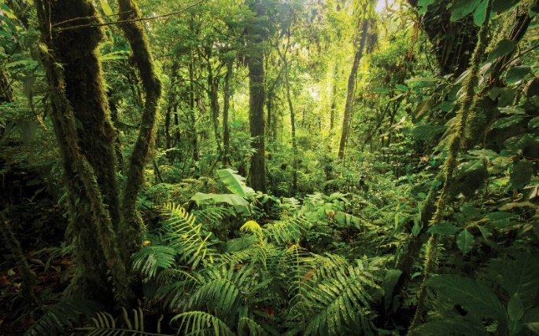
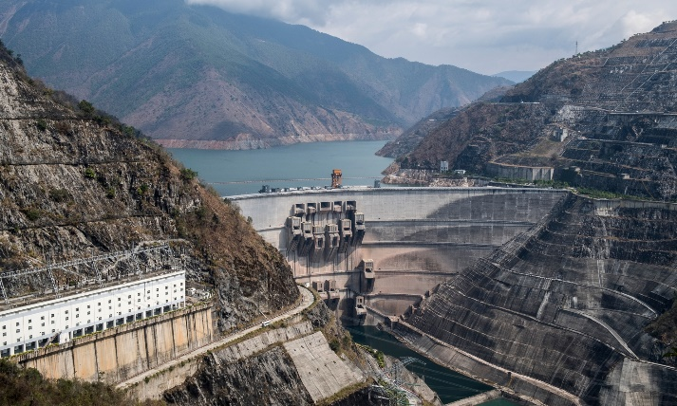
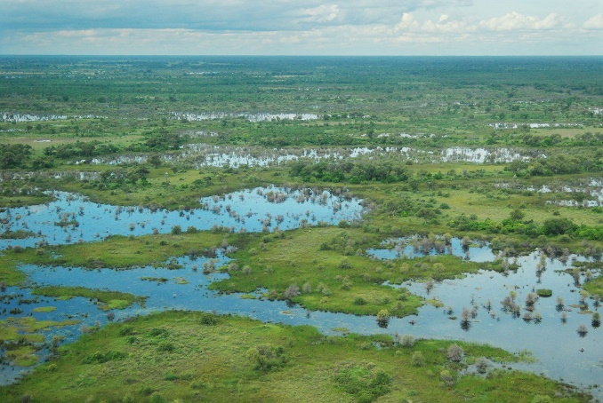
Course Content – Paper 2
Over the two year course, students study a set of key Geographical Themes. These are:
Core Theme 1 – Weather, Climate and Ecosystems
This Theme looks at:
The Issue of Climate Change
Global Weather Systems
Global Weather Hazards
Weather & Climate in the UK
Ecosystem Distribution, Processes, Threats & Management
Core Theme 2 – Development and Resource Issues
This Theme looks at:
Measuring Economic Development & assessing Global Patterns
Causes & Consequences of uneven development & Global Responses
Issues & Management of Water Resources
Regional Economic Development & Inequalities in the UK
Option Theme 8: Environmental Challenges
This Theme looks at:
The impact of consumer choices on the environment
The impacts of Climate Change
Methods to mitigate climate change
How can natural environments be managed & restored

Slide 5
Examinations
At the end of the course, you will sit 3 exams which are designed to test your knowledge of the three key themes and also your problem solving, fieldwork and Geographical skills:
Consists of 3 sections – Themes 1, 2 & 4
Questions can be asked about any of the topics you have studied.
There is a variety of questions from 1 mark gap fills leading up to an 8 mark question at the end of each section
Consists of 3 sections – Themes 5, 6 & 8
Questions can be asked about any of the topics you have studied.
There is a variety of questions from 1 mark gap fills leading up to an 8 mark question at the end of each section
Questions are asked about fieldwork methods and data presentation.
You are asked two 6 mark questions about your own fieldwork that we will carry out

Slide 6
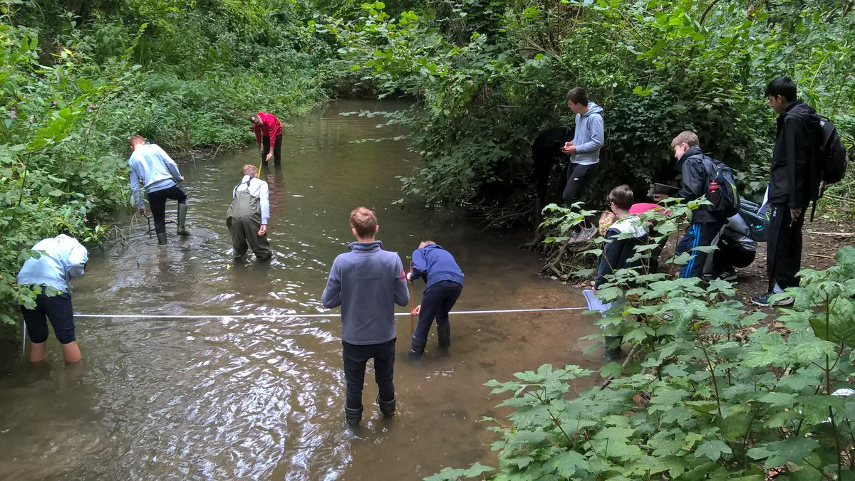
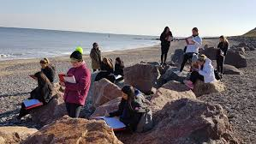
Fieldwork
You will go out and collect your own fieldwork so you can refer to it in your exam questions.
We receive a theme and an investigation topic that our fieldwork will be conducted around.
This will then be assessed in paper 3 of your exams.

Slide 7
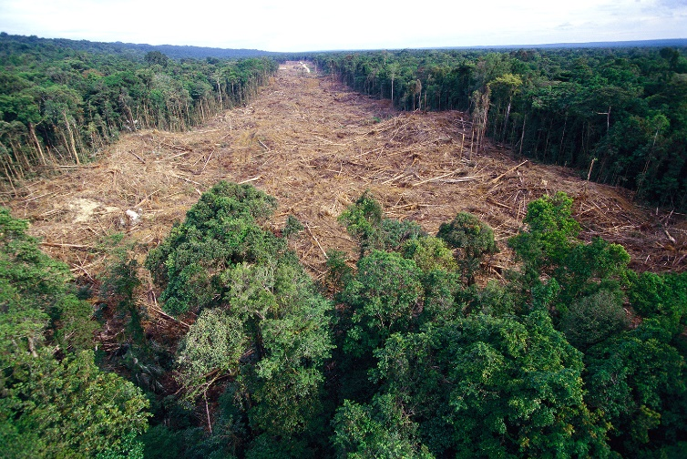
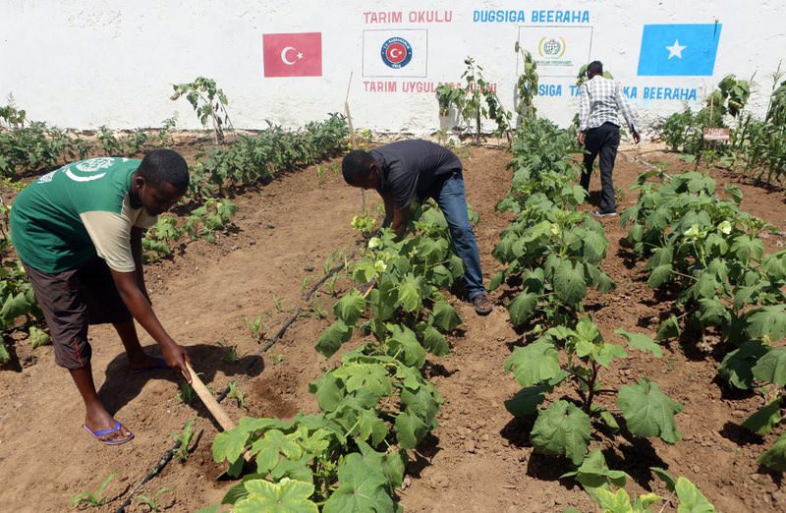
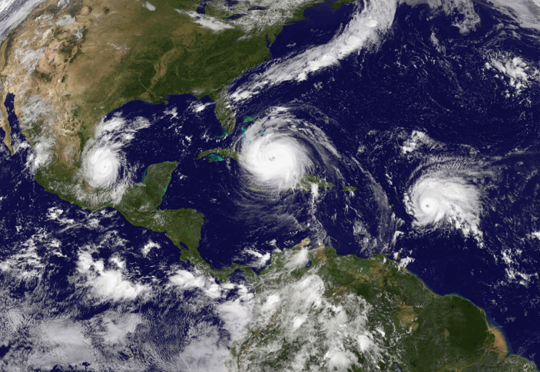
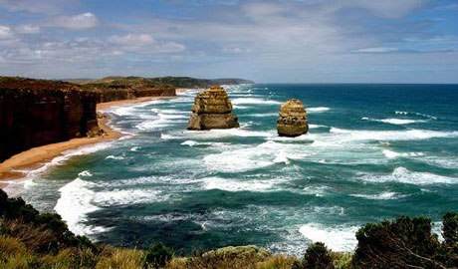
We’re here to help…
If you have any questions or issues you would like to discuss about the course please come and talk to Mr Curtis or Miss Mulligan

