Slide 1
Science at Caistor Yarborough Academy
RESPECTFUL RESILIENT RESOURCEFUL RESPONSIBLE

Slide 2
The Science Team
Mrs Coulson – Head of Science
Dr Morton – 2nd in Department
Mrs Biglands
Miss Casson
Miss Warner
RESPECTFUL RESILIENT RESOURCEFUL RESPONSIBLE

Slide 3
Science since September 2018:
Graded from 9-1
No coursework / controlled assessment tasks
100% external assessment
Pearson Edexcel exam board
RESPECTFUL RESILIENT RESOURCEFUL RESPONSIBLE

Slide 4
Pathways:
Combined Science (previously known as Science and Additional Science) – 2 GCSEs
Separate Sciences (previously known as Triple Science) – 3 GCSEs
RESPECTFUL RESILIENT RESOURCEFUL RESPONSIBLE

Slide 5
Assessing practical skills in Science
16 core practicals will be assessed in the Combined Science course
8 core practicals will be assessed in each of the separate science courses
Knowledge and understanding of these core practicals, as well as investigative skills will be tested in the exams (15% of marks).
RESPECTFUL RESILIENT RESOURCEFUL RESPONSIBLE

Slide 6
Assessing mathematical skills in Science
All Science courses will cover a list of required mathematical skills.
For Foundation tier, this will be at the level of KS3 maths.
For Higher tier, this will be at the level of Foundation tier maths.
There are different weightings for maths within the exams:
Combined science 20%
Biology 10%
Chemistry 20%
Physics 30%
RESPECTFUL RESILIENT RESOURCEFUL RESPONSIBLE

Slide 7
Combined Science
2 GCSEs
Covers Biology, Chemistry and Physics
6 exams – Biology: B1, B2
Chemistry: C1, C2
Physics: P1, P2
All exams are 1 hour 10 minutes / 60 marks
Foundation (1-5) and Higher (9-4) available
6 hours / week
RESPECTFUL RESILIENT RESOURCEFUL RESPONSIBLE

Slide 8
Separate Sciences
3 GCSEs – Biology, Chemistry and Physics
6 exams – Biology: B1, B2
Chemistry: C1, C2
Physics: P1, P2
All exams are 1 hour 45 minutes / 100 marks
Foundation (1-5) and Higher (9-4) available
6 hours / week
RESPECTFUL RESILIENT RESOURCEFUL RESPONSIBLE

Slide 9
Resources to help:
Active Learn, an online resource which has feedback and guidance
Seneca homework
There is the online book available in Active Learn
GCSEpod has short podcasts containing informative science content.
BBC Bitesize
Revision guides
Notes in books/lessons on teams
A3 knowledge organisers – provided by teachers
RESPECTFUL RESILIENT RESOURCEFUL RESPONSIBLE

Slide 10
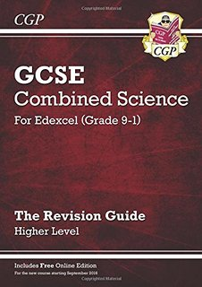
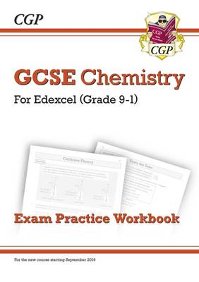
Revision guides: CGP
Edexcel 9-1 Combined science revision guide and workbook (£5.75 each) and answers (£1.00) £12 total
Foundation (1-5) and higher (4-9) available
Edexcel 9- 1 Separate sciences revision guides (£2.75) and workbooks (£2.75) and answers (£1.00) £19.50 total
RESPECTFUL RESILIENT RESOURCEFUL RESPONSIBLE

Slide 11
Contact us:
Louise.Coulson@cyac.org.uk
Angela.morton@cyac.org.uk
Jo.Biglands@cyac.org.uk
Cara.warner@cyac.org.uk
Erin.casson@cyac.org.uk
RESPECTFUL RESILIENT RESOURCEFUL RESPONSIBLE

