Slide 1

Science at Caistor Yarborough Academy
RESPECTFUL RESILIENT RESOURCEFUL RESPONSIBLE

Slide 2

The Science Team
Mrs Coulson – Head of Science
Dr Morton – Second in faculty
Mrs Biglands
Miss Casson
Miss Steele
Mr Gourlay
Mrs Colley – department LSA
RESPECTFUL RESILIENT RESOURCEFUL RESPONSIBLE

Slide 3

Science GCSE
Graded from 9-1
No coursework/controlled assessment tasks
100% external assessment
Pearson Edexcel exam board
RESPECTFUL RESILIENT RESOURCEFUL RESPONSIBLE

Slide 4
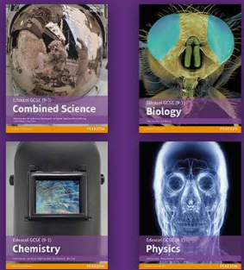
Pathways:
Combined Science– 2 GCSEs
2 tiers Higher (grades 4-9) and Foundation (grades 1-5)
Separate Sciences– 3 GCSEs
2 tiers Higher (grades 4-9) and Foundation (grades 1-5)
RESPECTFUL RESILIENT RESOURCEFUL RESPONSIBLE

Slide 5
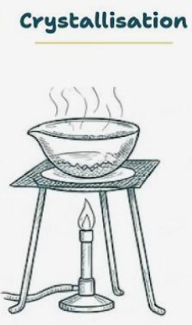
Assessing practical skills in Science
16 core practicals will be assessed in the Combined Science course
8 core practicals will be assessed in each of the separate science courses (24 overall)
Knowledge and understanding of these core practicals, as well as investigative skills is tested in the exams (15% of marks).
RESPECTFUL RESILIENT RESOURCEFUL RESPONSIBLE

Slide 6

Assessing mathematical skills in Science
All Science courses will cover a list of required mathematical skills.
For Foundation tier, this will be at the level of KS3 maths.
For Higher tier, this will be at the level of Foundation tier maths.
There are different weightings for maths within the exams:
  Combined science 20%
  Biology 10%
  Chemistry 20%
  Physics 30%
RESPECTFUL RESILIENT RESOURCEFUL RESPONSIBLE

Slide 7
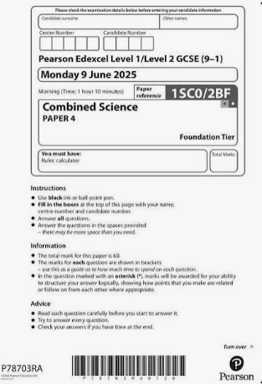
Combined Science
2 GCSEs
Covers Biology, Chemistry and Physics
6 exams – Biology: B1, B2
Chemistry: C3, C4
Physics: P5, P6
All exams are 1 hour 10 minutes / 60 marks
Foundation (1-5) and Higher (9-4) available
Lesson time 6 hours/week
RESPECTFUL RESILIENT RESOURCEFUL RESPONSIBLE

Slide 8
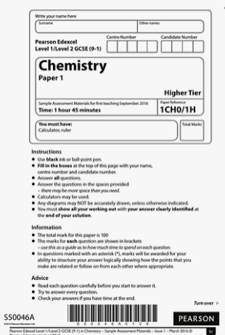
Separate Sciences
3 GCSEs – Biology, Chemistry and Physics
6 exams – Biology: B1, B2
Chemistry: C1, C2
Physics: P1, P2
All exams are 1 hour 45 minutes / 100 marks
Foundation (1-5) and Higher (9-4) available
Lesson time 6 hours/week
RESPECTFUL RESILIENT RESOURCEFUL RESPONSIBLE

Slide 9
Resources to help:
Science Sparx homework weekly
Active Hub, an online resource which has feedback and guidance
Online book available in Active Hub
Purchase scientific calculator
BBC Bitesize
Revision guides
All GCSE lessons available on teams
A3 knowledge organisers – provided by teachers
RESPECTFUL RESILIENT RESOURCEFUL RESPONSIBLE

Slide 10
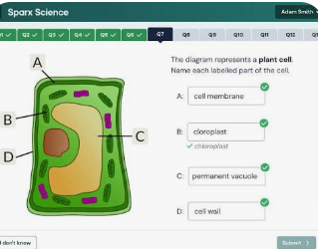
Sparx Science
Homework set weekly every Wednesday
Supports in lesson learning
Helps teacher to identify strengths and weaknesses of students
Gives students thoughtful practice outside of lessons
RESPECTFUL RESILIENT RESOURCEFUL RESPONSIBLE

Slide 11
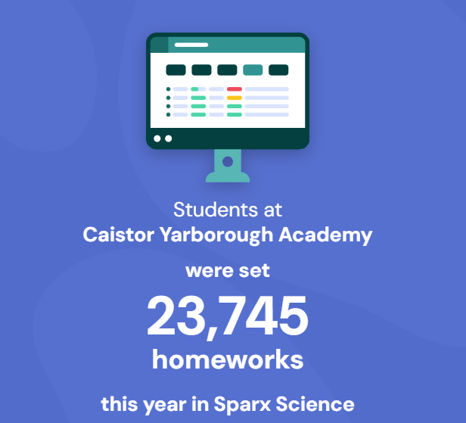

Sparx Science
RESPECTFUL RESILIENT RESOURCEFUL RESPONSIBLE

Slide 12
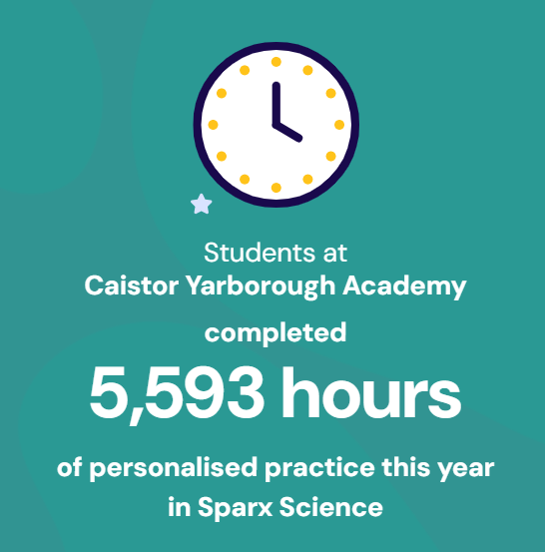

Sparx Science
RESPECTFUL RESILIENT RESOURCEFUL RESPONSIBLE

Slide 13

Activehub
Access to online text book for revision purposes
Access to online tasks to support learning
Access to feedback from assessment tracking to help students identify strengths and weaknesses
RESPECTFUL RESILIENT RESOURCEFUL RESPONSIBLE

Slide 14

BBCBitesize
Free online resource that supports learning and revision
Simple language and explanations for complex concepts
Quizzes, exam questions and multiple choice to test knowledge
RESPECTFUL RESILIENT RESOURCEFUL RESPONSIBLE

Slide 15


Scientific Calculator
Practice using the same calculator you will use in your exams. Casio Fx 83 GTCW or Casio Fx 85 GTCW
RESPECTFUL RESILIENT RESOURCEFUL RESPONSIBLE

Slide 16

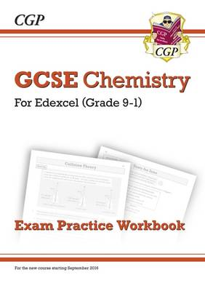
Revision guides: CGP
Edexcel 9-1 Combined science revision guide and workbook and answers Foundation (1-5) and higher (4-9) available
Edexcel 9- 1 Separate sciences revision guides and workbooks with answers
RESPECTFUL RESILIENT RESOURCEFUL RESPONSIBLE

Slide 17
Contact us:
Louise.Coulson@cyac.org.uk
Angela.Morton@cyac.org.uk
Jo.Biglands@cyac.org.uk
Erin.Casson@cyac.org.uk
Aoibh.Steele@cyac.org.uk
Harry.Gourlay@cyac.org.uk
RESPECTFUL RESILIENT RESOURCEFUL RESPONSIBLE

