Slide 1


Year 10
Attendance matters

Slide 2

Attendance
If you are not here, you are not learning
GCSE’S may seem a long way off for you and your child, however all absences can lead to gaps in your child’s learning
This in turn can :
Mean that they fall behind in work
Affect their motivation
Affect their desire to attend school regularly
Affect their enjoyment in learning
Potentially lead to poor behaviour
Affect their confidence in school
Did you know that :
A child who is absent a day of school per week misses an equivalent of two years of their school life
90% of young people with absence rates below 85% fail to achieve five or more good grades for GCSE
Poor examination results limit young people’s options and poor attendance suggests to colleges and employers that these students are not reliable
So plenty of time for shopping, family holidays and appointments.
180 days are not spent in school each year

Slide 3
Attendance
If you are not here, you are not learning
100% attendance
97% attendance
90% attendance
85% attendance
80% attendance
75% attendance
190 days
Nationally, pupils that have only 91%
attendance or less will drop at least one GCSE grade across their subjects.
184 days
171 days
162 days
152 days
143 days
This means 175 days not at school

Slide 4
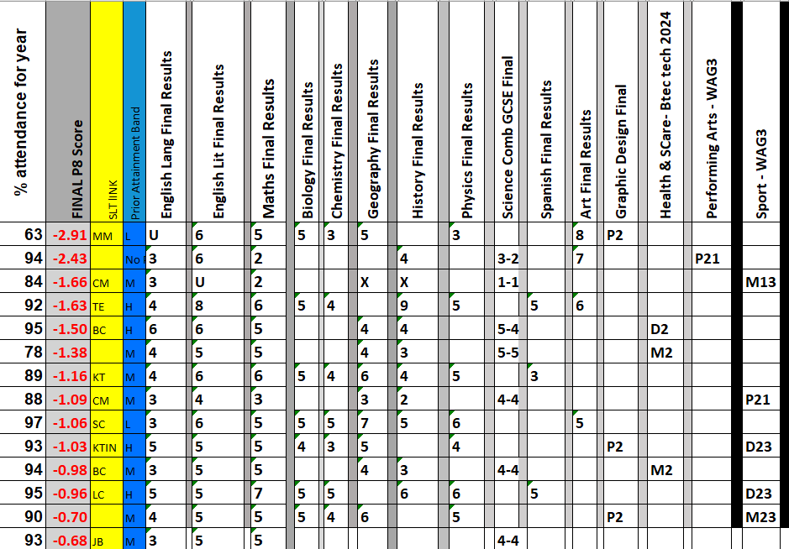
Attendance If you are not here, you are not learning
Our Year 11 2024
Of the 15 lowest achieving students, only 1 had an attendance of over 95%

Slide 5
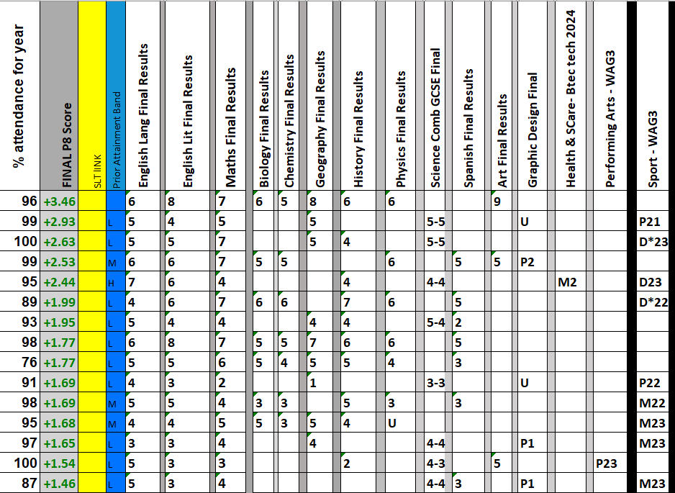
Attendance If you are not here, you are not learning
Our Year 11 2024
Of the 15 HIGHEST achieving students, only 4 had an attendance of below 95%

Slide 6
Work will be set on TEAMs, and MUST be completed
Attendance If you are not here, you are not learning

