Slide 1


Year 10
Curriculum Evening
- https://docs.google.com/presentation/d/1XveQJIya_ogoVhVJY9SELoYQfXp0gMtQGdY1JwvPyZo/edit?usp=sharing

Slide 2


The purpose of the next 2 years:
Vocational Course
College
Apprenticeship
Heta
Catch
A’Levels
College
Another pathway
How well you do will help determine which doors are open to you

Slide 3
How can you help yourself?
Work hard in all lessons (171 days left in Y10)
Ask for help if needed
Complete all homework
Attend intervention sessions
Attend EVERY DAY

Slide 4
Attendance
If you are not here, you are not learning
GCSE’S may seem a long way off for you and your child, however all absences can lead to gaps in your child’s learning
This in turn can :
Mean that they fall behind in work
Affect their motivation
Affect their desire to attend school regularly
Affect their enjoyment in learning
Potentially lead to poor behaviour
Affect their confidence in school
Did you know that :
A child who is absent a day of school per week misses an equivalent of two years of their school life
90% of young people with absence rates below 85% fail to achieve five or more good grades for GCSE
Poor examination results limit young people’s options and poor attendance suggests to colleges and employers that these students are not reliable
180 days are not spent in school each year
So plenty of time for shopping, family holidays and appointments.

Slide 5
Attendance
If you are not here, you are not learning
100% attendance
97% attendance
90% attendance
85% attendance
80% attendance
75% attendance
190 days
Nationally, pupils that have only 91%
attendance or less will drop at least one GCSE grade across their subjects.
184 days
171 days
162 days
152 days
143 days
This means 175 days not at school

Slide 6
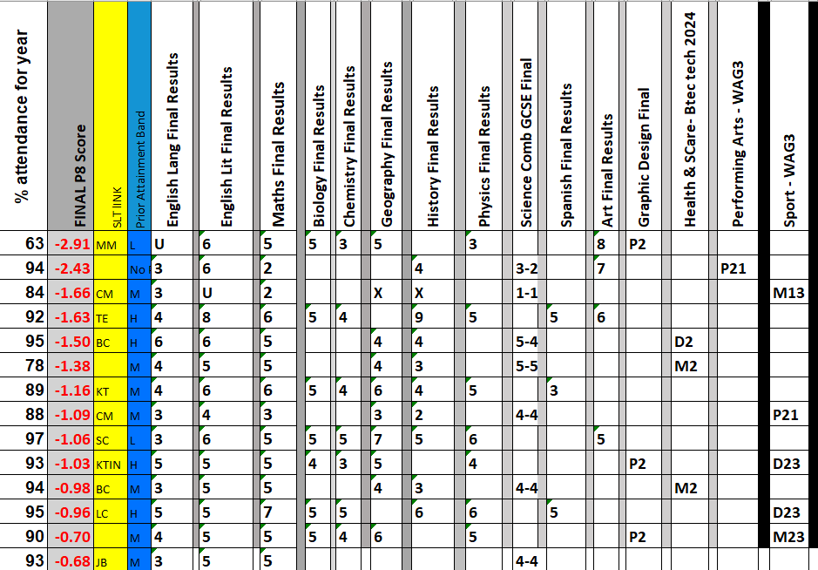
Attendance If you are not here, you are not learning
Our Year 11 2024 (last time P8)
Of the 15 lowest achieving students, only 1 had an attendance of over 95%

Slide 7
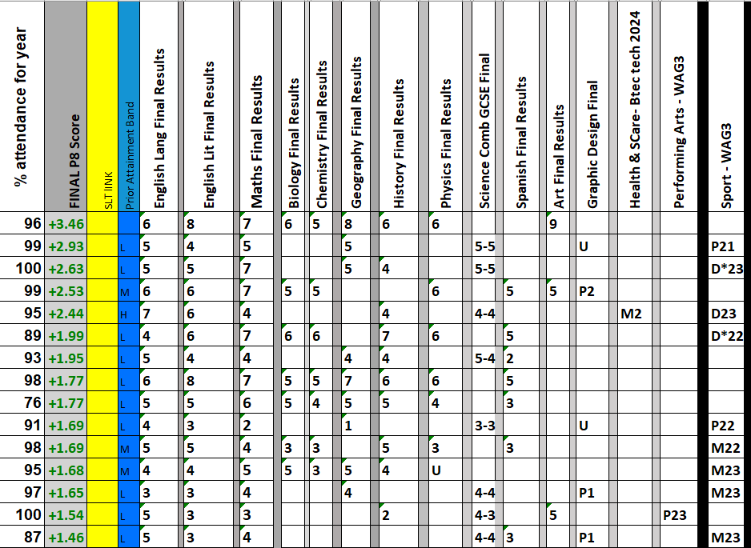
Attendance If you are not here, you are not learning
Our Year 11 2024 last time P8
Of the 15 HIGHEST achieving students, only 4 had an attendance of below 95%

Slide 8
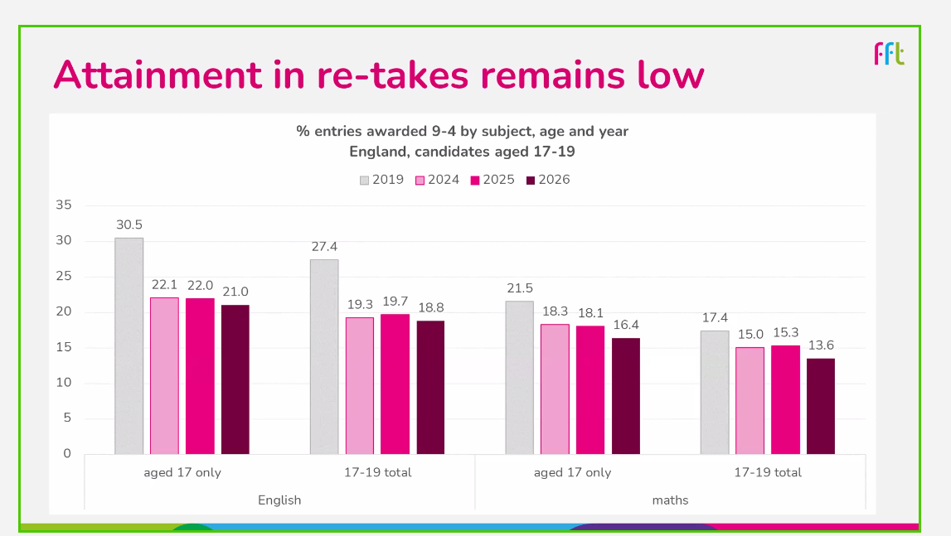

Slide 9

Attendance If you are not here, you are not learning

Slide 10




O
Revision Guides
Revision Guides will go on MCAS shortly and a letter will be sent
Assessments and Mocks
End Y10
Oct Y11
Feb Y11

Slide 11
O
Option subject talks are all in the T Block with the options staff
Time | Subject/room | Subject/room | Subject/room | Subject/room | Subject/room | Subject/room
Option A 6.50 – 7.00pm | Enterprise T9 | Drama T8 | History T2 | Photography T1 | Sport T4 | Travel and Tourism T6
Option B 7.05 – 7.15pm | Art T1 | Enterprise T9 | Geography T6 | Health and Social T8 | Sport T4
Option C 7.20 – 7.30pm | Geography T6 | Graphics T1 | History T2 | Spanish T8

