Slide 1
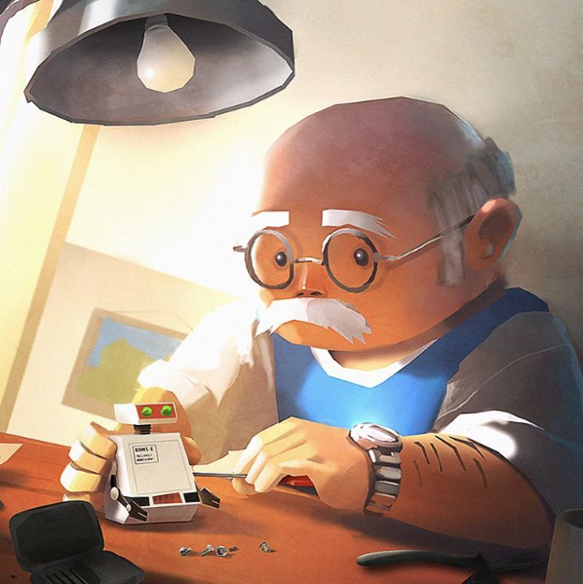
English Comprehension and Narrative writing.
Look carefully at this picture.
Can you make 6 questions about it?
Try not to be just literal (eg. What is the man doing?). Think about how the character feels.
Next, write a story about the Robot Maker. Who is he? Where has the robot come from? Does he fix it?

Slide 2
RE: Parables
We have already done some work on the Parables of Jesus and how they teach Christians important messages.
Watch the video and answer the questions.
https://classroom.thenational.academy/lessons/what-are-the-parables-of-jesus-6ngp4r
We acted out a modern version of the Good Samaritan.
What was the message?
Choose this or another parable.
You can write a playscript, a story or a poster to show your understanding.

Slide 3
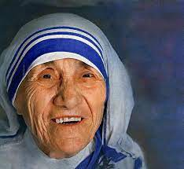
Research
In readiness for next week, please research
Mother Teresa.
She is another Christian who shows Agape.
Can you find a quote which has meaning for
you?

