Slide 1
MY Research on Greece
By Milo Holroyd

Slide 2
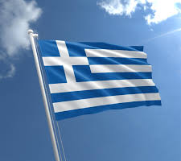
This is the Greek flag

Slide 3
Greek words
Hello Yassou
Goodbye Adío
Thankyou Efharistó
Good morning Kalimera
Good night kalinychta

Slide 4
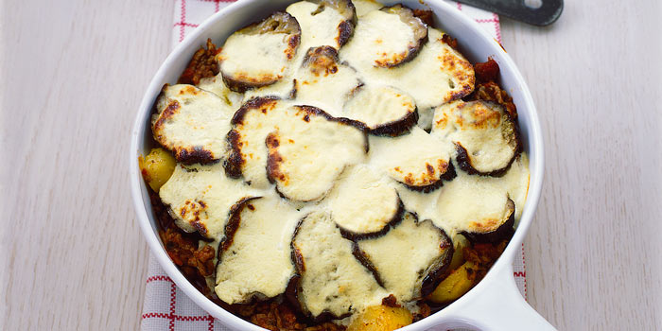
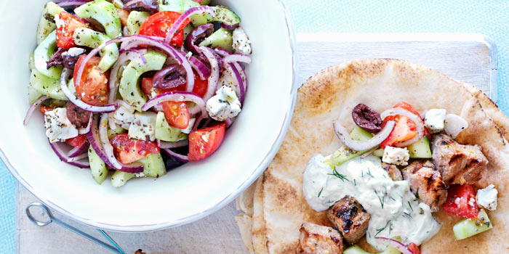
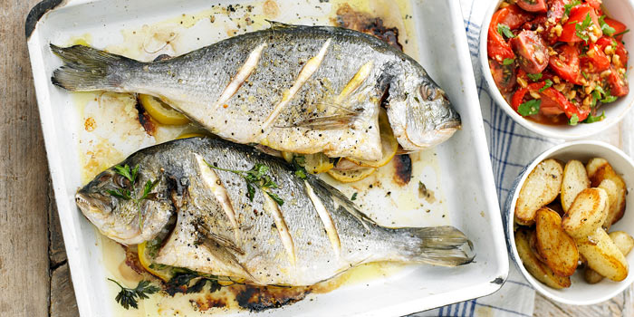
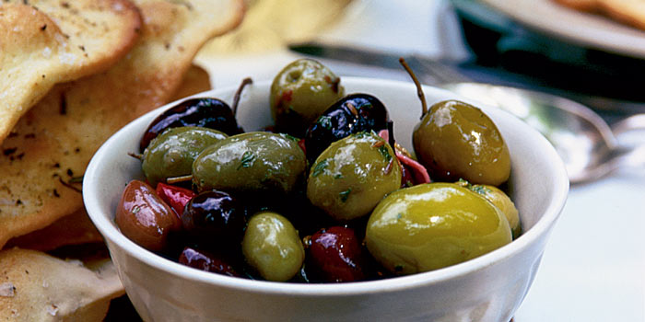
Greek food
moussaka
Feta cheese salad
Grilled fresh fish
Fresh olives in olive oil

Slide 5
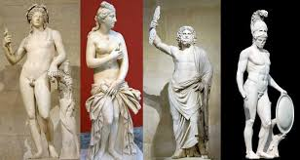
Greek Gods
Zeus. God of the Sky
Athena. Goddess of Wisdom, War, and Useful Arts
Hera. Goddess of Marriage, Mothers and Families
Apollo .god of Archery,Music and Dance
Artemis. God of hunt,the wildness, wild animals and the moon.
Poseidon. God of the Sea
Demeter. Goddess of Agriculture
Ares. God of War

Slide 6
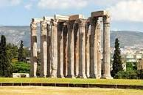
culture
The Greeks are religious, they are family orientated, they enjoy outdoor cooking and are very friendly
I want to go to Greece on holiday

Slide 7
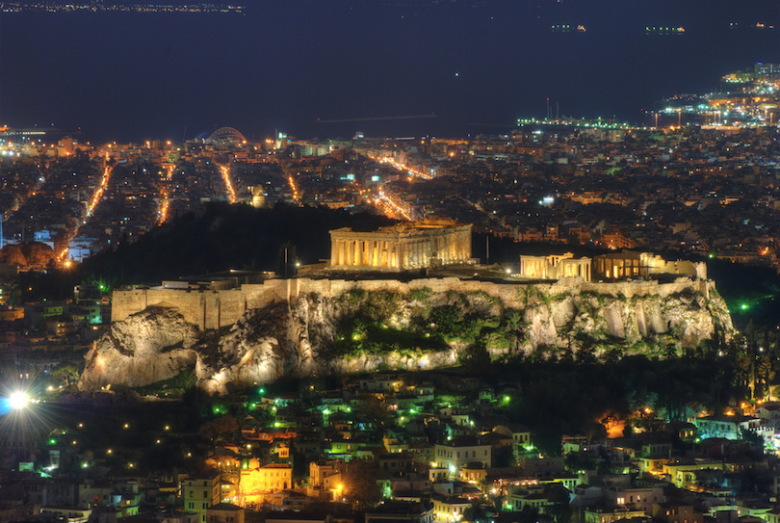
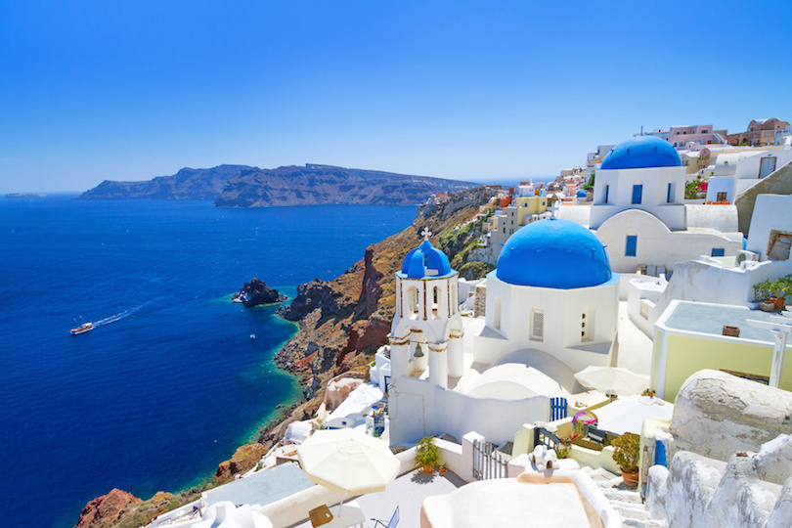
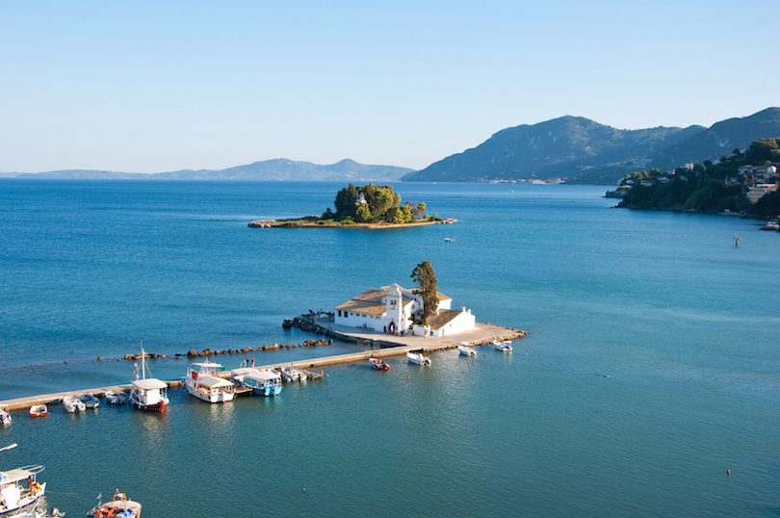
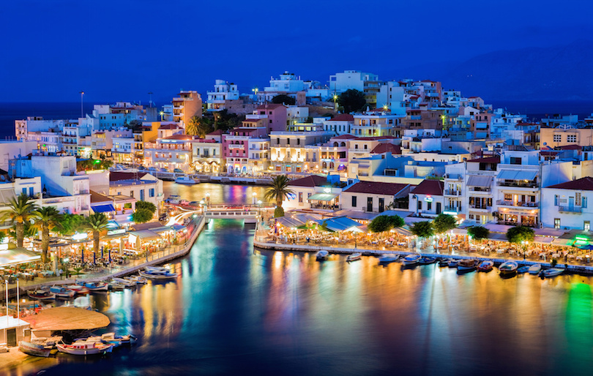
Places to visit in Greece
ATHENS!!! IS THE CAPITAL
Some Greek islands
Crete
Santorini
Corfu

