Slide 1
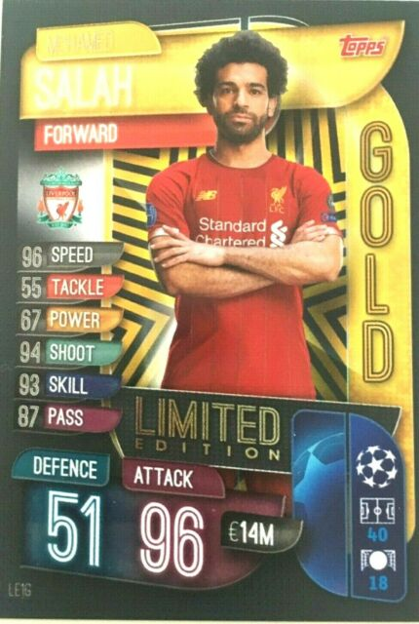
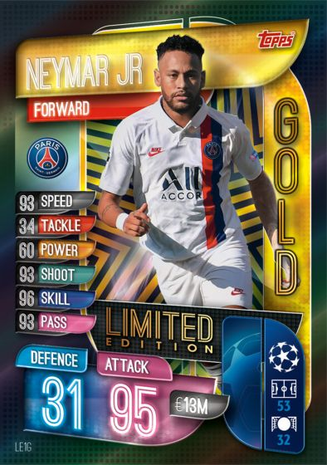
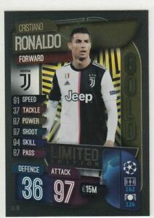
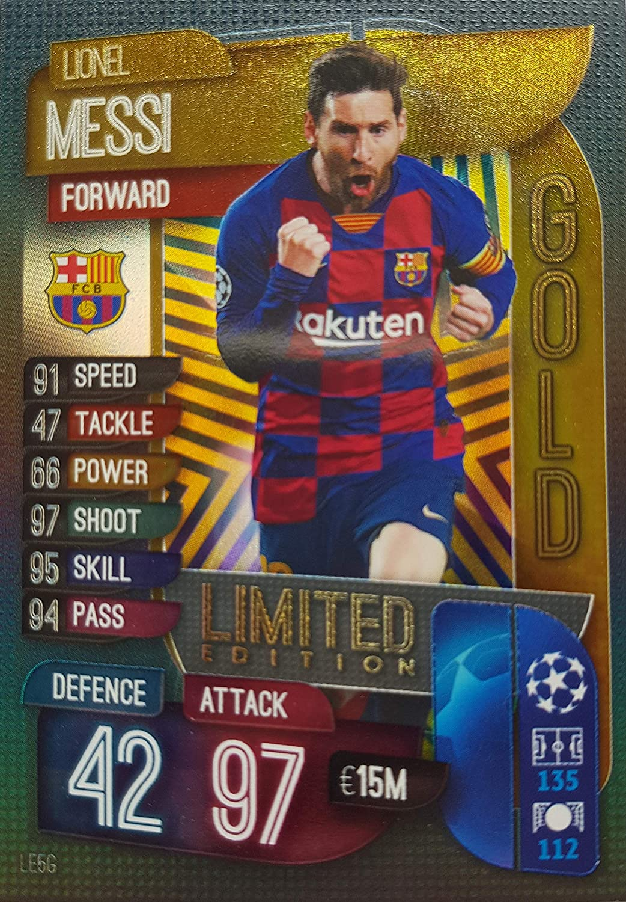
Match attax are football cards you can collect and swap with friends.
Match attax

Slide 2
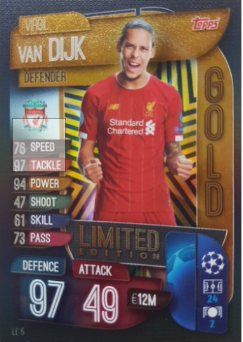
Match attax
these are my favourite players.
these are my favourite players because they pass the ball ,score goals and they are all good sportsmen. Ronaldo is my favourite player in the world because he scores Amazing goals!!!!!!!
But I support Liverpool.
Salah and Van Dijk are my best players.

Slide 3
BYMilo holroyd
I swap my cards with Cohen when we go to each others house.
My best card I had was Ronaldo ,I swapped him for van dijk 100 club, Thiago silva club legend,Coutinho super squad and Gold salah 97 rated.

