Slide 1
Morning Maths Handwriting Spelling activities 5 in 5
Home Learning

Slide 2
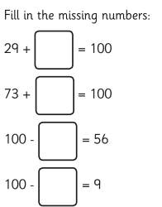
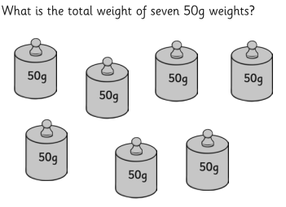
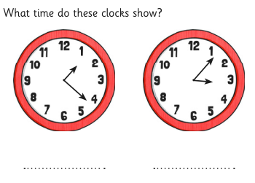
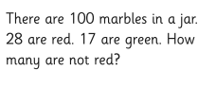
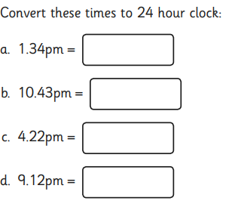
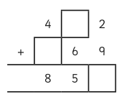
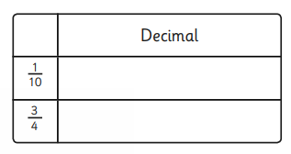
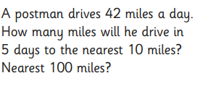
Thursday 8th July

Slide 3
Handwriting
Please practise handwriting these words on the line ensuring letter formation is precise.
complete decide
consider describe
continue different

Slide 4
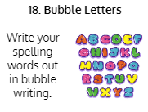
Spelling Challenge
Please find your spellings attached to the home learning page for this week.
To practise your today I would like you to

Slide 5
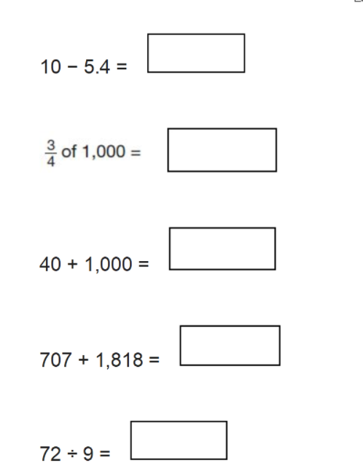
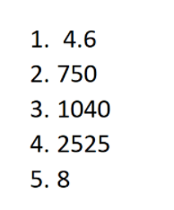
5 in 5
Answers

