Slide 1
Morning Maths Handwriting Spelling activities 5 in 5
Home Learning

Slide 2
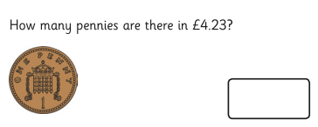
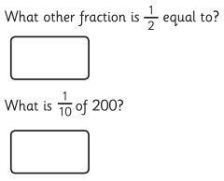
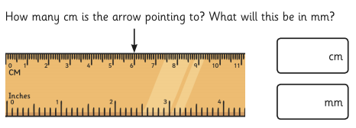
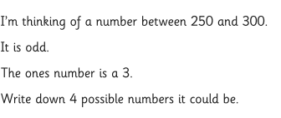
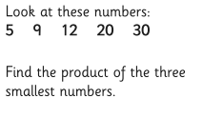
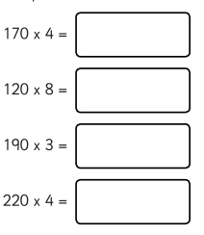
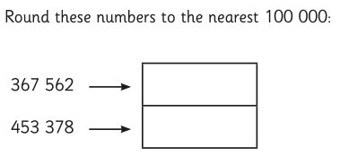
Friday 9th July

Slide 3
Handwriting
Please practise handwriting these words on the line ensuring letter formation is precise.
difficult earth
disappear eight
early eighth

Slide 4
Spelling Challenge
Please find your spellings attached to the home learning page for this week.
Please can you have a go at spelling your words with no support. What score did you get?

Slide 5
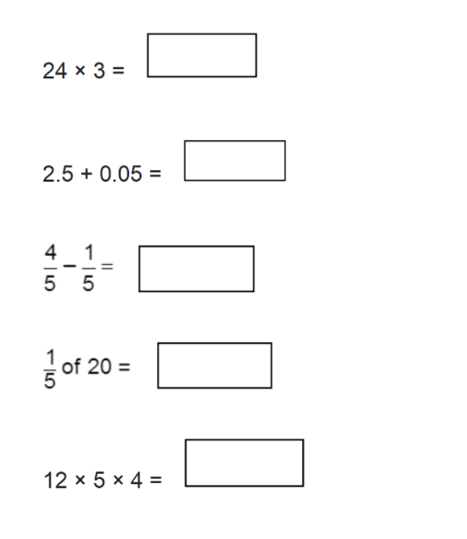
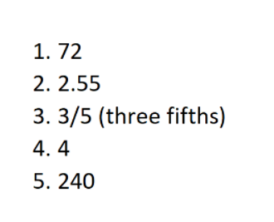
5 in 5
Answers

