Slide 1
Morning Maths Handwriting Spelling activities 5 in 5
Home Learning

Slide 2
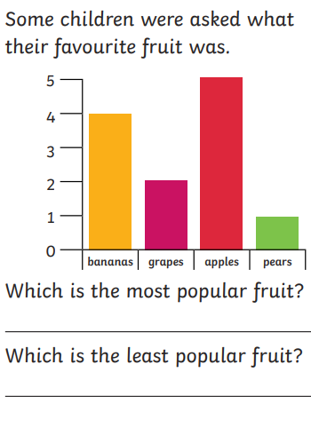
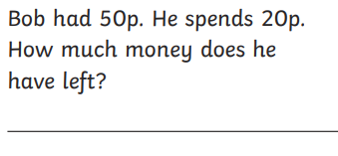
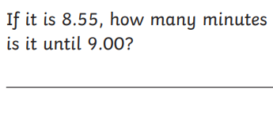
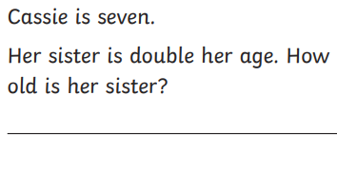
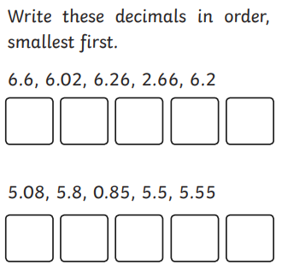
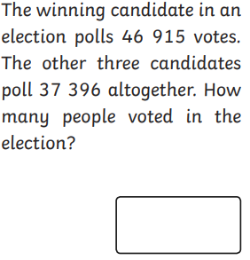
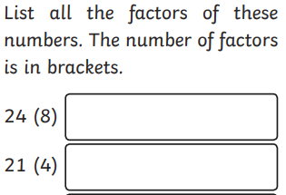

Slide 3
Handwriting
Please practise handwriting these words on the line ensuring letter formation is precise.
Natural guide
Mention group
Business guard

Slide 4
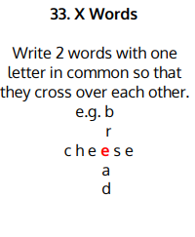
Spelling Challenge
Please find your spellings attached to the home learning page for this week.
To practise your spellings this week I would like you to

Slide 5
5 in 5
56 x 5
18 + 9 + 9
2749 + 317
49 divided by 7
242 x 4

