Slide 1
Morning Maths Handwriting Spelling activities 5 in 5
Home Learning

Slide 2
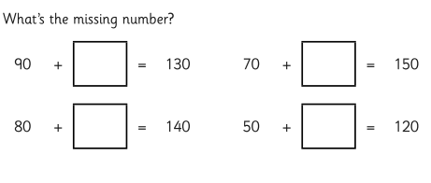
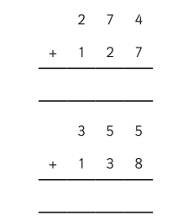
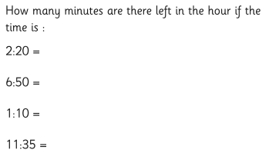
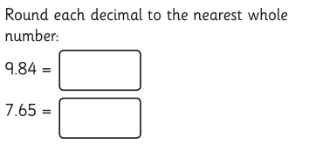
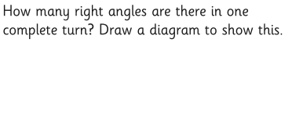
12 x 9 =
3 x 5 =
4 x 7 =
8 x 8 =

Slide 3
Handwriting
Please practise handwriting these words on the line ensuring letter formation is precise.
transition exercise
emotions recent
friend different

Slide 4
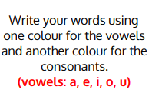
Spelling Challenge
Please find your spellings attached to the home learning page for this week.
To practise your spellings this week I would like you to

Slide 5
5 in 5
432 divided by 8 =
8.2 divided by 100 =
424 x 4 =
¼ of 36 =
340 + 100 =

