Slide 1
Morning Maths Handwriting Spelling activities 5 in 5
Home Learning

Slide 2
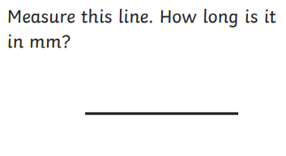
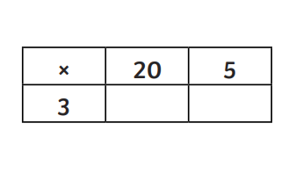
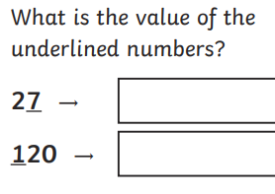
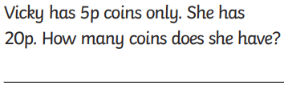
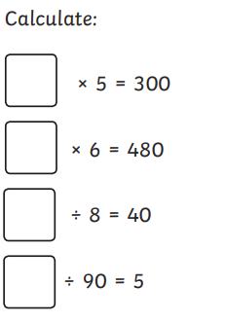
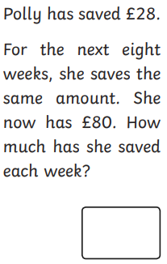
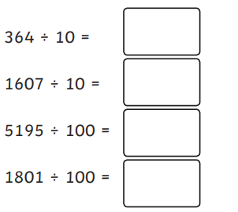
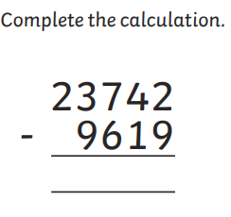

Slide 3
Handwriting
Please practise handwriting these words on the line ensuring letter formation is precise.
Therefore
Though
Opposite
important
Particular
special

Slide 4
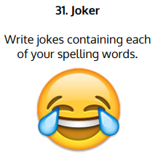
Spelling Challenge
Please find your spellings attached to the home learning page for this week.
To practise your spellings this week I would like you to

Slide 5
5 in 5
12 x 3 x 2
Divide 84 by 4
1.31 + 6.9
20.8 – 1.07
¾ of 48

