Slide 1
Morning Maths Handwriting Spelling activities 5 in 5
Home Learning

Slide 2
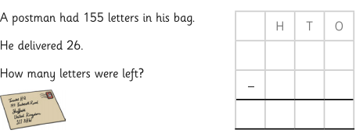
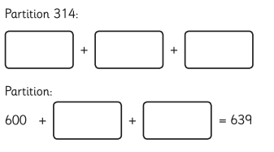
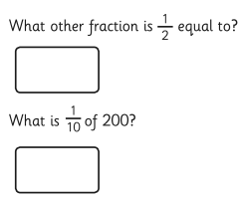
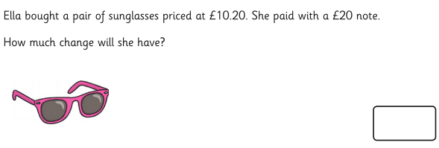
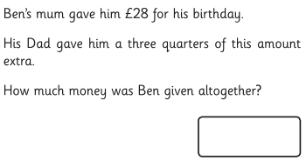
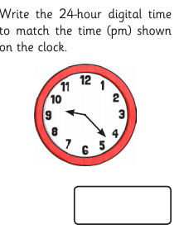
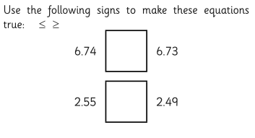

Slide 3
Handwriting
Please practise handwriting these words on the line ensuring letter formation is precise.

Slide 4
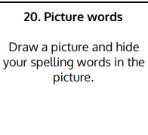
Spelling Challenge
Please find your spellings attached to the home learning page for this week.
To practise your spellings this week I would like you to

Slide 5
5 in 5
124 x 4=
8 x 9 =
165 x 0 =
16700 + 11500 =
? = 308 – 154

