Slide 1
Morning Maths Handwriting Spelling activities 5 in 5
Home Learning

Slide 2
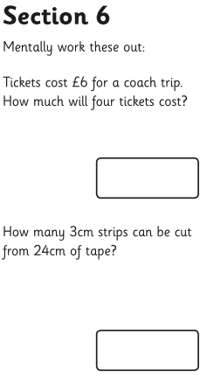
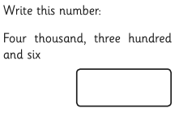
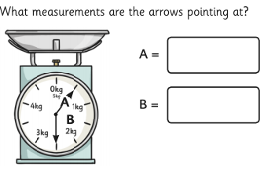
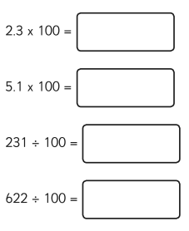
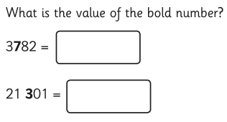
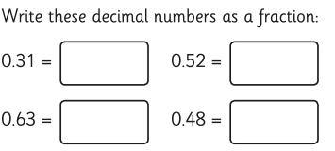

Slide 3
Handwriting
Please practise handwriting these words on the line ensuring letter formation is precise.
business important
position famous
strength though

Slide 4
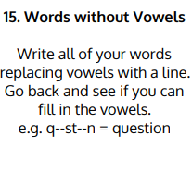
Spelling Challenge
Please find your spellings attached to the home learning page for this week.
To practise your spellings this week I would like you to

Slide 5
5 in 5
77 divided by 11
The product of 12 and 4
16 + 1000 + 1000
8.2 divided by 100
3/5 + 4/5

