Slide 1






Welcome to Reception at Carleton Green
Brown and Yellow Ducklings’ Classes

Slide 2
Our EYFS Curriculum
Prime Areas | Prime Areas | Prime Areas
Communication & Language | Listening, Understanding & Attention Speaking | Listening, Understanding & Attention Speaking
Personal, Social & Emotional Development | Self-Regulation Managing Self Building Relationships | Self-Regulation Managing Self Building Relationships
Physical Development | Gross Motor Fine Motor | Gross Motor Fine Motor
Specific Areas | Specific Areas
Literacy | Comprehension Word Reading Writing
Mathematics | Number Numerical Patterns
Understanding the World | Past and Present People, Culture and Communities The Natural World
Expressive Arts and Design | Creating with Materials Being Expressive and Imaginative
The prime areas are very important because they lay the foundations for children’s success in all other areas of learning and life.

Slide 3

A Typical Day in the Ducklings
We follow the same routines everyday, to help the children settle in and feel safe and welcome.
We encourage the children to be independent and to begin to organise their own belongings and their learning.

Slide 4

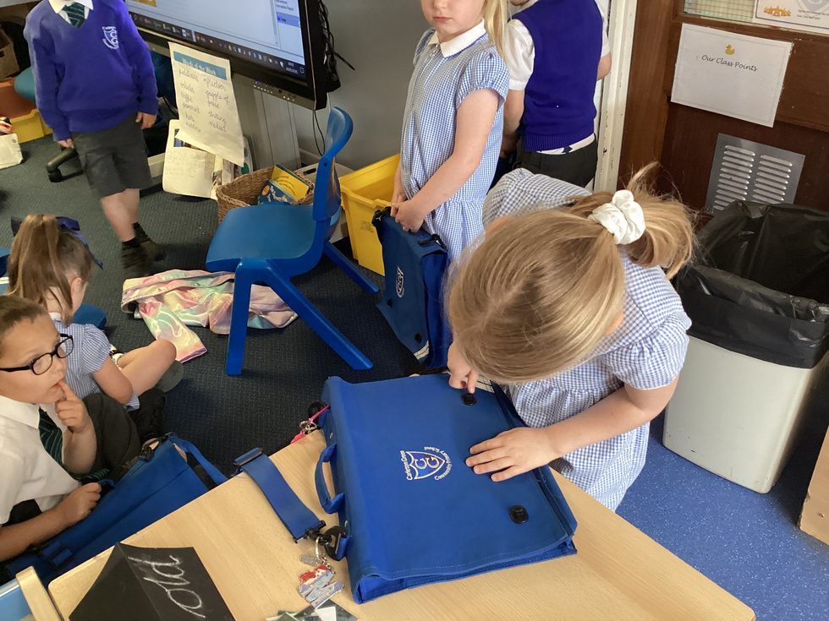
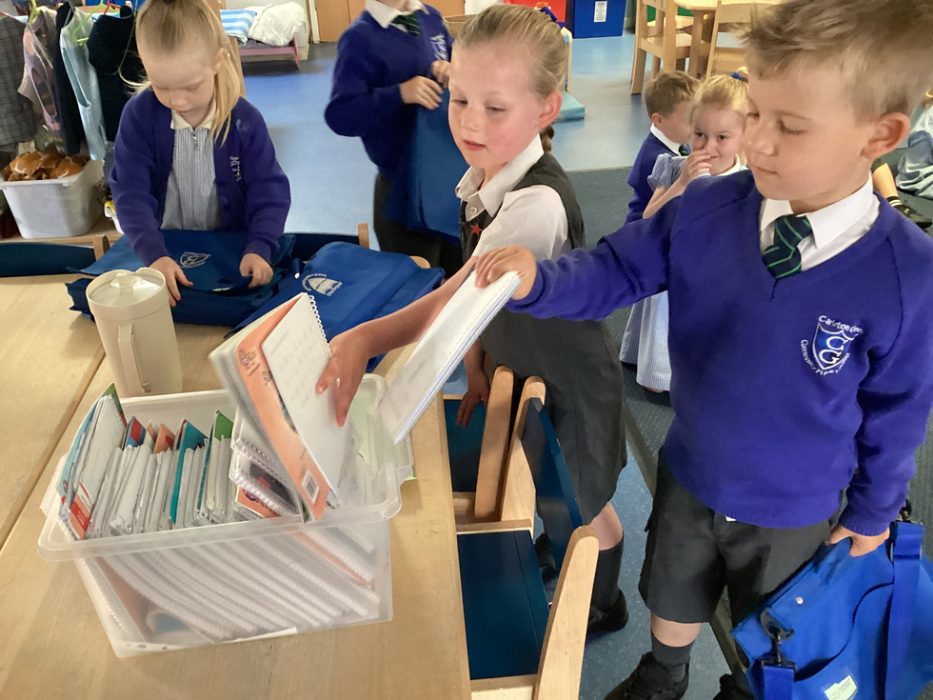
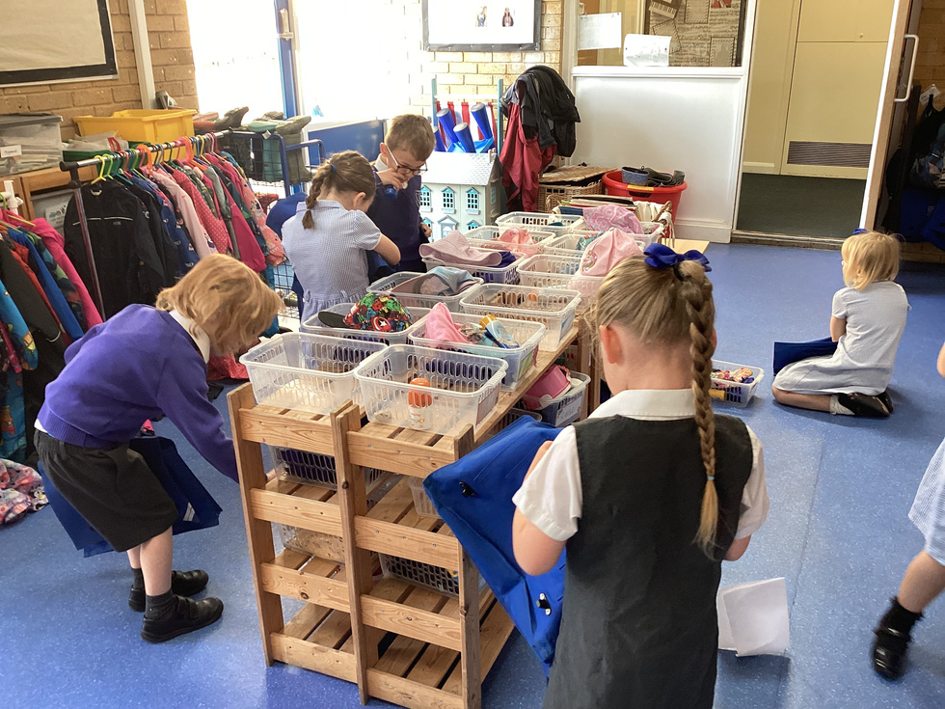
Good Morning!
Through ‘Meet and Greet,’ we welcome your child into class each morning from 8.55am and school starts at 9am.
Please wait on the playground at the back of school until we open the doors.
If you have information to pass on to us, you can speak to us at the door or contact us through Class Dojo.
As time goes on, your child will need less support and become more independent! But we are here to help them in anyway we can.

Slide 5
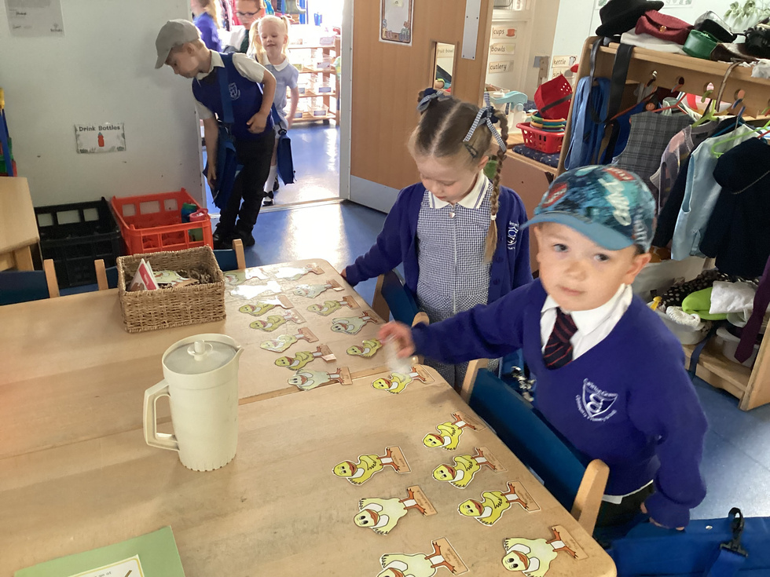
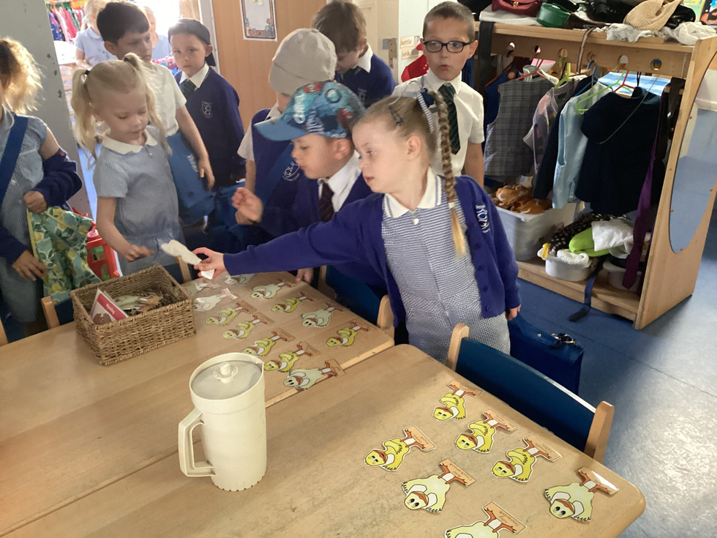
Self-Register
The children find and collect the duckling with their name on
to let us know they have arrived. Then, they begin to unpack and organise their belongings.

Slide 6
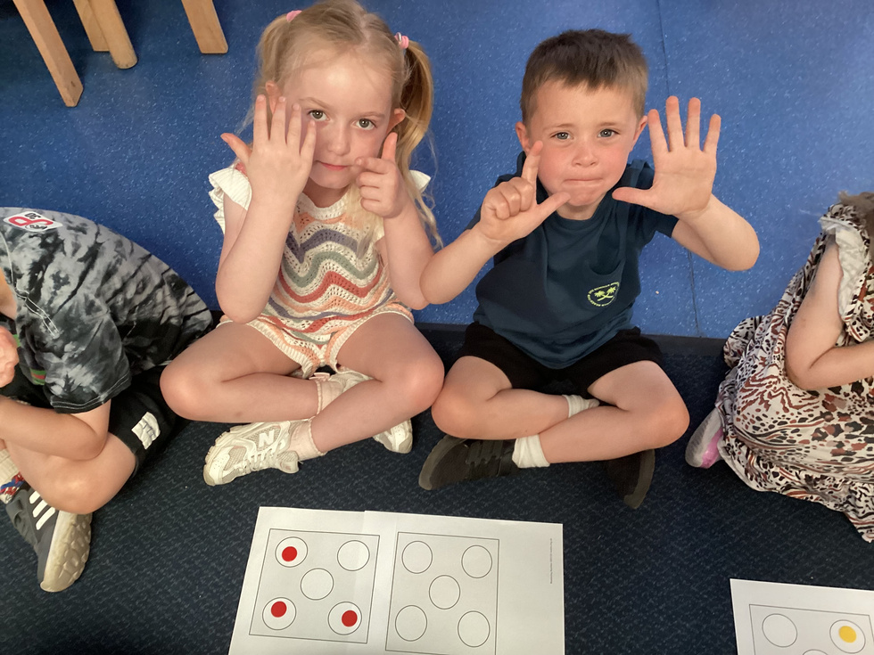
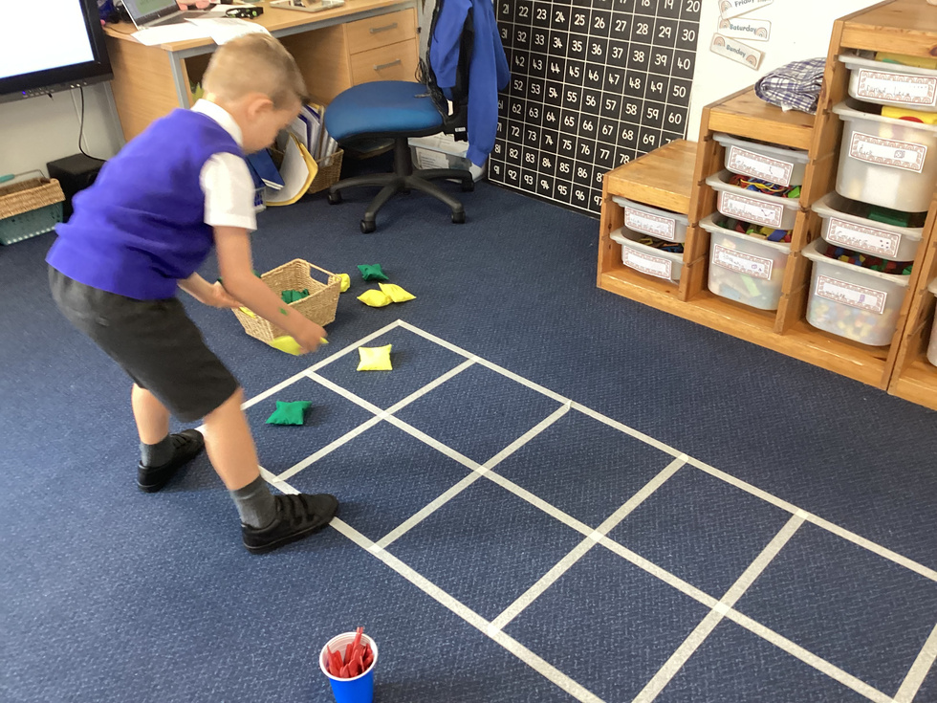
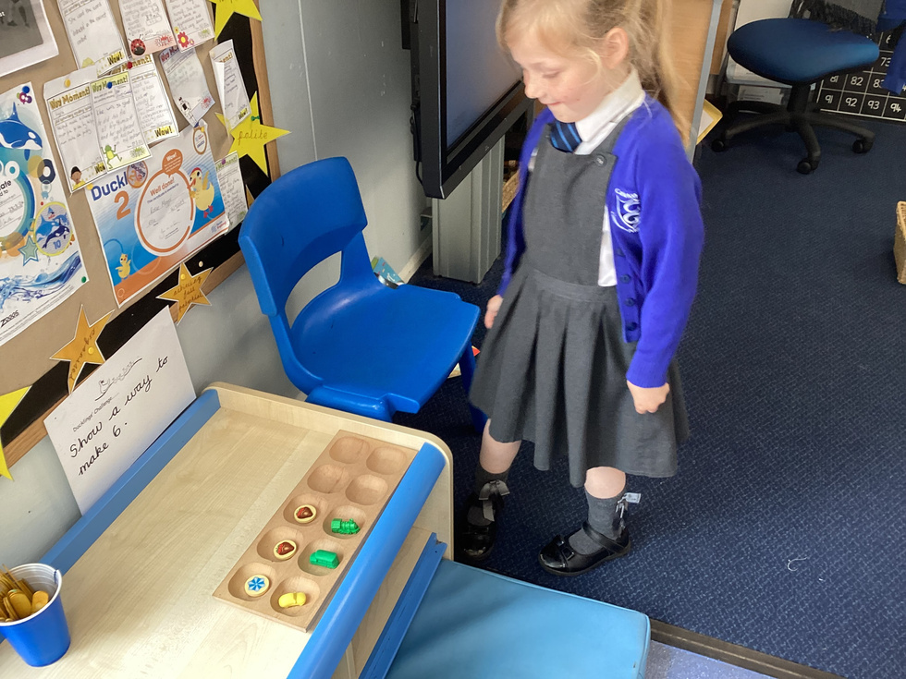
Morning Maths
We have a quick maths session each morning. This enables us to recap over mathematical knowledge and practise skills.
We sing counting songs and action rhymes, find 1 more or 1 less than numbers, name 2D or 3D shapes, solve simple addition and subtraction and solve real-life, everyday problems using our mathematics skills in general.

Slide 7
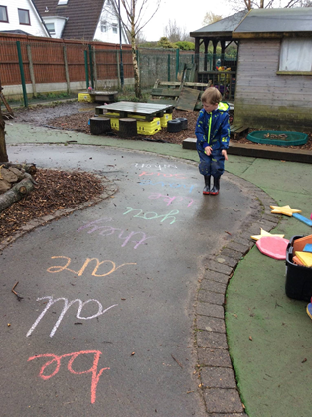
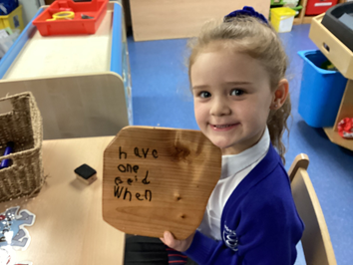
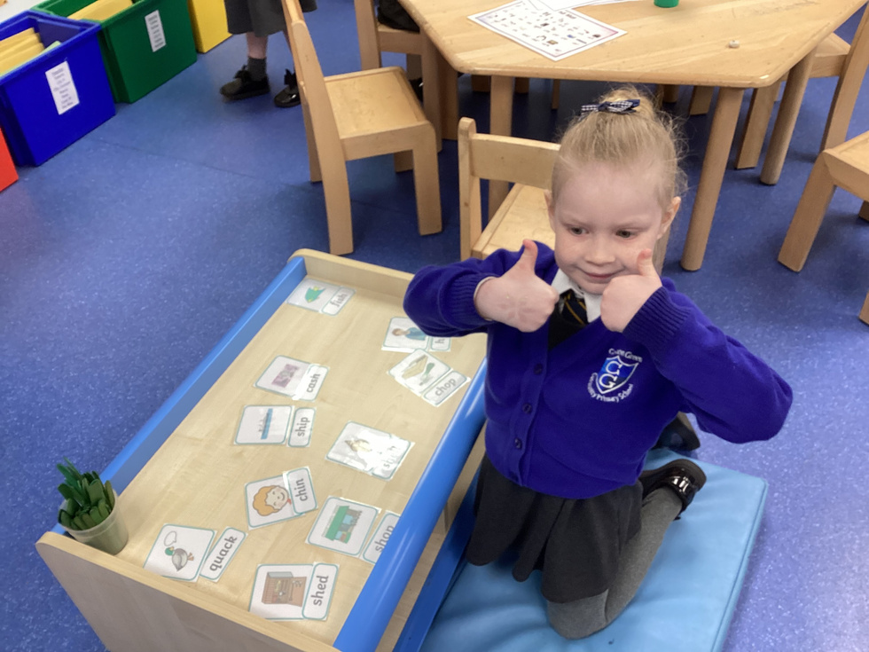
Phonics Time
We have a phonics session each morning too.
We learn to listen to sounds, recognise and read letters, blend them together to read words and sentences and segment words to be able to write their letters and sounds.

Slide 8
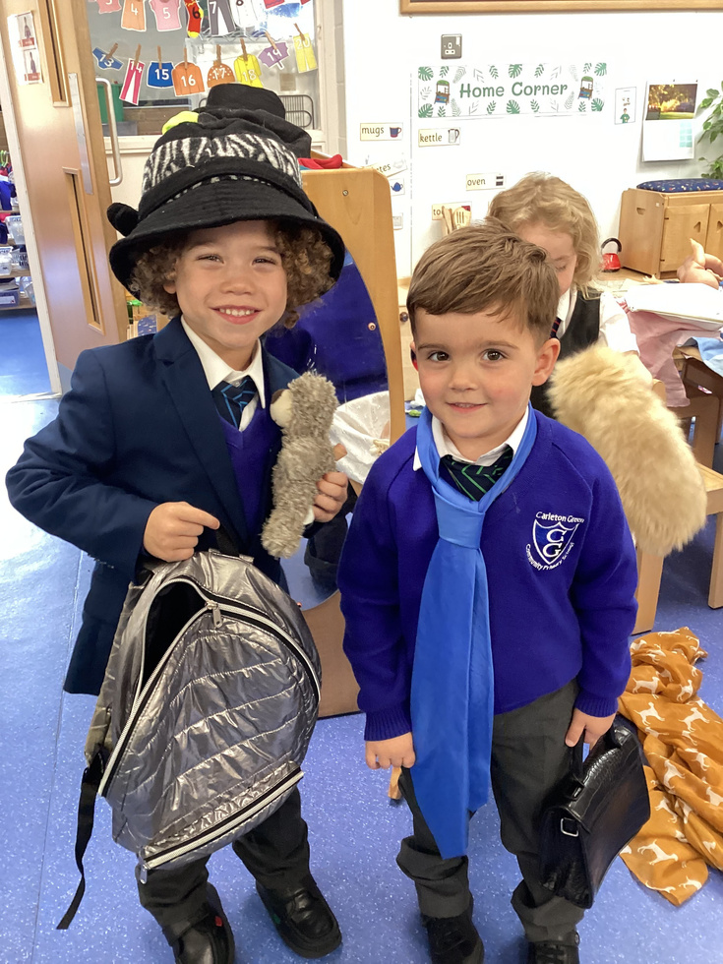
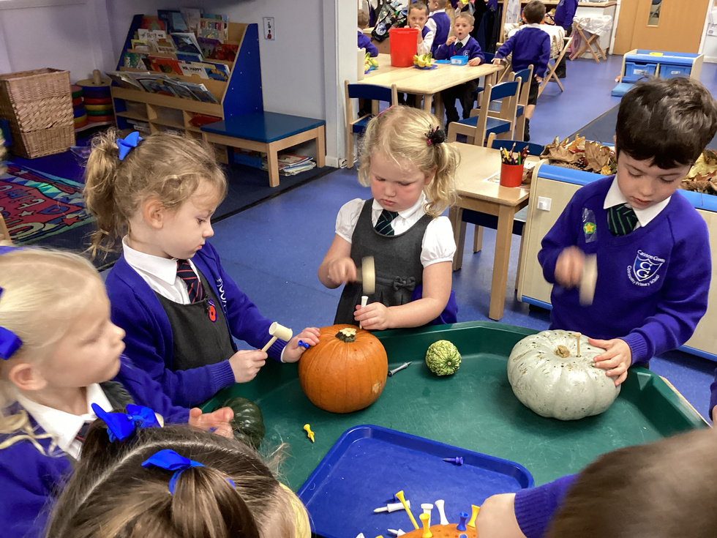
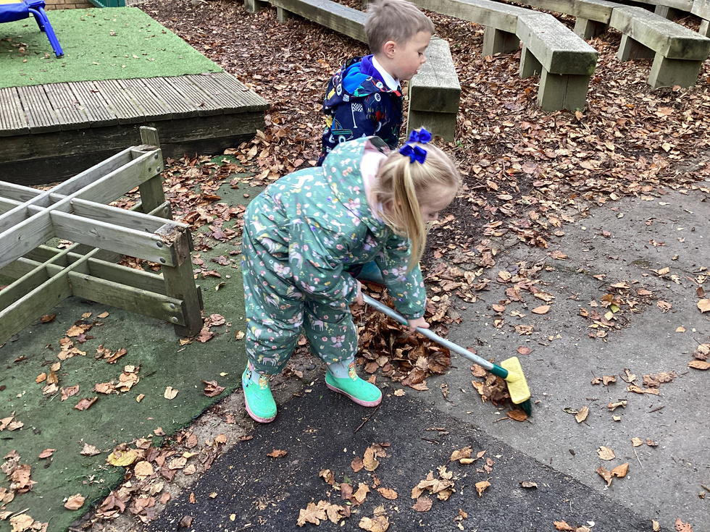
Continuous Provision Learning
Learning happens both indoors and outdoors, with free-flow.
The children explore a wide range of experiences across the curriculum.
Focused activities with the adults.
Free choice in the continuous provision
We learn indoors and outdoors all day, everyday.
Your paragraph text

Slide 9
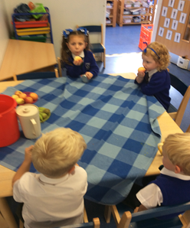
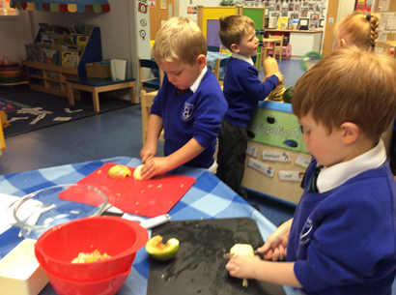
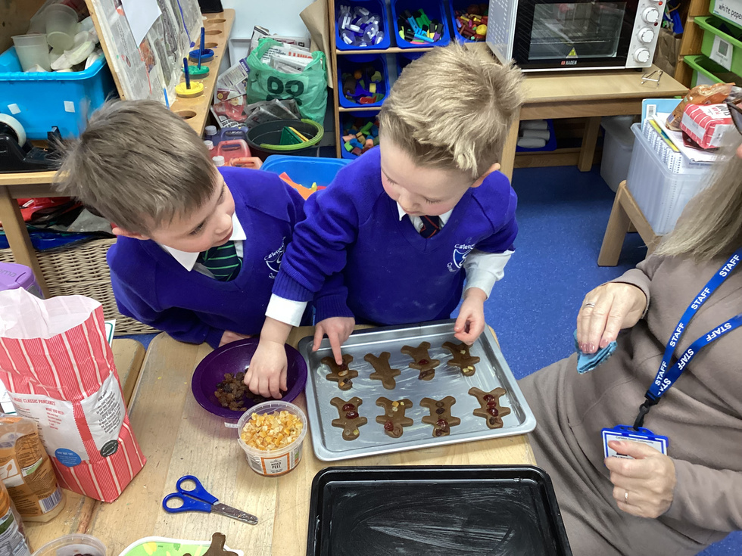
Snack Time
Snack is on offer throughout the morning and afternoon.
We are a healthy school! We offer milk, water and fruit/vegetables each day. Children are also welcome to bring in their own fruit or vegetable snack too.
This is a learning time, as well as a social time, covering most other areas of the Foundation Stage Curriculum.

Slide 10
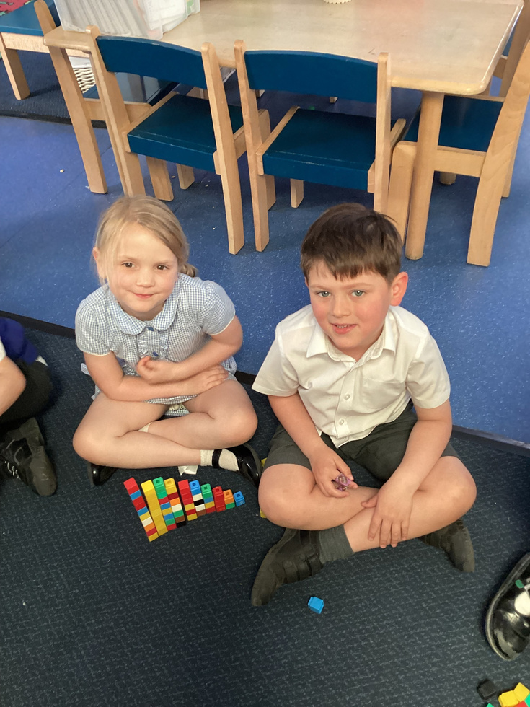
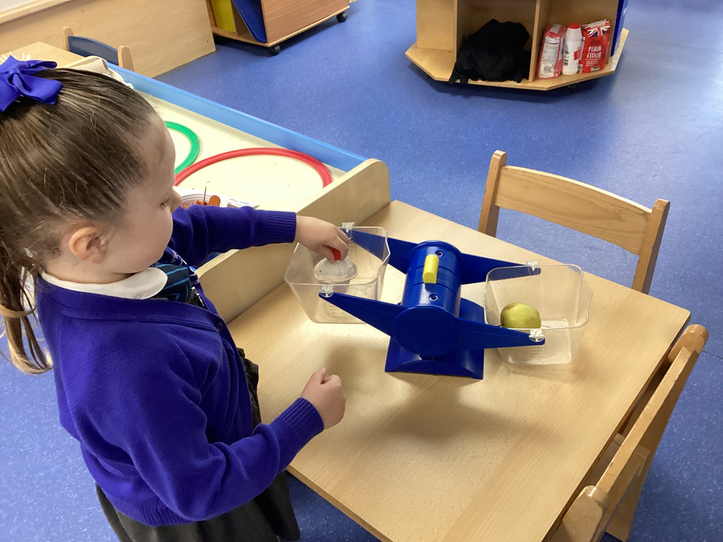
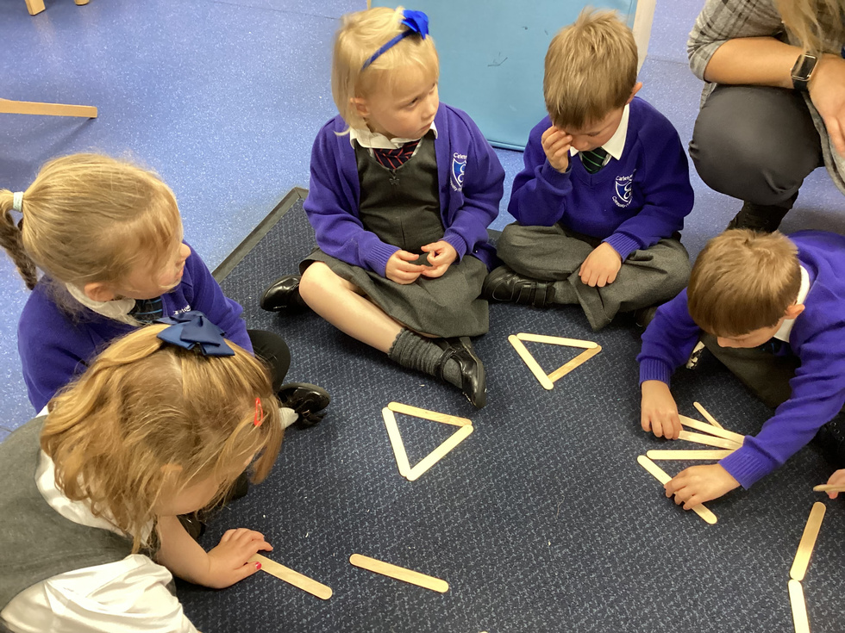
Mathematics Time
Each day we have a mathematics time.
We learn to count, identify amounts and match to numerals. We explore
subitising - being able to see a small amount without counting. We explore how different numbers of objects can be arranged and how numbers can be composed of smaller parts. We learn to identify and describe 2D and 3D shapes, make patterns and compare objects according to size, weight and capacity.

Slide 11
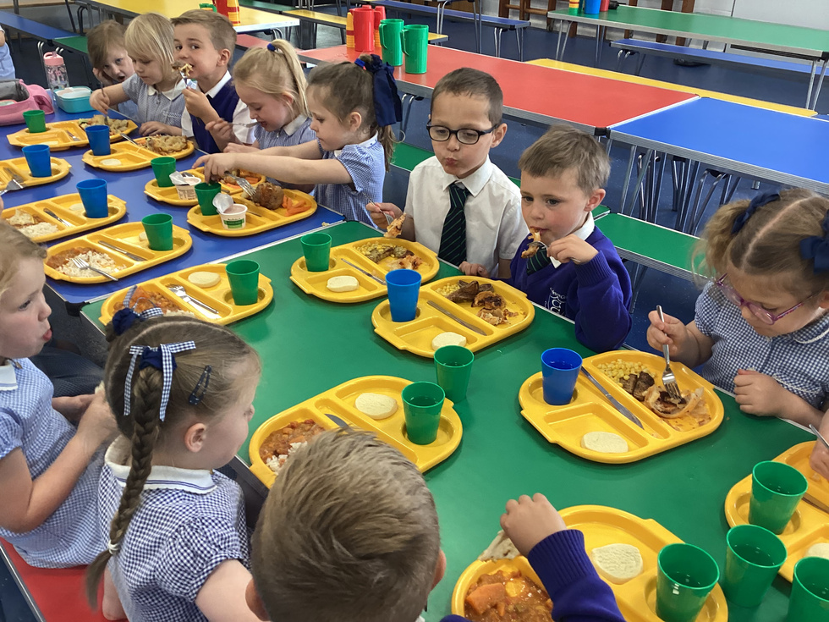
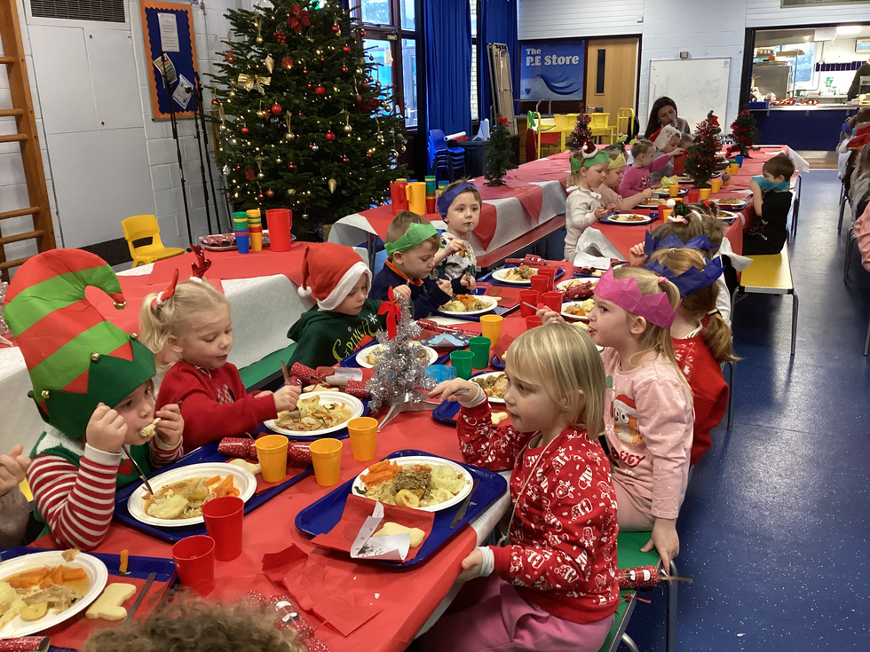
Lunch Time
The Ducklings are the first into lunch at 11.30am. The meals are healthy, tasty and free!
The staff enjoy them too! We stay and eat with the children for the first few weeks to help them.

Slide 12
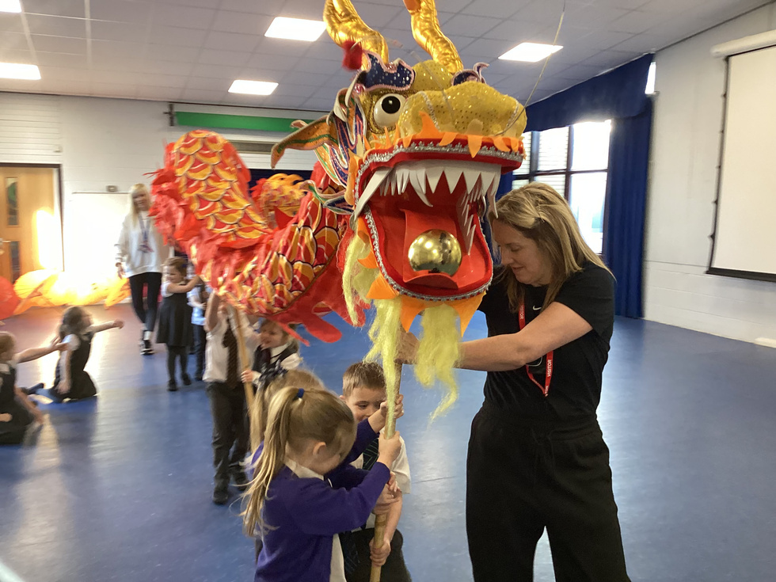
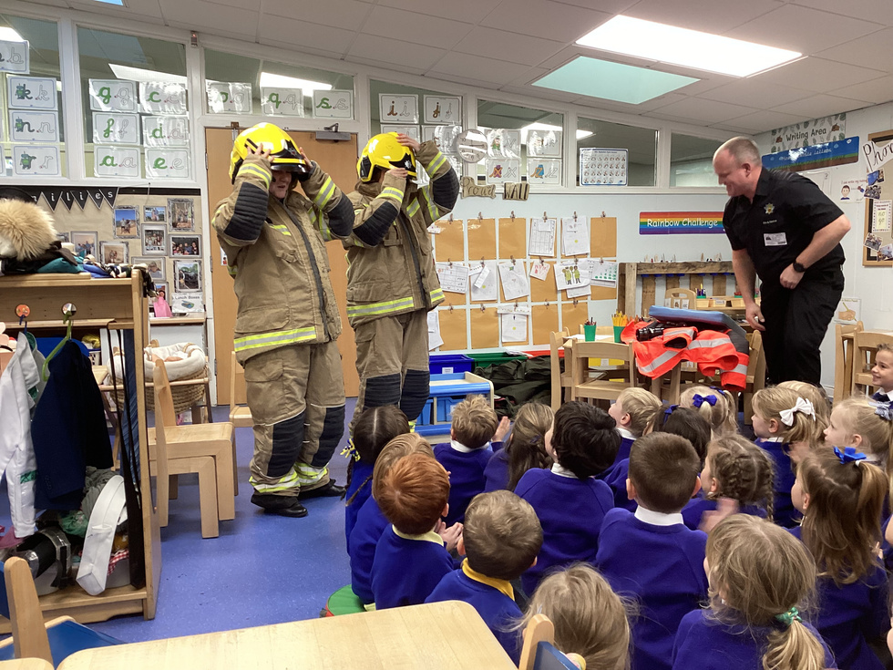
Topic Time
We start each afternoon learning about our current theme or children’s interests. This could be a story or an information book related to the topic we are currently learning about, a special celebration, occasion or something related to events happening in their life at home or at school.

Slide 13
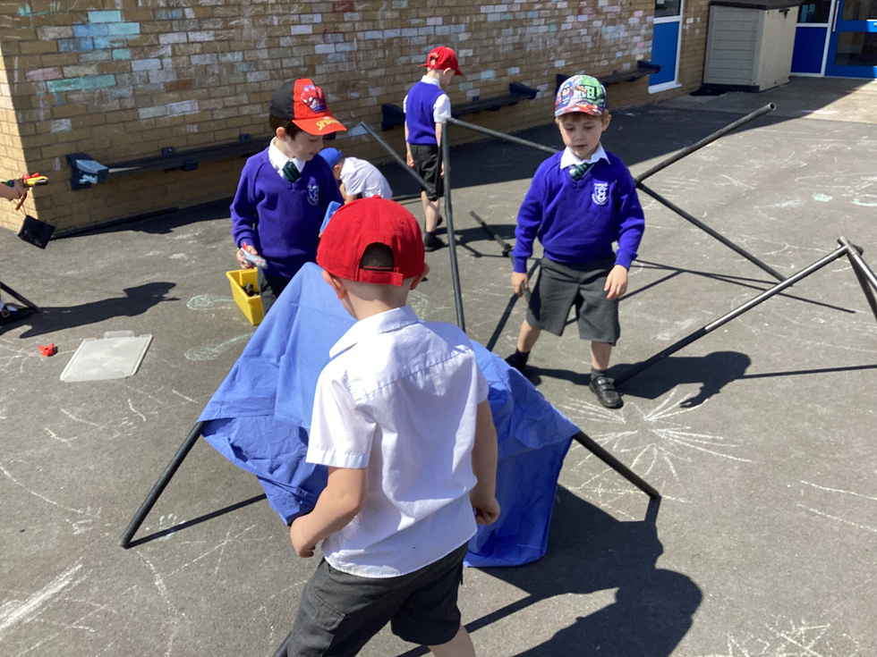
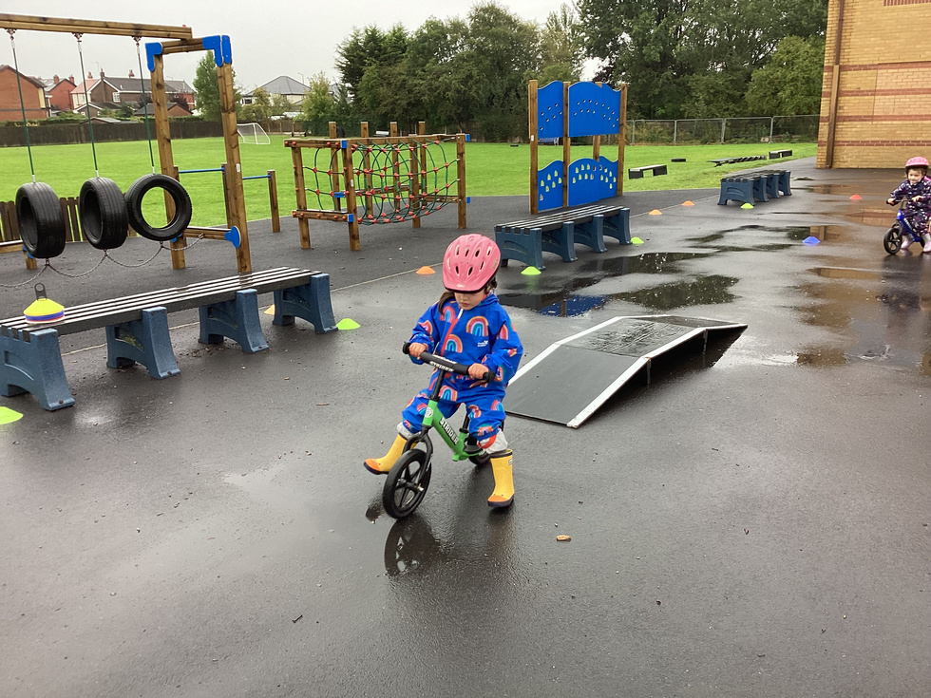
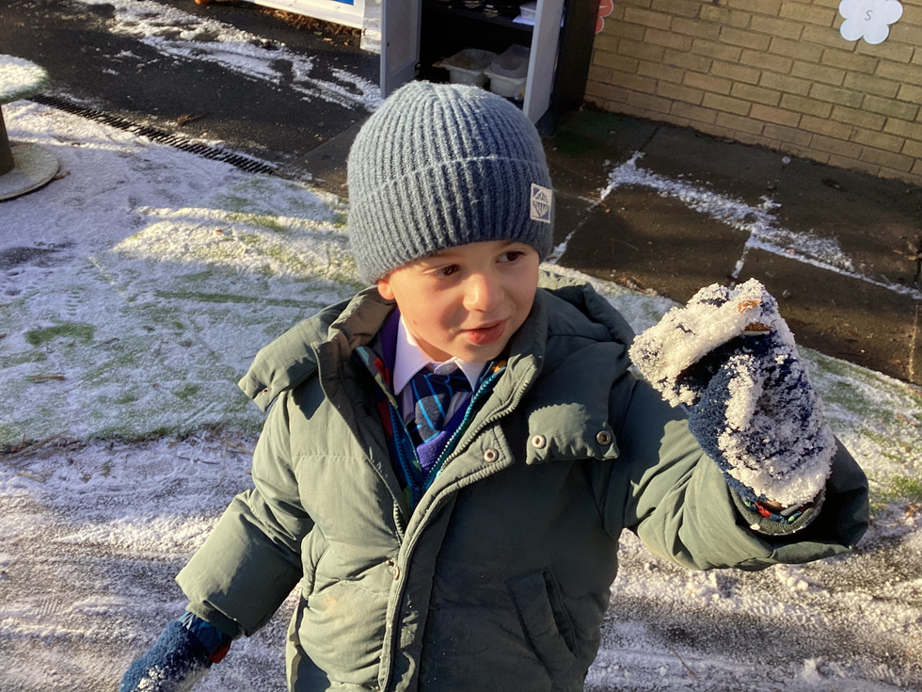
Continuous Provision Learning
Afternoon activities
We provide the same learning opportunities for all areas of learning, outside as well as inside. The outside also provides us with opportunities to do all those things you can’t do inside.
There are always two members of staff outside and two inside to support the children with their learning.

Slide 14
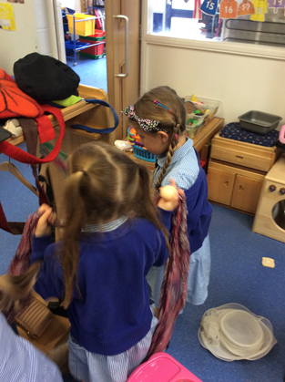
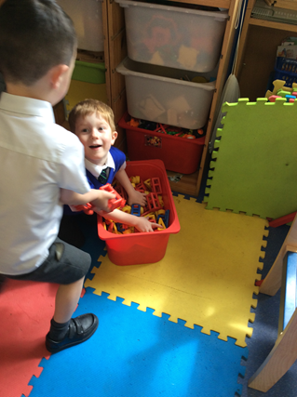
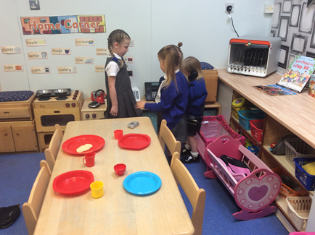
Tidy Up Time
The children are encouraged to tidy up independently as they go along.
We often use music to cue the times for tidying up.
We label the drawers and help the children share the responsibility of looking after their classroom.
We say, ‘Choose it. Use it. Put it away!’

Slide 15
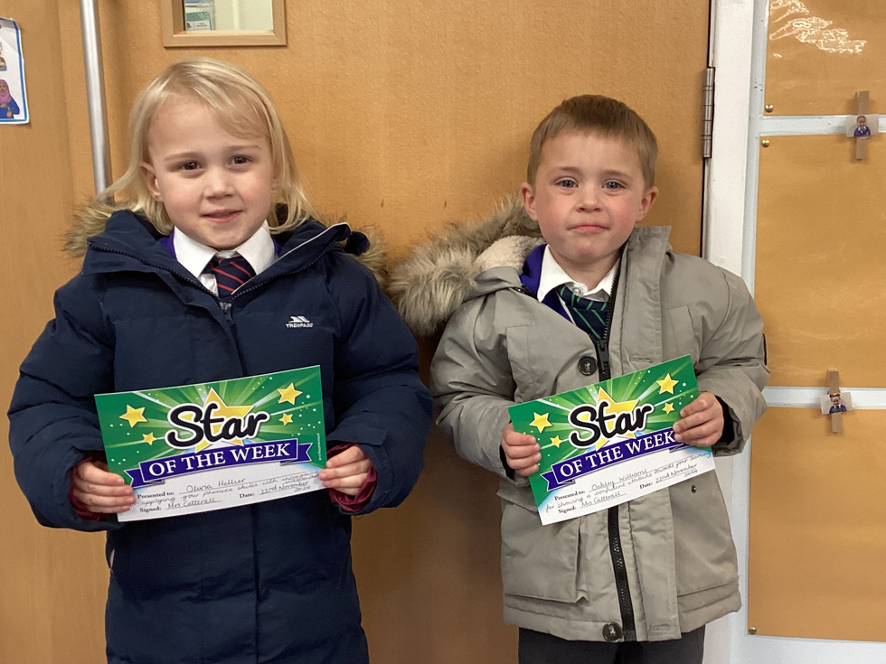
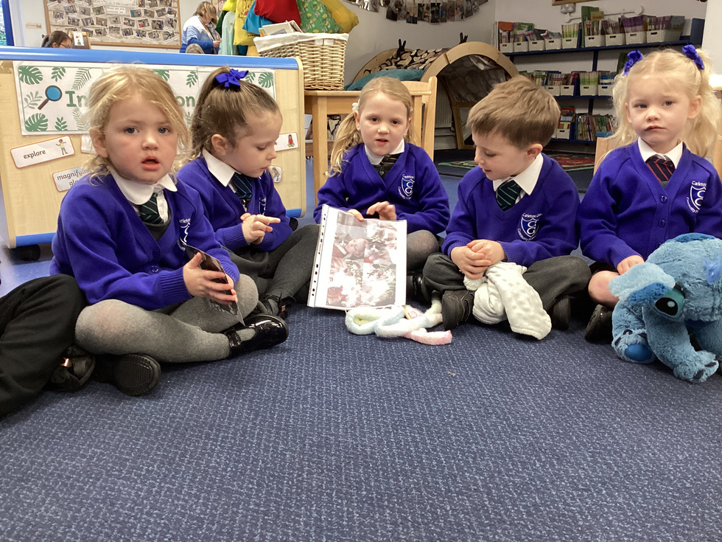
Reflection Time
At the end of each day we take time to think about what we have been learning.
We celebrate our learning achievements and talk about our day. We award ‘Danny Duck’ to a star pupil of the day.
We share special ‘wow!’ moments and certificates or news together.
We have class, year group and whole school assemblies too.

Slide 16
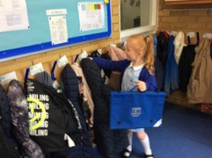
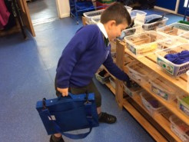
Home Time
By the end of the day we are all really tired!
Our day finishes at 3.30pm.
We pack our bags and gather up our belongings.
We bring the children out to you onto the playground.
This is an opportunity for us to talk to you about their day and a chance for you to
speak to us should you need to.

