Slide 1
GCSE 2015
Higher
facts and formulae to memorise

Slide 2


Rules of indices
$$x^{a}×x^{b}=x^{a+b}$$
$$x^{a}÷x^{b}=x^{a−b}$$
$$\frac{x^{a}}{x^{b}}=x^{a−b}$$
$$x^{−a}=\frac{1}{x^{a}}$$
$${\left(x^{a}\right)}^{b}=x^{ab}$$
$$x^{0}=1$$

Slide 3




Trigonometry
For angle $x$, you label up a triangle like this
For angle $y$, you label up a triangle like this
$$x$$
H
A
H
O
$$y$$
O
A

Slide 4
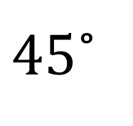
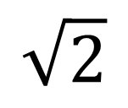
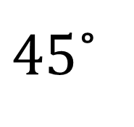

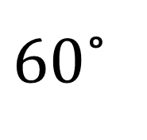
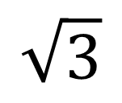
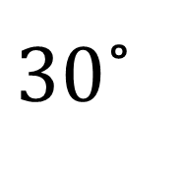
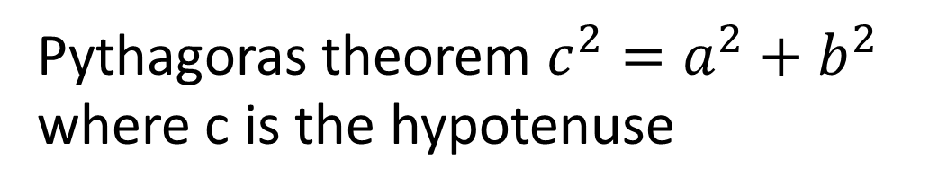
Trigonometry
$$\sin{x}=\frac{O}{H}$$
$$\cos{x}=\frac{A}{H}$$
$$\tan{x}=\frac{O}{A}$$
$30$˚
2
$$\sqrt{3}$$
$60$˚
1
$45$˚
$$\sqrt{2}$$
1
$45$˚
Pythagoras theorem $c^{2}=a^{2}+b^{2}$
where c is the hypotenuse
1

Slide 5
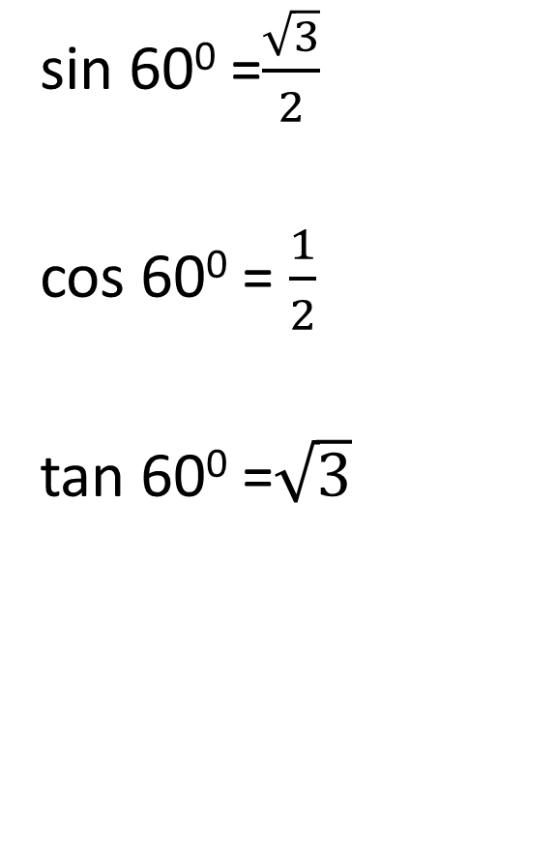
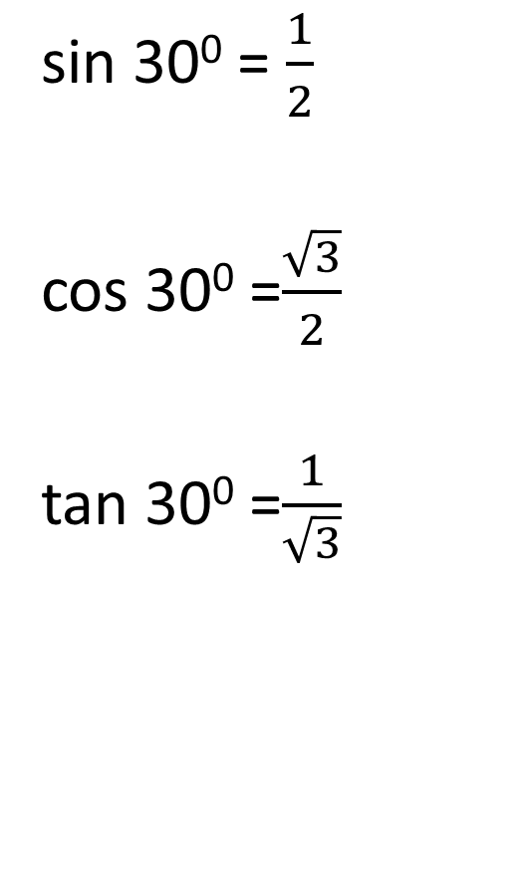
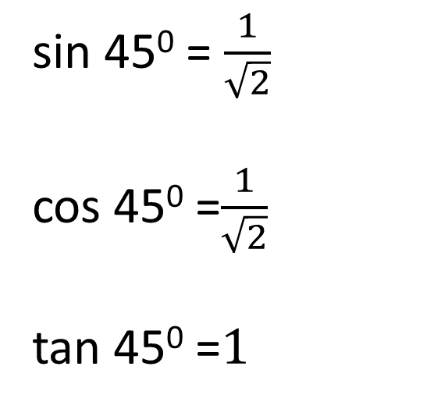
Exact Trig Values
sin 30⁰ = $\frac{1}{2}$
cos 30⁰ =$\frac{\sqrt{3}}{2}$
tan 30⁰ =$\frac{1}{\sqrt{3}}$
sin 60⁰ =$\frac{\sqrt{3}}{2}$
cos 60⁰ = $\frac{1}{2}$
tan 60⁰ =$\sqrt{3}$
sin 45⁰ = $\frac{1}{\sqrt{2}}$
cos 45⁰ =$\frac{1}{\sqrt{2}}$
tan 45⁰ =$1$

Slide 6





Trigonometry
Sine rule
$$\frac{sin A}{a}=\frac{\sin{B}}{b}$$
Cosine rule
$$a^{2}=b^{2}+c^{2}−2bc\cos{A}$$
Area of a triangle
$$Area=\frac{1}{2}ab\sin{C}$$
C
$$a$$
$$b$$
B
$$c$$
A

Slide 7
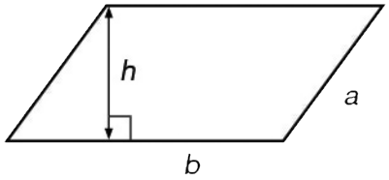
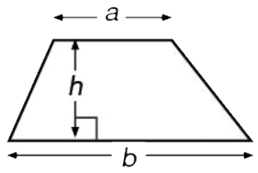
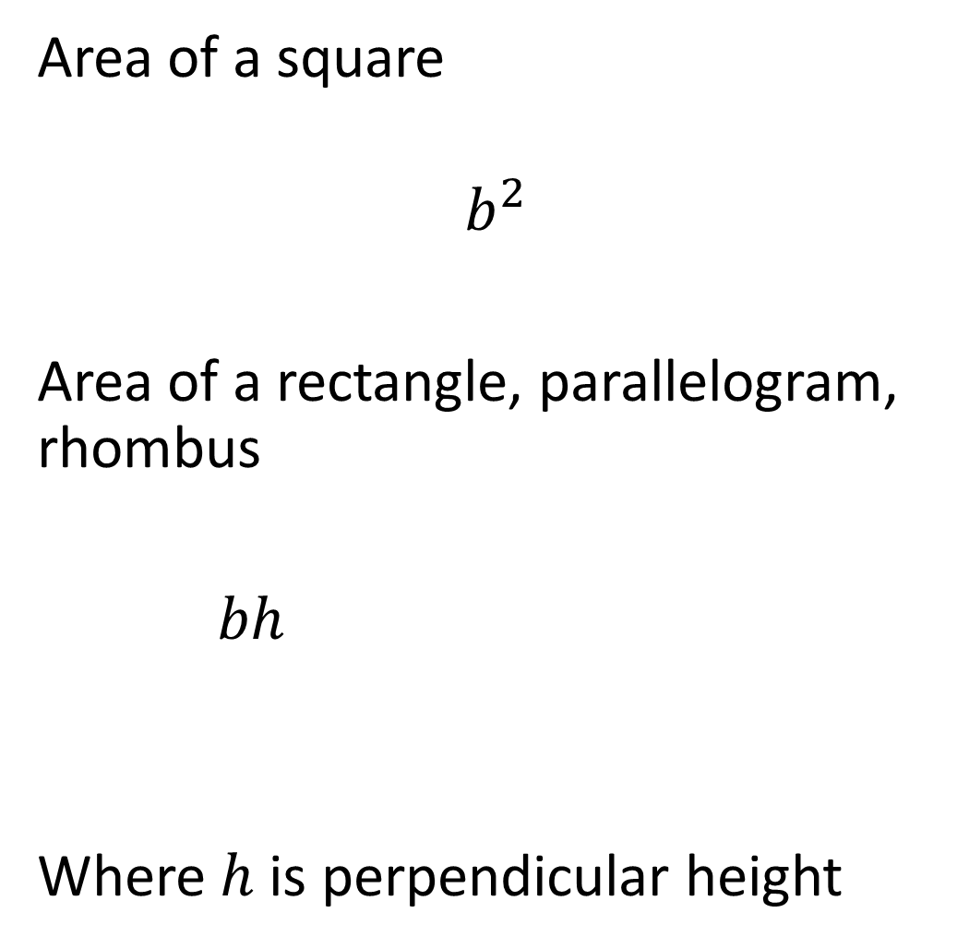

Area
Area of a square
$$b^{2}$$
Area of a rectangle, parallelogram, rhombus
$bh$
Where $h$ is perpendicular height
Area of a triangle
$$\frac{bh}{2}$$
Area of a trapezium
$$\frac{\left(a+b\right)h}{2}$$

Slide 8

Quadratics
Quadratic formula
$$x=\frac{−b±\sqrt{b^{2}−4ac}}{2a}$$

Slide 9

Trapezium rule
$$A≈\frac{h}{2}(y_{0}+2\left(y_{1}+…+y_{n−1}\right)+y_{n})$$
Where $h$ is the width of each trapezium.
NB. All your trapeziums must be the same width.

Slide 10
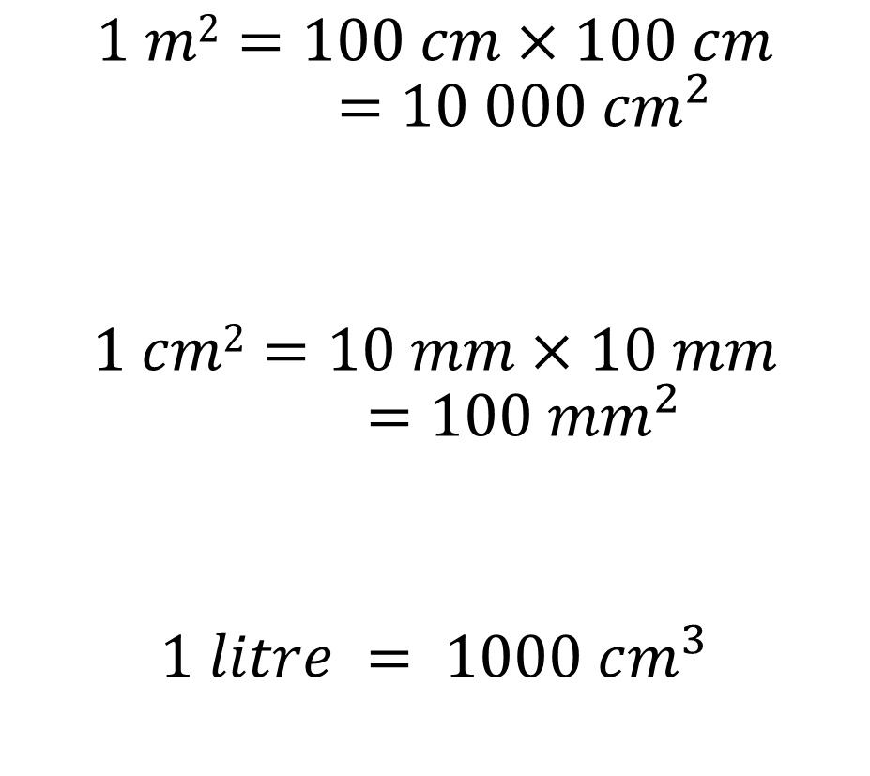
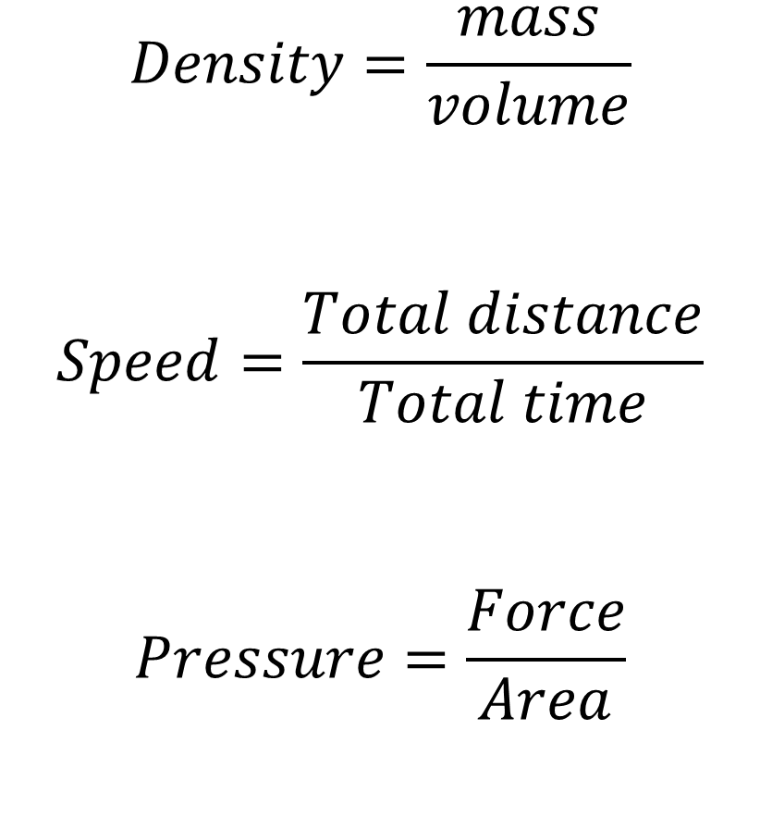
Compound measures
Converting units of measure
$$Density=\frac{mass}{volume}$$
$$Speed=\frac{Total distance}{Total time}$$
$$Pressure=\frac{Force}{Area}$$
$$1 m2=100 cm×100 cm$$
$$=10 000 {cm}^{2}$$
$$1 cm2=10 mm×10 mm$$
$$=100 {mm}^{2}$$
$$1 litre = 1000 cm^{3}$$

Slide 11

Circles
Circle area $πr^{2}$
Circumference $πd$ or $2πr$
Arc length $\frac{θ}{360}$ x 2 $πr$ where $θ$ is the angle in the sector
of a sector
Area of a sector $\frac{θ}{360}$ x $πr^{2}$

Slide 12
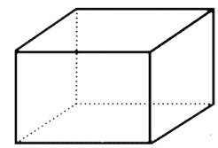
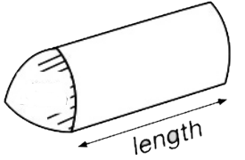
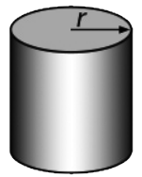
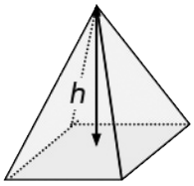
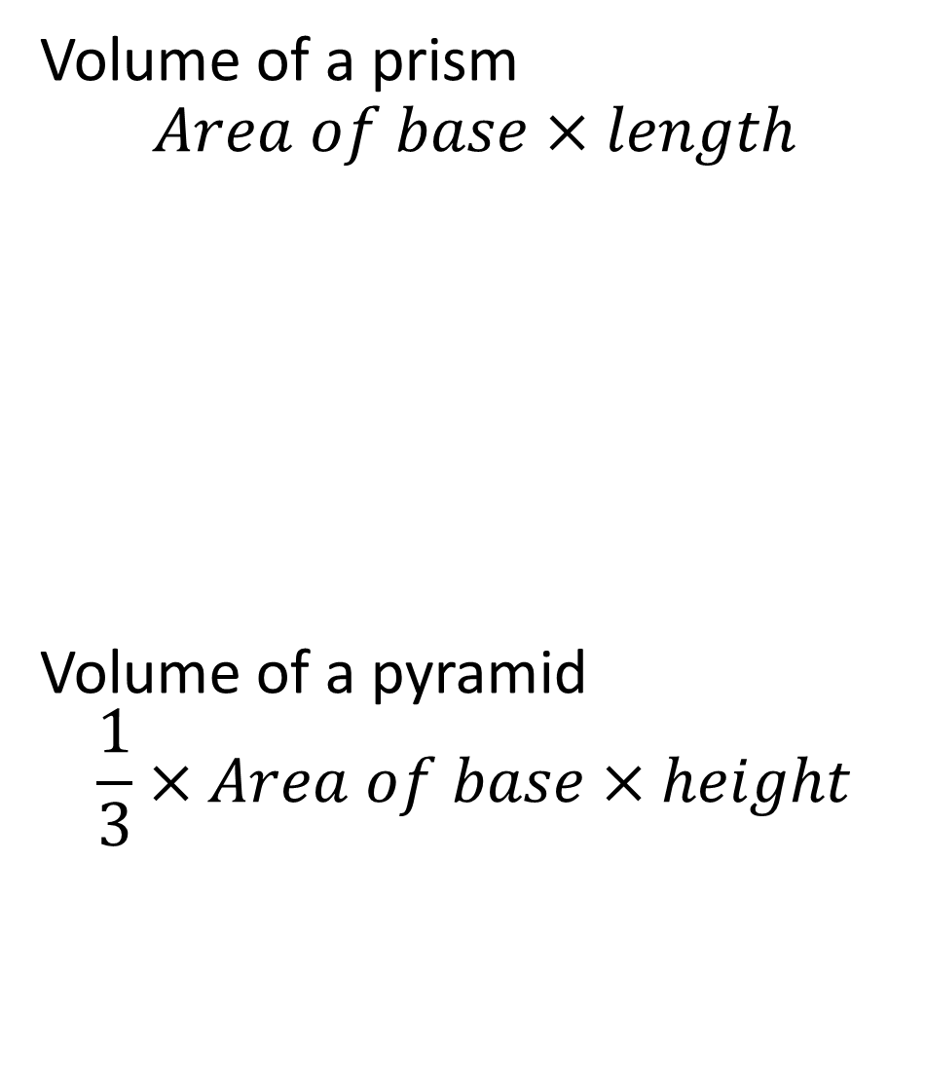





Volume
Volume of a prism
$$Area of base×length$$
Volume of a pyramid
$$\frac{1}{3}×Area of base×height$$
Volume of a cuboid
$bhl$
Volume of a cylinder
$πr^{2}h$
$$h$$
base
$$l$$
$$b$$
$$h$$

