Slide 1
GCSE 2015
Foundation
facts and formulae to memorise

Slide 2


Rules of indices
$$x^{a}×x^{b}=x^{a+b}$$
$$x^{a}÷x^{b}=x^{a−b}$$
$$\frac{x^{a}}{x^{b}}=x^{a−b}$$
$$x^{−a}=\frac{1}{x^{a}}$$
$${\left(x^{a}\right)}^{b}=x^{ab}$$
$$x^{0}=1$$

Slide 3




Trigonometry
For angle $x$, you label up a triangle like this
For angle $y$, you label up a triangle like this
$$x$$
H
A
H
O
$$y$$
O
A

Slide 4
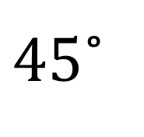

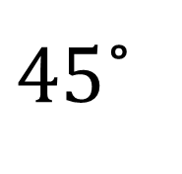

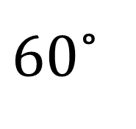

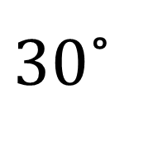
Trigonometry
$$\sin{x}=\frac{O}{H}$$
$$\cos{x}=\frac{A}{H}$$
$$\tan{x}=\frac{O}{A}$$
$30$˚
2
$$\sqrt{3}$$
$60$˚
1
$45$˚
$$\sqrt{2}$$
1
$45$˚
1

Slide 5
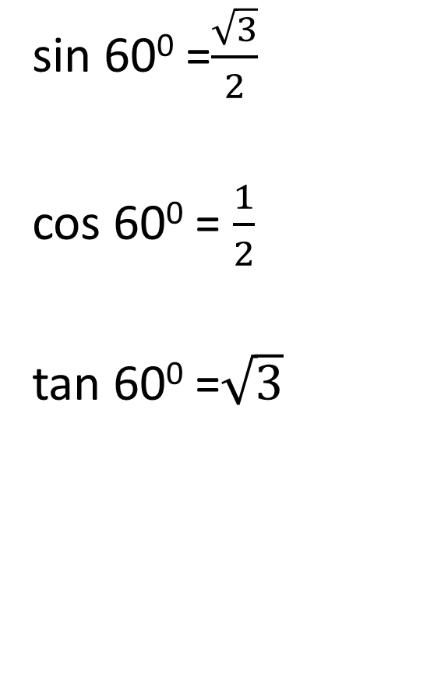
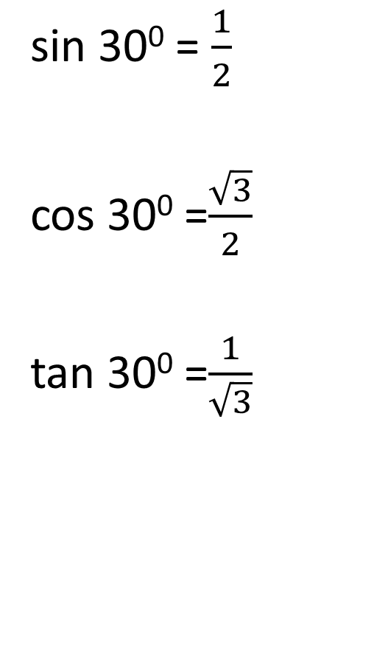
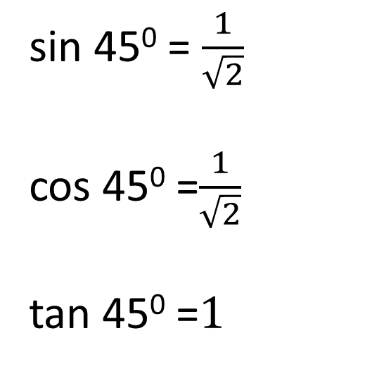
Exact Trig Values
sin 30⁰ = $\frac{1}{2}$
cos 30⁰ =$\frac{\sqrt{3}}{2}$
tan 30⁰ =$\frac{1}{\sqrt{3}}$
sin 60⁰ =$\frac{\sqrt{3}}{2}$
cos 60⁰ = $\frac{1}{2}$
tan 60⁰ =$\sqrt{3}$
sin 45⁰ = $\frac{1}{\sqrt{2}}$
cos 45⁰ =$\frac{1}{\sqrt{2}}$
tan 45⁰ =$1$

Slide 6
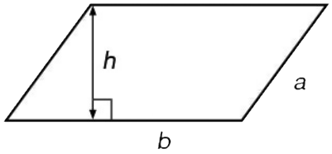
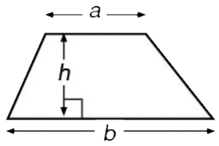
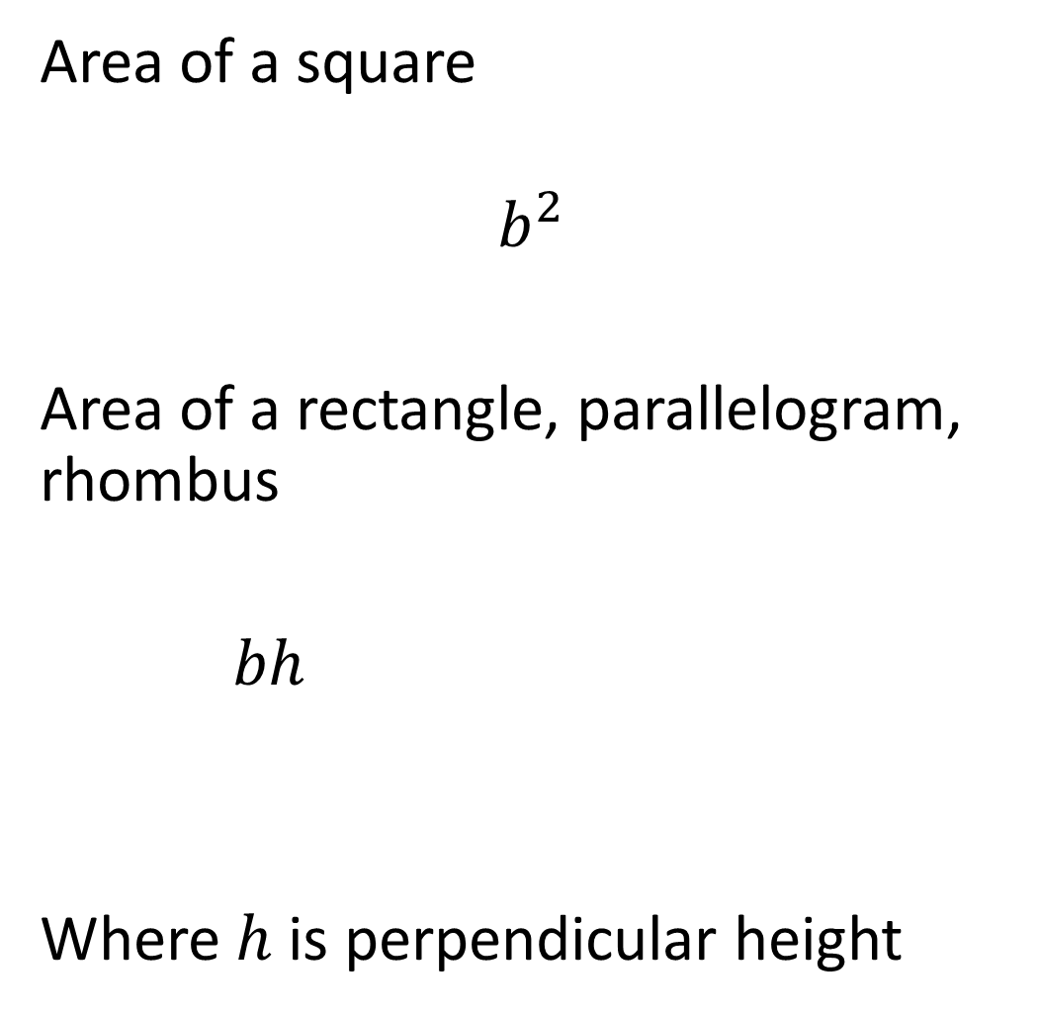

Area
Area of a square
$$b^{2}$$
Area of a rectangle, parallelogram, rhombus
$bh$
Where $h$ is perpendicular height
Area of a triangle
$$\frac{bh}{2}$$
Area of a trapezium
$$\frac{\left(a+b\right)h}{2}$$

Slide 7
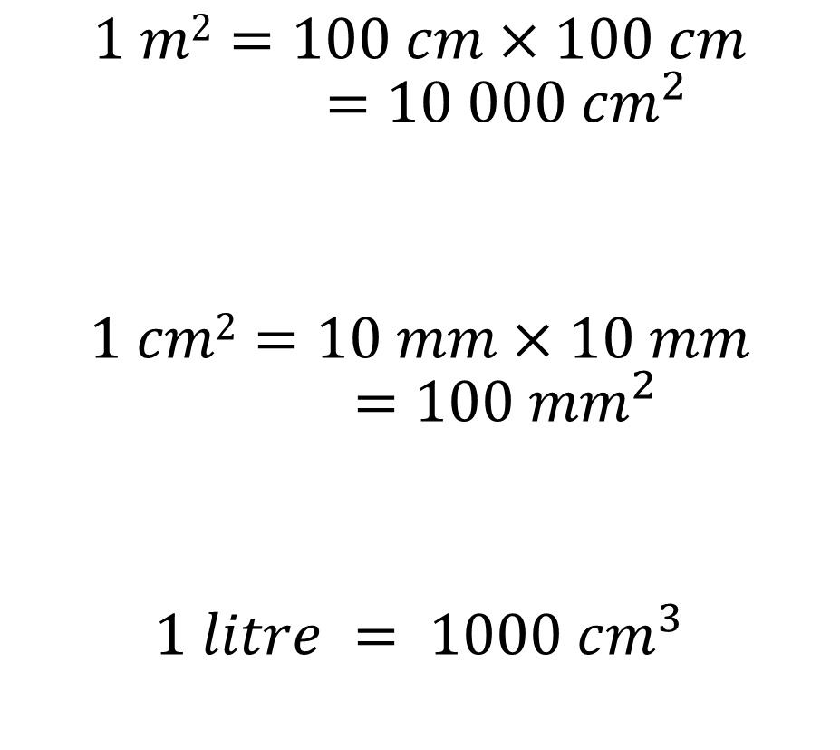
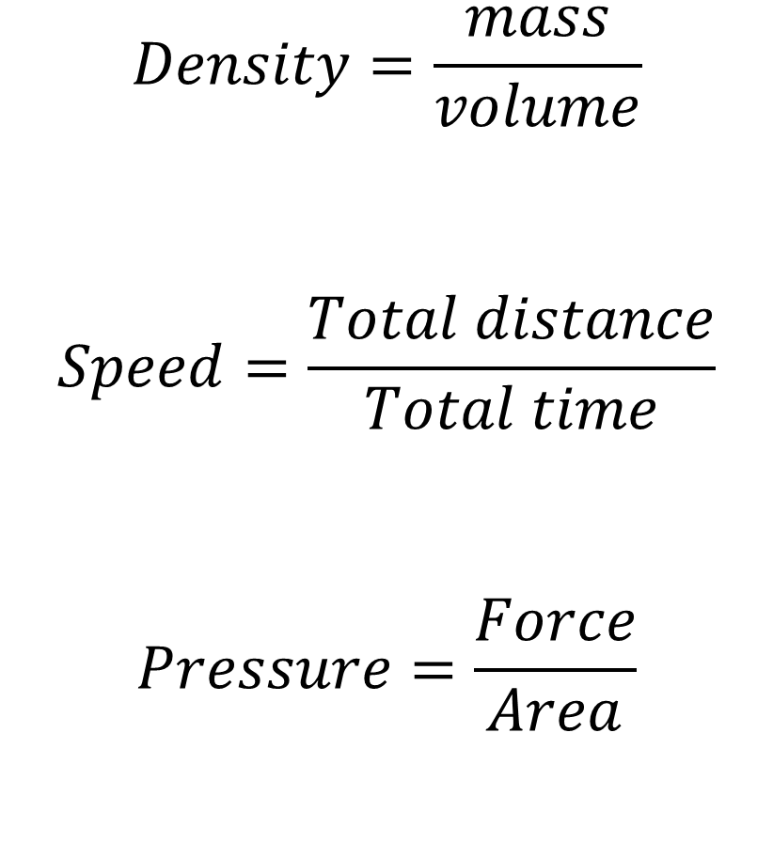
Compound measures
Converting units of measure
$$Density=\frac{mass}{volume}$$
$$Speed=\frac{Total distance}{Total time}$$
$$Pressure=\frac{Force}{Area}$$
$$1 m2=100 cm×100 cm$$
$$=10 000 {cm}^{2}$$
$$1 cm2=10 mm×10 mm$$
$$=100 {mm}^{2}$$
$$1 litre = 1000 cm^{3}$$

Slide 8


Circles
Circle area $πr^{2}$
Circumference $πd$ or $2πr$
Pythagoras’ theorem $c^{2}=a^{2}+b^{2}$
where c is the hypotenuse
c
a
b

Slide 9
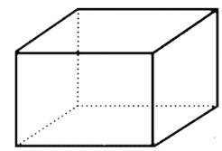
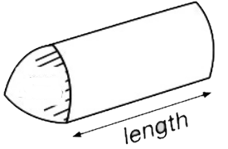







Volume
Volume of a prism
$$Area of base×length$$
Volume of a cuboid
$bhl$
Volume of a cylinder
$πr^{2}h$
$$h$$
base
$$l$$
$$b$$
$$h$$

Slide 10
Angles
Angles on a straight line add up to 180⁰.
Vertically opposite angles are equal.
Angles at a point add up to 360⁰.
Angles in a triangle add up to 180⁰.
Angles in a quadrilateral add up to 360⁰.

Slide 11
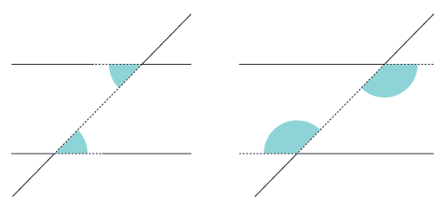
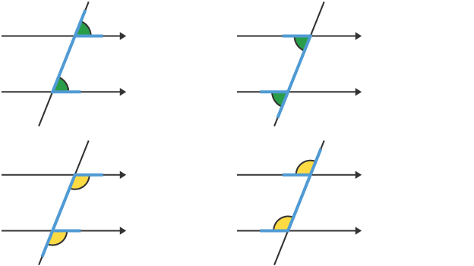
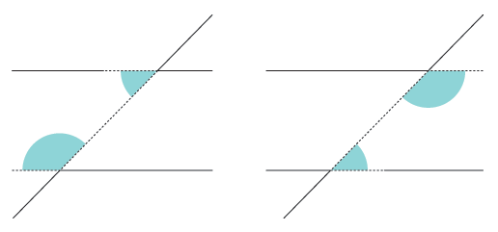
Angles
Angles on parallel lines
Alternate angles are equal
Corresponding angles are equal
Allied angles add up to 180⁰.

Slide 12
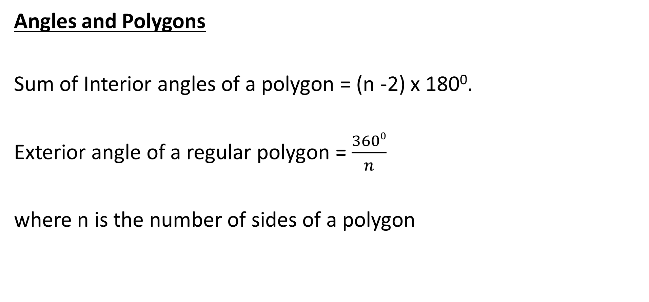
Angles
Angles and Polygons
Sum of Interior angles of a polygon = (n -2) x 180⁰.
Exterior angle of a regular polygon = $\frac{3600}{n}$
where n is the number of sides of a polygon

Slide 13

Straight Lines
The equation of a straight line $y= mx +c$
where $m$ is the gradient and $c$ is the y intercept.
Parallel line have the same gradient

Slide 14
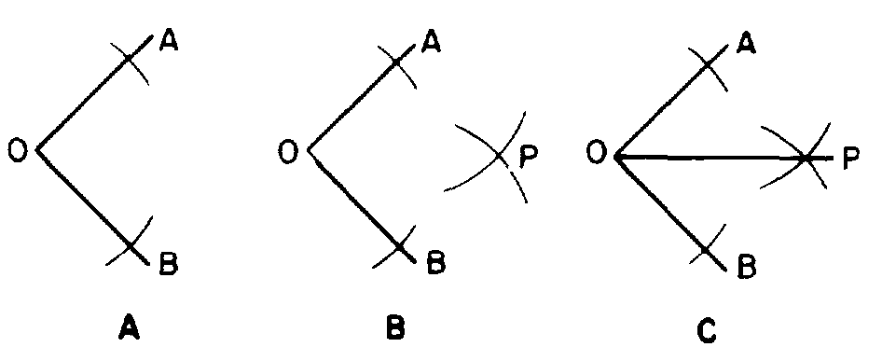
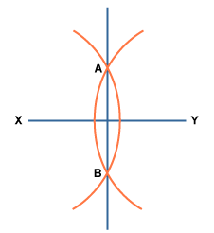
Constructions
Bisect an angle
Perpendicular bisector of a line

Slide 15
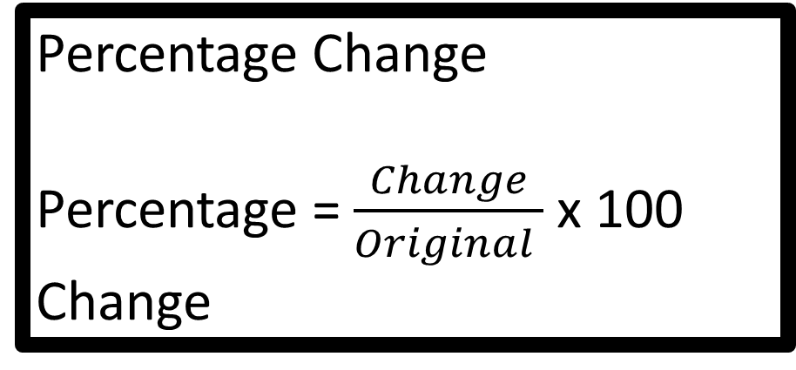
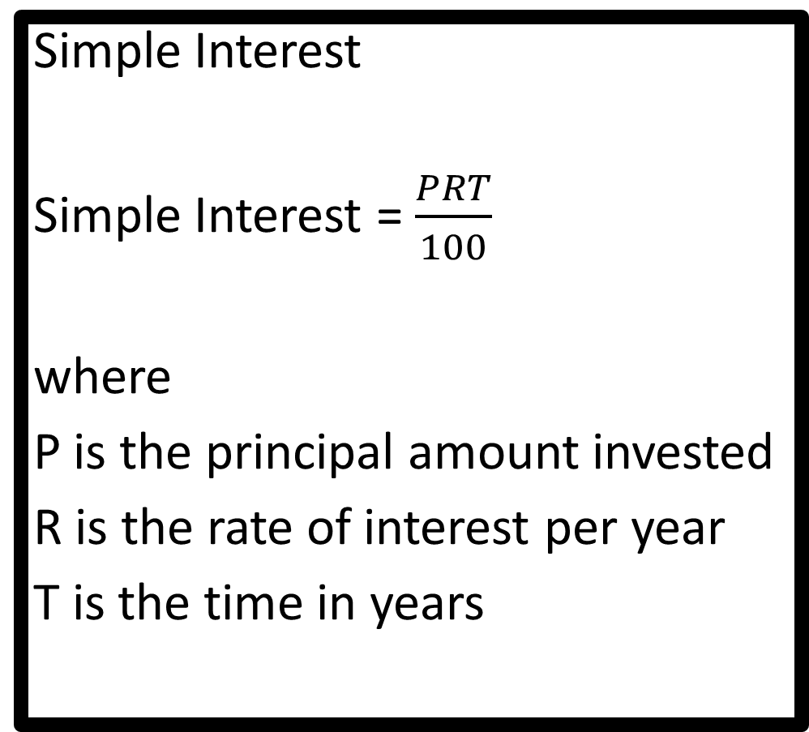
Percentage Change
Percentage = $\frac{Change}{Original }$ x 100
Change
Simple Interest
Simple Interest = $\frac{PRT}{100}$
where
P is the principal amount invested
R is the rate of interest per year
T is the time in years
Compound Interest
Amount at end = A x (MF)^{T}
A is the starting amount
MF is the multiplicative factor or multiplier
T is the time in years

