Slide 1
Early Years Maths Meeting for Parents January 2024

Slide 2
Why is Early Maths Important?
‘Developing a strong grounding in number is essential so that all children develop the necessary building blocks to excel
mathematically.’
‘It is important that children develop positive attitudes and
interests in mathematics, look for patterns and relationships, spot connections, ‘have a go’, talk to adults and peers about what they notice and not be afraid to make mistakes.’
- Statutory framework for the EYFS, gov.uk, updated 2023/24

Slide 3
Early Years Statutory Framework (EYFS)
‘Children should be able to count confidently, develop a deep understanding of the numbers to 10, the relationships between them and the patterns within those numbers.’
‘It is important that the curriculum includes rich opportunities for children to develop their spatial reasoning skills across all areas of mathematics including shape, space and measures.’
- Statutory framework for the eyfs, gov.uk, updated 2023/24

Slide 4
Early Learning Goals (ELGs)
The framework is split into ELGs which are statements that define the expected level of development in each area of the EYFS.
For maths this is split into:
- Number
- Numerical Patterns

Slide 5
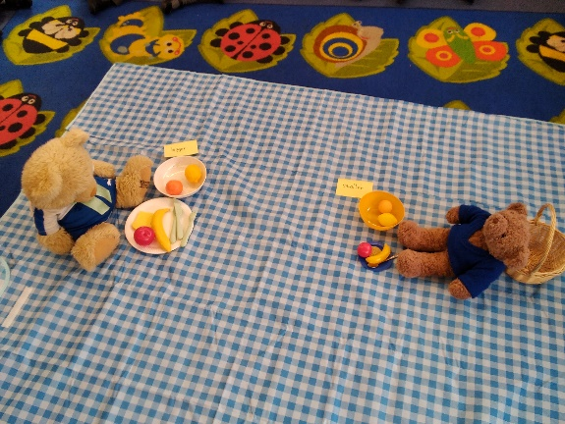
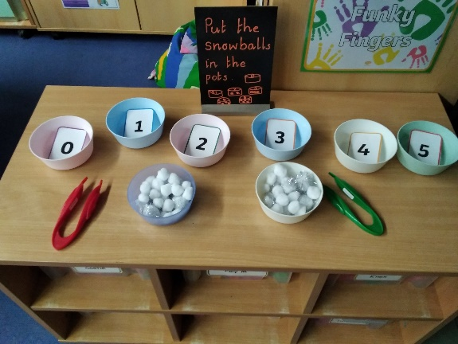
How do we do this?
We plan frequent and varied opportunities for the children to explore.
We allow them to develop a secure understanding, knowledge and vocabulary through the use of concrete objects and stem sentences.
We give them the tools and foundations needed for KS1.
We look at each number in depth, using Numberblocks to support learning.

Slide 6
ELG: Number
Children at the expected level of development will:
Have a deep understanding of number to 10, including the composition of each number
Subitise (recognise quantities without counting) up to 5
Automatically recall (without reference to rhymes, counting or other aids) number bonds up to 5 (including subtraction facts) and some number bonds to 10, including double facts.

Slide 7
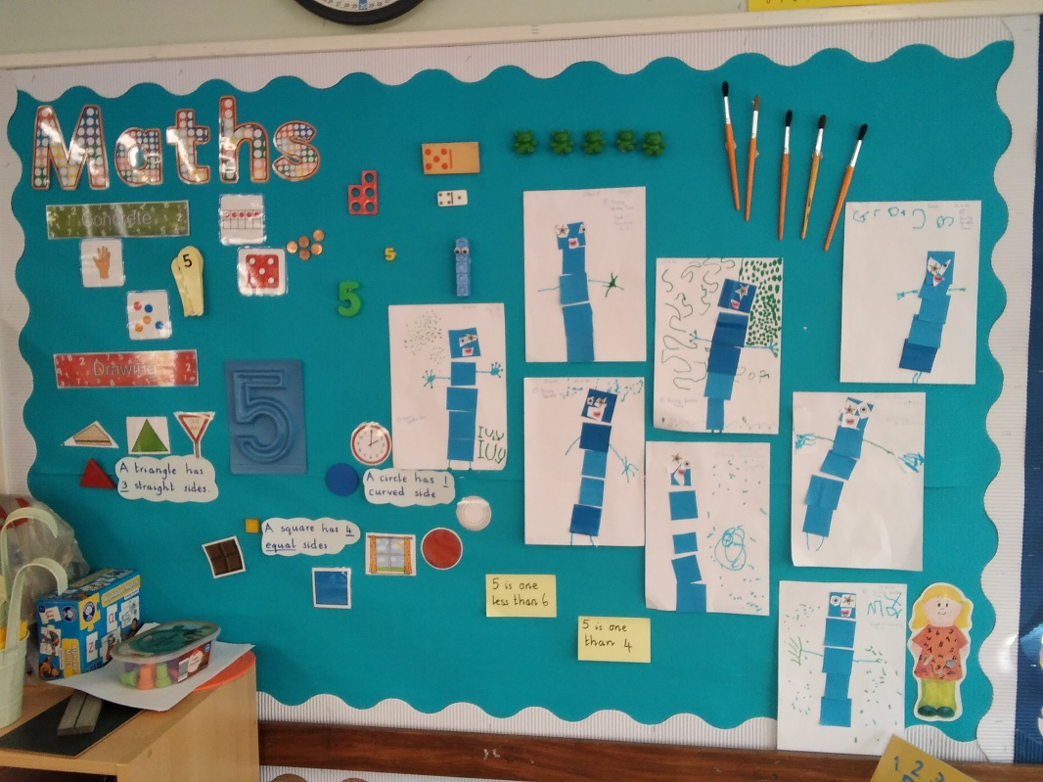
Numbers
Children need to know number names and be secure in recognising numbers to 10 and then beyond
It is important that they understand and can show one-to-one correspondence when counting an amount
They need to able to match numerals to the number of objects

Slide 8
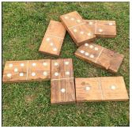
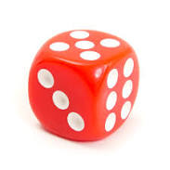
Subitising
Subitising is the ability to instantly recall the number of objects or images without needing to count them individually.
Subitising can help children to build images for numbers, to visualise and to learn number facts

Slide 9
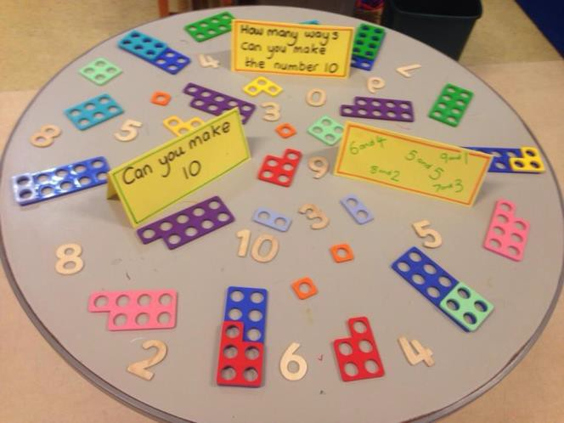
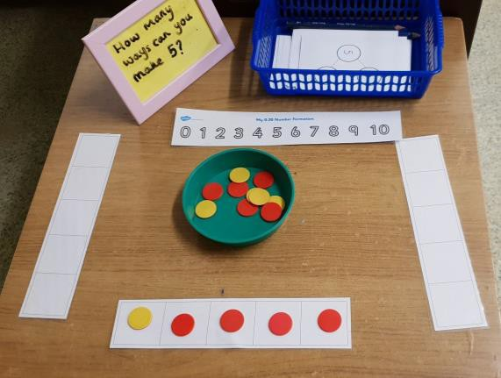
Number composition/ Number bonds
Knowing that numbers have a value and can be made in different ways
Knowing numbers can be made up of two or more other smaller numbers
Learning to ‘see’ a whole number and parts at the same time

Slide 10
ELG: Numerical Patterns
Children at the expected level of development will:
Verbally count beyond 20, recognising the pattern of the counting system
Compare quantities up to 10 in different contexts, recognising when one quantity is greater than, less than or the same as the other quantity
Explore and represent patterns within numbers up to 10,
including evens and odds, double facts and how quantities can be distributed equally.

Slide 11
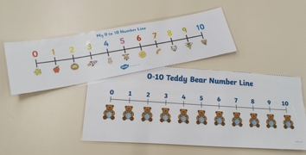
Counting to 10 and beyond
Once children know number names 0-10, they begin extending to larger numbers
Being able to count verbally to 20 and then to 30 is important to prepare the children for Year 1

Slide 12
Cardinal Value
The cardinal value of a number refers to the quantity of things it represents
Knowing the last number counted gives the total so far

Slide 13
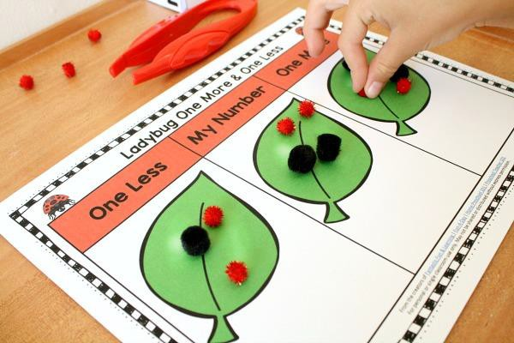
Comparing numbers
Comparing numbers involves knowing which numbers are worth more or less than each other
More than/Less than
Knowing the ‘one more than/less than’ relationship between sequential numbers

Slide 14
Explore and represent number patterns
Developing an awareness of pattern helps young children to notice and understand mathematical relationships
Evens and Odds
Doubling
Sharing and grouping

Slide 15
Repeating patterns
Make patterns with varying rules – e.g. AB, or ABB, ABBC.
Patterns can be made with objects e.g cubes, small toys, outdoor materials, movements and sounds
Printed patterns

Slide 16
Shape, space and measures
Positional language – in, on, under, up, down, across
shape properties – describing and comparing 2D and 3D shapes
Comparing weight, length and capacity e.g ‘shorter’
‘taller’ ‘long’ ‘full’ ‘empty’ ‘heavy’ ‘light’
Time – comparing the time it takes to complete activities

Slide 17
Reasoning
Reasoning, by asking the children to explain their ideas,
is an important part of development. It helps them to organise their thinking and gives us an insight into their knowledge and understanding of the concepts taught in maths.
We constantly ask the children, ”How do you know?”

Slide 18
Math Sessions – How are they delivered?
15-20 Minutes
Counting – e.g. number songs
Quick starter game – e.g. subitising, number recognition
Introduce new learning
I – Teacher to model first
We – Teacher to model with the class, with LSA support
You – Individual work, pairs, small groups, enhanced and continuous provision (Sparkle Time)

Slide 19
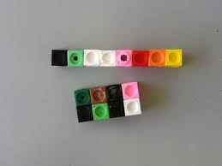
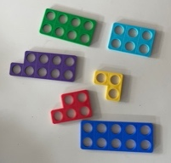
Concrete, Pictorial & Abstract
A Concrete Pictorial Abstract (CPA) approach
attempts to help
improve the understanding of topics
5+1=6

Slide 20
Common Misconceptions
Counting - Missing out an object or counting an object twice
Saying a teen number instead of a tens number e.g saying, thirteen instead of thirty
Comparing – Children not comparing the quantity within a group of objects but considering the size of the objects

Slide 21
How can you help at home?
Play games which involve counting, like snakes and ladders
Sing counting songs
Talk to children about groups of everyday objects and talk about how
many are in that group - who has more? Who has the bigger group?
Counting in their everyday routine, how many toys did you tidy
away?
Draw their attention to time, how long will it take for the cake to bake in the oven?
Encourage activities that develop shape awareness e.g building blocks,
shape puzzles etc.
Play games which involve quickly revealing and hiding numbers of
objects. When you play these games, encourage children to keep track
of the score using dots, a tally or numeral cards.

