Slide 1
Keep Calm and Make Music
Weekly Wonder
Sound Seekers
Carnival of the Animals

Slide 2
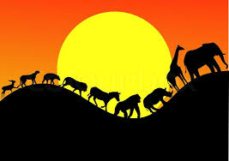
Sound seekers
Mini sound explorations and discoveries

Slide 3
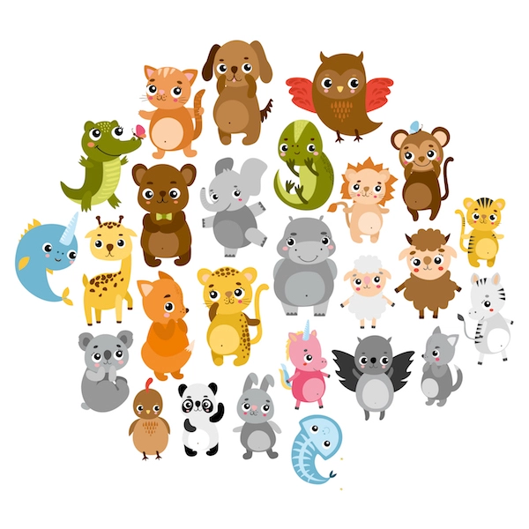
Call of the Wild
How many animal sounds can you already make?
Make a list and categorise them for e.g.
loud / quiet sounds
long / short sounds
high / low sounds
If you can, record your sounds on a phone / iPad / tablet
Try them out and see if other people can recognise them

Slide 4
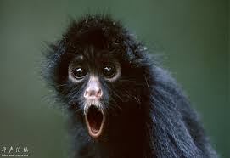
Call of the wild
Investigate new animal sounds
start by checking out these websites
soundboard animals
animal sound effects
animal sounds
see if you can echo /match them
Add the sounds to your list and categorise them by one of their qualities (loud/quiet, long/short….)
If you can, download the sounds you find and create an animal sounds quiz to match sounds and pictures together
You could try telling a story and adding your sound effects to it

Slide 5
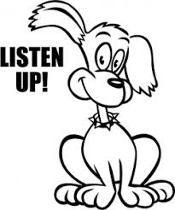
Some people are amazing at mimicking animal sounds….
Animazing!
And sometimes animals can sound like humans
Grumpy Nanny Pretty Polly
Sometimes composers use animal sounds in their music - check out this duet inspired by Rossini in the late 1800s
Meow!
And this piece Called Waltzing cats by Leroy Anderson
Meow 2!
Do you think these 2 cats are friends?
Listen for the violin meows

Slide 6
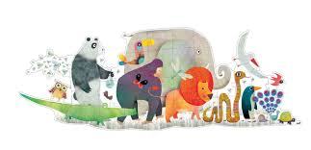
Carnival of the Animals Camille Saint-Saens
The French composer Camille Saint-Saens composed this piece in 1886
It is a set of 14 little pieces and lasts for about 25 minutes
This clip Carnival of the Animals
is the whole piece which you can listen to if you have 25 minutes now……..
or you could listen to specific sections

Slide 7
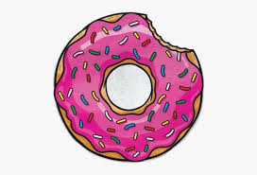
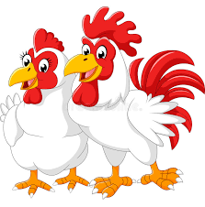
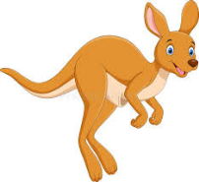
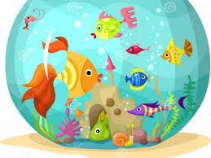
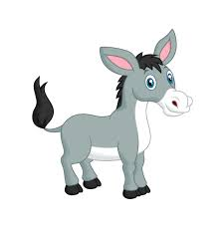
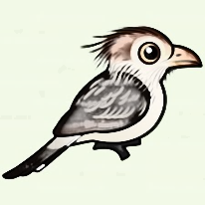
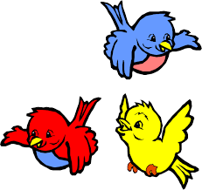
Carnival of the Animals bite size
Section 2 – Hens and Roosters (at 1 min 50)
Listen for the pecking and clucking sounds, find something to make clucking / pecking sounds with
Section 6 – Kangaroos (at 6 mins 33)
Hear the kangaroos hopping around, make your fingers hop up and down your arm in time to the music
Section 7 – Aquarium (at 7 mins 30)
Imagine the different fish in an aquarium, move your hand like a fish darting in and out of the rocks, listen to the watery sounds, blow bubbles while listening to the music, fill a clear bottle with water and glitter and swirl it around while you listen
Section 8 – Persons with Long Ears (at 10 mins)
Listen for the Hee-haw sounds, flap your hands like ears each time you hear them. What happens to the sounds?
Section 9 – Cuckoo (at 10mins 45)
Listen out for the cuckoo in the woods – how many times do you hear it call? Can you echo the Cuckoo call?
Section 10 – Aviary (at 13 mins 12)
Imagine all the birds flying around the aviary. If you have room, move around as if your were a bird. Draw a picture showing as many different birds as you can, find a feather and see how It feels on your arm. Try drawing with a feather tip
Carnival of the Animals

