Slide 1
Keep Calm and Make Music
One Hit Wonder Workshop
Sound Seekers – Rhythm of Life

Slide 2
Sound seekers
Mini sound explorations and discoveries

Slide 3
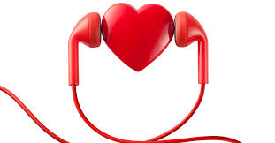
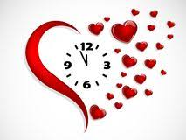
Rhythm of life
Find a place to be really quiet and find your heart beat
Listen to it, feel it beating
Tap your feet in time to your heart beat
Run up and down the stairs / on the spot / around your garden for 30 seconds – 1 minute
Find your heart beat again – feel it, tap it – what do you notice?
Try breathing in for 4 heart beats and out for 4 heart beats
Try breathing in and out for a longer count of heart beats – what do you notice?

Slide 4
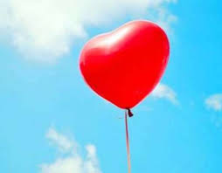
Beating and Breathing
Our heart beat and our lungs breathing are our natural body rhythms
When we exercise they speed up, when we’re calm they slow down
Listen to this song, listen for the heart beats at the beginning (introduction) and at the end (coda)
Try singing along with the song
Try adding a steady tapping beat as you sing
Try adding steady movements while you sing
e.g. arms up / down to the count of 4, arms left / right to the count of 4

Slide 5
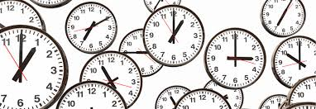
Make each second count
Find a ticking clock
Tap in time to the ticks
Walk around your room in time to the ticks
What else could you do in time to the ticking clock?
Is there anything else you can find that makes a regular / steady beat like your heart or a clock?

Slide 6
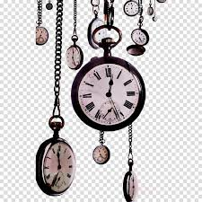
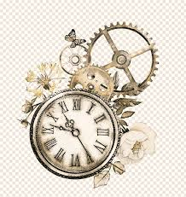
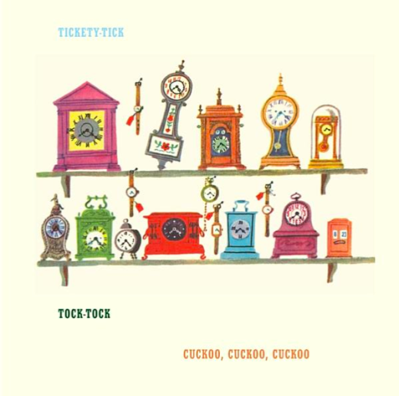
Tick tock…
Find a piece of paper and fold it in half
Write Clockwork on one half and Clocks on the other
Try drawing or writing underneath each heading while you listen to each piece in turn
Listen to the first piece - clockwork by Philipp Klein
Listen for the clock sound, can you hear the ticking all the way through?
What happens at the end?
Now listen to this music – clocks by Guru Prasanna
How is it different to the first piece?
How does it start / finish?

Slide 7
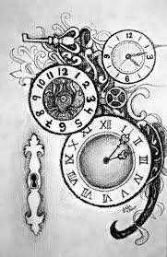
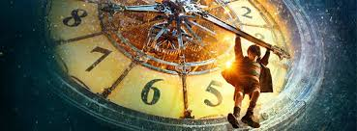
…and now….
Which one did you prefer?
Can you say why?
Can you find any other music inspired by clocks? Perhaps you could do some research and make a poster to share with someone else…or make your own power-point presentation to send to someone?
There is a fabulous film called Hugo which features a clockmaker – see if you can find it and watch it
(Pssst – here is a sneak preview…Hugo)

