Slide 1


Keep Calm and
Make Music
Weekly Wonder
WW 2 - The Blitz - KS2

Slide 2
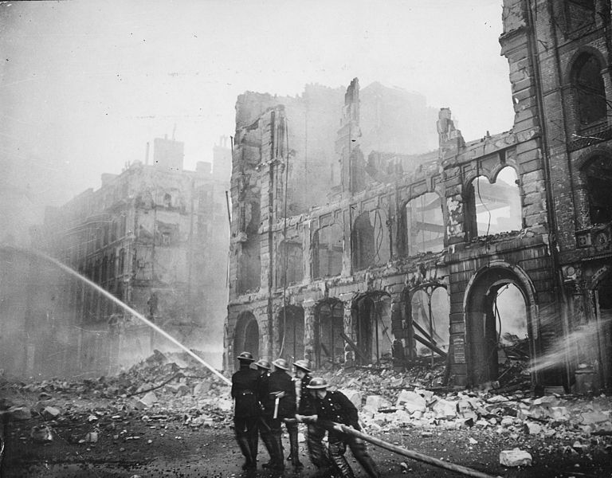
WWII - The Blitz
WW2 – The Blitz

Slide 3
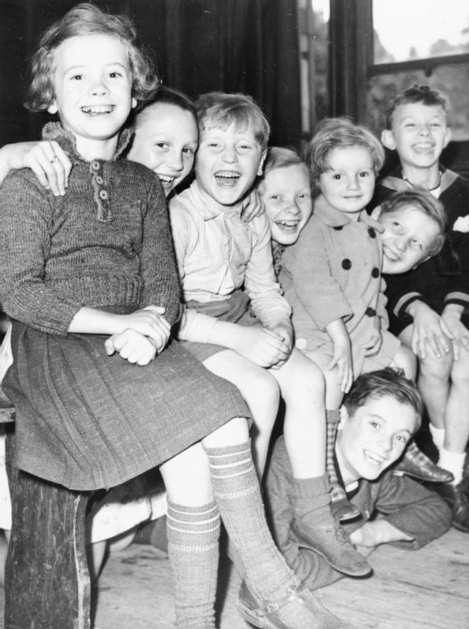
When You’re a Kid in WW2
Click on the link below to view the images as you listen to the song: When you're a Kid in World War 2
Listen again and keep the steady beat
along to the song (it is in 4 metre,
that means count in 4s – 1, 2, 3, 4)
You could try clicking or clapping
just on beat 2 and beat 4 (these
are called the “off” beats)
Finally sing along with the children
- when you feel confident you could
perform the song to your family

Slide 4
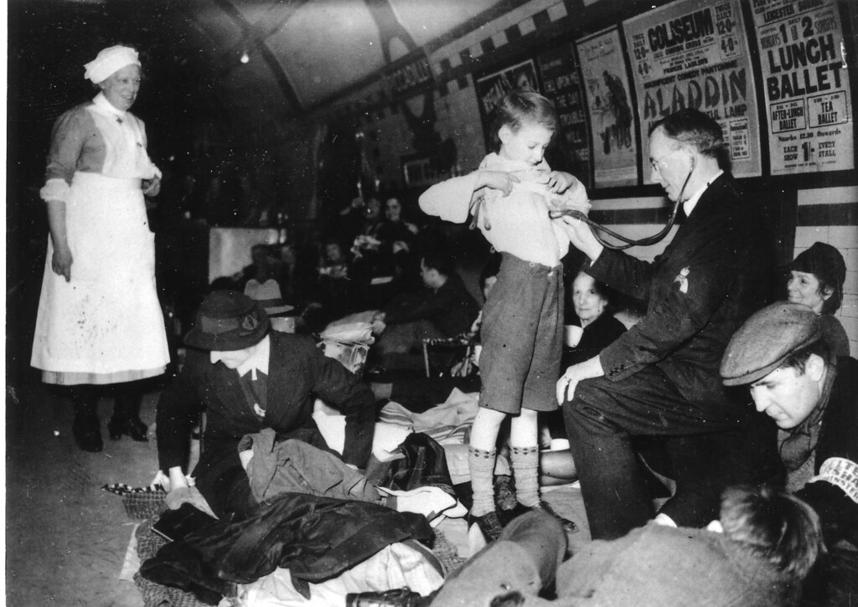
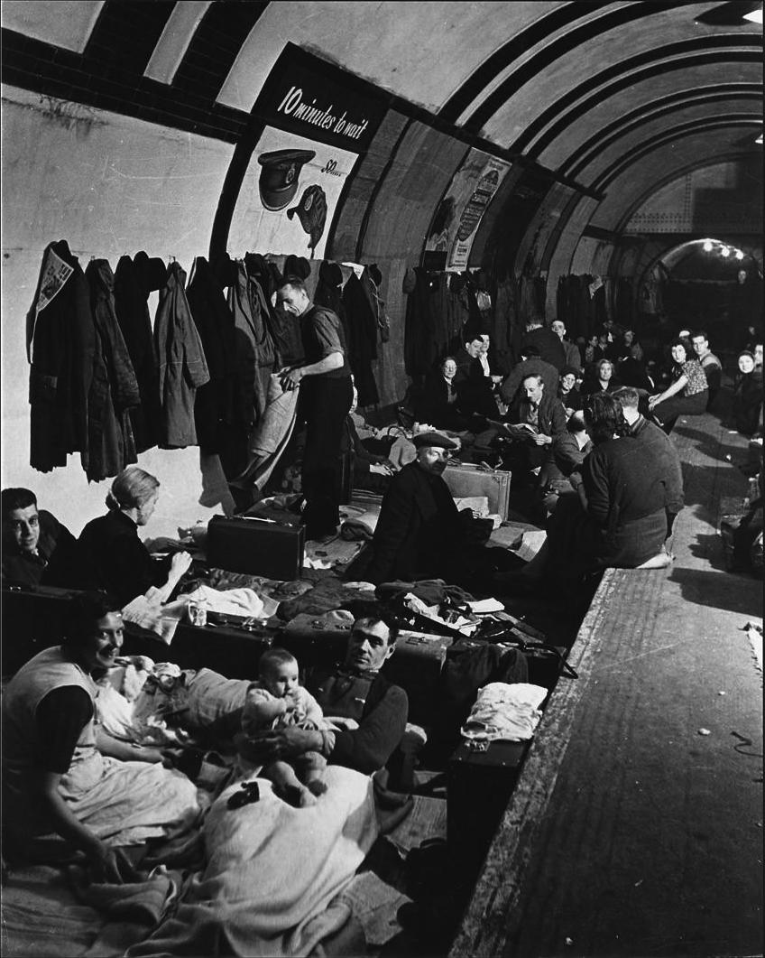
Families in London staying safe
seeing the doctor and sleeping
on the underground platforms!
Do you think they sang songs to keep
their spirits up?

Slide 5
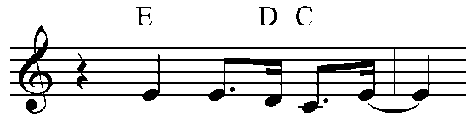
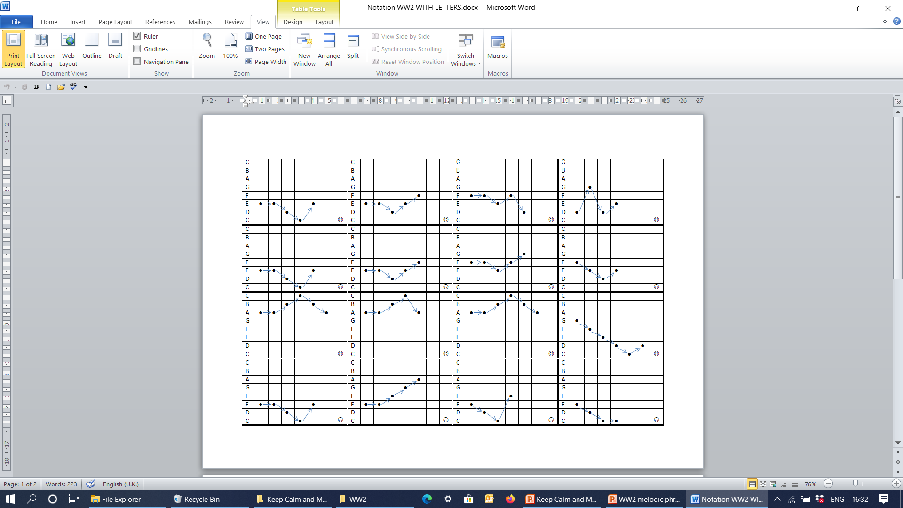
Can you play part of the tune?
(optional activity)
To play part of the tune you will need the notes of the C major scale
C D E F G A B and high C - these are the white notes on a piano or
keyboard from middle C up to the next C
(If you haven’t got a keyboard or piano you could try playing on a virtual piano
or find a free app on an ipad or iphone – find a link for a virtual piano on slide 7
and suggestions for instrument apps on slide 8
The first phrase “No lights in the streets” uses the
notes E E D C E and looks like this in stave notation
In grid form the notes of the tune can be written like
this. Can you play it?
How about the next phrase “Two ounces of
sweets”? (E E D E F)
(The full sequence of notes for most of the tune is written in grid form on the next slide if want to have a look at it)

Slide 6
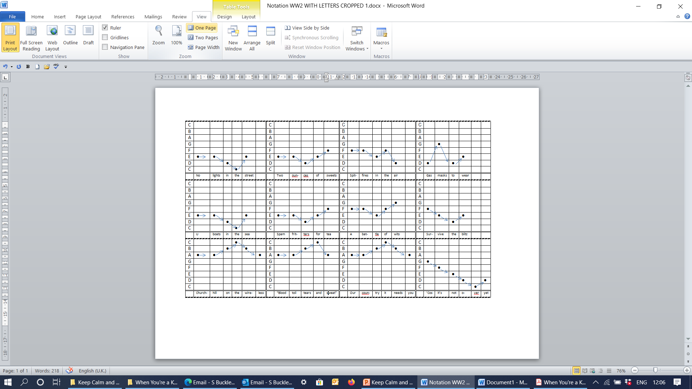
When You’re a Kid in WW 2
Here is the sequence of notes for the first 12 lines of the song
Can you match the tune to the lyrics for the rest of the song - the tune above is repeated almost exactly apart from the lines “Who knows what’s in store? and “When you’re a kid in WW 2”?

Slide 7
Here is an online musical instrument site to explore
Follow this link to a virtual piano which you can use to play the tune. Find E4 in the middle of the keyboard – the note name will appear in the mini screen / window on the piano
(E is the white note to the right of the two black keys)
“No lights in the street” is E4, E4, D4, C4, E4 – you need to play the rhythm of the words in the song to make it sound right!
If you click the SOUNDS button on the piano you will be able to choose different types of sounds to try – Have fun!

Slide 8
Apple Apps
If you have an iPhone or iPad you could use some of these free apps:
Marimba, Xylophone, Vibraphone
V Piano Synthesizer Audio Beat
Garage Band

Slide 9
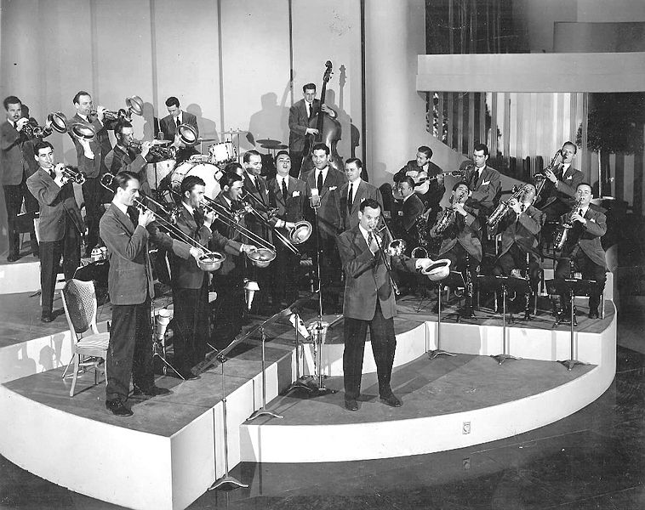
Meet Glenn Miller and his Big Band
What instruments can you see?

Slide 10
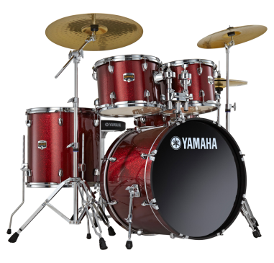
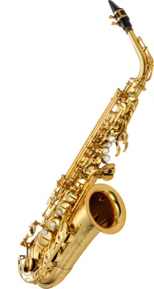
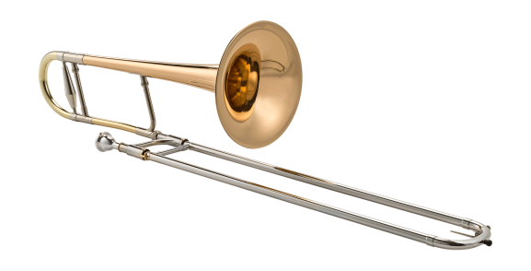
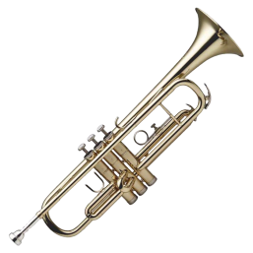
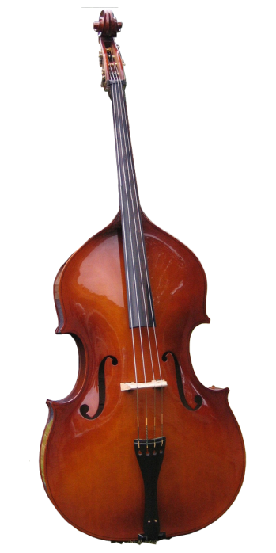
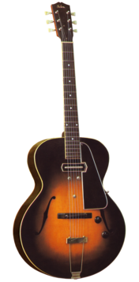
Glenn Miller
Glenn Miller was the best-selling recording artist from 1939 to 1943, leading one of the best-known big bands
In just four years Glenn Miller had 23 number-one hits - more than Elvis Presley (18 No. 1s, 38 top 10s) and the Beatles (20 No. 1s, 33 top 10s) did in their careers.
While he was traveling to entertain U.S. troops in France during World War II, Miller's aircraft disappeared in bad weather over the English Channel and was never found.
Listen to In the Mood by Glenn Miller and his band? Does it sound familiar?
(the tune is used for the introduction of When you’re a kid in WW2)
Listen to and join in with the words and the actions with a modern day song called Hey Mr Miller also based on the tune of In the Mood

Slide 11
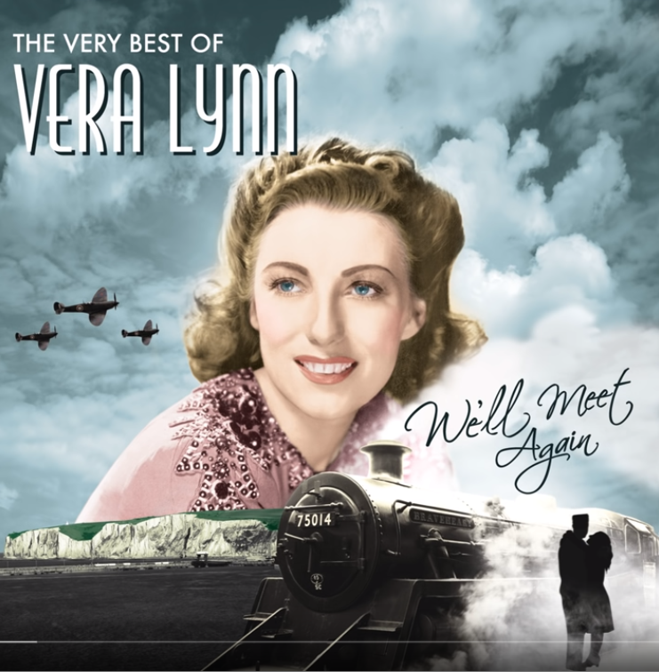
Sing along with Vera Lynn
Dame Vera Lynn (born in 1917) is an English
singer, songwriter and actress, whose musical
recordings and performances were enormously
popular during the Second World War
She was known as the “Forces’ Sweetheart” for giving outdoor concerts for the troops during World War 2
Follow the link below to one of her most famous songs
We'll Meet Again and enjoy singing along

Slide 12
WWII - The Blitz
We will meet again!

