Slide 1
RECEPTION INFORMATION EVENING
Information for Parents
“I will instruct you and teach you in the way you should go; I will counsel you with my eye upon you.” Psalm 32:8

Slide 2
MORNING/ END OF DAY ROUTINE
NO PARKING
RECEPTION CHILDREN COME THROUGH EAST ROAD GATE FROM 8.35AM. WALK INTO THE PLAYGROUND AND DROP OFF YOUR CHILD TO AN ADULT AT THE WELCOME BACK BANNER.
YOUR CHILD WILL LINE UP WITH MRS LEE, TA’S AND THE OTHER CHILDREN IN THEIR CLASS. ONE MEMBER OF STAFF WILL BE AVAILABLE TO TALK TO AFTER YOU HAVE DROPPED YOUR CHILD OFF.
CHILDREN BRING IN PE BAGS / BOOK BAG/COATS / LUNCH BOXES IF NEEDED
PARENTS TO EXIT USING BIG GATE AT TOP OF PLAYGROUND
GATES CLOSE AT 8.45AM.
CHILDREN CHOOSE LUNCH ON PARENTPAY IN THE MORNING
CHILDREN BRING OUT BELONGINGS AND LINE UP ON PLAYGROUND
PARENTS WAIT ON THE PLAYGROUND FOR RECEPTION TO BE CALLED
REC CHILDREN (AND SIBLINGS) WILL BE SENT TO YOU
EXIT VIA BIG GATE AS IN THE MORNING

Slide 3
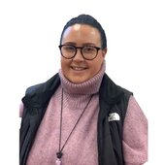
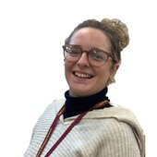
STAFF YOUR CHILD WILL TALK ABOUT
Mrs Lee
Miss McShane
Miss Conroy

Slide 4
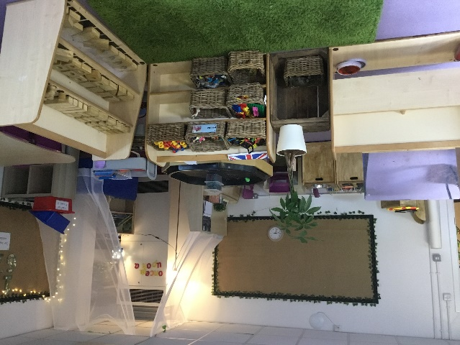
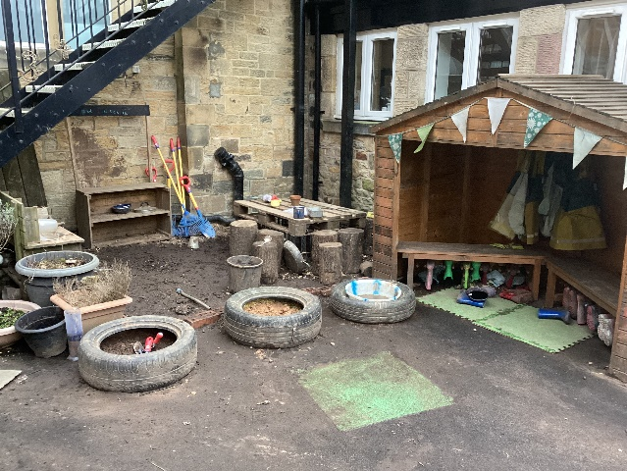
A DAY IN THE LIFE OF RECEPTION
 |  | Phonics Number Rhymes/songs Writing Continuous provision RE
Indoor classroom | Outdoor classroom

Slide 5
A DAY IN THE LIFE

Slide 6
HOME LEARNING
Reading and phonics activities
Link and learn books
Sharing other stories
Talk, talk, talk

Slide 7
HOME LEARNING
Practise phonics, spellings,
Listen to your child read
Read to and with your child
Talk about books. Ask questions
Encourage wider reading
Ensure work done at home is of a good standard
CHILDREN MAKE THE MOST PROGRESS WHEN PARENTS SUPPORT THE WORK OF A SCHOOL

Slide 8
READING
Home reading and Guided reading
Early Learning Goal – Word Reading:
Say a sound for each letter in he alphabet and at least 10 digraphs; read words consistent with phonics knowledge by sound-blending; read aloud simple sentences and books consistent with phonics knowledge, including some common exception words.
Early Learning Goal – Comprehension:
Demonstrate understanding of what has been read to them by retelling stories and narratives using their own words and recently introduced vocabulary; Anticipate – where appropriate – key events in stories; Use and understand recently introduced vocabulary during discussions about stories, non-fiction, rhymes and poems and during role-play.
Create good reading habits from day 1…

Slide 9
Phonics
Phase 1-tuning into sounds
Phase 2-single sounds
Phase 3-digraphs and trigraphs
Phase 4-reinforcing blending

Slide 10
Good habits

Slide 11
First 3 steps to becoming a good reader...
Step one- become familiar with the book. Get an overall feel for the book, look at the pictures, discuss what you can see. Do you recognise any familiar characters or settings? Do you automatically recognise any words in the text?
Step two -decode the text. One page at a time decode, word by word re-reading every sentence. This step may need to be repeated several times before the child can confidently read the story. Your child will only get books with phonemes and tricky words they have covered in class until they finish Letters and Sounds. For most children this is until the end of KS1.
Step three -so what was that all about? Talk about the story, retell it in your own words. Give and seek opinions, chat about the good bits.

Slide 12
WRITING
Early Learning Goal:
Write recognisable letters, most of which are correctly formed; Spell words by identifying sounds in them and representing the sounds with a letter or letters; Write simple phrases and sentences that can be read by others.

Slide 13
HANDWRITING
Nelson handwriting scheme

Slide 14
Number
Early Learning Goal - Number:
Have a deep understanding of number to 10, including the composition of each number; Subitise up to 5; Automatically recall number bonds up to 5 and some number bonds to10, including double facts.
Early Learning Goal – Number Pattern:
Verbally count beyond 20, recognising the pattern of the counting system; Compare quantities up to 10 in different contexts, recognising when one quantity is greater than, less than or the same as the other quantity; Explore and represent patterns within numbers up to 10, including evens and odds, double facts and how quantities can be distributed equally.

Slide 15
PE
Monday (hall time)
Daily outdoor learning and gross motor sessions
Named PE kit – What happens if no kit?
No earrings
Hair
Inhalers

Slide 16
Inclusion
Inclusion manager role
Provide additional support-what that looks like
Nurture support
Sensory room
Concerned - contact s.benson@cathedral.lancs.sch.uk

Slide 17
ATTENDANCE
Whole school target of 97%
PA – 95%
Half termly updates
Must be in school before 8.45am
No holidays authorised
Proof of medical – if in doubt, send them in; we can always call if they are ill

Slide 18
ParentPay
Once your child starts full time you will receive an activation letter for Parent Pay, our cashless payment system.
Must register online to activate account
Limit cash if possible.
Lunches ( Reception lunches are free) / Breakfast / After school payment must be kept up to date and paid in advance
Trips and paid clubs can be paid on Parent Pay and must be paid before the visit takes place.
No need to sign a permission slip for trips if paid on Parent Pay for before the trip goes ahead

Slide 19
Breakfast and After school club.
After school club: 3.15-6pm-collect from front door
Breakfast club: 7.45 till 8.45am-drop off at front door
Bookings can be made by ringing the office or emailing bursar@cathedral.lancs.sch.uk and having your child’s name put on a register. There are limited places and you MUST book 24 hours in advance. Unless your child’s name is on the register they can’t attend the club.

Slide 20
Communication
PARENT APP-this is our communication App that is essential. All letters and notifications go out on this.
Once full time download the app PA connect APP.
www.cathedral.lancs.sch.uk
Regularly updated
Class page and blog
Parent’s section

Slide 21
Communication
Share email address – 2 email addresses
Write a letter to the class teacher
Phone for an appointment
PARENT MAIL – NEWSLETTERS ETC
CLASS NEWSLETTERS
PARENTS EVENING
REPORTS – INCLUDING INTERIM

Slide 22
PTA
Activities
Frequent PTA disco nights
Table top sales
Christmas and Summer fairs
Family food nights
PTA 100 club
Fundraising (events and grants)

Slide 23
Practicalities
Names-very important!
Ore-school list-please add to your child’s name
Getting to know about your child-transition meeting-telephone/visit
Induction visits-sign up for 2
Monday 26th June 9.30-11.00am Tuesday 27th June 1.00-2.30pm
Wednesday 28th^{th} June 9.30-11.00am Thursday 29th June 1.00-2.30pm
PLEASE COME AND FIND US IF YOU HAVE ANY QUESTIONS

