Slide 1
YEAR ONE INFORMATION EVENING
Information Evening for Parents SEPTEMBER 2023
Unlocking potential together in Faith and love

Slide 2
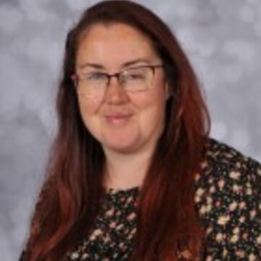
STAFF YOUR CHILD WILL TALK ABOUT
Miss Whitaker Mrs Cook Mrs Milford Miss Duddy
Wednesday afternoon Wednesday morning
Thursday Monday
Friday Tuesday

Slide 3
A DAY IN THE LIFE OF YEAR 1

Slide 4
HOME LEARNING
Daily reading – record/initial in reading record. Read books 3 times - the first ‘read’ is only looking at the pictures and discussing them. The second read is for decoding. The third read is for fluency and comprehension. You don’t have to read the whole book or a ‘whole read’ in one night, but please write in the record where you are up to.
Tricky Words book – we will regularly test your child on whether they can read and spell the words in their book. If they can, then they will receive the next set to learn. Please help your child to learn them at home!

Slide 5
Complete Tricky Words practice
Listen to your child read
Talk about books your child enjoys reading. Ask questions
Read to and with your child
Encourage wider reading
Ensure work done at home is of a good standard
CHILDREN MAKE THE MOST PROGRESS WHEN PARENTS SUPPORT THE WORK OF A SCHOOL

Slide 6
MATHS
Children in Year 1 begin by consolidating their understanding of numbers to 20, then over the year this develops into learning numbers up to 100 and over. The children will gain an understanding of Place Value with tens and ones.
They will learn simple addition and subtraction, and number bonds up to 20. Doubling and halving, plus finding halves and quarters of a quantity. We begin learning about time, measuring minutes and seconds and telling the time to the hour and half past.
The times tables we learn are the 2s, 5s and 10s.

Slide 7
ENGLISH
In Year One, the children are learning to write short sentences by following these steps: thinking of what they want to write, then saying the sentence out loud, then using their Phonics to write it down and read it back to themselves.
Phonics is a huge focus, and we teach it every day. This involves teaching the children all the different sounds in our language and the different ways of spelling them and blending them together to form words. We also teach tricky words that can’t be sounded out.
Guided reading is part of our daily timetable. In Year One, children are learning how to read and to understand what they are reading. Guided reading is a mix of activities to develop children’s reading skills.
Children must read every night with an adult.

Slide 8
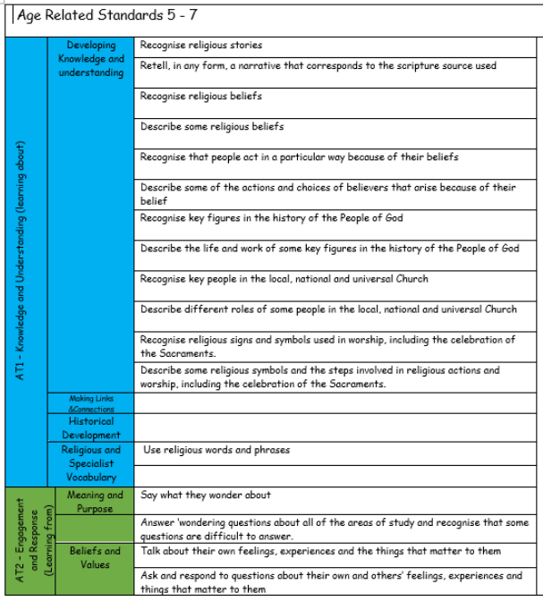
R.E.
In Year One, the children learn a variety of topics including our Church and Parish, Baptism, Christmas, Lent, Pentecost.

Slide 9
SCIENCE
In Year One, the following Science topics are covered:
Human body
Materials
Animals
Plants

Slide 10
TOPICS
Autumn 1 – ‘Family Album’
Autumn 2 – ‘Fire! Fire!’
Spring 1 – ‘Penguins, Pigs and Possums’
Spring 2 – ‘Growth and Green Fingers’
Summer 1 – ‘The Great Outdoors’
Summer 2 – ‘Robots’

Slide 11
PE
Tuesday
PE kit is needed for every lesson.
Earrings need to be either taken out or have plasters on.
HAIR – hair that is shoulder length or longer should always be tied up.
INHALERS – if your child needs an inhaler, please ensure they have a labelled, in-date inhaler in school at all times.
Please label your child’s kit!

Slide 12
ENRICHMENT
This year we are planning the following enrichment activities:
Trip to Judges Lodgings Cottage and Schoolroom in Autumn 1.
Visitors about the Great Fire of London in Autumn 2.
Spring term visit to Lakeland Oasis Zoo.
Local area hunt for Plants in Spring 2.
Summer term walk to Williamson Park
Visiting the Toy Museum at Judges Lodgings in Summer 2.

Slide 13
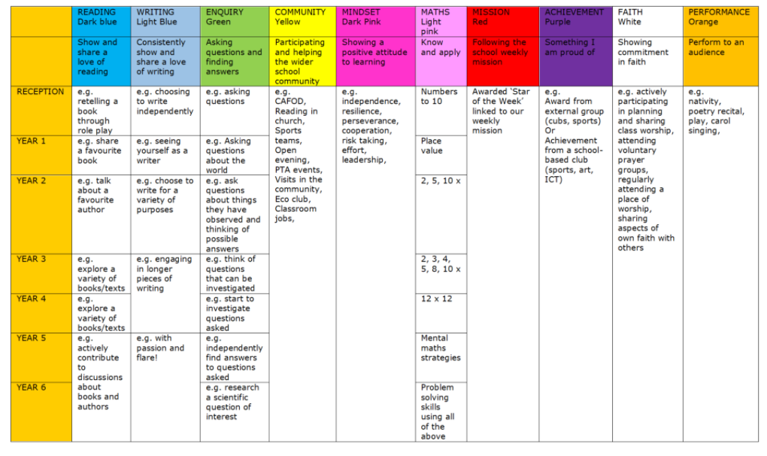
REWARDS
WHOLE SCHOOL – Star of the Week certificate, Keys to Success
CLASS BASED – stars
INDIVIDUAL – achievement and behaviour points
INSERT KEYS TABLE

Slide 14
MORE INFORMATION
SCHOOL WEBSITE
PARENT APP – newsletters and letter are put on the app.
CURRICULUM OVERVIEW – on website to show what the class will be learning about
PARENTS’ EVENING – Autumn Term and Spring/early Summer
REPORTS – interim reports are send out at the end of each term with a full report sent out in the Summer term.
Parent Pay- way of paying for all items in school.

Slide 15
ATTENDANCE
Whole school target of 97%
Half termly updates
Must be in school before 8.45am, gates open at 8.35am
No holidays authorised
Proof of medical – if in doubt, send them in; we can always call if they are ill

Slide 16
WEBSITE
www.cathedral.lancs.sch.uk
Regularly changes and has lots of information about the class on Class page.
Parents section
Blogs – generally updated once a week
Useful links

Slide 17
Online Safety
Why?​
​
KCSIE 2023 is a complete statutory guide that all schools must comply with​
Part One and Annex B clearly outlines how schools have a statutory responsibility to keep children safe online in or out of school​

Slide 18
Online Safety

Slide 19
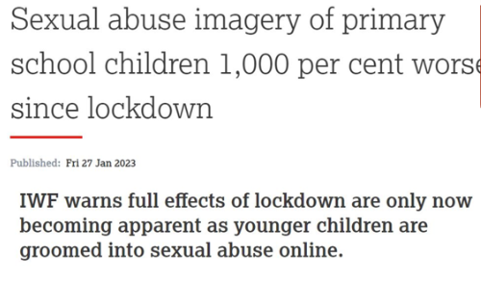
Online Safety

Slide 20
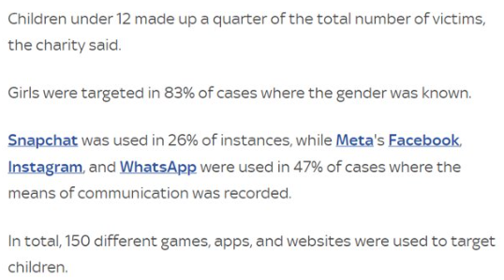
Online Safety

Slide 21
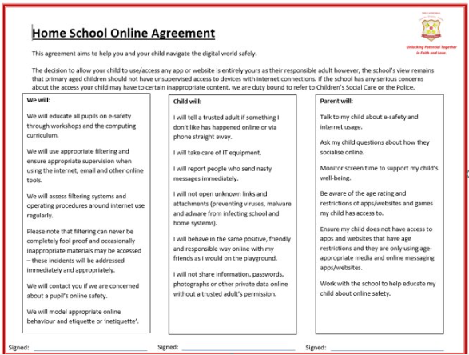

Slide 22
ANY QUESTIONS?
If you wish to contact us and you can’t make it into school, our email addresses are below and on the school website. You can also phone the school office if you wish to make an afterschool appointment to speak to us.
The best time to speak to us at length/confidentially is after school but you can use the mornings to keep us up to date / ask any questions etc
Please ensure you keep school up to date with any changes in contact telephone numbers.
h.whitaker@cathedral.lancs.sch.uk
r.cook@cathedral.lancs.sch.uk

