Slide 1
YEAR 2 INFORMATION EVENING
Information Evening for Parents
WEDNESday 13th September 2023
“Unlocking Potential together in faith and love”

Slide 2
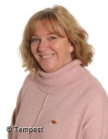
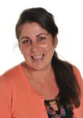
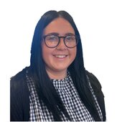
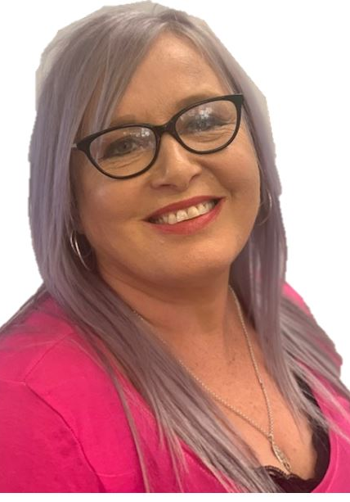
STAFF YOUR CHILD WILL TALK ABOUT
Mrs Grierson Miss Stevens Mrs Norris Miss McShane

Slide 3
Life in Year 2

Slide 4
HOME LEARNING
Homework
Daily reading practice-books signed by an adult
Times tables practice-games
Spellings-Purple Mash

Slide 5
Practise phonics, spellings, tables, number bonds
Listen to your child read
Read to and with your child
Talk about books. Ask questions
Encourage wider reading
Ensure work done at home is of a good standard
CHILDREN MAKE THE MOST PROGRESS WHEN PARENTS SUPPORT THE WORK OF A SCHOOL

Slide 6
MATHS
MATHS - At the end of Year 2, I will be able to say that…
Number
I can read and write all numbers to at least 100 in numerals and words.
I recognise odd and even numbers to 100.
I can count in steps of 2, 3 and 5 from 0.
I recognise and can define the place value of each digit in a 2 digit number.
I can compare and order numbers from 0 to 100 using the < > and = signs.
I can name the fractions 1/3, 1/4, 1/2 and 3/4 and can find fractional values of shapes, lengths and numbers.
I can recall and use multiplication and division facts for the 2, 5 and 10x tables.
I can add and subtract a 2-digit number and ones.
I can add and subtract a 2-digit number and tens.
I can add and subtract two 2-digit numbers.
I can add three 1-digit numbers.
I can solve problems involving addition and subtraction.
I understand and can use commutivity in relation to addition, subtraction, multiplication and division.
Measurement, geometry and statistics
I can choose and use appropriate standard units to estimate length, height, temperature and capacity.
I can tell and write the time to 5 minute intervals.
I recognise and can use the symbols £ and p when solving problems involving addition and subtraction of money.
I can describe the properties of 2D and 3D shapes to include edges, vertices and faces.
I can interpret and construct pictograms, tally charts, block diagram and simple tables.

Slide 7
READING
READING - At the end of Year 2, I will be able to say that…
Word reading
I can decode automatically and fluently.
I can blend sounds in words that contain the graphemes we have learnt.
I can recognise and read alternative sounds for graphemes.
I can read accurately words of two or more syllables that contain the same GPCs.
I can read words with common suffixes.
I can read common exception words.
I can read and comment on unusual correspondence between grapheme and phoneme.
I read most words quickly and accurately when I have read them before without sounding out and blending.
I can read most suitable books accurately, showing fluency and confidence.
Comprehension
I can talk about and give an opinion on a range of texts.
I can discuss the sequence of events in books and how they relate to each other.
I use prior knowledge, including context and vocabulary, to understand texts.
I can retell stories, including fairy stories and traditional tales.
I can read for meaning and check that the text makes sense. I go back and re-read when it does not makes sense.
I can find recurring language in stories and poems.
I can talk about my favourite words and phrases in stories and poems.
I can recite some poems by heart, with appropriate intonation.
I can answer and ask questions.
I can make predictions based on what I have read.
I can draw (simple) inferences from illustrations, events, characters’ actions and speech.

Slide 8
WRITING
Writing - At the end of Year 2, I will be able to say that…
Grammar and punctuation
I can use subordination and co-ordination.
I can use expanded noun phrases.
I can say how the grammatical patterns in a sentence indicate its function.
I consistently use the present tense and past tense correctly.
I can use the progressive forms of verbs in the present and past tense.
I use capital letters for names of people, places, day of the week and the personal pronoun ‘I’.
I correctly use question marks and exclamation marks,
I can use commas to separate items in a list.
I can use apostrophes to show where letters are missing and to mark singular possession in nouns.
Composition
I can write narratives about personal experiences and those of others, both real and fictional.
I can write for different purposes, including real events.
I can plan and discuss the content of writing and record my ideas.
I am able to orally rehearse structured sentences or sequences of sentences.
I can evaluate my own writing independently, with friends and with an adult.
I can proof-read to check for errors in spelling, grammar and punctuation.

Slide 9
HANDWRITING
Handwriting - At the end of Year 2, I will be able to say that…
Handwriting
I can form lower-case letters of the correct size relative to one another.
I can begin to use some of the diagonal and horizontal strokes needed to join letters.
I show that I know which letters are best left unjoined.
I use capital letters and digits of the correct size, orientation and relationship to one another and to lower case letters.
I use spacing between words that reflects the size of the letters.
Nelson handwriting
How to join up

Slide 10
SPELLING
Spelling - At the end of Year 2, I will be able to say that…
Transcription
I can segment spoken words into phonemes and record these as graphemes.
I can spell words with alternatives spellings, including a few common homophones.
I can spell longer words using suffixes such as ‘ment’, ‘ness’, ‘ful’, ‘less’, ‘ly’.
I can use my knowledge of alternative phonemes to narrow down possibilities for accurate spelling.
I can identify phonemes in unfamiliar words and use syllables to divide words.

Slide 11
TOPICS
Autumn 1- Explorers
Autumn 2- Island Life
Spring 1-Fantasy Worlds
Spring 2- An African Safari
Summer 1- The Three Little Wolves and the Big Bad Pig
Summer 2-The Victorian Seaside

Slide 12
PE
PE is Tuesday and Friday
KIT – What if my child has no kit?
HAIR-tied back boys and girls
INHALERS
INDEPENDENCE-Please encourage your child to dress themselves!

Slide 13
REWARDS AND CONSEQUENCES
READING Dark blue | WRITING Light Blue | ENQUIRY Green | COMMUNITY Yellow | MINDSET Dark Pink | MATHS Light pink | MISSION Red | ACHIEVEMENT Purple | FAITH White | PERFORMANCE Orange
Show and share a love of reading | Consistently show and share a love of writing | Asking questions and finding answers | Participating and helping the wider school community | Showing a positive attitude to learning | Know and apply | Following the school weekly mission | Something I am proud of | Showing commitment in faith | Perform to an audience
WHOLE SCHOOL
CLASS BASED
KEYS

Slide 14
UNIFORM
The Department for Education strongly encourages schools to have a uniform as it can play a valuable role in contributing to the ethos of a school and setting an appropriate tone.
We expect all children to wear school uniform. The majority of our uniform is available for you to order from the Uniform and Leisurewear Company, Common Garden Street, Lancaster. The tartan school skirt is only available from the school office.
The only jewellery allowed in school is a digital / analogue wrist watch. Children may wear a pair of small, plain studs.
Please ensure that your child's hair style / colour is appropriate for school. Bright colours, shaven patterns or gelled styles are no suitable for school. Hair past shoulder-length should be tied back.
Black shoes with either velcro, buckle or laces. (If your child comes to school in trainers, they will be asked to wear pumps whilst in the building)
Please label all clothing clearly. Thank you

Slide 16
Online Safety
Why?
KCSIE 2024 is a complete statutory guide that all schools must comply with
Part One and Annex B clearly outlines how schools have a statutory responsibility to keep children safe online in or out of school

Slide 17
It states:

Slide 18
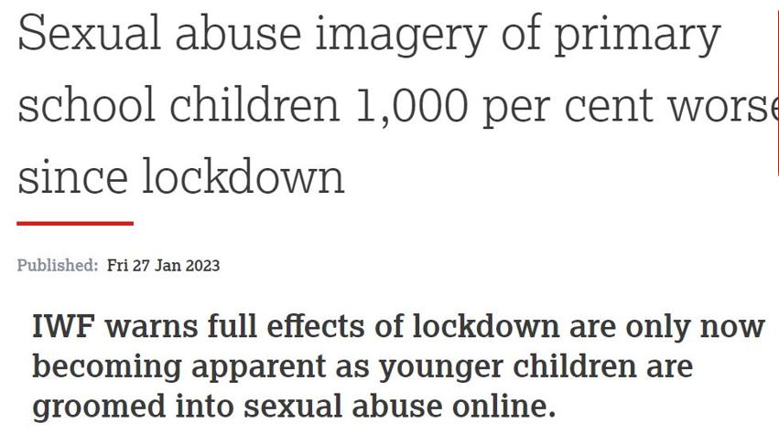

Slide 19
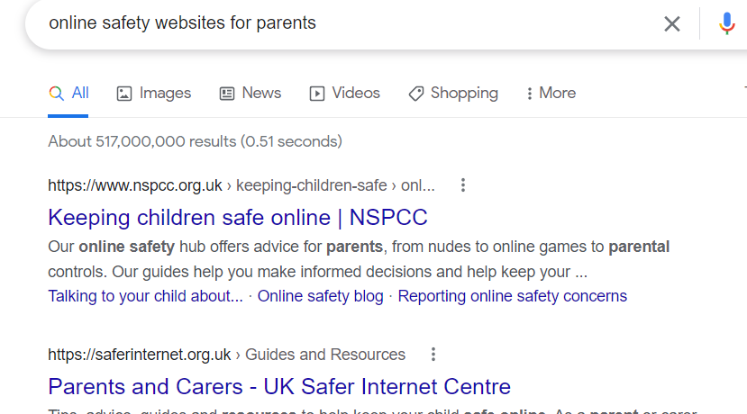
Online Safety

Slide 20
WEBSITE
www.cathedral.lancs.sch.uk​
This regularly changes and has lots of information about the class on Class page.​
Parents section​
Blogs – generally updated once a week​
Useful links

Slide 21
ANY QUESTIONS?
s.grierson@cathedral.lancs.sch.uk
If you need to see me…

