Slide 1
YEAR 3 INFORMATION EVENING
Information Evening for Parents SEPTEMBER 2023
Unlocking potential together in Faith and love

Slide 2
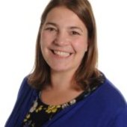
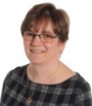
STAFF YOUR CHILD WILL TALK ABOUT
Mrs Lowe Miss Mc Shane Mrs Porter

Slide 3
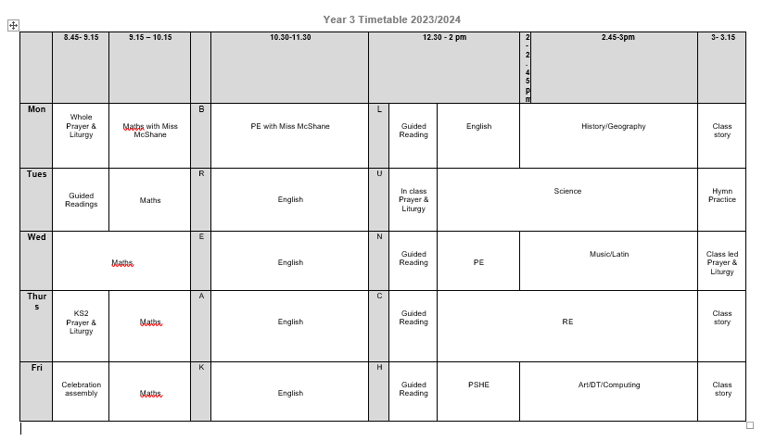
A DAY IN THE LIFE OF YEAR 3

Slide 4
HOME LEARNING
Daily reading – record/initial in reading record
Spelling Purple Mash
Weekly maths homework – goes home on Friday to be returned by Wednesday
Maths times tables practice

Slide 5
Practise spellings and times tables
Listen to your child read
Talk about books your child enjoys reading. Ask questions
Read to and with your child
Encourage wider reading
Ensure work done at home is of a good standard
CHILDREN MAKE THE MOST PROGRESS WHEN PARENTS SUPPORT THE WORK OF A SCHOOL

Slide 6
MATHS
Children are expected to know all multiplication and division facts for the 1, 2, 3, 4, 8 & 10 x tables. They need secure and rapid recall of these to prepare them for maths across their school career
In Year Three, children will further develop their understanding of place value and calculations. They will develop greater fluency in mental maths and will be introduced to formal written methods for addition and subtraction.
Children develop their ability to solve a range of simple problems, including problems involving simple fractions, measures, shapes and a range of charts and graphs.

Slide 7
ENGLISH
In Year Three, children are expected to write and punctuate their work clearly and neatly. Spellings of KS1 words and words that have been taught in class should be correct in their written work.
Children’s understanding and enjoyment of stories, poetry, plays and non-fiction develops as does their knowledge and skills in reading non-fiction about a wide range of subjects.
Guided reading is part of our daily timetable. In Year Three, children start to move their skills beyond simple retrieval of facts and start to use simple inference about what they have read.
Children are encouraged to read independently everyday, particularly books from a series or collection by a chosen author.

Slide 8
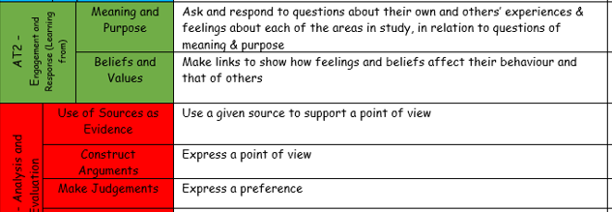
R.E.

Slide 9
SCIENCE
In Year Three, the following science topics are covered:
Skeletons and Movement
Light and Shadows
Rocks and Fossils
Forces and Magnets
Nutrition and Diet
Plants (functions and parts)
In science, children are encouraged to ask questions and take initiative for developing their own investigations to find the answers to their questions.

Slide 10
TOPICS
Autumn 1 – ‘There’s No Place Like Home’
Autumn 2 – ‘Light and Dark’
Spring 1 – ‘Stones and Bones’
Spring 2 – ‘Mighty Metals’
Summer 1 – ‘Healthy Humans’
Summer 2 – ‘How Does Your Garden Grow?’

Slide 11
PE
Monday and Wednesday
PE kit is needed for every lesson. Please ensure that all kit is clearly named.
Earrings need to be taken out for PE or left at home that day.
HAIR – hair that is shoulder length or longer should always be tied up.
INHALERS – if your child needs an inhaler, please ensure they have a labelled, in-date inhaler in school at all times.

Slide 12
ENRICHMENT
This year we are planning the following enrichment activities:
Local area walk (no cost)
Shelter Building (no cost)
Visit to Lancaster Castle (cost to be confirmed)
Williamson Park Art/Science Visit (no cost)
Stone Age Experience (cost to be confirmed)
Zoo Trip (cost to be confirmed)

Slide 13
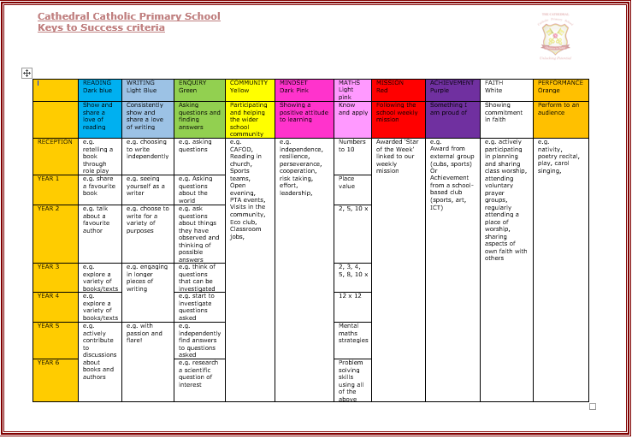
REWARDS AND CONSEQUENCES
WHOLE SCHOOL – weekly certificate, Keys to Success
CLASS BASED – stars
INDIVIDUAL – achievement and behaviour points

Slide 14
MORE INFORMATION
SCHOOL WEBSITE
PARENT APP – newsletters and letter are put on the app.
CURRICULUM OVERVIEW – on website to show what the class will be learning about
PARENTS’ EVENING – Autumn Term and Spring/early Summer
REPORTS – interim reports are send out at the end of each term with a full report sent out in the Summer term.
Parent Pay- way of paying for all items in school.

Slide 15
WALKING HOME
Written permission is needed for each individual child before children in Year 5 or 6 will be allowed to walk home without a parent/carer.

Slide 16
ATTENDANCE
Whole school target of 97%
PA – 95%
Half termly updates
Must be in school before 8.45am, gates open at 8.35am
No holidays authorised
Proof of medical – if in doubt, send them in; we can always call if they are ill

Slide 17
WEBSITE
www.cathedral.lancs.sch.uk
Reguarly changes and has lots of information about the class on Class page.
Parents section
Blogs – generally updated once a week
Useful links

Slide 18
Online Safety
Why?
KCSIE 2023 is a complete statutory guide that all schools must comply with
Part One and Annex B clearly outlines how schools have a statutory responsibility to keep children safe online in or out of school

Slide 19
It states:

Slide 20
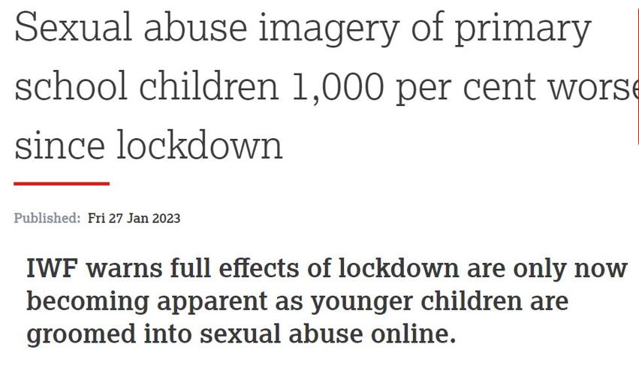

Slide 21
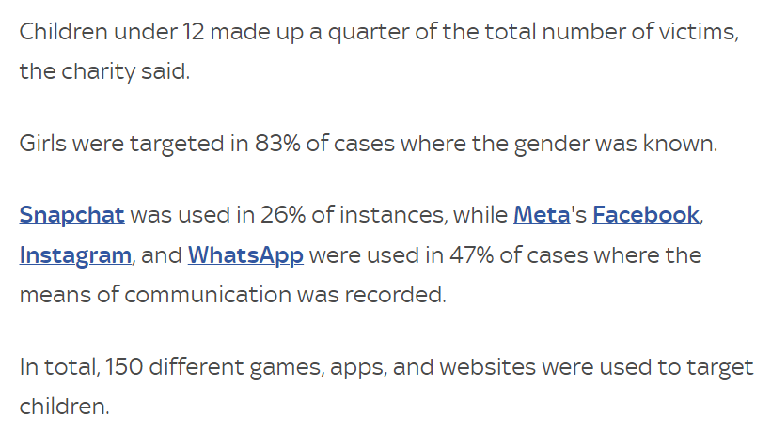

Slide 22
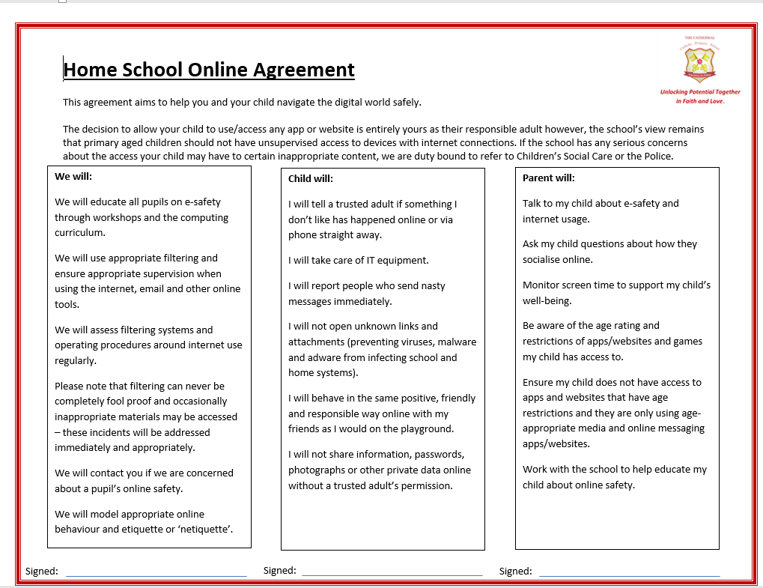

Slide 23
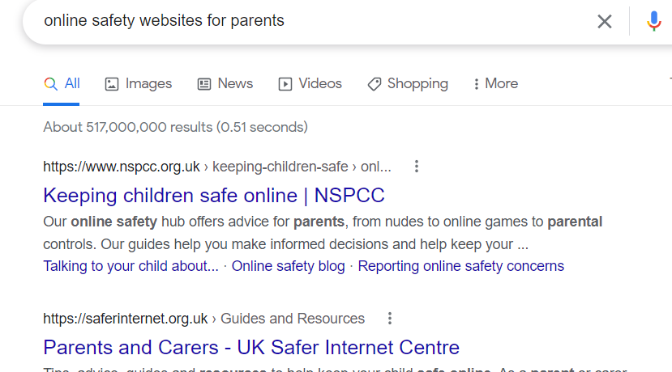
Online Safety

Slide 24
ANY QUESTIONS?
If you wish to contact us and you can’t make it into school, our email addresses are below and on the school website. You can also phone the school office if you wish to make an afterschool appointment to speak to us.
The best time to speak to us at length/confidentially is after school but you can use the mornings to keep us up to date / ask any questions etc
Please ensure you keep school up to date with any changes in contact telephone numbers.
flowe@cathedral.lancs.sch.uk

