Slide 1
YEAR FOUR INFORMATION EVENING FOR PARENTS
SEPTEMBER 2023
Unlocking potential together in Faith and love

Slide 2
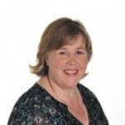
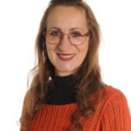
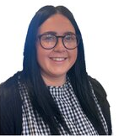
STAFF YOUR CHILD WILL TALK ABOUT
Mrs Beveridge Mrs Szleszynska Miss McShane

Slide 3
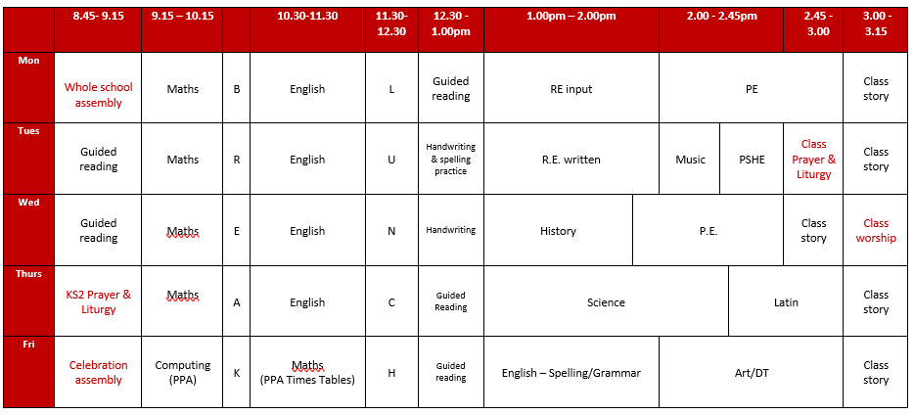
A DAY IN THE LIFE OF YEAR 4
Mrs Beveridge has released time on a Friday morning; Miss McShane teaches computing and maths.

Slide 4
HOME LEARNING
Daily reading – record/initial in reading record. Remember to include other books your child reads at home.
Spelling – children will be given spellings to learn and practise at home – these will be stuck in their planners. There will also be activities linked to these each week on Purple Mash.
Daily times tables practice. Your child should know which times tables they are learning – please help them to practise their times tables every evening.

Slide 5
Practise spellings and times tables
Listen to your child read
Talk about books your child enjoys reading. Ask questions
Read to and with your child
Encourage wider reading
Ensure work done at home is of a good standard
CHILDREN MAKE THE MOST PROGRESS WHEN PARENTS SUPPORT THE WORK OF A SCHOOL

Slide 6
MATHS
Children are expected to know all multiplication facts up to 12 x 12 by the end of Year Four – please practice these at home! In the summer term, all children in Year Four will be formally tested on their recall of multiplication facts up to 12 x 12.
In Year Four, children should become increasingly fluent with whole numbers and the four operations, including number facts and understanding of place value. This helps them to develop efficient written and mental methods and perform calculations with increasingly large whole numbers (up to 4 digits).
Children develop their ability to solve a range of problems, including problems involving simple fractions, decimals, measures, shapes and a range of charts and graphs.

Slide 7
ENGLISH
READING
Children’s understanding and enjoyment of stories, poetry, plays and non-fiction develops as does their knowledge and skills in reading non-fiction about a wide range of subjects. They learn how to use evidence from a text when they are putting forward a point about a character or answering questions from non-fiction texts.
WRITING
Children learn how to use commas and speech punctuation correctly. They begin to use more varied sentence starters and descriptive phrases to make their writing more interesting. Writing is organised into paragraphs in both fiction and non-fiction writing. They are given time to proofread their writing to check for spelling, punctuation and grammar errors which they then edit and improve.
SPELLING
Children are expected to learn and correctly spell all words on the Year 3/4 common exception word list. This term, we are also revisiting spelling rules for adding –s, -ing and –ed to words and children will be expected to apply these rules correctly in their writing. Following this, we will be looking at patterns in words using different prefixes and suffixes.

Slide 8
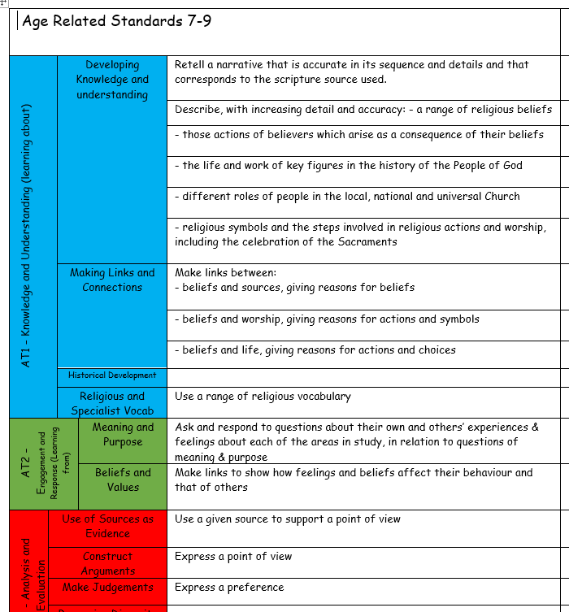
R.E.
Our RE topics cover the Church’s seasons of Advent, Christmas, Lent, Easter and Pentecost.
We look at the Sacraments of Baptism, Confirmation and Eucharist.
Children learn Bible stories and reflect on what believers can learn from them.

Slide 9
SCIENCE
In Year Four, the following science topics are covered:
Teeth and the digestive system
Sound
Electricity
Solids, liquids and gases
States of matter
Habitats
These are taught through investigative work.
Working scientifically (adapted from the National Curriculum)
During years 3 and 4, pupils are taught to use the following practical scientific methods, processes and skills:
asking relevant questions and using different types of scientific enquiries to answer them
setting up simple practical enquiries, comparative and fair tests
making systematic and careful observations
gathering, recording, classifying and presenting data in a variety of ways
recording findings using simple scientific language, drawings and charts
reporting on findings from enquiries,
using results to draw simple conclusions
identifying differences, similarities or changes related to simple scientific ideas and processes
using straightforward scientific evidence to answer questions or to support their findings.

Slide 10
TOPICS
Autumn – ‘A Fresh Start’
Spring – ‘Sparks Might Fly’
Summer – ‘Water, water everywhere’

Slide 11
PE
Mondays and Wednesdays.
PE kit is needed for every lesson.
Earrings need to be taken out for PE or left at home that day.
HAIR – hair that is shoulder length or longer should always be tied up.
INHALERS – if your child needs an inhaler, please ensure they have a labelled, in-date inhaler in school at all times.

Slide 12
ENRICHMENT
This year we are planning the following enrichment activities:
Autumn term visit to Lancaster Roman Museum and the Bath-House(no cost) and Leighton Hall Estate (see separate letter)
Autumn term Anglo-Saxon visitor (cost to be confirmed)
Spring term visit to Lancaster Maritime Museum (no cost)
Summer term residential visit to Castlerigg Manor (see separate letter)
Summer term visit to Morecambe (PTA subsidised cost)

Slide 13
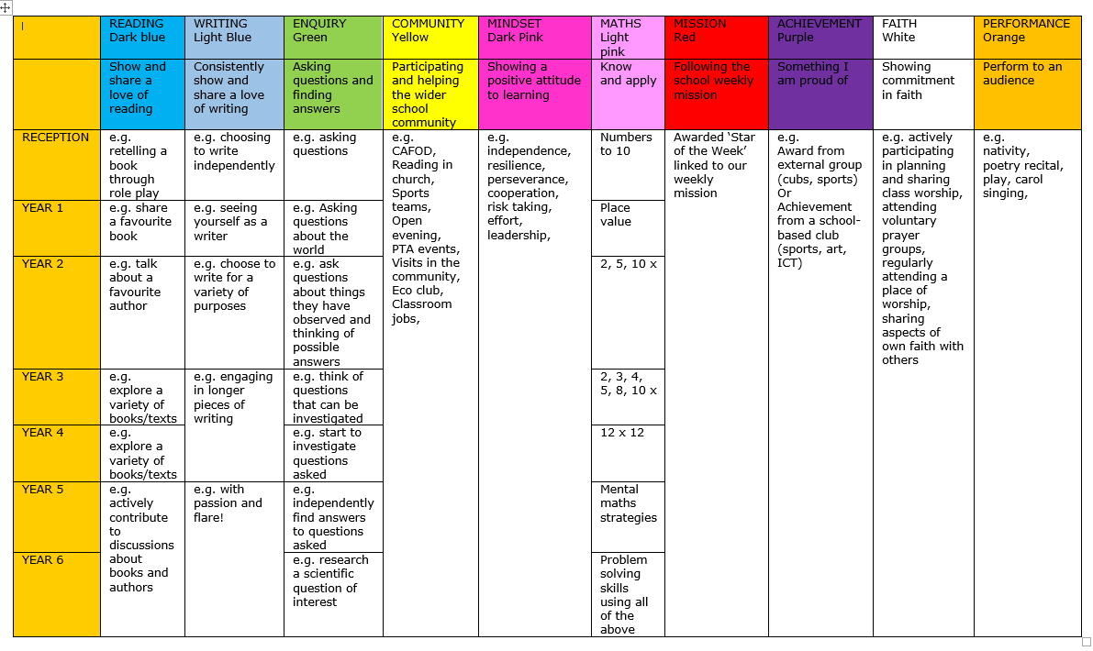
REWARDS AND CONSEQUENCES
WHOLE SCHOOL – weekly certificate, Keys to Success
CLASS BASED – stars
INDIVIDUAL – achievement and behaviour points

Slide 14
MORE INFORMATION
SCHOOL WEBSITE
PARENT APP – newsletters and letter are put on the app – please ensure you can access parent app.
CURRICULUM OVERVIEW – on website to show what the class will be learning about
PARENTS’ EVENING – Autumn Term and Spring/early Summer
REPORTS – interim reports are send out at the end of each term with a full report sent out in the Summer term.
Parent Pay- way of paying for all items in school.

Slide 15
WALKING HOME
Written permission is needed for each individual child before children in Year 5 or 6 will be allowed to walk home without a parent/carer.

Slide 16
ATTENDANCE
Whole school target of 97%
PA – 95%
Half termly updates
Must be in school before 8.45am, gates open at 8.35am
No holidays authorised
Proof of medical – if in doubt, send them in; we can always call if they are ill

Slide 17
WEBSITE
www.cathedral.lancs.sch.uk
Regularly changes and has lots of information about the class on Class page.
Parents section
Blogs – generally updated once a week
Useful links

Slide 20
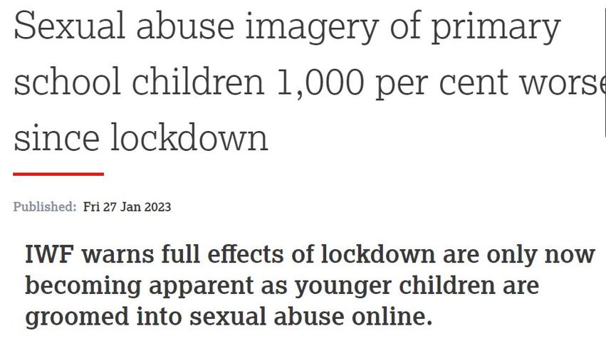

Slide 21
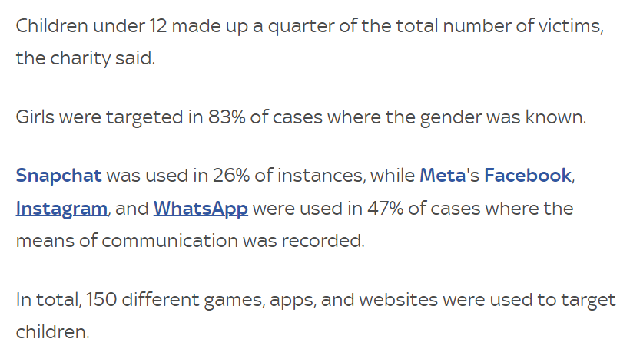

Slide 22
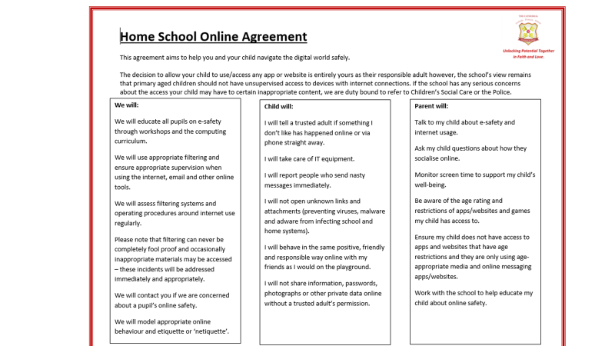

Slide 23
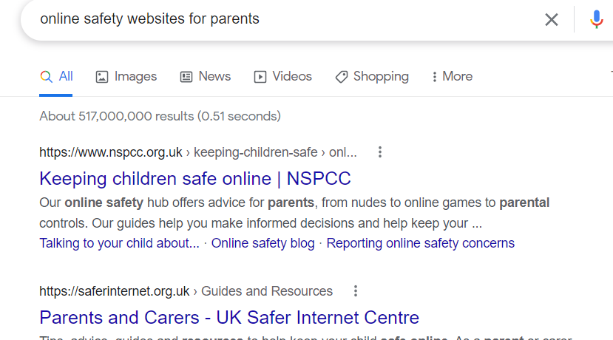
Online Safety

Slide 24
ANY QUESTIONS?
If you wish to contact me and you can’t make it into school, my email address is below and on the school website. You can also phone the school office if you wish to make an afterschool appointment to speak to me.
The best time to speak to me at length/confidentially is after school but you can use the mornings to keep me up to date / ask any questions etc.
Please ensure you keep school up to date with any changes in contact telephone numbers.
c.beveridge@cathedral.lancs.sch.uk

