Slide 1

YEAR FIVE
INFORMATION
EVENING
Information Evening for Parents SEPTEMBER 2024
Unlocking potential together in Faith and love

Slide 2

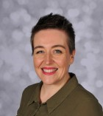
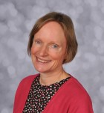
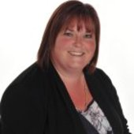
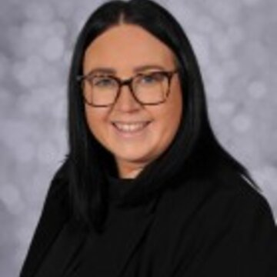
STAFF YOUR CHILD WILL TALK ABOUT
Mrs Benson Mrs Dickinson Mrs Nott Miss McShane

Slide 3
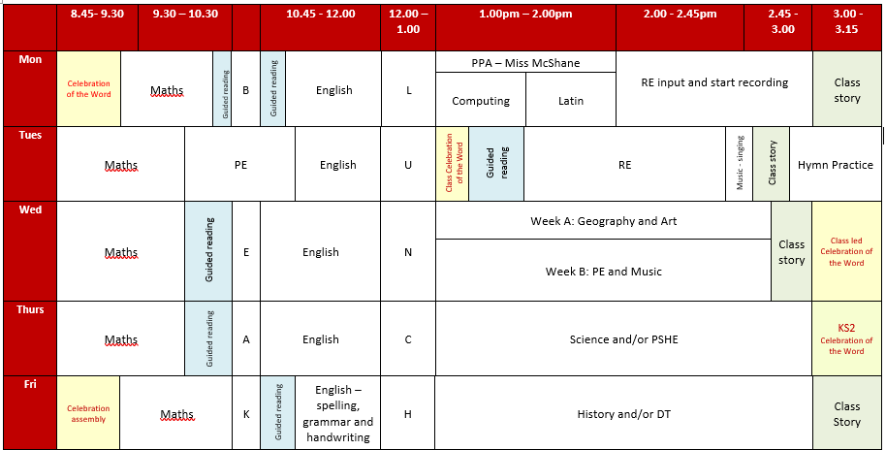
A DAY IN THE LIFE OF YEAR 5
Mrs Dickinson and Mrs Benson meet for planning and assessment on Monday afternoon.

Slide 4
HOME LEARNING
Daily reading – parent/carer to record/initial in reading record every day
Weekly maths homework – goes home on Monday to be returned by Friday. Each child should complete 4 pieces of maths homework per half term.
Project – A project outline is given out each term. The projects should be fun, engaging and creative!
  Children are expected to spend half an hour a week on their project. Two or three times during the half term they will be asked to bring in the work they have completed so far.

Slide 5

Practise spellings and times tables
Listen to your child read
Talk about books your child enjoys reading. Ask questions
Read to and with your child
Encourage wider reading
Ensure work done at home is of a good standard
CHILDREN MAKE THE MOST PROGRESS WHEN PARENTS SUPPORT THE WORK OF A SCHOOL

Slide 6
MATHS
In Year Five, children should develop a good understanding of place value of whole numbers up to 1 000 000 and decimals with up to 3 decimal places.
They become increasingly fluent at applying times tables facts and number bonds to mental and written calculations.
They develop efficient mental and written methods for addition, subtraction, multiplication and division with whole numbers to 1 000 000 and decimals.
They develop their ability to solve a range of problems, including problems involving fractions, decimals, measures, shapes and a range of charts and graphs.

Slide 7
ENGLISH
Children’s understanding and enjoyment of stories, poetry, plays and non-fiction develops. They should have a good understanding of the key layout and language features of the main text types.
Guided reading is part of our daily timetable. In Year Five, children become increasingly independent in explaining their views about what they have read. They learn how to use evidence from the text to support a point of view and how to infer information about characters and their feelings, motives and actions.
Children are encouraged to read independently everyday, particularly books from a series or collection by a chosen author.

Slide 8
RELIGIOUS EDUCATION and PRAYER AND LITURGY
In a Catholic school, RE is a core subject.
In Year 5, we learn about the mission of the Church in responding to a world in need, the sacraments of marriage and the Eucharist, the Church’s seasons and the lives of some saints.
Children develop the ability to understand links between a person’s religious beliefs and their actions.
In addition to whole school times of prayer, children in Year 5 take it in turns to prepare and lead a time of prayer in class each week.

Slide 9
SCIENCE
In Year Five, the following science topics are covered:
Autumn 1 – Material properties
Autumn 2 – Materials-reversible and irreversible changes
Spring 1 – Earth and Space
Spring 2 – Forces and falling objects
Summer 1 – Life cycle changes in plants and animals
Summer 2 – Growth and development of humans

Slide 10
TOPICS
Autumn – ‘A Kingdom United ’
Spring – ‘Inventors and Inventions’
Summer – ‘Ancient and Amazing Americas’

Slide 11
PE
PE is on Tuesday and alternate Wednesdays (see parent letter for dates) - children COME INTO SCHOOL in their full PE kit.
Earrings need to be taken out on PE days.
HAIR – hair that is shoulder length or longer should always be tied up.
INHALERS – if your child needs an inhaler, please ensure they have a labelled, in-date inhaler in school at all times.

Slide 12
Instrumentation Lessons
Lancashire music provide a specialist music teacher, Mr Lupton, to teach Year 5 or Year 6 each week.
Year 5 will start to learn to play the ukulele from Spring 2 onwards.
The children will bring their ukulele home after each lesson; please ensure they bring it in each week.
Encourage your children to practise each week.

Slide 13
ENRICHMENT
This year we are planning the following enrichment activities:
Autumn
Lego workshop, Viking workshop, Viking dress up day, local geography field trip
Spring
Borwick Hall (Further information to be sent home), Inventors dress up day
Summer
Rainforest dress up day, Lancaster Butterfly House visit, Lancaster University visit

Slide 14
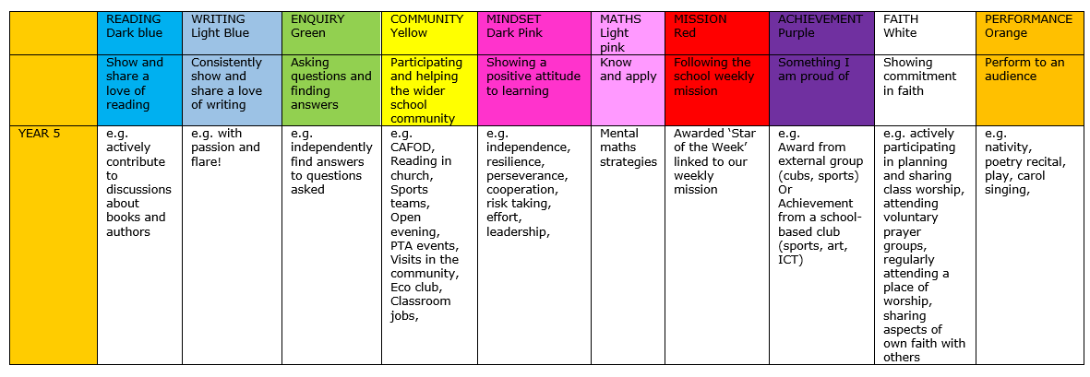
REWARDS
WHOLE SCHOOL – weekly certificate, Keys to Success
CLASS BASED – stars
INDIVIDUAL – achievement points

Slide 15
MORE INFORMATION
SCHOOL WEBSITE
PARENT APP – newsletters and letter are put on the app.
CURRICULUM OVERVIEW – on website to show what the class will be learning about
PARENTS’ EVENING – Autumn Term and Spring/early Summer
REPORTS – interim reports are sent out at the end of each term with a full report sent out in the Summer term.
Parent Pay- way of paying for all items in school.

Slide 16
WALKING HOME
Written permission is needed for each individual child before children in Year 5 or 6 will be allowed to walk home without a parent/carer.

Slide 17
ATTENDANCE
Whole school target of 97%
PA – 95%
Half termly updates
Must be in school before 8.45am, gates open at 8.35am
No holidays authorised
Proof of medical – if in doubt, send them in; we can always call if they are ill

Slide 18
WEBSITE
www.cathedral.lancs.sch.uk
Regularly changes and has information about the class on Class Page.
Parents section
Blogs – generally updated once a week
Useful links

Slide 19

Online Safety
Why?
KCSIE 2024 is a complete statutory guide that all schools must comply with
Part One and Annex B clearly outlines how schools have a statutory responsibility to keep children safe online in or out of school

Slide 20
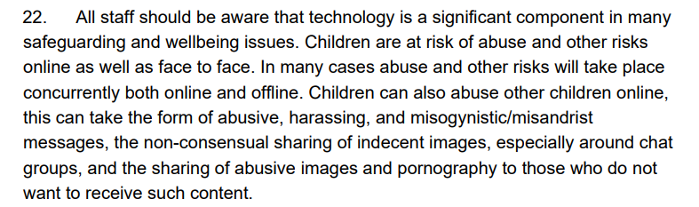
It states:

Slide 21
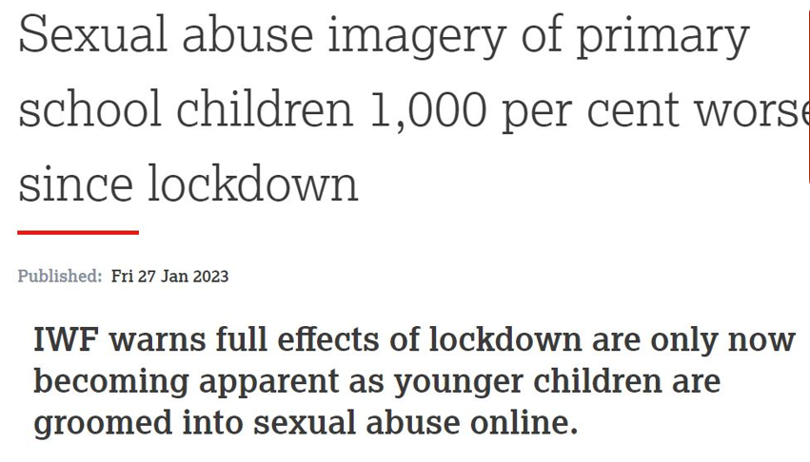
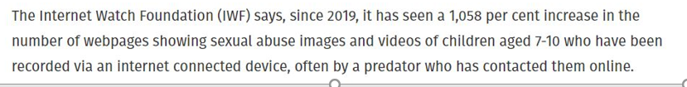

Slide 22
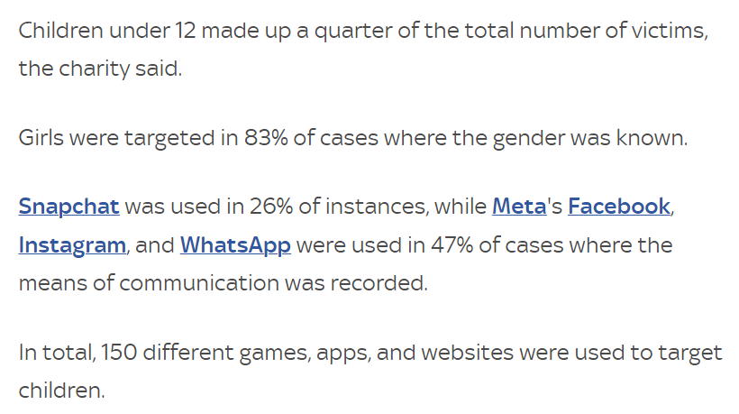

Slide 23
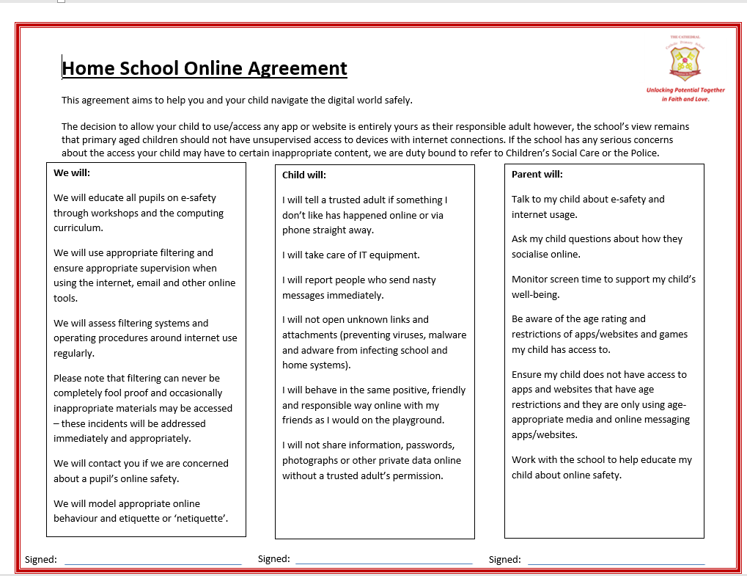

Slide 24
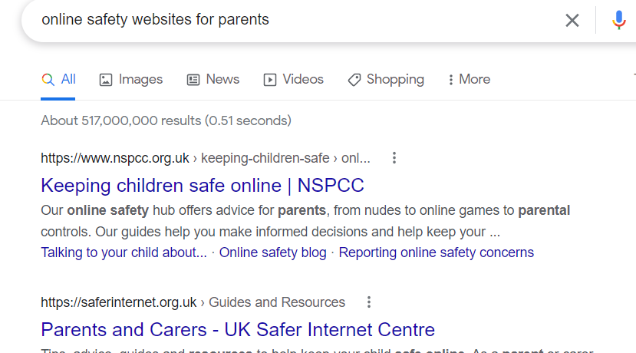
Online Safety

Slide 25
ANY QUESTIONS?
If you wish to contact us and you can’t make it into school, our email addresses are below and on the school website. You can also phone the school office if you wish to make an afterschool appointment to speak to us.
The best time to speak to us at length/confidentially is after school but you can use the mornings to keep us up to date / ask any questions etc
Please ensure you keep school up to date with any changes in contact telephone numbers.
c.dickinson@cathedral.lancs.sch.uk s.benson@cathedral.lancs.sch.uk

