Slide 1
YEAR 6 INFORMATION EVENING
Information Evening for Parents SEPTEMBER 2023
Unlocking potential together in Faith and love

Slide 2
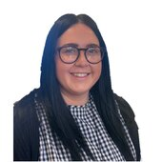
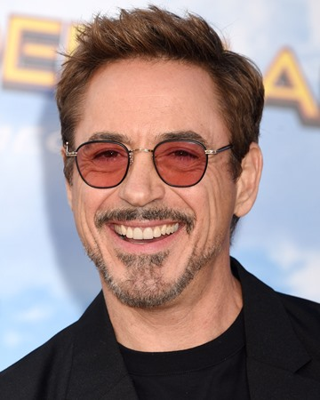
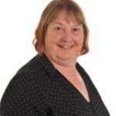
STAFF YOUR CHILD WILL TALK ABOUT
Miss McShane, Mrs Copsey & Dr Hodder

Slide 3
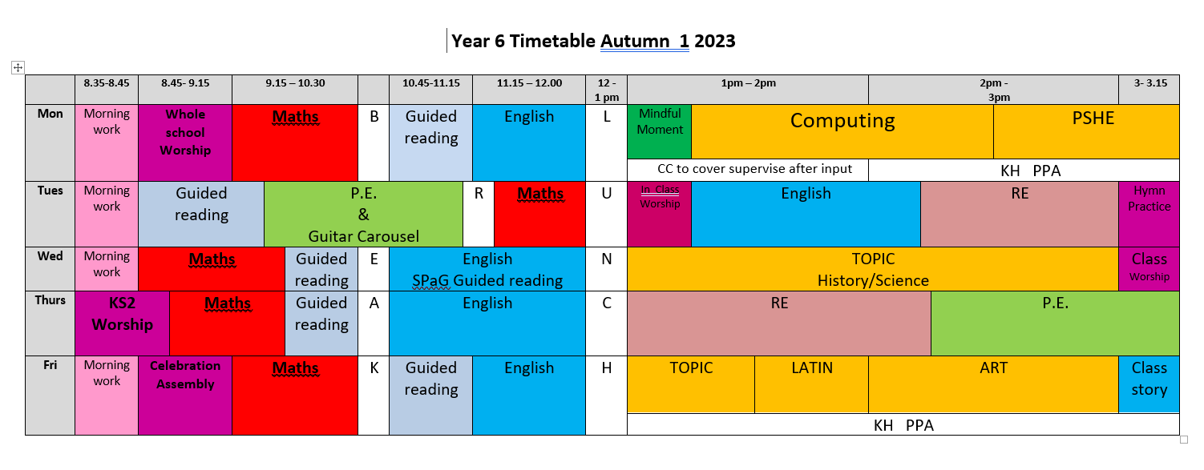
A DAY IN THE LIFE OF YEAR 6

Slide 4
HOME LEARNING
Daily reading – record/initial in reading record
Weekly spelling practice – Purple Mash online
Weekly maths homework – Thursday to Monday
Half-term project – on website and given to each child – must be ready for the first day back after each break. Effort, fun and creative!
Timestables should be embedded – backwards, forward, sideways and in your sleep!

Slide 5
Practise spellings and times tables
Listen to your child read
Talk about books your child enjoys reading. Ask questions
Read to and with your child
Encourage wider reading
Ensure work done at home is of a good standard
CHILDREN MAKE THE MOST PROGRESS WHEN PARENTS SUPPORT THE WORK OF A SCHOOL

Slide 6
MATHS
Children MUST know:
the multiplication tables
Time
Money
How to multiple, divide, add and subtract to 6 digits
In Year Six, children must apply all their mathematical learning to a range of written word questions (reasoning) and rapid arithmetic questions.

Slide 7
ENGLISH
Children will write in a range of styles and for a range of audiences. They are expected to assess, edit and improve on their writing as well as draw on a wider range of text types for ideas and styles.
Reading = Writing
Guided reading is part of our daily timetable. In Year Six, children are independent learners. They use evidence from the text to support a point of view and how to infer information about characters and their feelings, motives and actions. They compare and contrast characters and styles across a text and between texts.
Children are must also read independently everyday, particularly books from a series or collection by a chosen author.

Slide 8
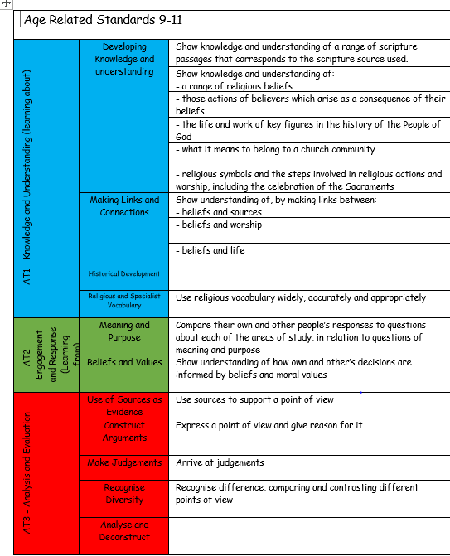
R.E.
Topics across the year include:
Church
Vocation
Death and new life
The Common good

Slide 9
SCIENCE
In Year 6, the following science topics are covered:
Recap of Electricity
Evolution
Exercise and Health
Classification of organisms
Recap of KS2 Science

Slide 10
TOPICS
Autumn – Survival and the 2004 Boxing Day Tsunami
Spring – History Detectives and the Ancient Egyptians
Summer – Frances Elizabeth Johnson and the Lancaster Slave Trade

Slide 11
PE
In School Tuesday & Thursday – wear kit to school.
Earrings need to be taken out for PE or left at home that day.
HAIR – hair that is shoulder length or longer should always be tied up.
INHALERS – if your child needs an inhaler, please ensure they have a labelled, in-date inhaler in school at all times.

Slide 12
ENRICHMENT
This year we are planning the following enrichment activities:
Visit Lancaster Maritime Museum for Slavery workshops(no cost)
Spring term visit to Walker Art Gallery, Liverpool(cost TBC)
Residential visit to Liverpool Albert Dock and City (cost TBC)
Bikeability (no cost)
Lego Coding Workshop(no cost)
Bush-tucker Challenge AND Shelter Day(no cost)
End of Year Performance (no cost)

Slide 13
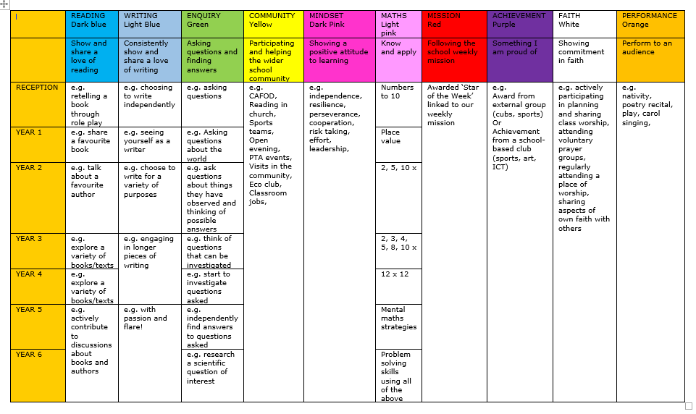
REWARDS AND CONSEQUENCES
WHOLE SCHOOL – weekly certificate, Keys to Success
CLASS BASED – stars
INDIVIDUAL – achievement and behaviour points
INSERT KEYS TABLE

Slide 14
MORE INFORMATION
SCHOOL WEBSITE
PARENT APP – newsletters and letter are put on the app.
CURRICULUM OVERVIEW – on website to show what the class will be learning about
PARENTS’ EVENING – Autumn Term and Spring/early Summer
REPORTS – interim reports are send out at the end of each term with a full report sent out in the Summer term.
Parent Pay- way of paying for all items in school.

Slide 15
WALKING HOME
Written permission is needed for each individual child before children in Year 5 or 6 will be allowed to walk home without a parent/carer.

Slide 16
ATTENDANCE
Whole school target of 97%
PA – 95%
Half termly updates
Must be in school before 8.45am, gates open at 8.35am
No holidays authorised
Proof of medical – if in doubt, send them in; we can always call if they are ill

Slide 17
WEBSITE
www.cathedral.lancs.sch.uk
Regularly changes and has lots of information about the class on Class page.
Parents section
Blogs – generally updated once a week
Useful links

Slide 18
Online Safety
Why?
KCSIE 2023 is a complete statutory guide that all schools must comply with
Part One and Annex B clearly outlines how schools have a statutory responsibility to keep children safe online in or out of school

Slide 19
It states:

Slide 20
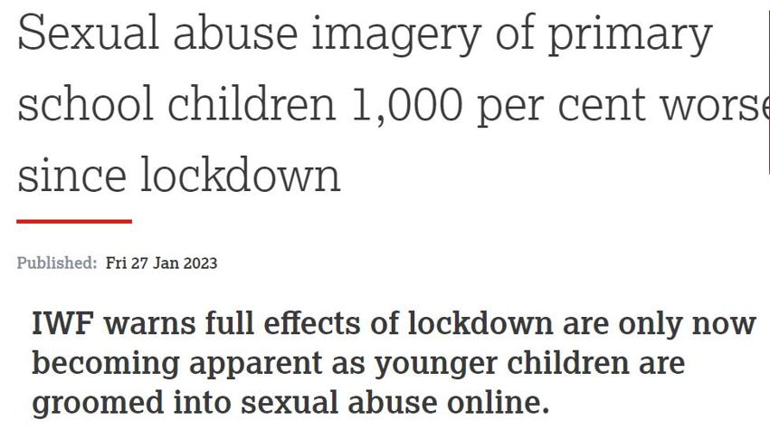

Slide 21
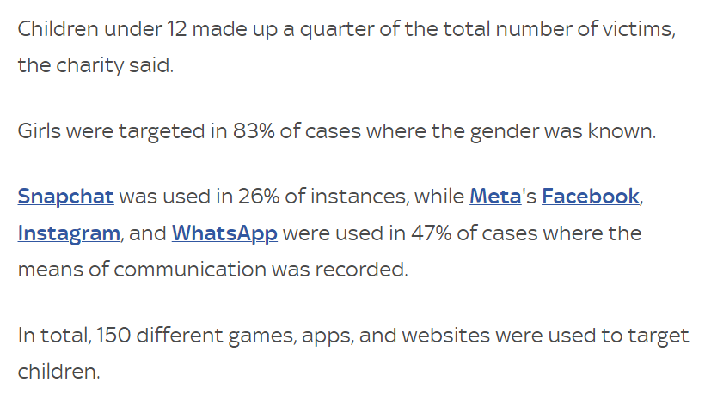

Slide 22
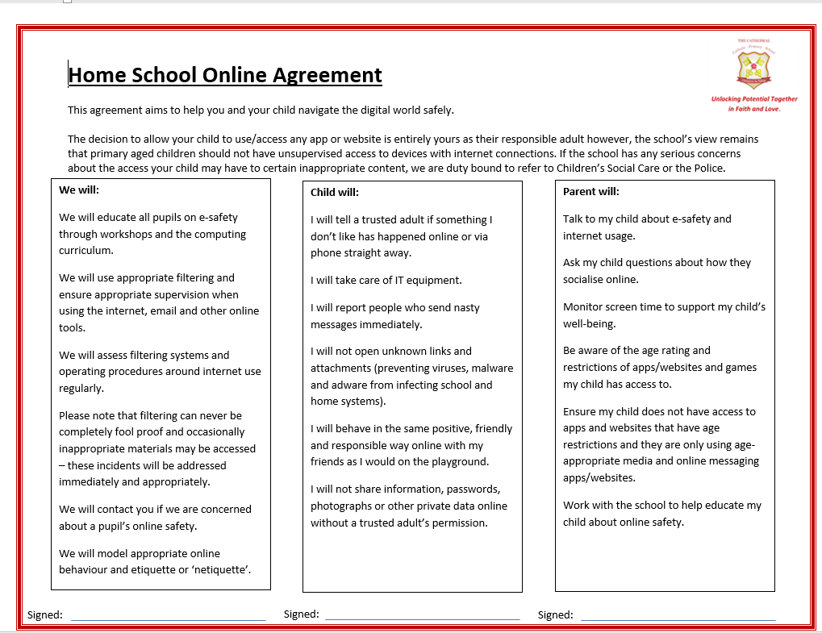

Slide 23
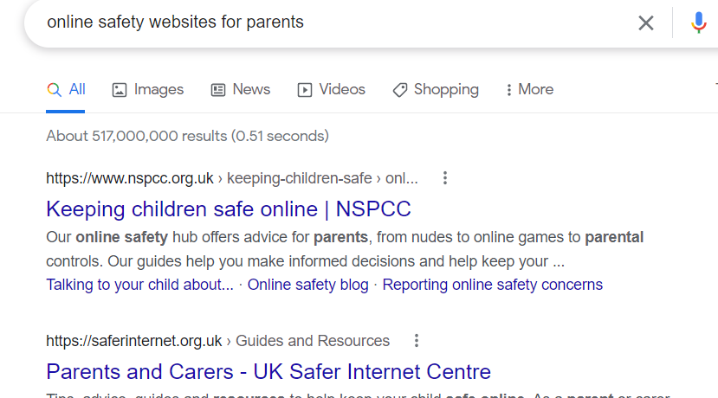
Online Safety

Slide 24
ANY QUESTIONS?
If you wish to contact us and you can’t make it into school, our email addresses are below and on the school website. You can also phone the school office if you wish to make an afterschool appointment to speak to us.
The best time to speak to us at length/confidentially is after school but you can use the mornings to keep us up to date / ask any questions etc
Please ensure you keep school up to date with any changes in contact telephone numbers.
K.hodder@cathedral.lancs.sch.uk

