Slide 1
RECEPTION INFORMATION EVENING
Information Evening for Parents SEPTEMBER 2024
Unlocking potential together in Faith and love

Slide 2
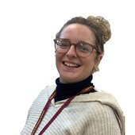
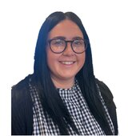
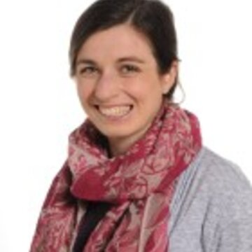
STAFF YOUR CHILD WILL TALK ABOUT
Mrs Lee – Class Teacher
Mrs Taylor – TA
Miss Conroy – TA
Miss McShane – HLTA

Slide 3
EYFS (Early Year Foundation Stage)
Prime Areas:
Communication and Language
PSED (Personal, Social and Emotional Development)
Physical Development
Specific Areas
Literacy
Mathematics
Understanding the World
EAD (Expressive Art and Design)

Slide 4
A DAY IN THE LIFE OF RECEPTION
Mrs Lee has her planning time on Friday morning and Miss McShane will be in class.

Slide 5
HOME LEARNING
Daily reading - record/initial in reading record
Tricky words will be sent home when we learn a new word in school
Finnegan Fox

Slide 6
Reading
Each book should be read 3 times before it is changed
First Read
Look at the pictures, discuss the characters and make predictions
Second Read
Decode the words in the book
Third Read
Comprehension – answer questions about the book

Slide 7
Reading Meeting
Wednesday 2nd October
9.00
3.15
5.00

Slide 8
MATHS
ELG – Number
Composition of numbers to 10
Automatically recall number bonds to 5 and some to 10 (including subtraction and doubles)
Subitise
ELG – Numerical Patterns
Verbally count to 20
Compare quantities to 10
Exploring and representing patterns to 10 (including odds and evens)

Slide 9
Literacy
ELG – Comprehension
Understanding what has been read
Anticipating events
Using new vocabulary
ELG – Word Reading
Saying the sounds for each letter of the alphabet and at least 10 digraphs
Read words consistent of phonics knowledge
Reading aloud (including tricky words)
ELG – Writing
Correctly form letters
Write words that are phonetically plausible
Write words and sentences that can be read by others

Slide 10
R.E.
Creation and Covenant
Prophecy and Promise (Advent and Christmas)
Galilee to Jerusalem (Jesus’ time on earth)
Desert to Garden (Lent)
Eastertide and Pentecost
Dialogue and Encounter (other Religions)

Slide 11
TOPICS
Autumn 1 – ‘Marvellous Me’
Autumn 2 – ‘Superheroes’
Spring 1 – ‘Animals’
Spring 2 – ‘Journeys and Transport’
Summer 1 – ‘Fairy Tales’
Summer 2 – ‘Growing’

Slide 13
PE
Our PE day is Thursday.
PE kit is needed for every lesson. If no kit, we will send home a reminder or speak to parents. Please make sure that the PE kit and school uniform is named as it can easily be mixed up.
Small stud Earrings are allowed but these must be removed on PE days.
HAIR – hair that is shoulder length or longer should always be tied up.
INHALERS – if your child needs an inhaler, please ensure they have a labelled, in-date inhaler in school at all times.

Slide 14
Independence
In EYFS we want to build children’s independence
Children putting on their own coats
Children feeding themselves
Children changed themselves
Children going to the toilet themselves
Children walking to school themselves

Slide 15
ENRICHMENT
This year we are planning the following enrichment activities:
Barton Grange
Train to Grange-over-Sands
Walks to Williamson’s Park
Police Museum

Slide 16
REWARDS
WHOLE SCHOOL – weekly certificate, Keys to Success
CLASS BASED – stars
INDIVIDUAL – Achievement Points/Dojos

Slide 17
MORE INFORMATION
SCHOOL WEBSITE
PARENT APP – newsletters and letter are put on the app.
CURRICULUM OVERVIEW – on website to show what the class will be learning about
PARENTS’ EVENING – Autumn Term and Spring/early Summer
REPORTS – interim reports are send out at the end of each term with a full report sent out in the Summer term.
Parent Pay- way of paying for all items in school.

Slide 18
ATTENDANCE
Whole school target of 97%
PA – 95%
Half termly updates
Must be in school before 8.45am, gates open at 8.35am
No holidays authorised
Proof of medical – if in doubt, send them in; we can always call if they are ill

Slide 19
WEBSITE
www.cathedral.lancs.sch.uk
Regularly changes and has lots of information about the class on Class page.
Parents section
Blogs – generally updated once a week
Useful links

Slide 20
Stay and Play
Friday 18th October 2024
Friday 13th December 2024
Friday 14th February 2025
Friday 28th March 2025
Friday 23rd May 2025
Friday 11th July 2025
All of these sessions are at 2.00PM

Slide 21
Online Safety
Why?
KCSIE 2024 is a complete statutory guide that all schools must comply with
Part One and Annex B clearly outlines how schools have a statutory responsibility to keep children safe online in or out of school

Slide 22
It states:

Slide 23
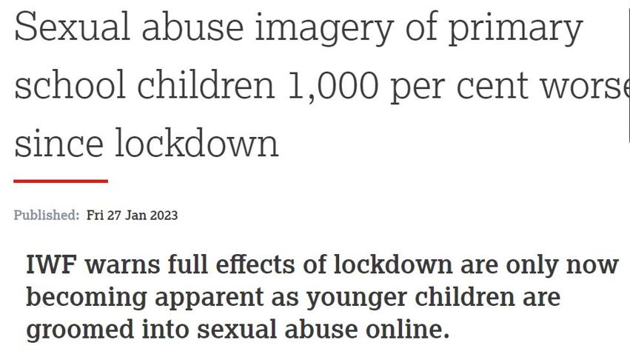

Slide 24
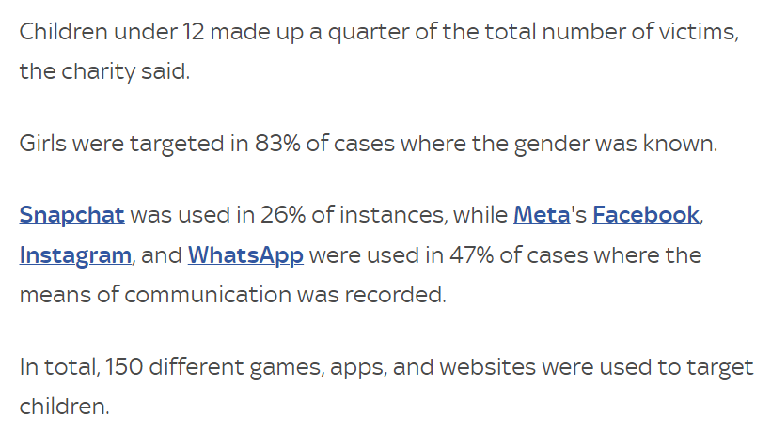

Slide 25
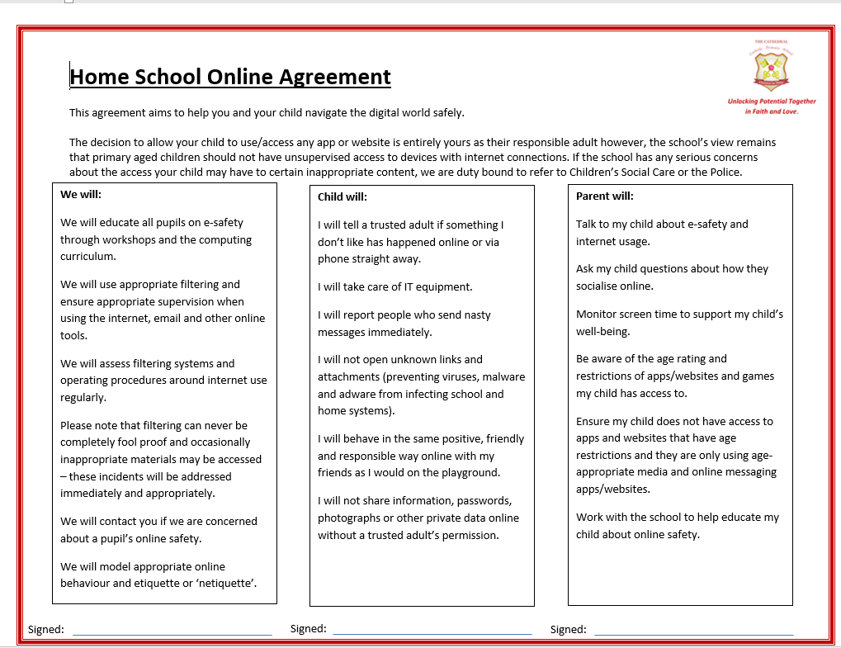

Slide 26
ANY QUESTIONS?
If you wish to contact us and you can’t make it into school, our email addresses are below and on the school website. You can also phone the school office if you wish to make an afterschool appointment to speak to us.
The best time to speak to us at length/confidentially is after school but you can use the mornings to keep us up to date / ask any questions etc
Please ensure you keep school up to date with any changes in contact telephone numbers.
k.lee@cathedral.lancs.sch.uk

