Slide 1
Reception Stay and Play
12th December 2024

Slide 2
Online Safety
Why?
KCSIE 2024 is a complete statutory guide that all schools must comply with
Part One and Annex B clearly outlines how schools have a statutory responsibility to keep children safe online in or out of school

Slide 3
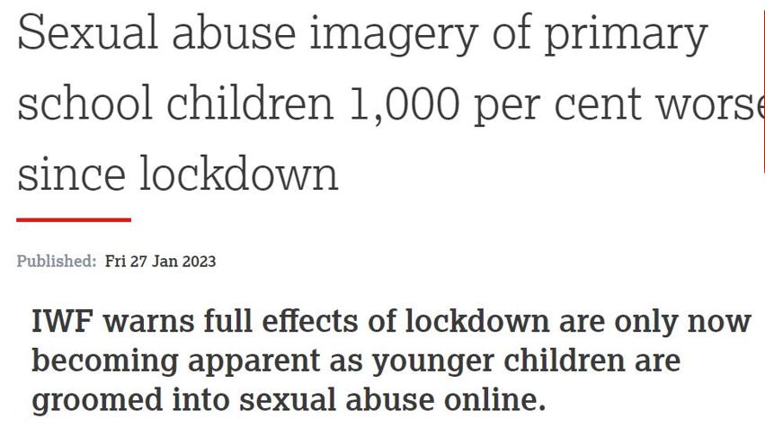

Slide 4
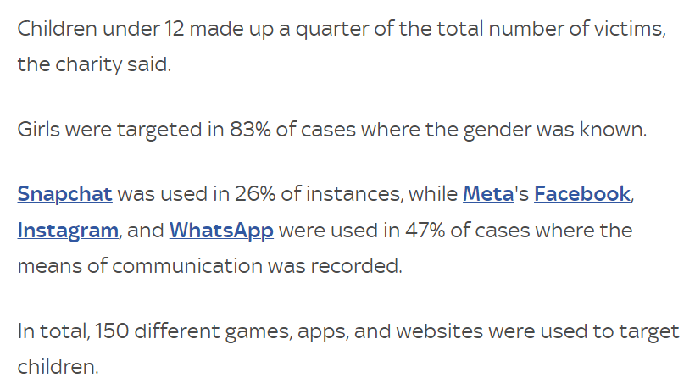

Slide 8
Online Safety

Slide 9
Games and Age Ratings
Minecraft – Pegi 7
Roblox – Pegi 7

Slide 10
Games and Age Ratings
Fortnite – Pegi 12

Slide 11
Apps and Age Ratings
Tik Tok – Age 13
Instagram – Age 13

Slide 12
Apps and Age Ratings
YouTube – Age 13
Poppy Playtime – Age 8

