Slide 1

RECEPTION
INFORMATION
EVENING
Information for Parents
“I will instruct you and teach you in the way you should go; I will counsel you with my eye upon you.” Psalm 32:8

Slide 2

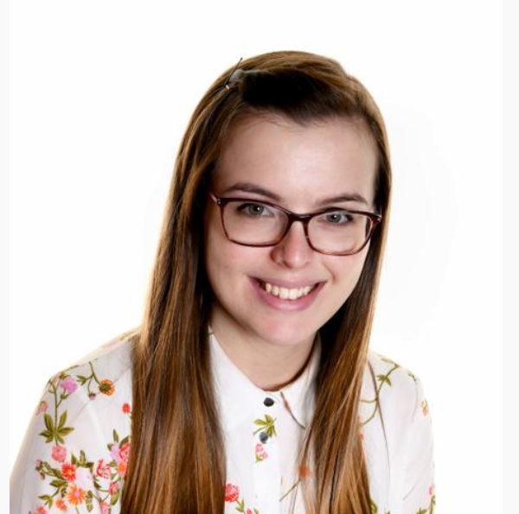
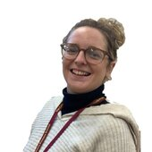
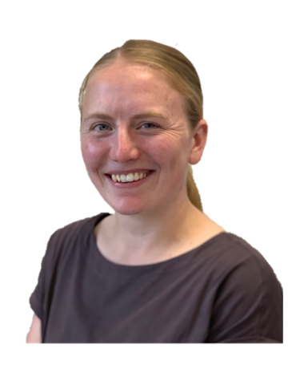
STAFF YOUR CHILD WILL TALK ABOUT
Mrs Lee
Miss Conroy
Mrs Verden

Slide 3
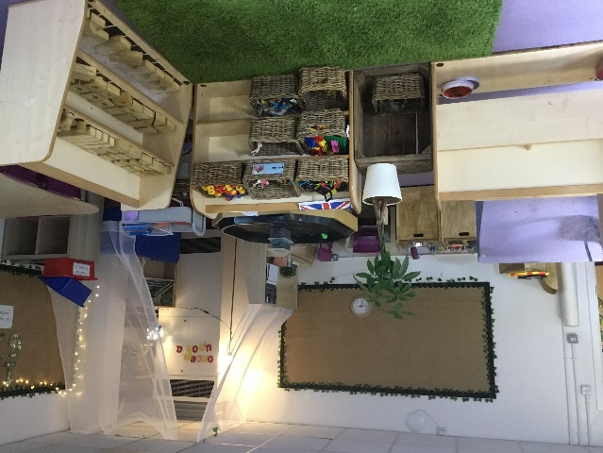
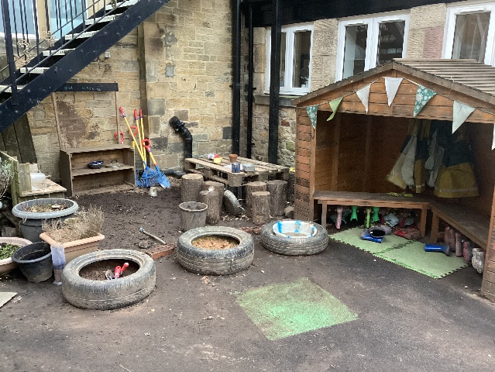
A DAY IN THE LIFE OF RECEPTION
 |  | Phonics Number Rhymes/songs Writing Continuous provision RE
Indoor classroom | Outdoor classroom

Slide 4
MORNING/ END OF DAY ROUTINE
NO PARKING – please see leaflet and activity book about how to walk to school safely.
RECEPTION CHILDREN COME THROUGH EAST ROAD GATE FROM 8.35AM. WALK INTO THE PLAYGROUND AND DROP OFF YOUR CHILD TO AN ADULT AT THE WELCOME BACK BANNER.
YOUR CHILD WILL LINE UP WITH MRS LEE, TA’S AND THE OTHER CHILDREN IN THEIR CLASS. ONE MEMBER OF STAFF WILL BE AVAILABLE TO TALK TO YOU AFTER YOU HAVE DROPPED YOUR CHILD OFF.
CHILDREN BRING IN PE BAGS / BOOK BAG/COATS / LUNCH BOXES IF NEEDED
GATES CLOSE AT 8.45AM.
CHILDREN CHOOSE LUNCH IN CLASS IN THE MORING
END OF THE DAY
CHILDREN BRING OUT BELONGINGS AND LINE UP ON PLAYGROUND
PARENTS WAIT ON THE PLAYGROUND FOR RECEPTION TO BE CALLED
REC CHILDREN (AND SIBLINGS) WILL BE SENT TO YOU

Slide 5
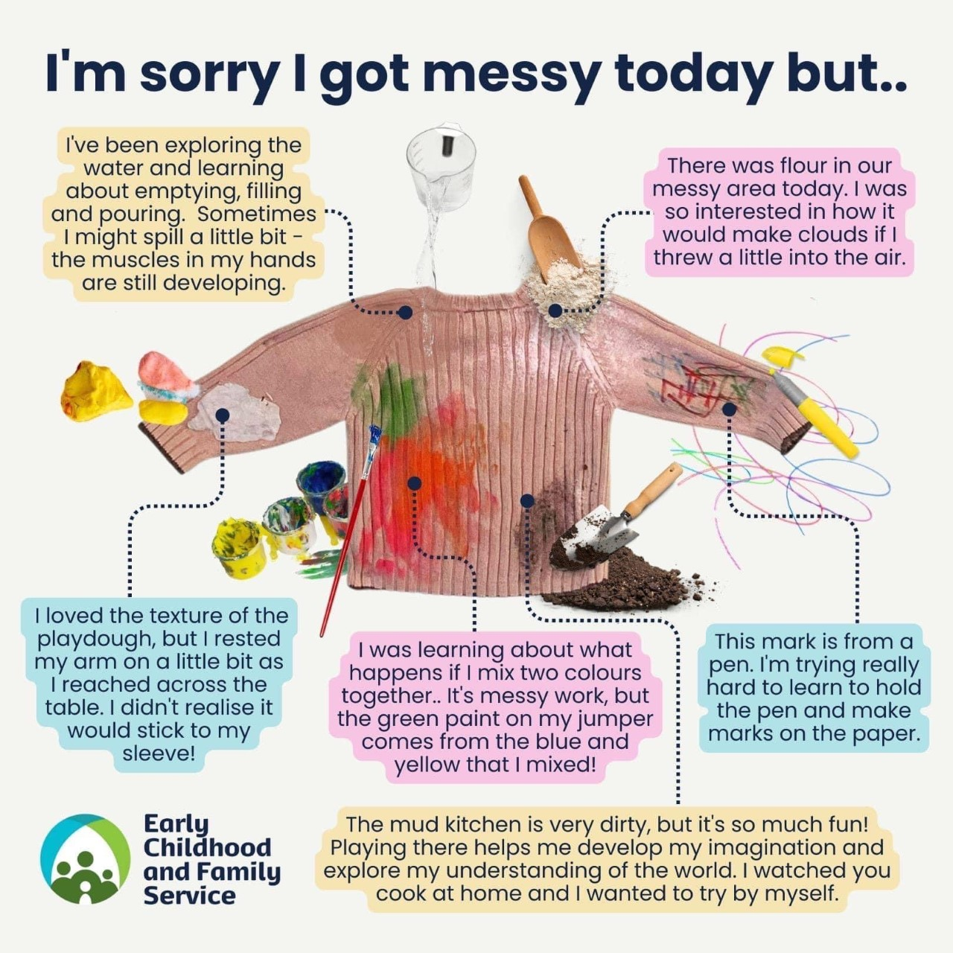
A DAY IN THE LIFE

Slide 6
READING
Home reading and Guided reading
  Early Learning Goal – Word Reading
  Early Learning Goal – Comprehension
Create good reading habits from day 1.

Slide 7
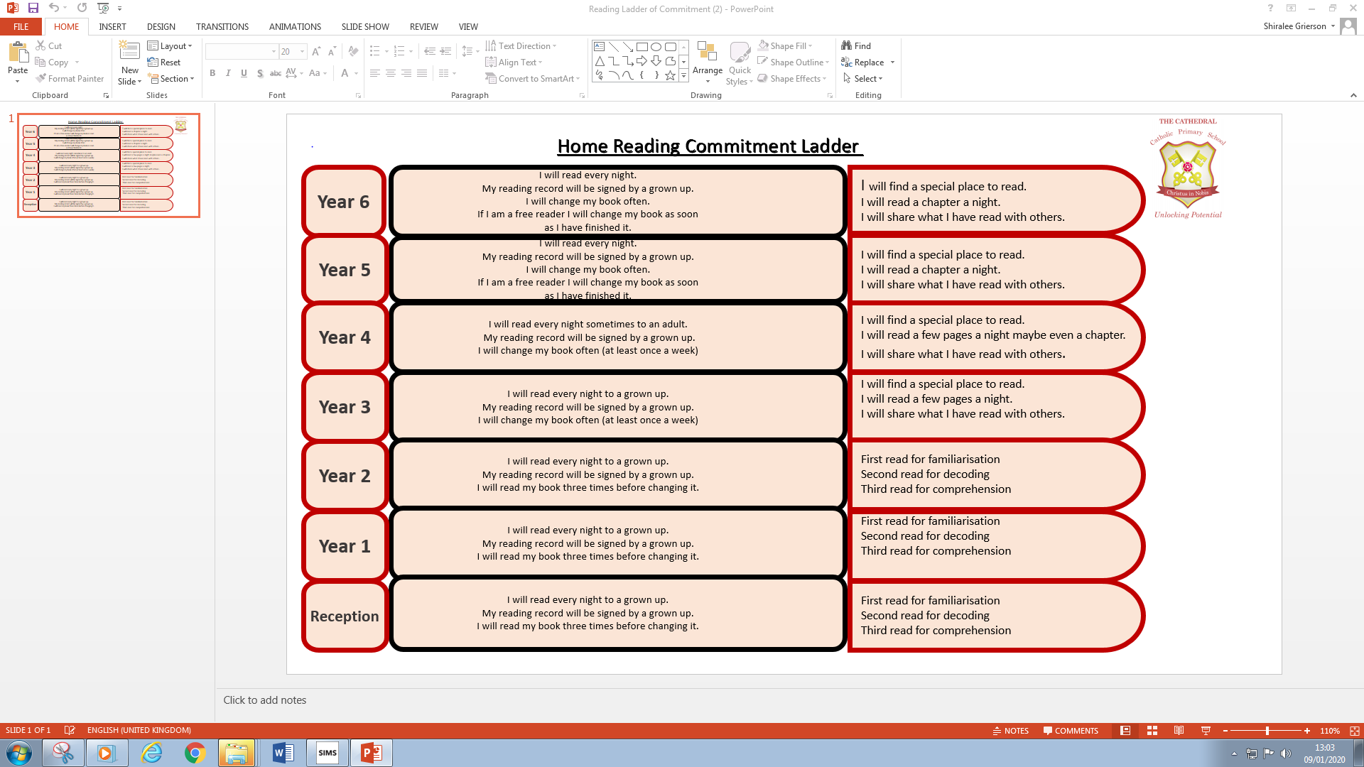
Good habits

Slide 8
Phonics
Phase 1-tuning into sounds
Phase 2-single sounds
Phase 3-digraphs and trigraphs
Phase 4-reinforcing blending

Slide 9
WRITING
Early Learning Goal:
Write recognisable letters, most of which are correctly formed; Spell words by identifying sounds in them and representing the sounds with a letter or letters; Write simple phrases and sentences that can be read by others.

Slide 10

HANDWRITING
Nelson handwriting scheme

Slide 11
Number
Early Learning Goal - Number
Early Learning Goal – Number Pattern
Focus on building a deep understanding of numbers to 10

Slide 12
PE
Daily outdoor learning and gross motor sessions
Named PE kit
No earrings on PE days
Hair
Inhalers

Slide 13
RE
RE Lessons
Celebration of the Word
Hymn Practice
Mass

Slide 14
HOME and School partnership
There is greater impact on development when parents are actively involved in their children’s learning.
To help your child at school, these are some things we need your support with –
Being involved in school life – come to school events like stay and play. Friday once a half term
Reading regularly to your child and encourage them to join in.
Sharing stories
Talking to your child regularly about what is happening, what they can see and what interests them
Being consistent in your approach to your child’s behaviour
Encouraging them to be active and make healthy choices and try different foods
Playing counting and number games
Talk, talk, talk

Slide 15
Digital Wellbeing
‘Maladaptive excessive screen time behaviour in children has been recently associated, among others, with adverse physical (e.g., overweight/obesity), psychological (e.g., language delay) and social health consequences (de Rezende et al., 2014; Li et al., 2020; Lissak, 2018), as well as with impaired executive functions (Zeng et al., 2021).’
Often the amount of screen time isn’t the issue, WHAT children are accessing and seeing is.
App’s are marketed at children, often gamifying every day “learning” and mimic the effect of dopamine in the brain which can lead to disengagement in other activities, reduced social time with peers and family and difficulties with sleep, attention and emotional regulation.
There are age limits on App’s and games for a reason. App’s marketed at children e.g. Kids YouTube, are no safer in terms of content than the regular App’s. The safest way to protect your children is to limit their access completely until they are old enough to know the safety rules.
We expect parents to educate themselves and be active moderators and protectors for their child's online world and screen usage.
We are required, by safeguarding guidance, to act on children reporting that they use apps and sites underage, or if they report seeing inappropriate content for their age and stage of development.

Slide 16
Digital Wellbeing
“Our children are only as safe as their friend with the weakest digital rules”
Top tips for educating yourselves and keeping our children safe:
  Normalise asking other parents/people caring for your child what their online/screen usage rules are before play dates etc
  Check your child's devices daily and involve them in regular discussions about safe usage of screens, devices and their online presence
  Use school as a resources to help if you need us – we can give advice, talk to children and even look at safety settings and controls on devices with you
  Use your own social media and internet access as a tool for learning:
    Dr Alison Yeung, MD, GP https://www.instagram.com/thesmartphoneeffectmd/#
    Catherine Knibbs – Child Therapist specialising in Cybertrauma https://www.instagram.com/catherine_knibbs/#
    Smartphone Free Childhood Campaign https://www.instagram.com/smartphonefreechildhood/#
    esafekids - Body Safety, Cyber Safety & Pornography
    Education Specialist https://www.instagram.com/esafekids/#

Slide 17
Special Educational Needs & Inclusion
Many children struggle with learning at some point in their educational life.
Cognition & Learning Needs
Communication and & Interaction Needs
Social, Emotional & Mental Health Needs
Sensory & Physical (independence and Self Help) Needs
Every teacher is a teacher of SEND & what is helpful for SEND pupils is helpful for all children.
Provision or support that is additional to & different from their peers
(SEN Support) Universal Support, Group Support
(Education Health and Care Plan) Individual & Intensive support
Key documents and guidance on the school website - Inclusion and Equality | The Cathedral Catholic Primary School

Slide 18
ATTENDANCE and PUNCTUALITY
When your child attends in Reception, we want them to come every day and on time.
We expect children’s attendance to stay above 96%, and we hope as many of our children as possible will be an Attendance HERO – Here Everyday Ready On time.
If your child is too ill to attend school or is absent for any other reason, please contact the school by ringing the school office on 01772 556306 on the first day of absence before registration closes at 9am. If you leave a voicemail, please include child’s name, class and reason for absence.
If your child is going to an appointment, please note we cannot authorise these without the letter or appointment card.
Holidays during term time are not authorised unless in exceptional circumstances. Please note that all leave during term time for any length of time must be applied for with a form from the school office.

Slide 19
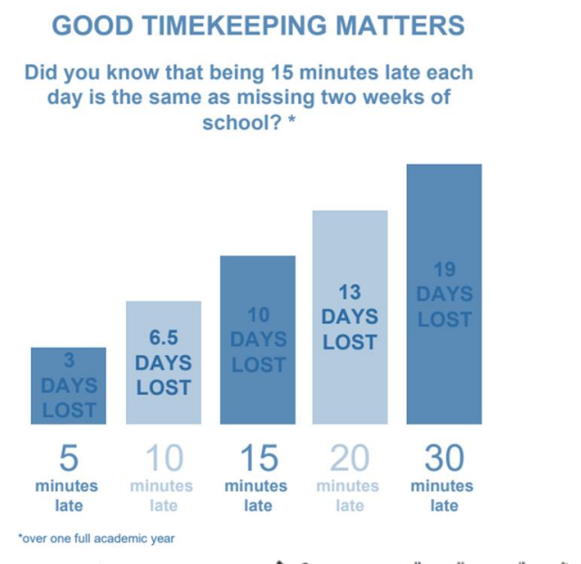
Punctuality
Children need to be in the line by ¼ to nine.
Great chance to socialise and meet up with friends, choose their lunch and start learning.

Slide 20
Arbor
Once your child starts full time you will receive an email to join Arbor.
See leaflet in your pack
Breakfast / After school payment must be kept up to date and paid in advance on Arbor
Trips and paid clubs can be paid on Arbor and must be paid before the visit takes place.
No need to sign a permission slip for trips if paid on Arbor before the trip goes ahead.

Slide 21
Communication
Emails
www.cathedral.lancs.sch.uk – save it on your desktop so much to see on there.
Regularly updated on Reception class page and blog Lots of photos and what they have been learning each week.
Parent’s section – newsletter every Friday for reference
Meet the teacher will take place in September and parents evening in Autumn and Spring Term. Share email address – 2 email addresses on your data form
See a staff member in the morning, write a note, phone school or email to the class teacher using k.lee@cathedral.lancs.sch.uk.
Written reports come out once a term. End of year one is more detailed.
Facebook - https://www.facebook.com/profile.php?id=61584762347179&locale=en_GB

Slide 22
School dinners and milk and water
All children are entitled to a FREE school lunch whilst in Reception, Year 1 and Year 2!
Our meals are cooked daily on site.
Children decide what they will eat for lunch when arriving at the classroom door each morning. There is a choice of three things including a vegetarian option.
Any help practicing using a knife and fork before September is very much appreciated.
Reception children under the age of 5 are entitled to receive a free carton of milk daily. Please use the Cool milk leaflet to order this online for your child.
Please send in a water bottle with plain water for your child to access throughout the day. School bottles are available in the office for £1.50

Slide 23
Breakfast and After school club.
After school club: 3.15-6pm-collect from front door
Breakfast club: 7.45 till 8.45am-drop off at front door
Bookings can be made by ringing the office or emailing bursar@cathedral.lancs.sch.uk and having your child’s name put on a register. There are limited places and you MUST book 24 hours in advance. Unless your child’s name is on the register they can’t attend the club.

Slide 24
PTA
You are all members of the PTA. Great to have new volunteers and help raise money for your children.
Activities
  Frequent PTA disco nights
  Cultural food night.
  Christmas and Summer fairs
  Family food nights
  PTA 100 club
  Fundraising (events and grants)
  Money goes directy to school and this year has bought: VR sets, new digital cameras and funded all classes an extra visit and lots more.

Slide 25
School Nurse

Slide 26
Stay and Play
Take place one a half term.
Wednesday 15th July 2026: 2.30 - 3.00pm

Slide 27
Things to do now.
Names-very important. Make sure we have the correct spelling and pronunciation.
Nursery list – tell us which nursery your child is at.
Home Visits – Telephone number and language spoke at home.
Induction visits at school -sign up for 2,
  Tuesday 30th June 9.30-11.00am Tuesday 30th June 1.00-2.30pm
  Thursday 2nd July 9.30-11.00am Thursday 2nd July1.00-2.30pm
PLEASE COME AND FIND US IF YOU HAVE ANY QUESTIONS
Complete paperwork. We need this back on the induction days or tonight.

Slide 28
Finally…
Lots of information in your packs.
We really appreciate your support.
We look forward to welcoming you to our school family.
Any questions?

