Slide 1
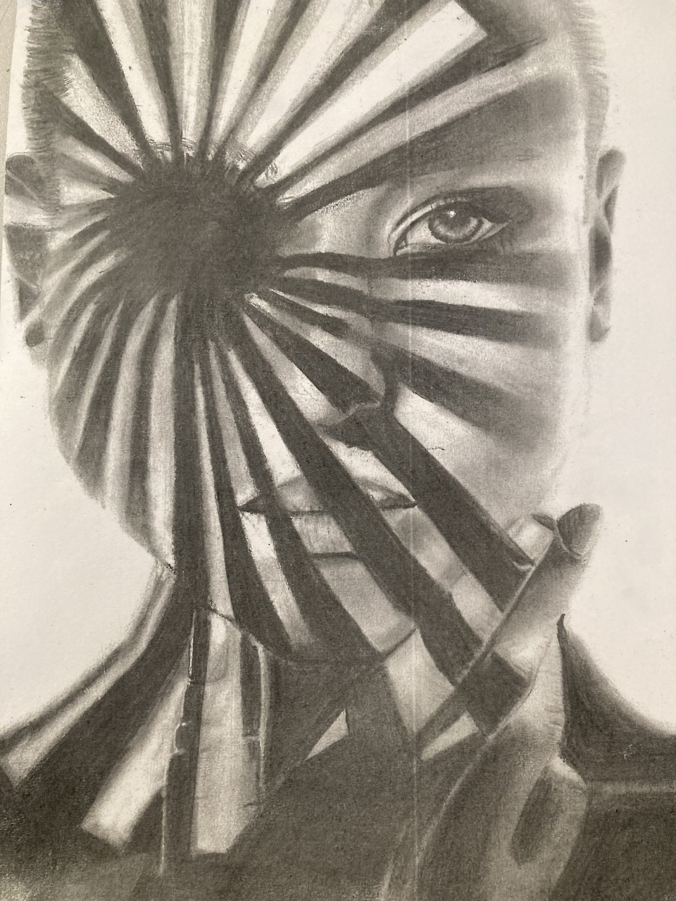
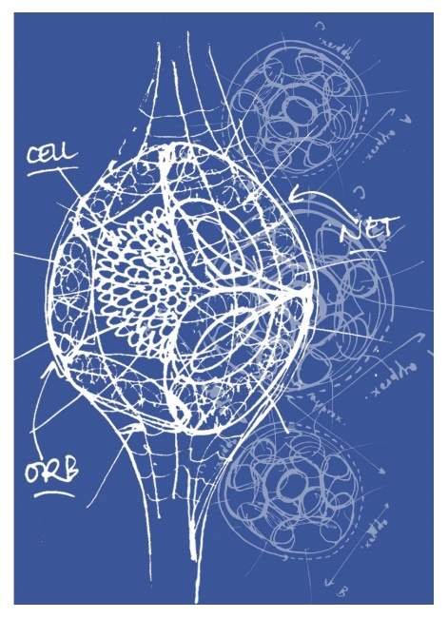
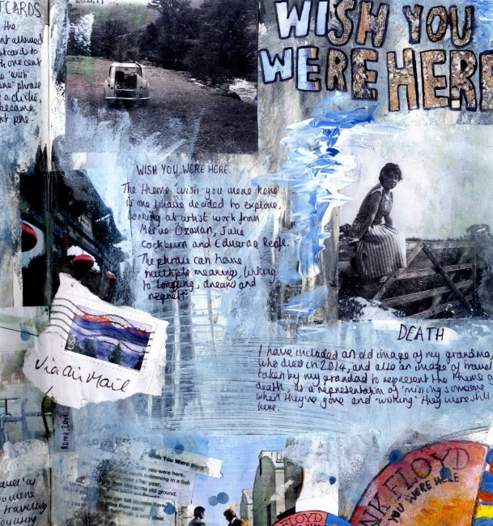
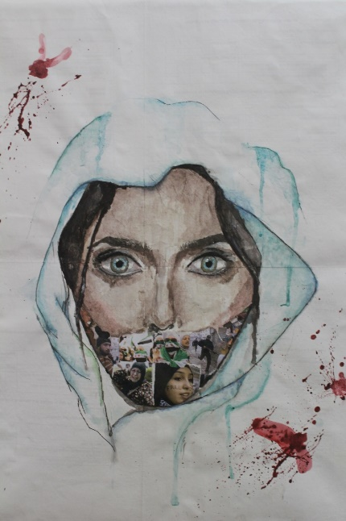
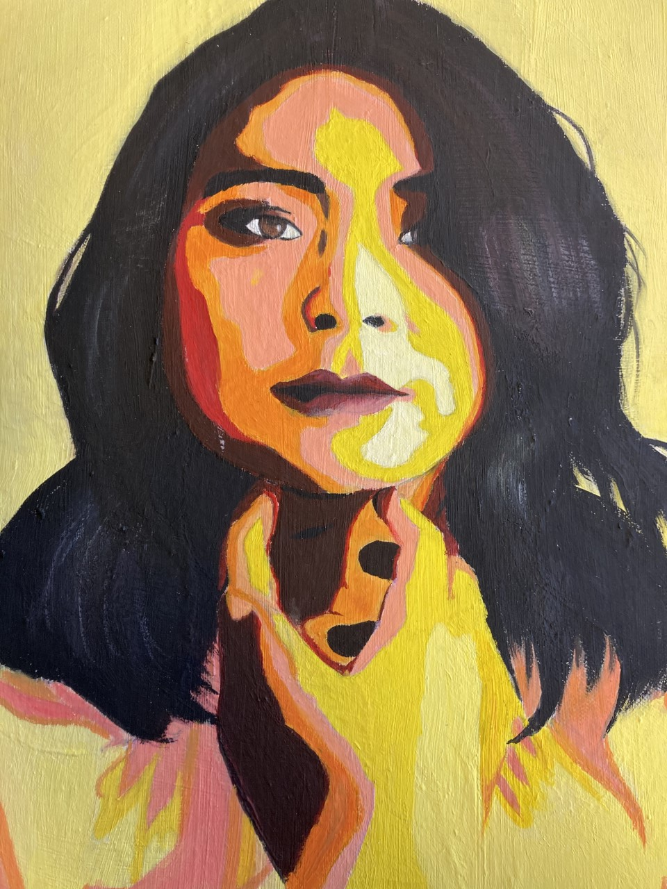
GCSE Art & Design
Mrs Stephenson
Tuesday 3rd February 2026
“Art is the oxygen that makes all other subjects breathe”
Alan Parker Filmmaker

Slide 2
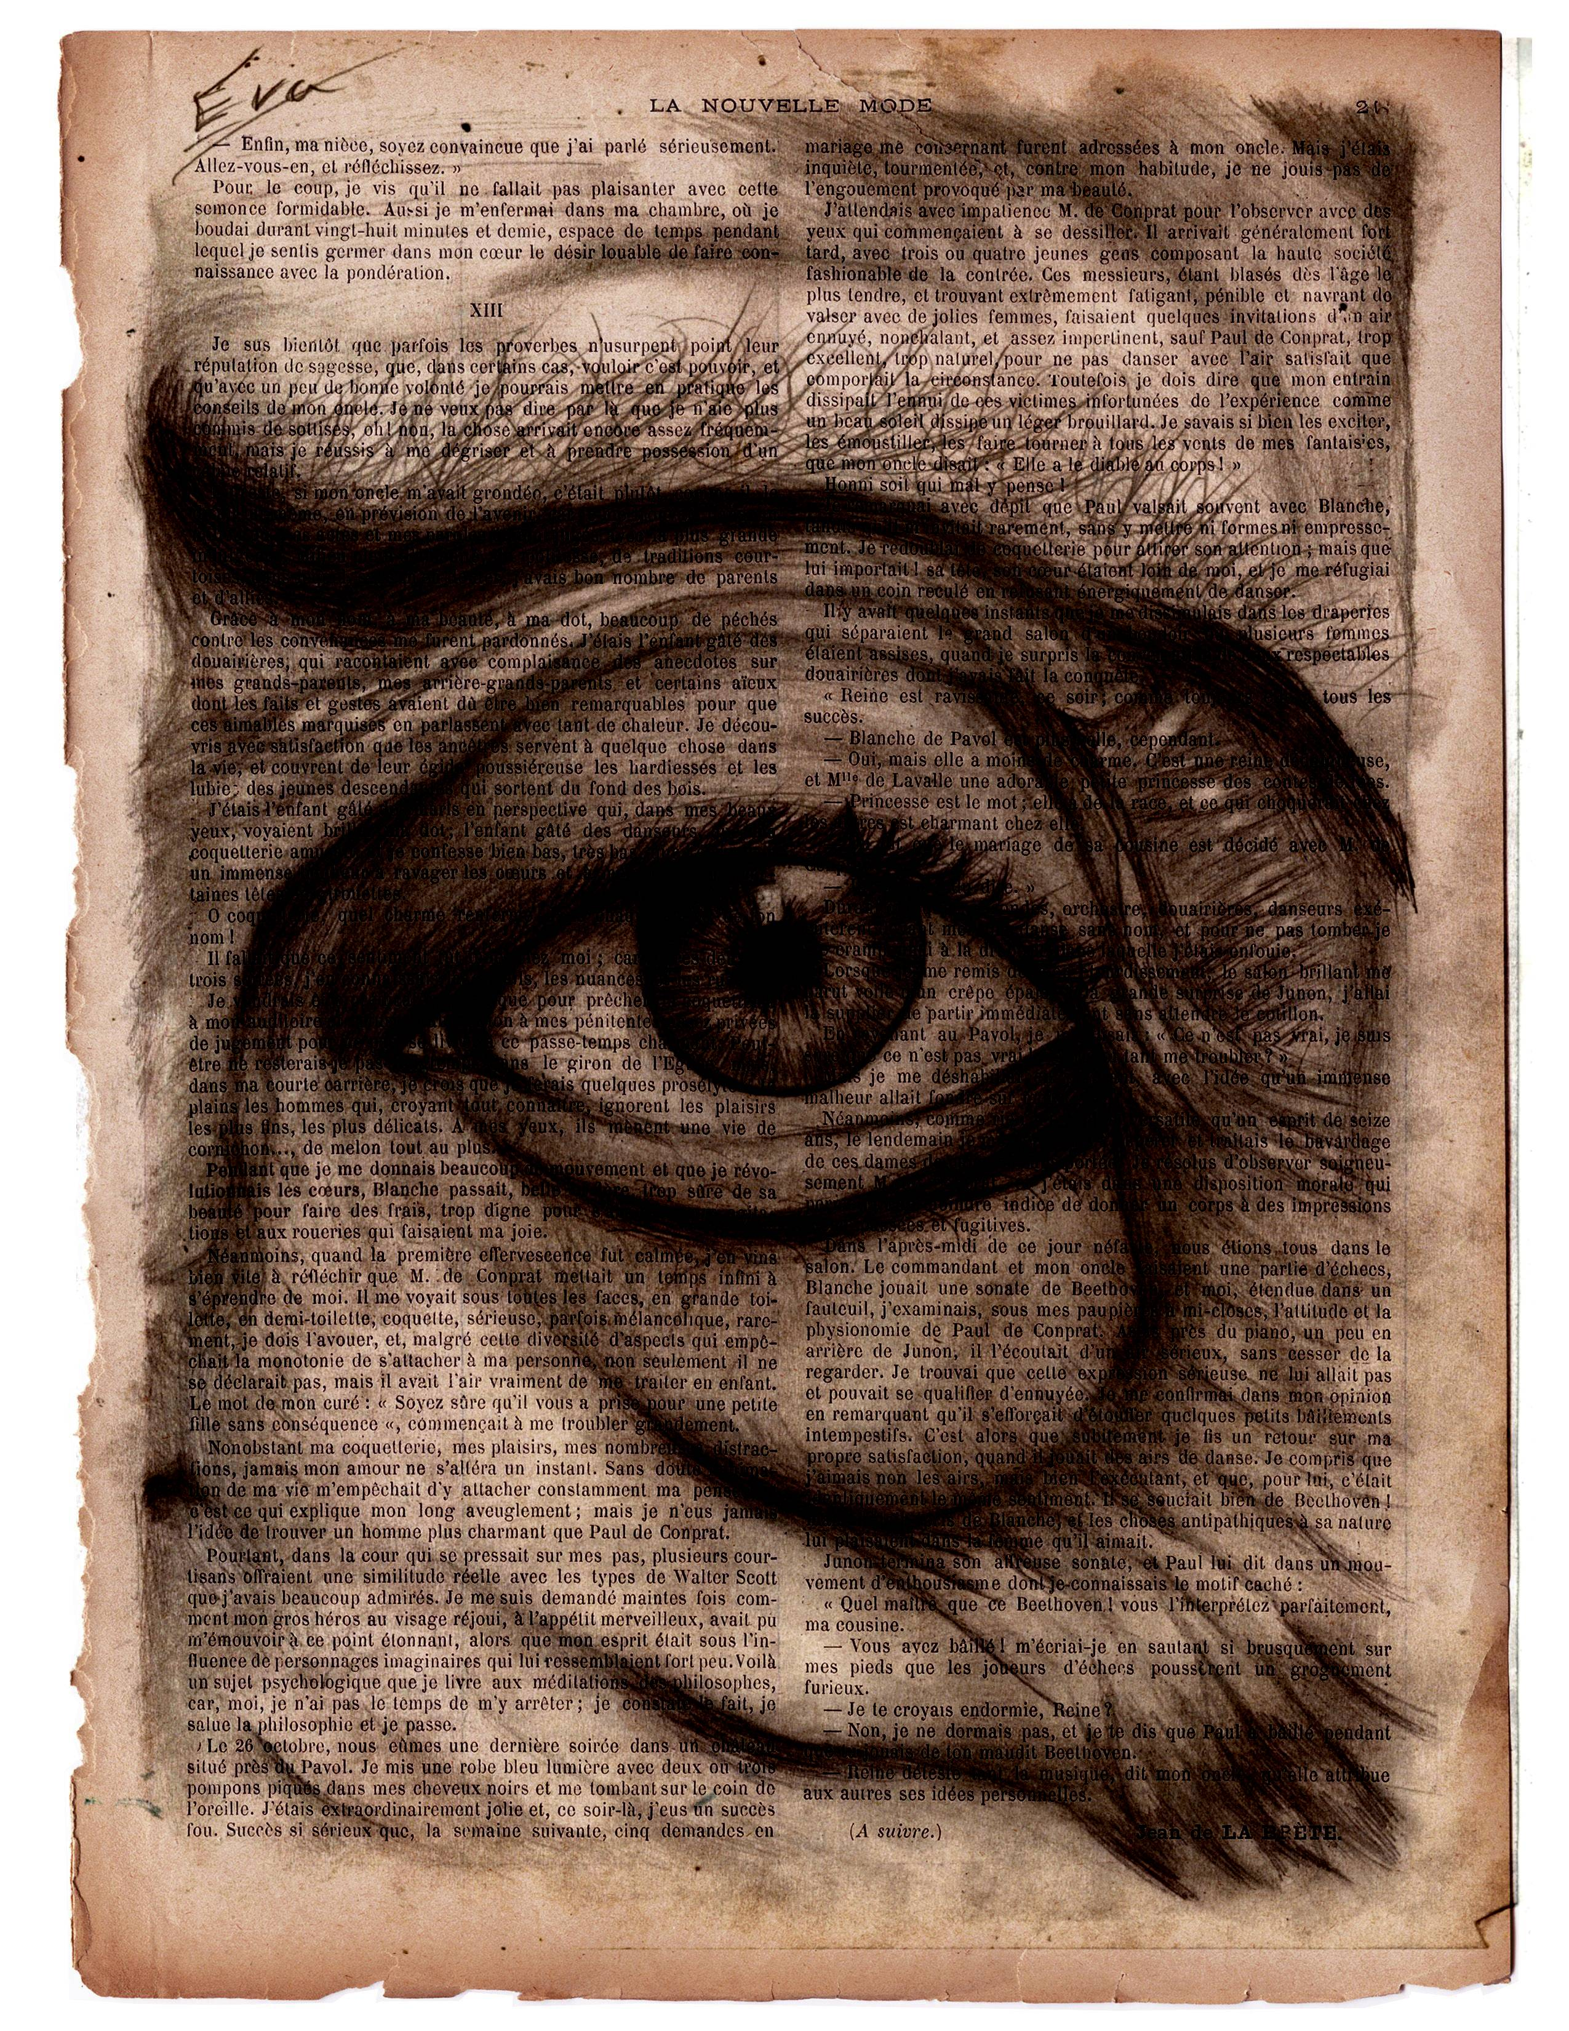
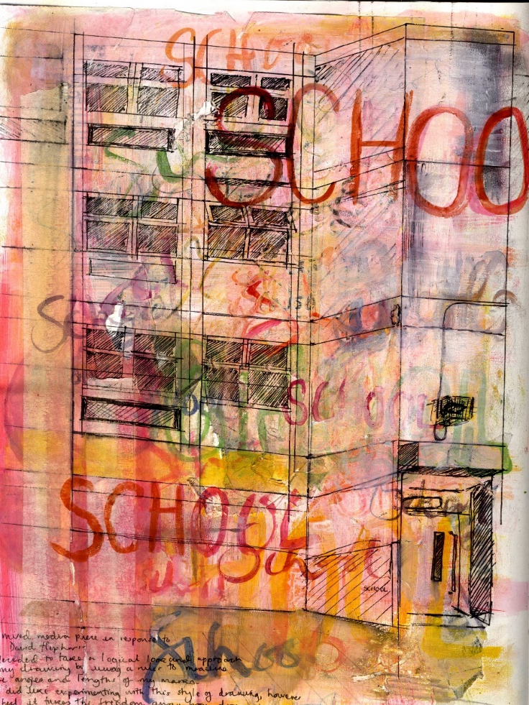
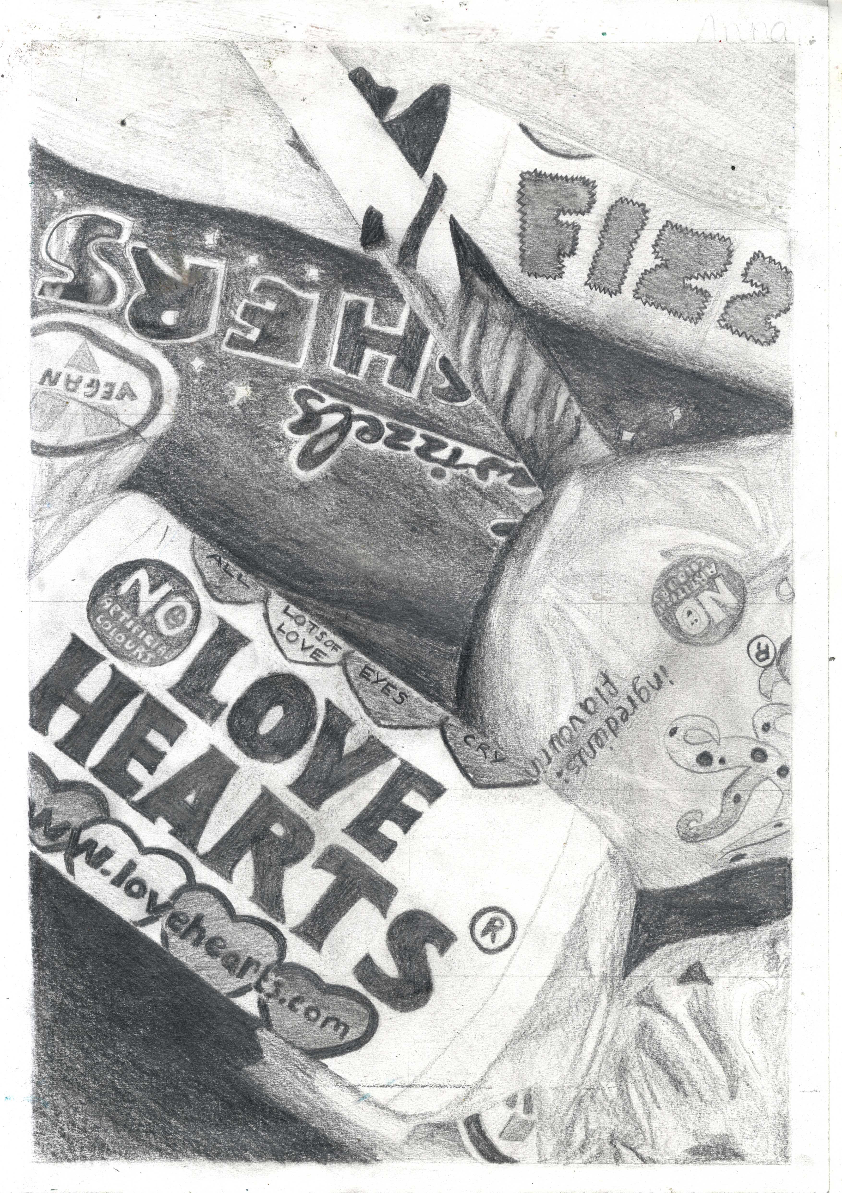

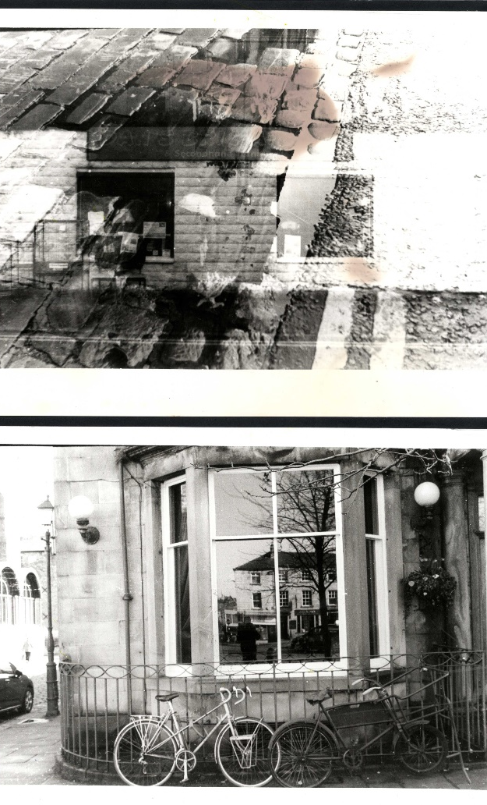

Are you creative, imaginative and enthusiastic?
Do you like finding out about the work of other artists and
designers?
Are you self motivated and have a passion for Art?
Do you enjoy experimenting with skills and techniques using a wide variety of materials including drawing, painting, mixed media, printmaking and digital
outcomes?
Do you enjoy art lessons in
Year 9?

Slide 3
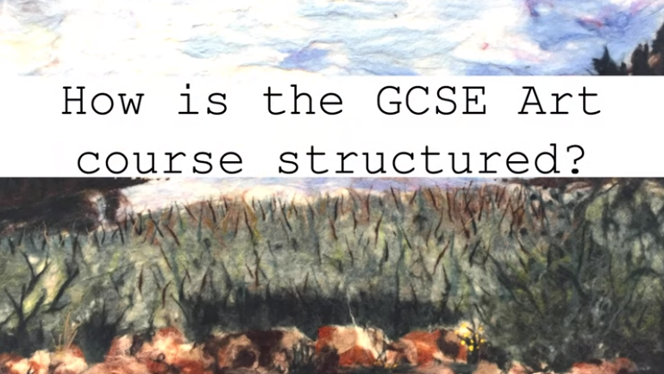
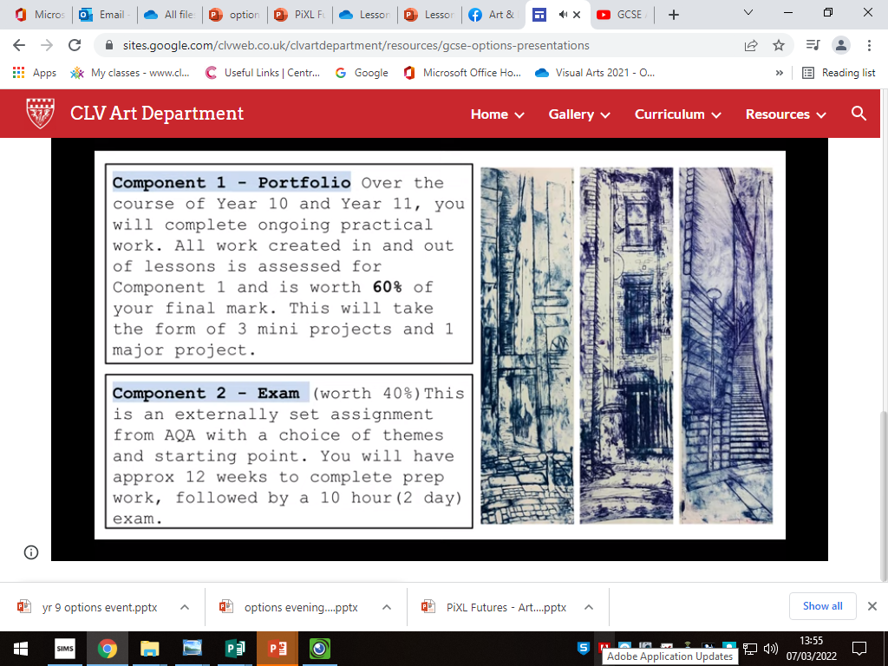
How is the course structured?

Slide 4
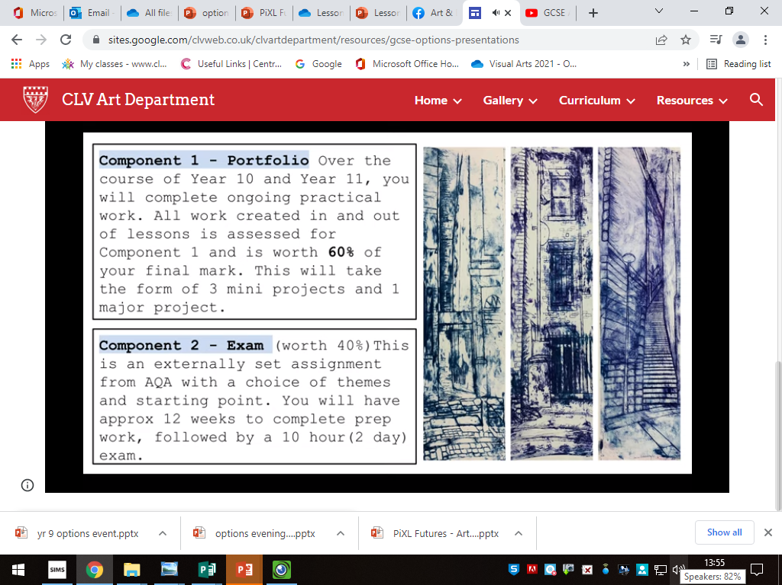
GCSE Assessment
Exam board: AQA
Component 1 –
Portfolio of work (worth 60%)
Over the course of year 10 and 11 you will complete ongoing practical work.
All work created in and out of lessons is assessed for component 1.
This will take the form of two projects.
Component 2 –
Externally set task (worth 40%)
This is an externally set assignment from AQA with a choice of themes and starting points.
You will have approximately 12 weeks to complete prep work followed by a 10 hour (2 day) exam

Slide 5
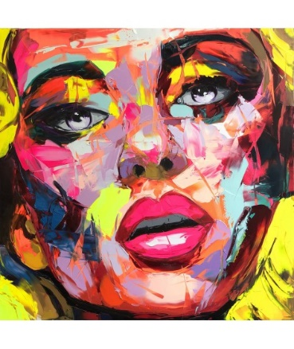
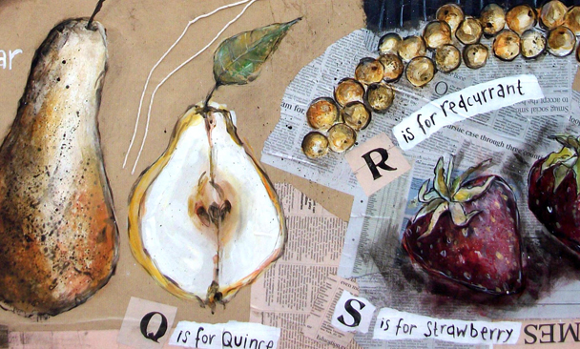
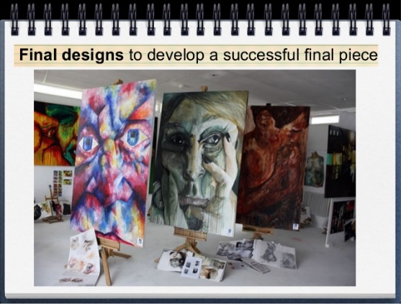
Year 10
Autumn Term
Project: Workshop based skills
Develop drawing and painting skills.
Study work from different artists and painters enabling you to find your own personal style.
Develop a range of image editing techniques.
Explore different printmaking processes.
Spring Term
Mock Exam: Natural Forms
Spring-Summer Term
Project: self-directed theme (sustained project)
This project is an independent work project where pupils experiment with ideas developed from a selection of starting points given to them by their teacher. They should be encouraged to work with their strengths that they discovered whilst completing past work.
Year 11
Continuation of sustained project until December.
January: Exam preparation starts.
April: 10 hour exam

Slide 6
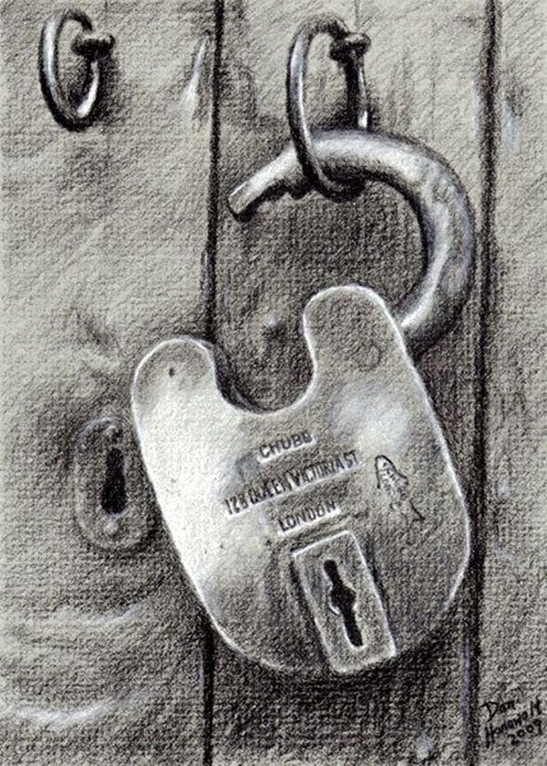
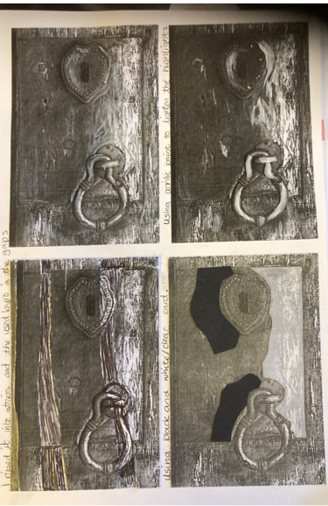
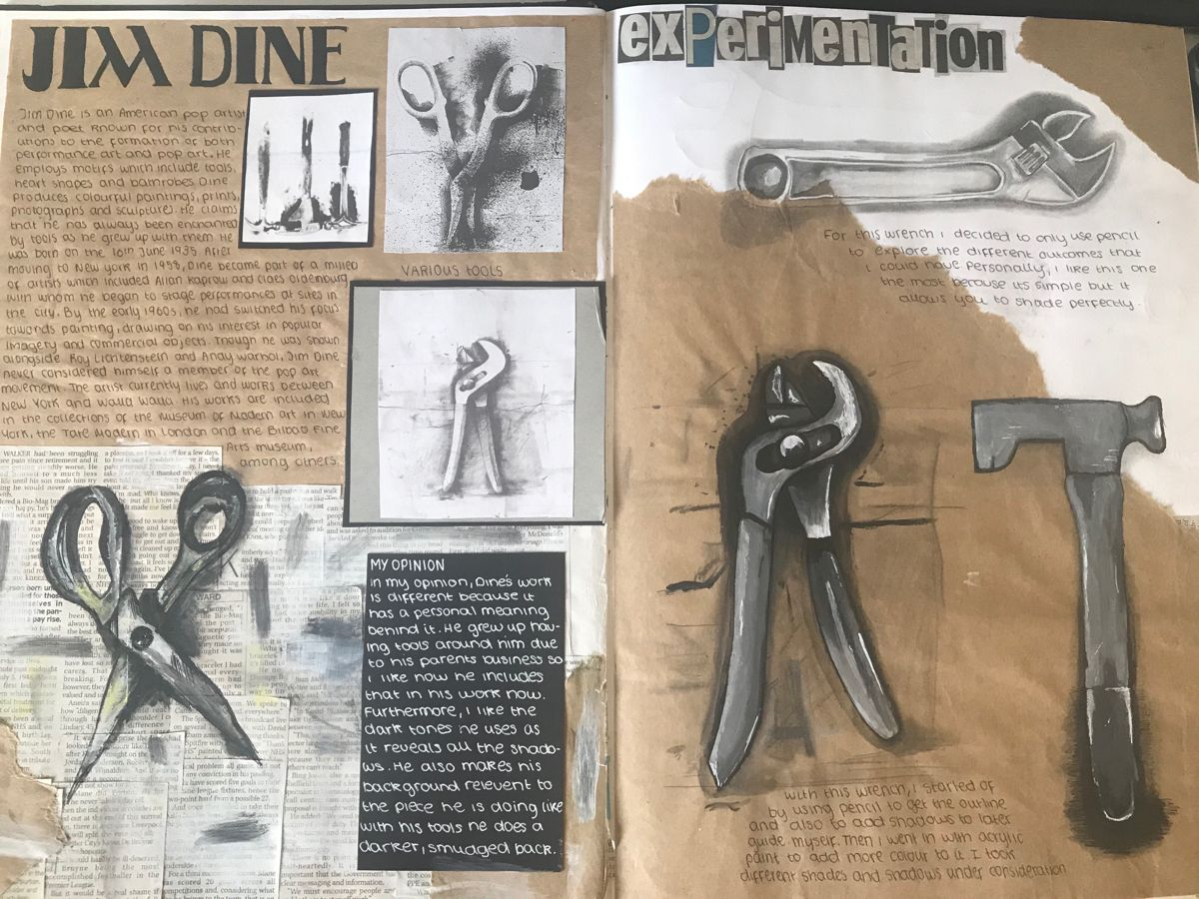
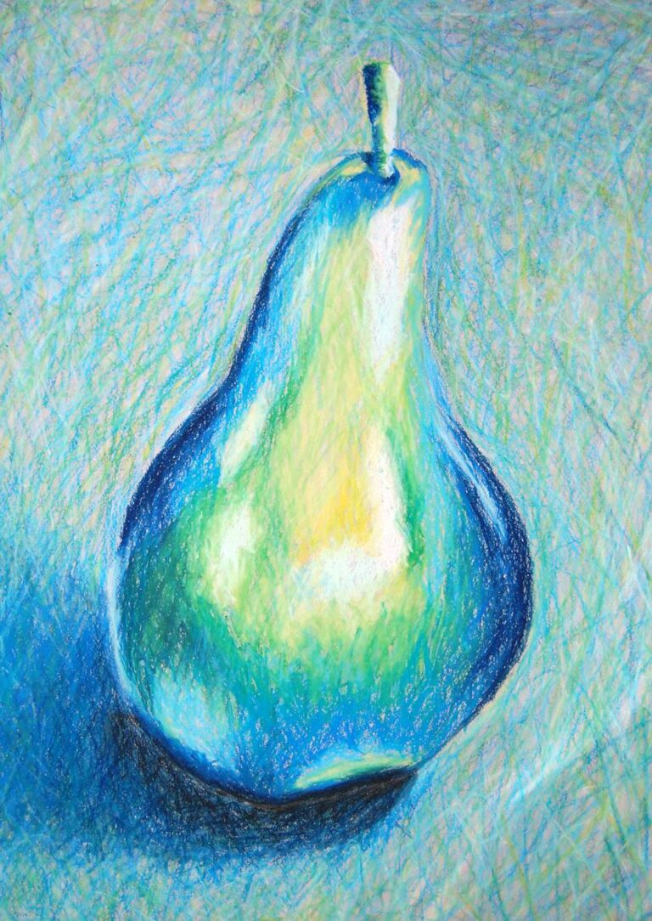

Year 10
'Skills based workshops'

Slide 7
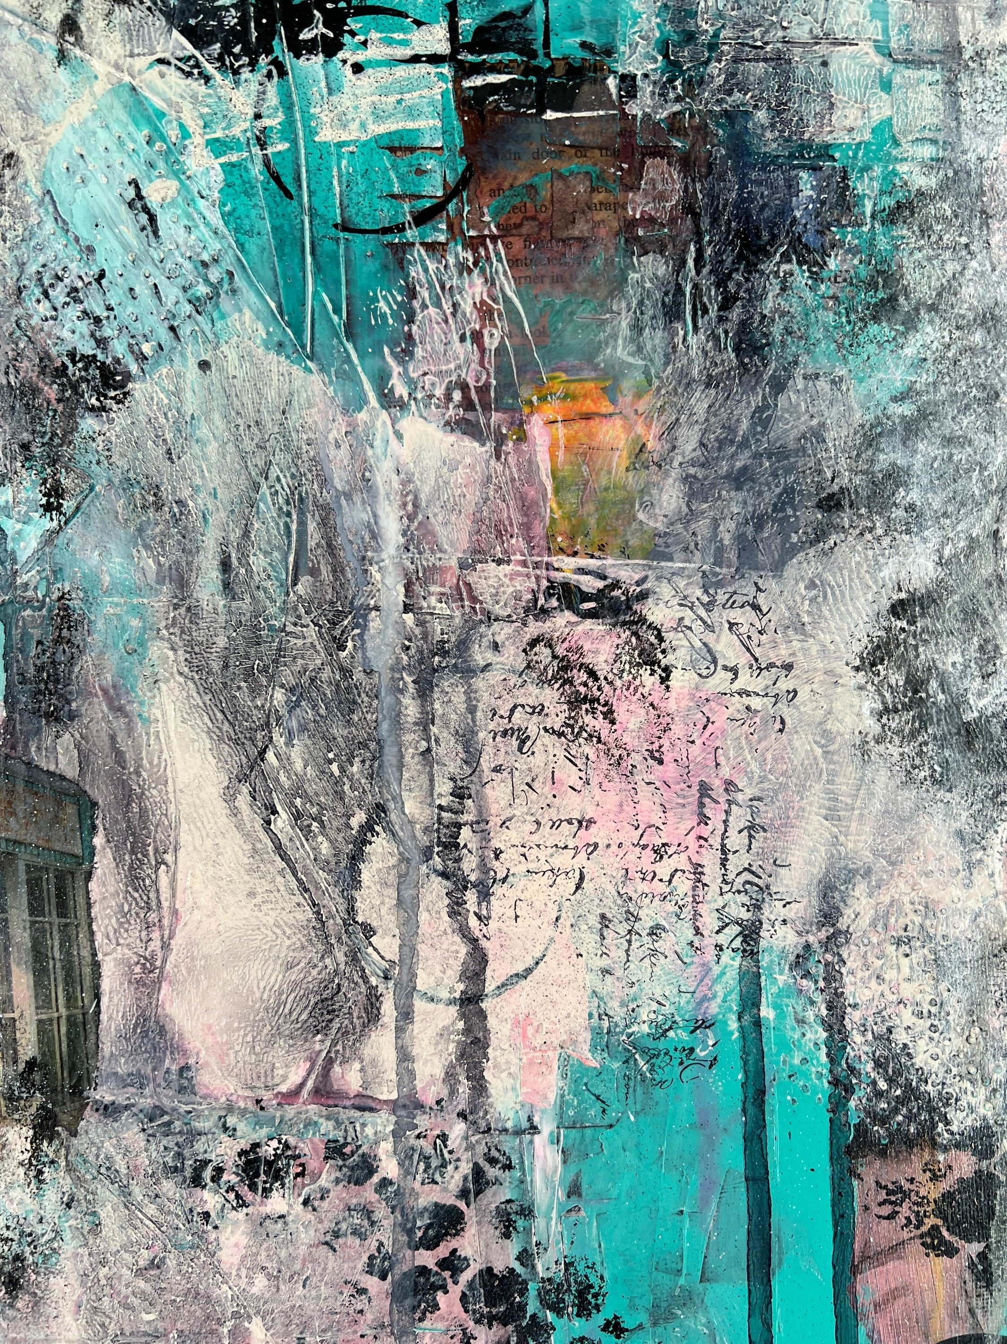
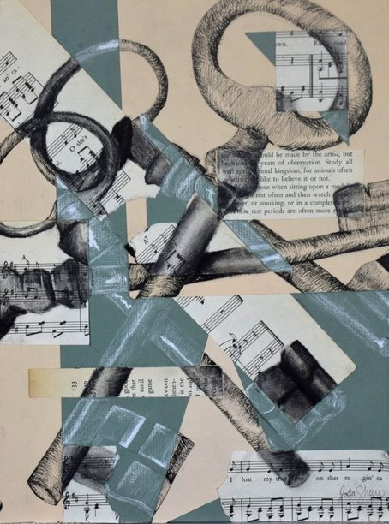
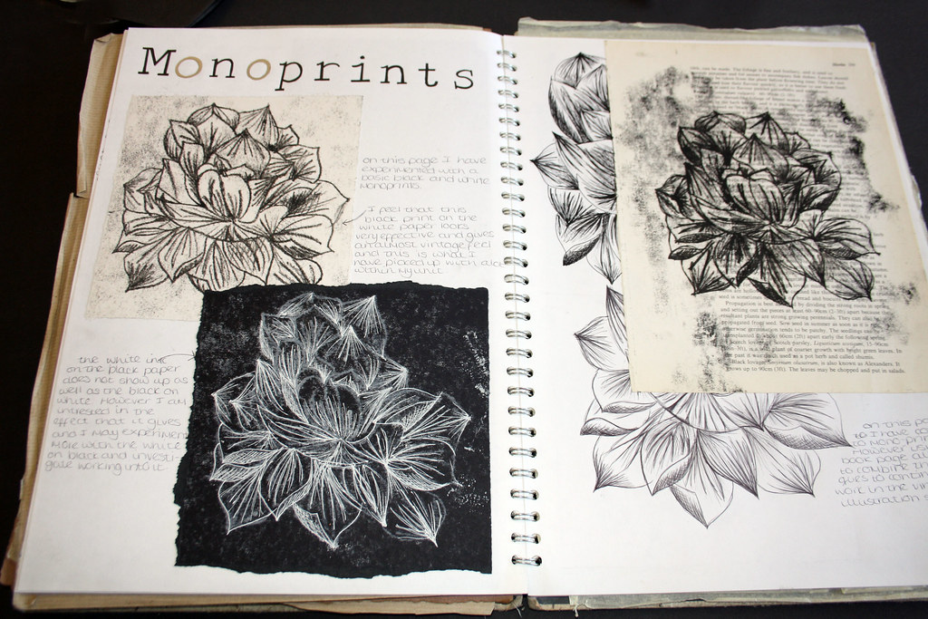
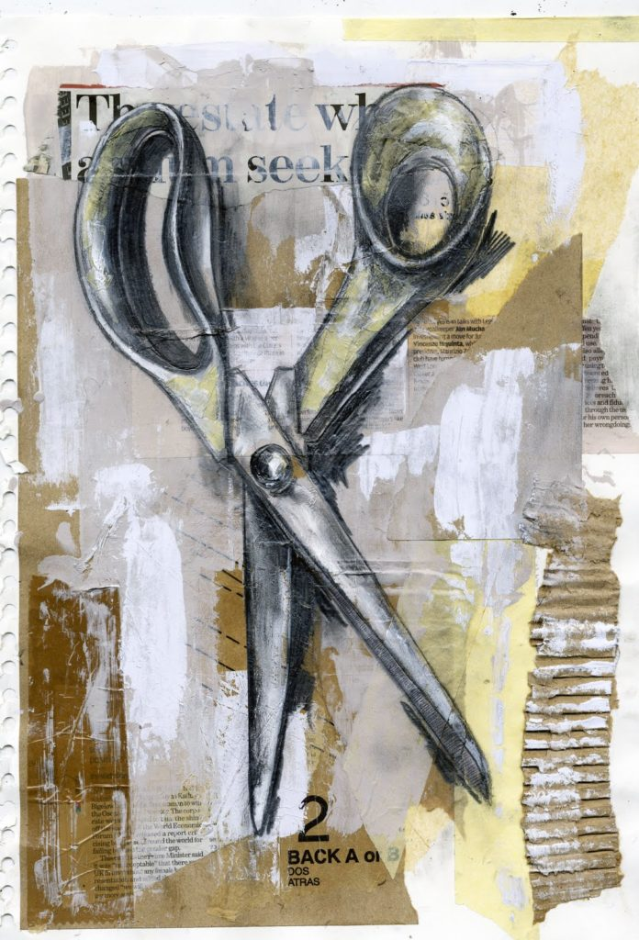
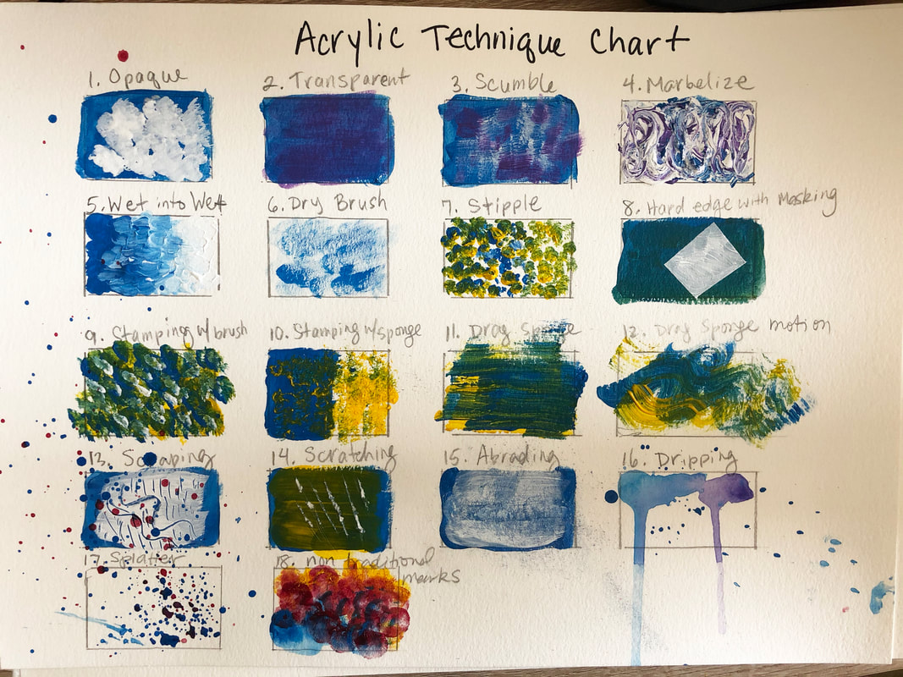
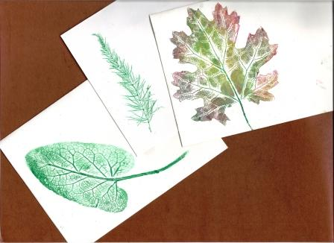

Slide 8
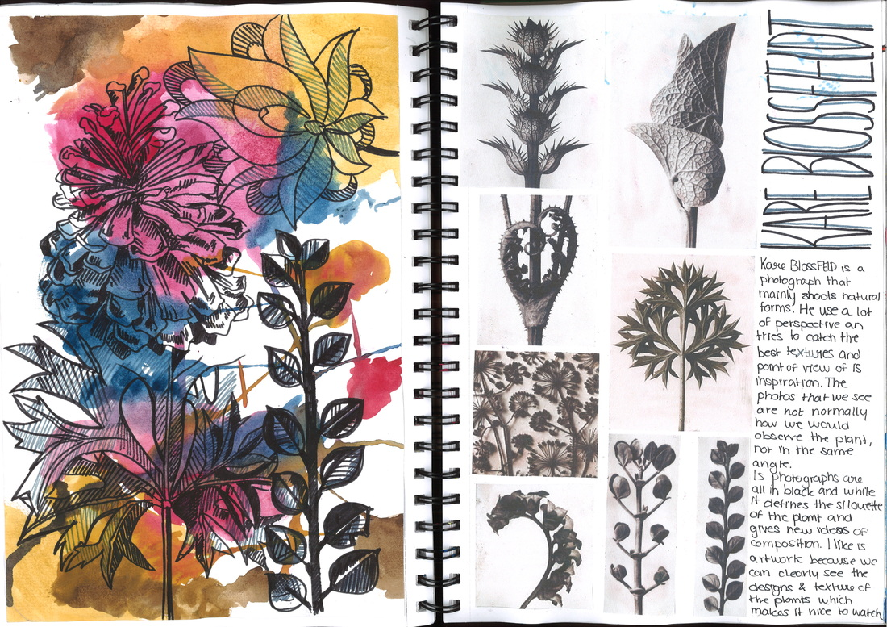

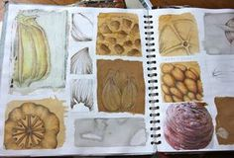
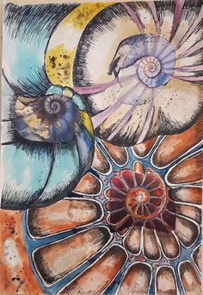
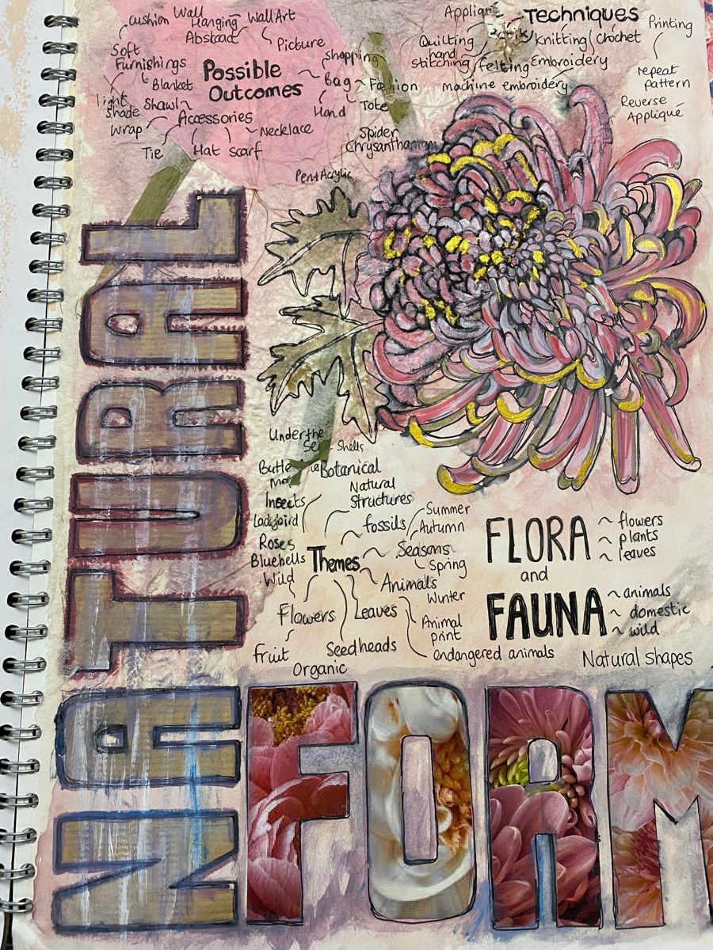
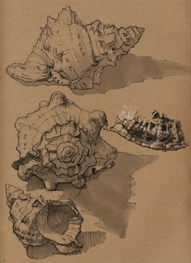
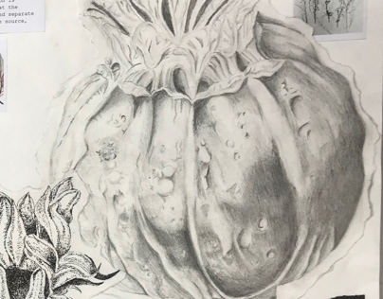
Year 10
'Mock Exam'

Slide 9
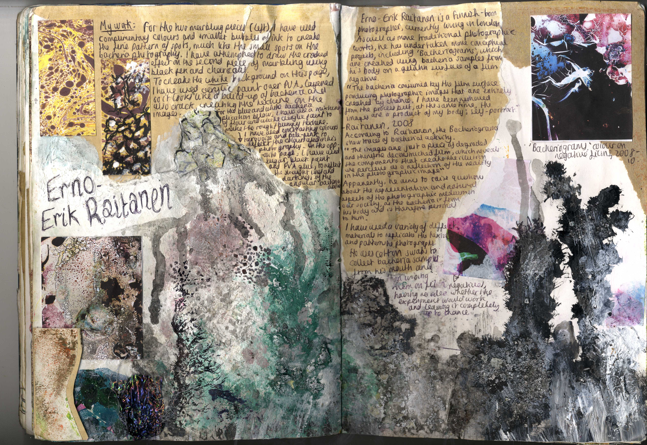
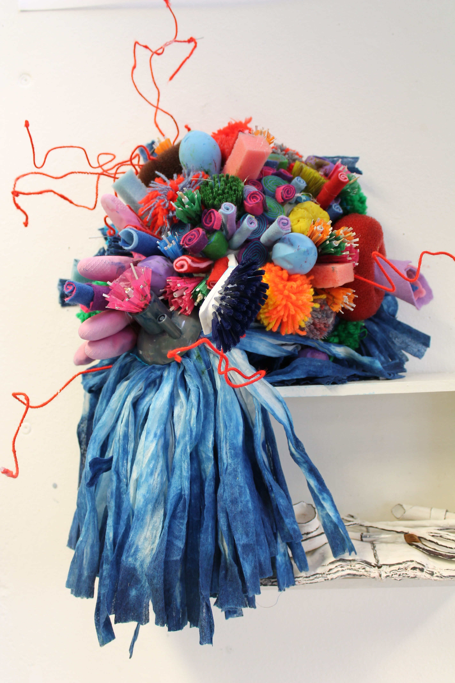
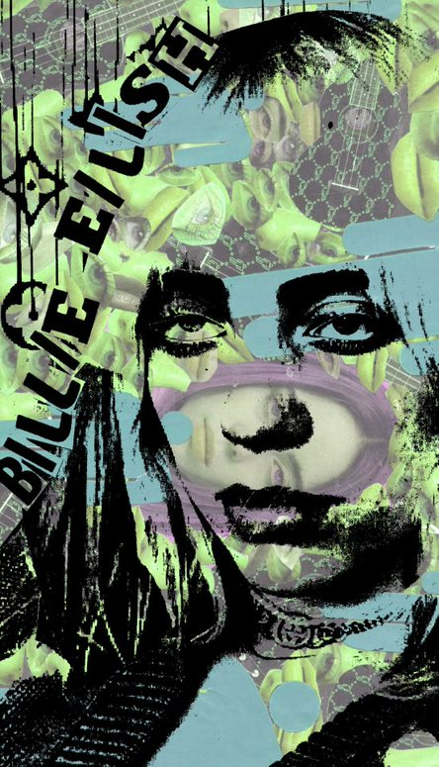
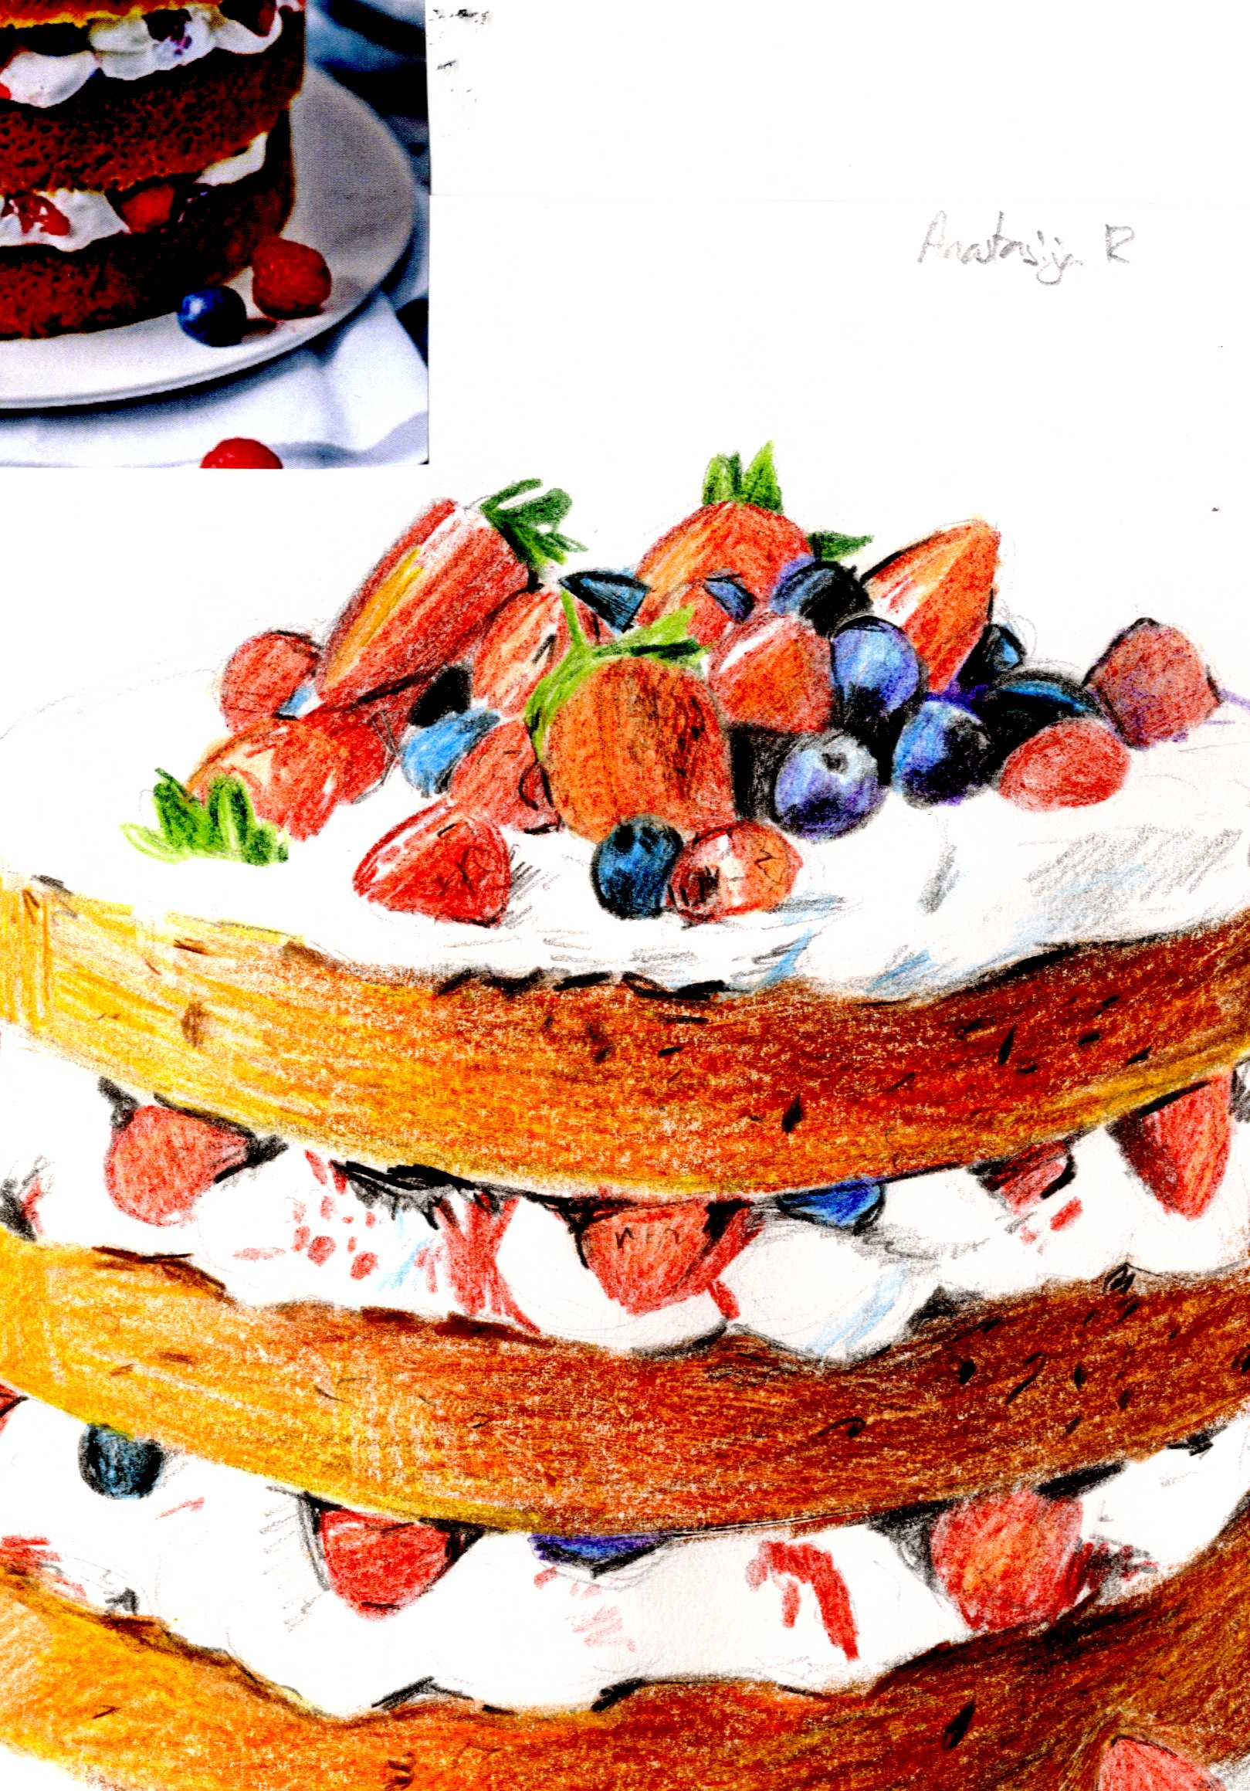
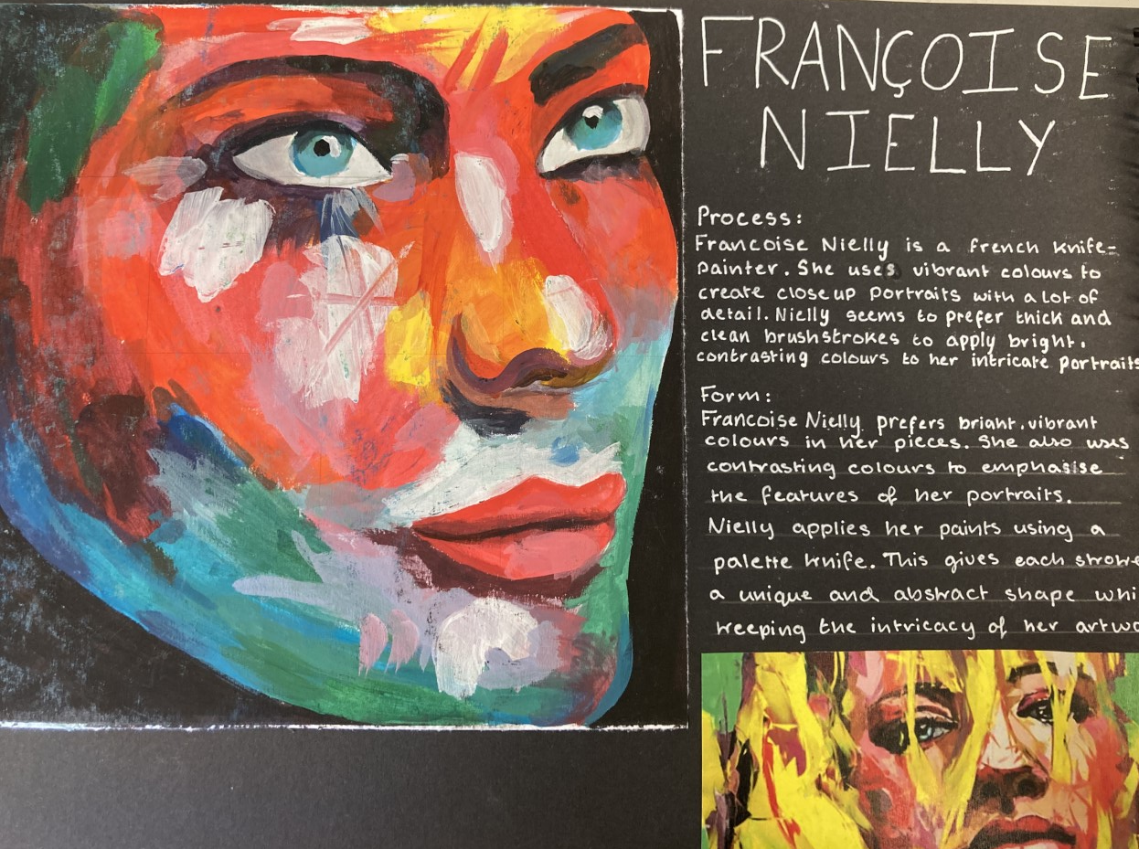
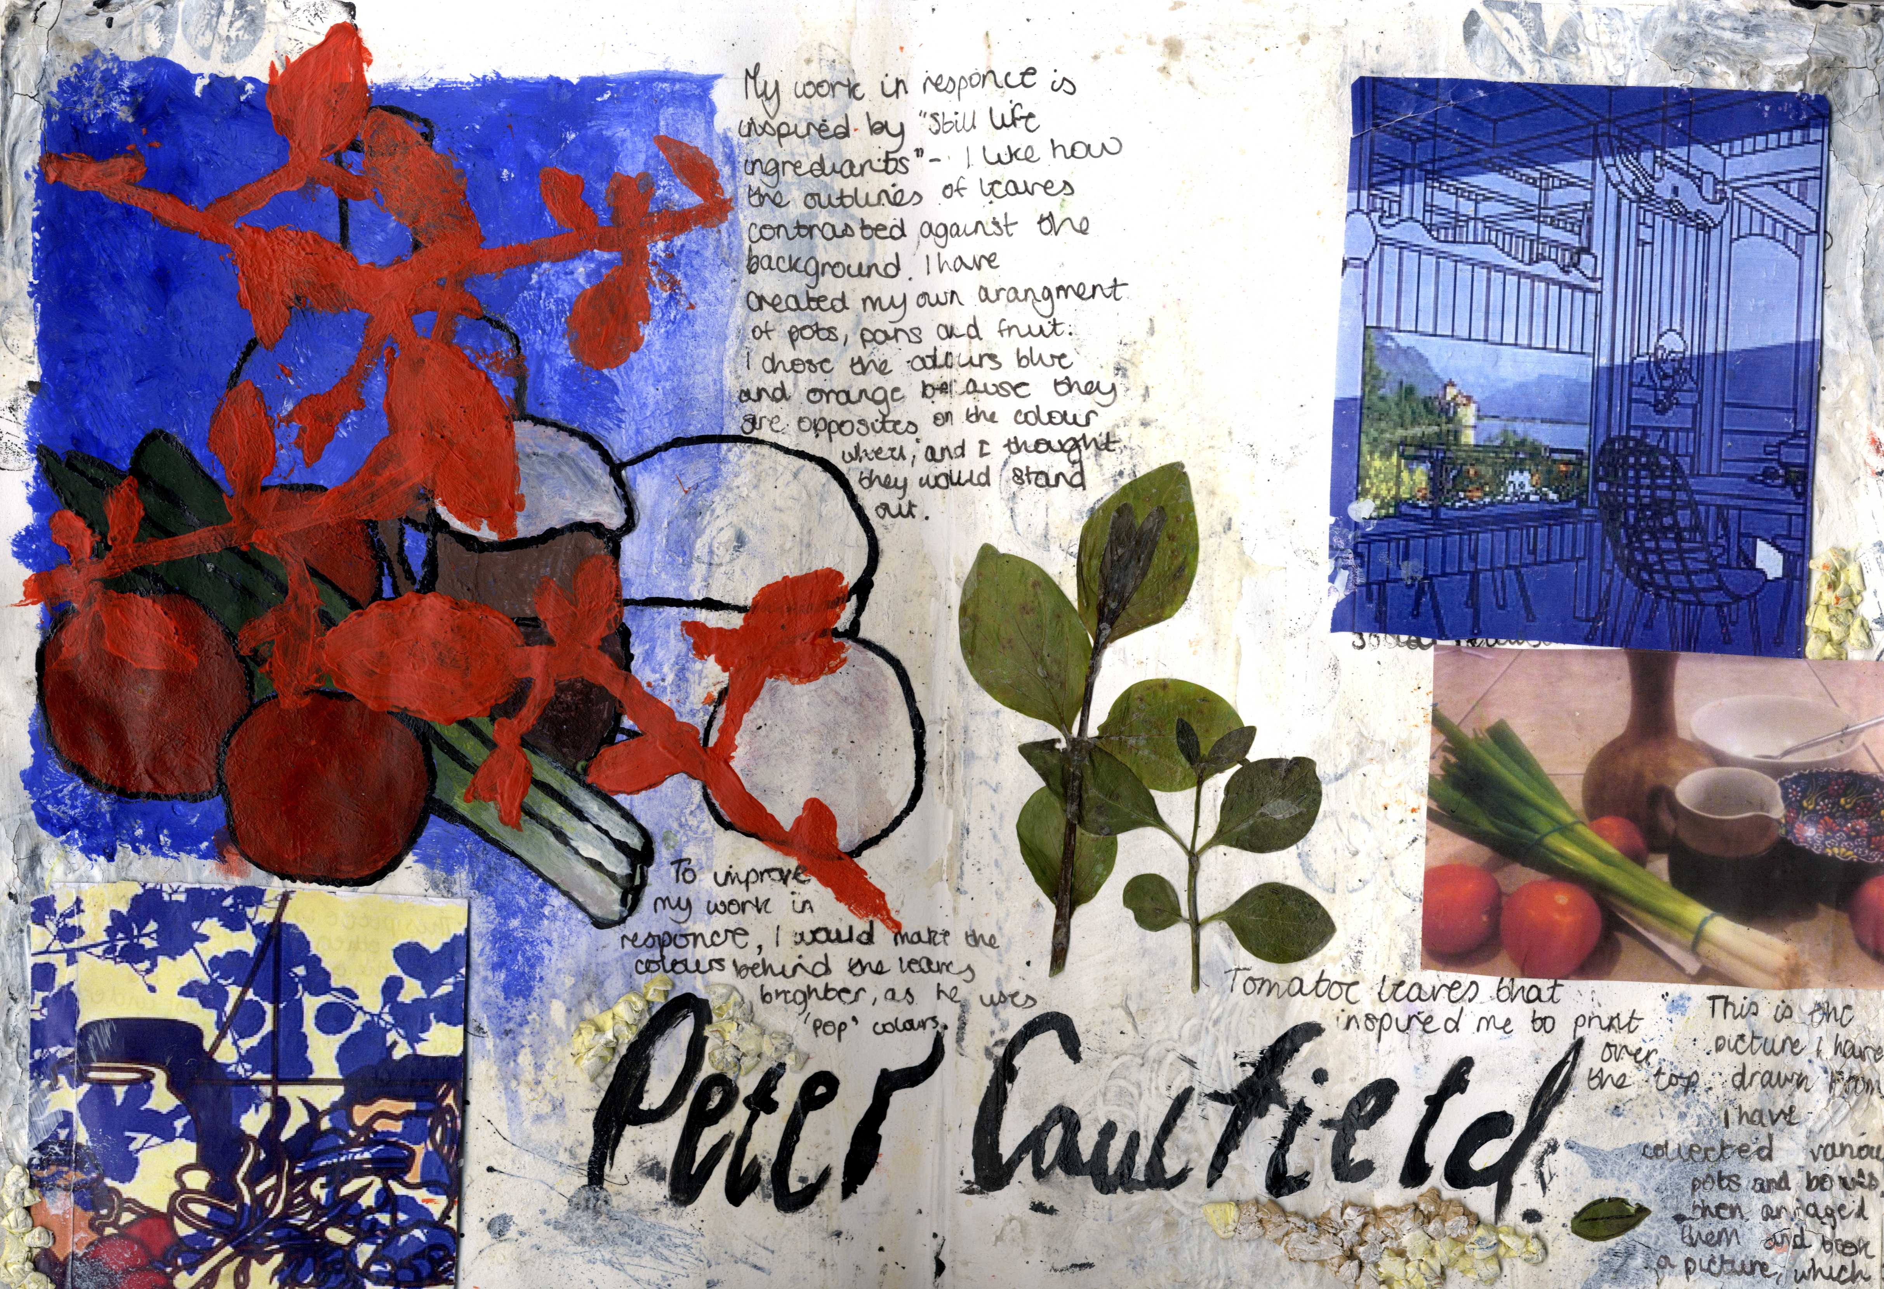
Year 10/11
‘Self-directed theme’

Slide 10
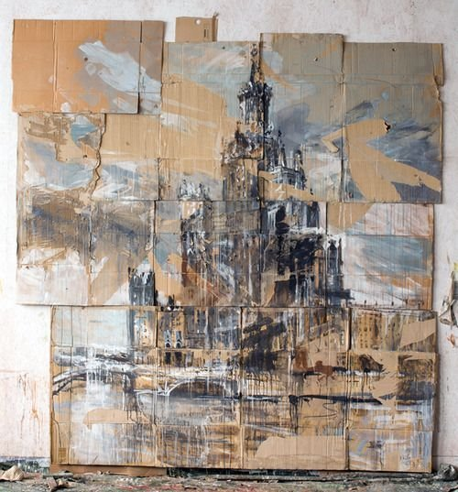

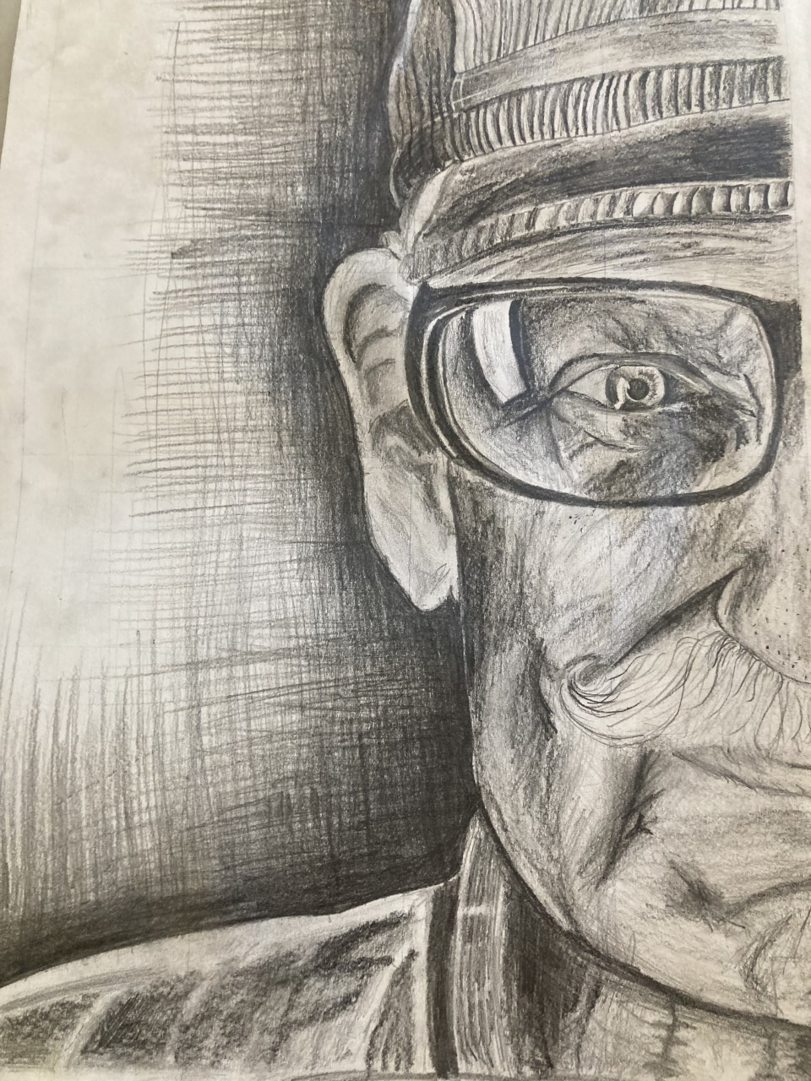
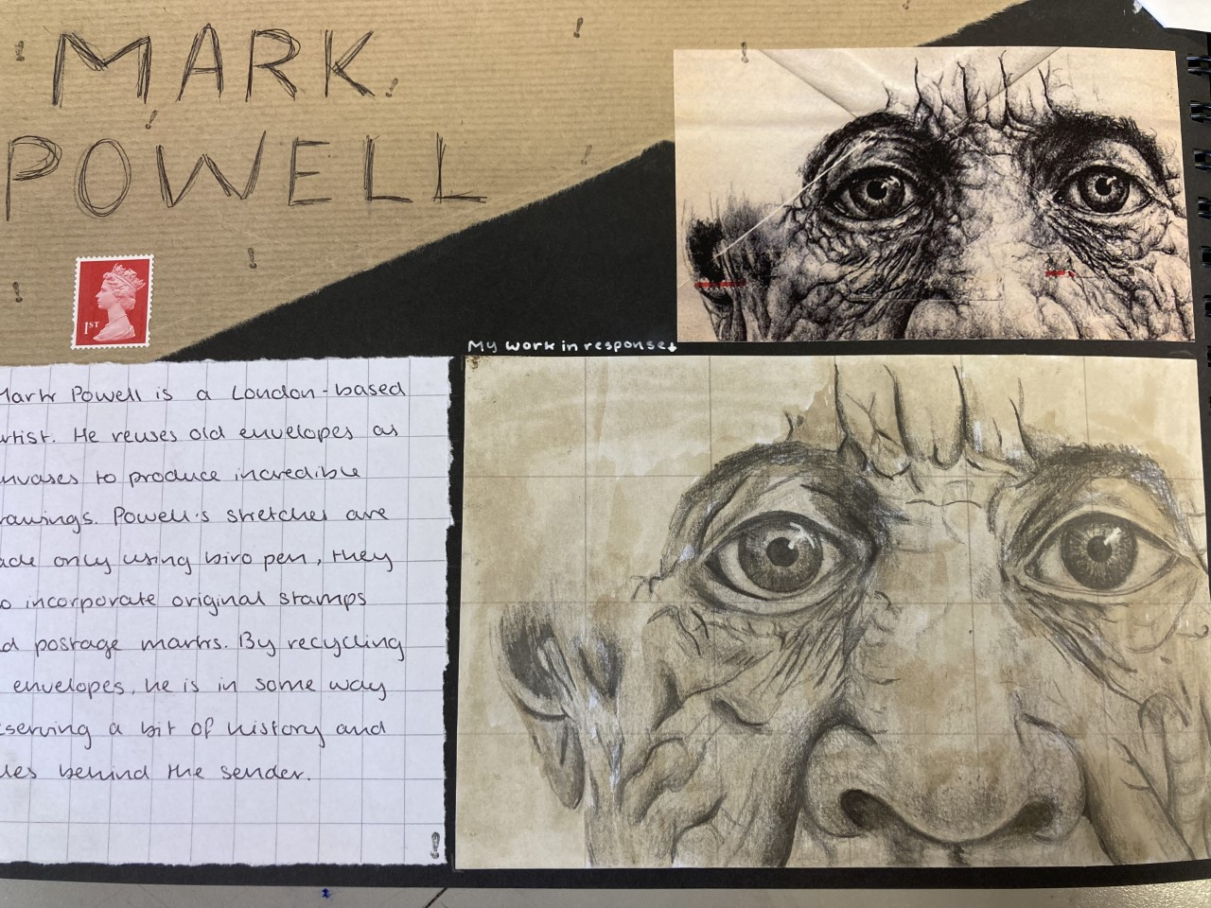

Slide 11
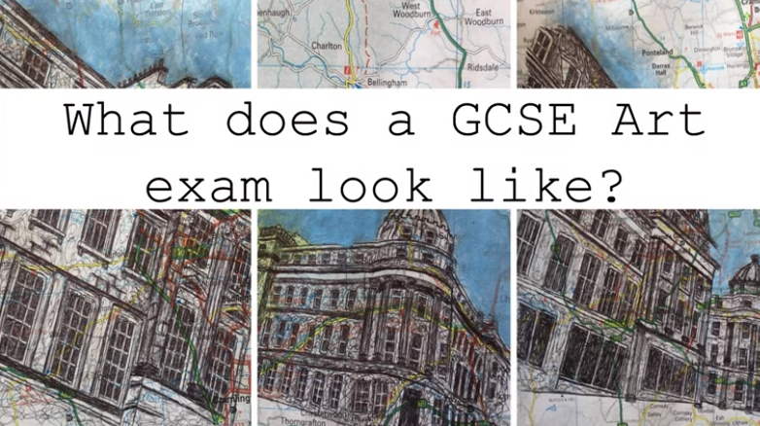
What does an art exam look like?
There is no written exam in art but a practical one instead.
You will be in the art room for two days (10 hours in total) with break and lunch as normal. During this time you will create a piece of artwork that you have planned over a series of weeks.

Slide 12
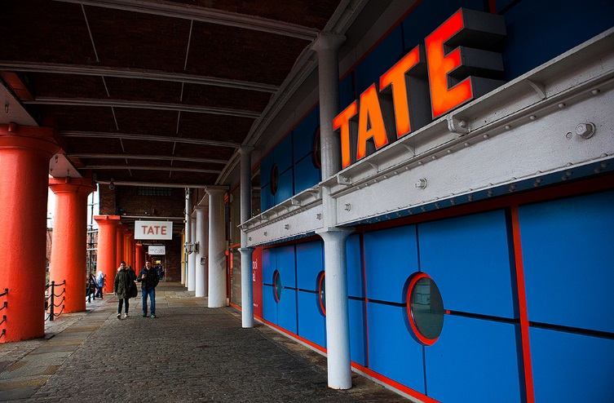
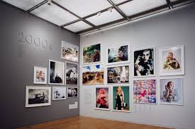

Visits
We organise visits to art galleries and sites for our students in Year 10.
These visits are a very important part of the GCSE courses and students who opt for Art and Design are required to go as they are a vital resource and an experience which cannot be gained by any other means.

Slide 13
Pathways for post-16 study
Pupils can go onto to any of the local 6th form providers to study A’ Level Art and Design and associated subjects eg. Textiles
Alternatively local colleges offer full-time study in art and design at level 2 and 3.
Post-18 students can progress to a wide range of degrees in the visual arts at universities both nationally or internationally, or, they may choose to pursue an apprenticeship or go into employment.

Slide 14
The creative industries in the U.K are rapidly growing. They contribute £92 billion to the economy and employ over 3 million people.
People with creative skills are highly valued in a rapidly changing world of work.
•Animator
•Architect
•Art Therapist
•Blacksmith
•Ceramics
•Cartoon/Comic art
•Community arts
•Costume design
•Exhibition design
•Fashion design
•Film director
•Graphic design
•Illustrator
•Interior design
•Jewellery design
•Make up/Hair design
•Medical illustrator
•Photographer
Film director
•Fine artist
•Furniture design
•Game design
Product design
•Sculptor
•Set designer
•Tattoo artist
•Teacher
•Theatre design
•Web design

Slide 15
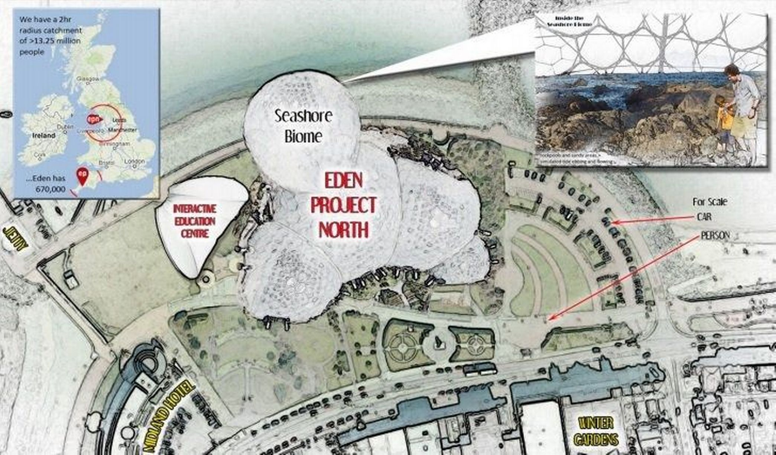






Creative industries in the local area

Slide 16
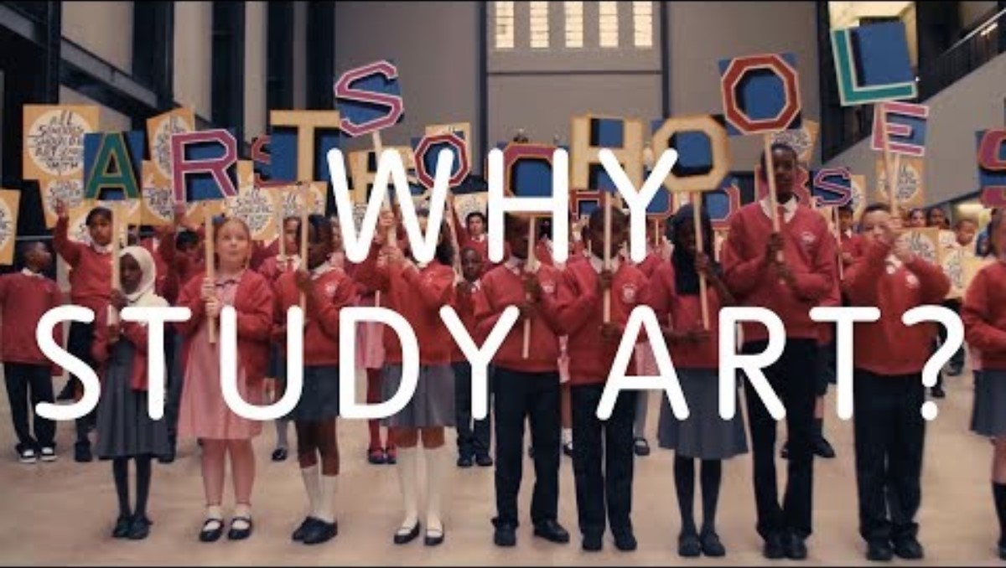

Slide 17
For more information about the course,
please speak to your child's art teacher at progress evening
OR
contact me via email:
Rstephenson@lancasterhigh.lancs.sch.uk

