Slide 1
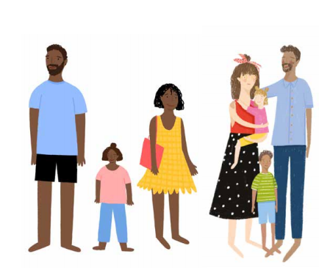
Healthy Relationships A course that helps parents/ carers in conflict improve communication

Slide 2
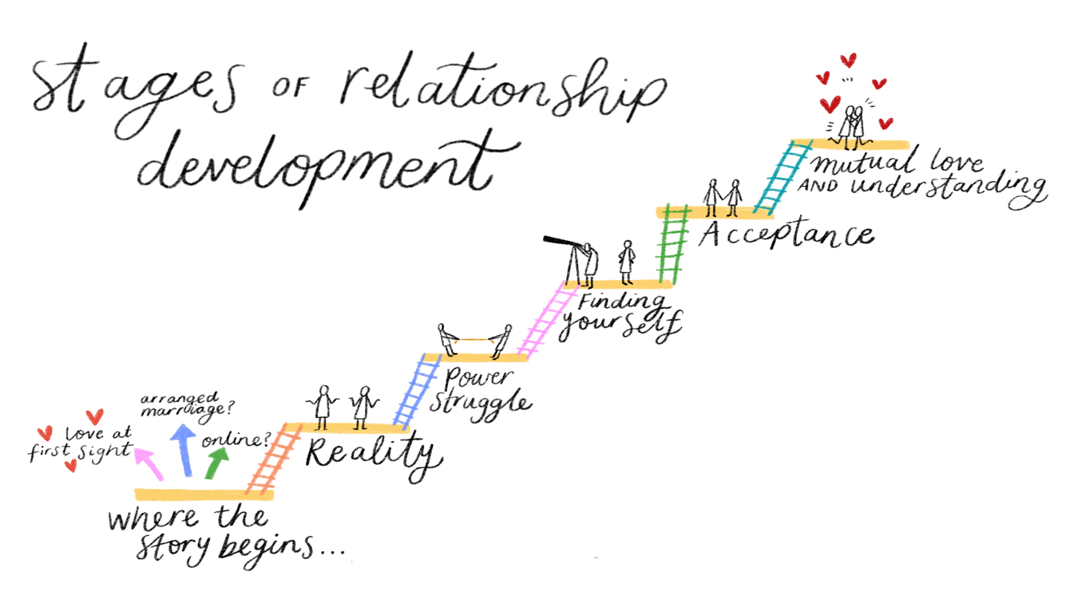
Course Content
A pre- course contact with practitioner: - what is involved, expectations, course suitability
4 weeks - Sessions include:
Effects of conflict on parents and children – Causes of conflict - Why do we need to argue less? Why does it matter?
The stages of relationship development - What we bring and how we manage stress in a relationship
Constructive and Destructive Communication – Types of conflict styles and how this impacts on communication
Thoughts, Feelings and Behaviours – Identifying how communication can drift into negative behaviours and how to turn this around
The Feelings Wheel – Problems and Issues - What's really going on?
Strategies to enable better communication when under stress

Slide 3
Parental Conflict or Domestic Abuse?
Parental conflict is not low level domestic abuse, or something that is escalating towards domestic abuse
Domestic abuse involves a victim and a perpetrator. There is a power imbalance in a relationship and can lead to violence but not always – one person is usually living in fear
Parental conflict is caused by a breakdown in healthy communication that can turn toxic
Parental conflict when it is harmful can be defined as frequent, intense and poorly resolved
The impact on children is often the same for both
This course is inappropriate where Domestic Abuse is present -our Freedom course would be more appropriate
Conflict shouting or loud arguments stuck in a pattern of arguing over the same things and never sorting them out not speaking to each other regularly or for long periods of time sulking or walking away struggling to apologise or being disrespectful | Abuse Does your partner ever: threaten, intimidate or make you feel fearful? physically hurt you? pressure you or make unwanted sexual demands? isolate you from friends & family? tell you what to wear or think? control the money

Slide 4
Are you aware of a child who may be suffering because there are frequent arguments at home? Do you see evidence that parents are fighting and openly hostile towards each other? Do you get embroiled in arguments and differences between parents that are impacting negatively on their child(ren)? Are you supporting a family where frequent, intense and unresolved conflict is impacting on their ability to parent. Or are you working with a family that needs help to communicate in a more healthy way…
…Consider referring to CFW Healthy Relationship Course

Slide 5
Healthy Relationships support offer
Healthy Relationships course
Book a place 01524 581280 ( Tuesday Feb 20th, or April 16th 9:30am Lune Park Family Hub) ( Level 1 or 2)
Healthy Relationships 1:1
Could request 1:1 Healthy Relationships as part of support if you are referring in for a Family Support Worker (Level 3 )
Free Online courses for Parents/ Carers
Arguing better - Disagreements are a normal part of life. How you approach them can make all the difference to you, your partner, and your children.
Me, you and baby too (for new parents) - Navigate the changes that happen in a relationship when a baby arrives
Getting it right for children (for separating parents) - When parents are separating or separated, children can often get caught in the middle
Visit the OnePlusOne parents website, select Lancashire and create an account.
Training for Professionals
Reducing Parental Conflict E Learning: 4 Modules, 30-40 minutes per module completed in your own time and at your own pace. To access register on astute: Astute LXP (astute-elearning.com)
Relationship Toolkit - A day's course exploring what parental conflict is, what the research tells us and exploring the pan Lancashire evidence based toolkit to use in practice. Relationship Toolkit: Reducing Parental Conflict

